Slide 1
LOCKERBIE ACADEMY
TRANSPORT UNIT
S1-S3 Road Safety & PHYSICS

Slide 2
MINDMAP OF ROAD TRANSPORT MATERIAL
Velocity
Displacement
Distance
Momentum
(advanced only)
ACCELERATION
SPEED
Practicals
Fun &Games
Measuring ‘a’
The Physics
of
Car Crashes
measuring
FORCES?
INVESTIGATION
FORCES
ANALYSIS
Types of
FORCES
Studying Accidents
History of
Cars
What are
FORCES?

Slide 3
WARNING
If you have problems with learning about Physics through CAR CRASHES then PLEASE let your TEACHER KNOW a.s.a.p
car crash compilation (ouch!)

Slide 4

Not to be taken lightly
for Stuart & Grant's sake

Slide 5

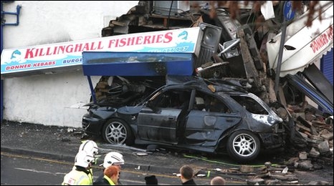
BACKGROUND
bbc news background
For an everyday activity, travelling by road is probably the riskiest thing many of us do on a regular basis.
On average, some seven people are killed every day on the roads in Great Britain. Hundreds more are injured, many of them seriously, often with life changing consequences.
In the past 10 years, the death toll has amounted to 32,298. As such road crashes are the largest single cause of accidental death for people aged between 5 and 35 years.

Slide 6
CRASH TEST VIDEOS
http://www.youtube.com/watch?v=cdCn8ci-mWM
http://www.youtube.com/watch?v=ZMfOWPL81P0&NR=1
http://www.youtube.com/watch?v=AMrSxi1Ooro&feature=related
http://www.youtube.com/watch?v=mzs1sIoLhU&feature=related

Slide 7
CRASH TEST VIDEOS
Baby seats
http://www.youtube.com/watch?v=Qef1TXZ05Dg&feature=related
http://www.youtube.com/watch?v=B1ItU6LvaNg&feature=channel
http://www.youtube.com/watch?v=Q8gU9zzCGA8
NEWTON 1st Law
http://www.youtube.com/watch?v=8zsE3mpZ6Hw&feature=related

Slide 8
Cross curricular Experiences and Outcomes
I know and can demonstrate how to travel safely. Health and well being (HWB) 2-18a, 3-18a,4-18a.
I am learning to assess and manage risk, to protect myself and others, and to reduce the potential harm where possible. HWB 2-16a, 3-16a, 4-16a.

Slide 9
The curriculum for excellence requires all teachers to promote numeracy and one of the experiences and outcomes identified is that the pupil’s learning should enable them to:
Interpret numerical information appropriately and use it to draw conclusions, assess risk, make reasoned evaluations and informed decisions.

Slide 10
All teachers are teachers of literacy. Pupils could be asked their opinion on 20 mph speed limits
I can persuade, argue, explore issues or express an opinion using relevant supporting detail and or evidence. LIT 3-29a
When listening and talking with others for different purposes, I can:
  communicate information, ideas or opinions
  explain processes, concepts or ideas
  identify issues raised, summarise findings or draw conclusions. LIT 3-09a

Slide 11



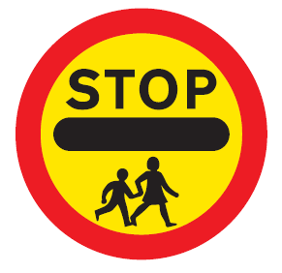





LOCKERBIE ACADEMY TRANSPORT UNIT
Notes:
All of these road signs relate to Physics in some way, whether mention of speed, force, acceleration or other physics terms. We are going to use the topic of road safety to teach you about MECHANICS. DYNAMICS and KINEMATICS (there are some big words for you to find out about)
We will use the upside down car, which we made up as our logo for this topic. It is meant to represent no road accidents here as we know about the Physics behind driving and we should know how to be safe.

Slide 12
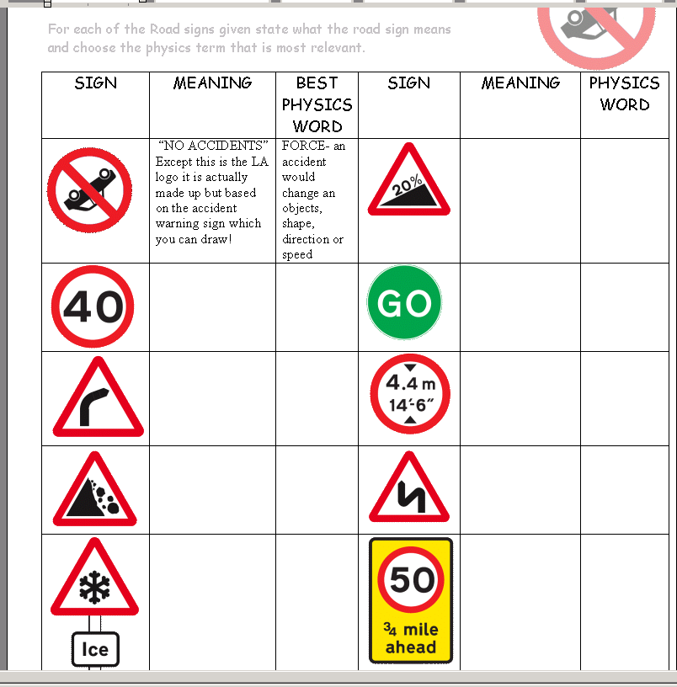
HOMEWORK
HOMEWORK
Collect one of the ROAD SIGN SHEETS
Put your name on the top
Find out what each of your road signs means.
Only fill in the “Meaning Column”

Slide 13
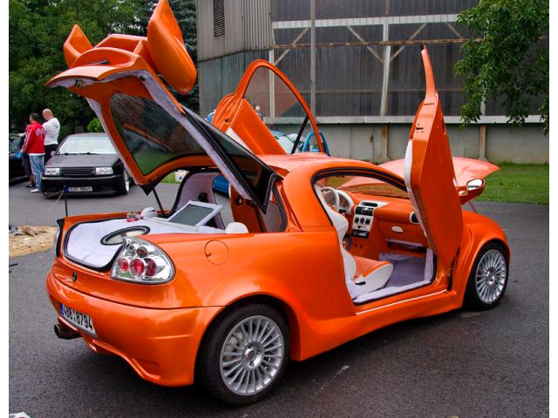
TEAM- CHALLENGES
WORK in Groups.
Choose your group
Choose a team name
Choose a logo.
  simple
  Agreed
  On A4
  Scan and electronic
Tigra
Tigers
Notes:
Much of the work will be in groups.
Choose your group now and decide on a team name and logo.
Make the logo simple and something you all agree

Slide 14
Make up your Team Name
Rules
1. Each team member must have a say
2. No decision can be reached unless everyone in the team agrees
3. No member agrees to a group decision if they have a serious objection 4.No one is to talk to a member of another team.

Slide 15
Rules for doing investigations
1. No one is to talk to any member of another group.
I will not answer individual questions. Discuss problems with your group members first.
3. If a group has a question then every member of that group is to raise their hand.

Slide 16
LOCKERBIE ACADEMY TRANSPORT UNIT
We plan to find out and understand about the following terms
P distance
P displacement
P speed
P velocity
P instantaneous/ average/ uniform/ speed
P forces, including weight, and friction
P time
P acceleration
P & momentum if you can handle it!
Notes:
We are going to learn about some vital and basic parts of Physics through a unit on ROAD SAFETY (catchy name needed over to Mr Bowles). We will be looking at road accidents and safe driving. If you have a problem with this YOU MUST tell your teacher who will ensure that you are not given work that makes you upset.
We plan to find out and understand about the following terms
P distance
P displacement
P speed
P velocity
P instantaneous speed
P forces, including weight, and friction
P time
P acceleration
If we have time we might mention momentum.

Slide 17
LOCKERBIE ACADEMY TRANSPORT UNIT
We plan to find out and understand about the following terms
P at rest
P mechanics
P dynamics
P kinematics
Notes:
We are going to learn about some vital and basic parts of Physics through a unit on ROAD SAFETY (catchy name needed over to Mr Bowles). We will be looking at road accidents and safe driving. If you have a problem with this YOU MUST tell your teacher who will ensure that you are not given work that makes you upset.
We plan to find out and understand about the following terms
P distance
P displacement
P speed
P velocity
P instantaneous speed
P forces, including weight, and friction
P time
P acceleration
If we have time we might mention momentum.

Slide 18
WORDBANK
S1 Physics Transport
Copy the following words into your jotter and literacy logs
Back to mind map

Slide 19
LOCKERBIE ACADEMY TRANSPORT UNIT
WORDBANK
MECHANICS
The branch of Physics dealing with motion (how things move).
KINEMATICS
Mechanics dealing with motion, speed, acceleration etc
DYNAMICS
The mechanics part dealing with Forces

Slide 20
INVESTIGATIONS & TEAM CHALLENGE
LOCKERBIE ACADEMY
S1-S3 Road Safety & PHYSICS

Slide 21
Safety cage
Anti-lock Brakes
Traction control
Safety Features in Cars
Crumple zones
Electric windows
Seatbelts
Air bags
Paddle shift controls
Notes:
21

Slide 22
TART MA CART
Class challenge

Slide 23
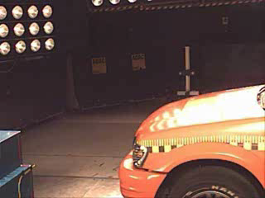
Collisions
Hyperlink to clip
What makes a car ‘safe’?
Why are some cars better in crashes than others?
What happens during a crash?
Is this car safe?

Slide 24
Making a car safe
Depends on
driver education and attitude
road design
car maintenance
car construction

Slide 25
Driver education
30% of accidents involve a driver under the age of 21.
8% of driving licences are held by drivers under 21.
One in three drivers will have an accident by the time they reach 21.
Boys under 21 are twice as likely to be involved in an accident.

Slide 26

Hyperlink to video if clip doesn't work
Notes:
Black area hyperlinks to a Quicktime movie.

Slide 27
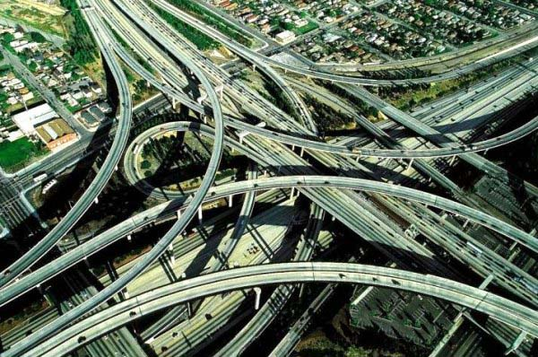
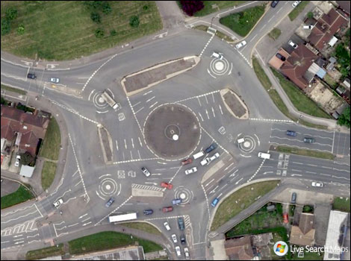
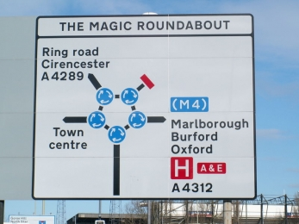
Road Design
New roads are subject to strict design standards covering gradients, radius of curvature of bends etc.
Although sometimes it can be a bit confusing!
bbc archive film

Slide 28
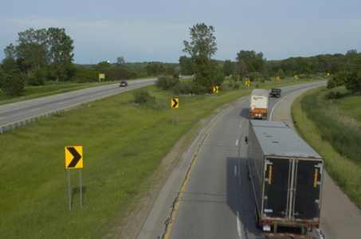
Road Design
Existing roads are subject to review and accident black spots improved.

Slide 29
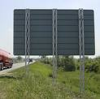
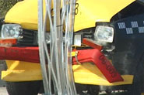
Road Design
Roadside furniture is being replaced with crushable structures to minimise vehicle intrusion in a crash.

Slide 30
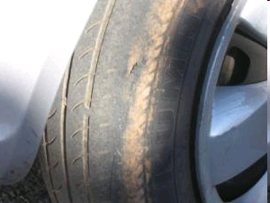
Car Maintenance
Accident prevention is the best way of protecting people in cars.
Proper maintenance of safety systems - brakes, lights, steering, suspension and tyres - is essential to preventing accidents.
Very few accidents are attributed to mechanical failure.

Slide 31

..\..\TRANSPORT SAFETY\Tart Ma Cart\CrashTest_WMV V9.wmv
Notes:
Black area hyperlinks to a Quicktime movie

Slide 32
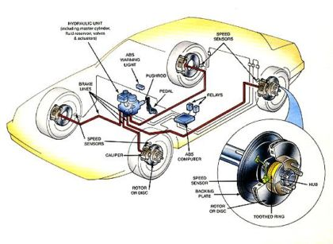
Car Construction
Active safety systems include ABS, traction control, brake assist, dual circuit brakes.

Slide 33
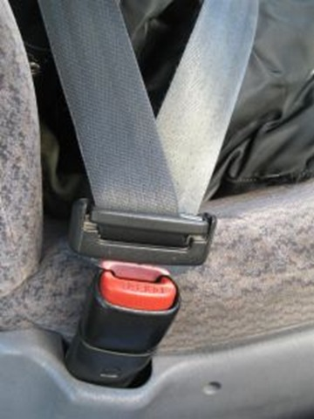
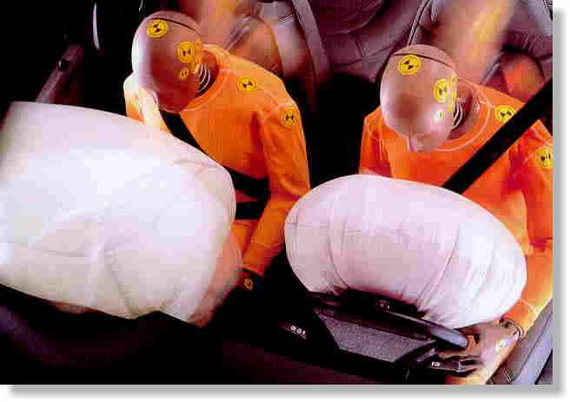
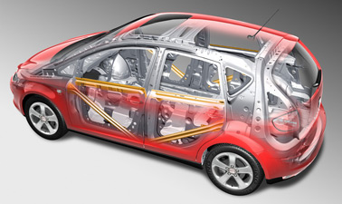
Car Construction
Passive safety systems include
seat belts,
air bags,
safety cages and padding hard surfaces.

Slide 34
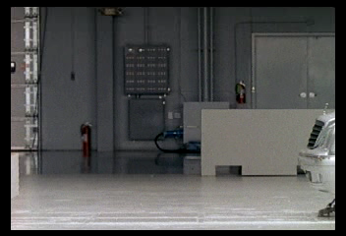
Car Construction
..\..\TRANSPORT SAFETY\Tart Ma Cart\40mercedeseclass_WMV V9.wmv
Cars are built with a passenger cage.
A well designed cage should stay intact during a crash.
Is this car safe?

Slide 35
FINAL
TEAM INVESTIGATION

Slide 36
INVESTIGATIONS
Choose one of the investigations to choose from or design your own
• Friction and the driving surface,
• Car tyre design,
• Brakes how to make them better,
• Being a crash test dummy,
• Seatbelts are they worth it?
• Run offs what should they be made of?
• How and why lorry brakes smell at the bottom of a slope (height and speed)

Slide 37
PERSONAL
RESEARCH
INVESTIGATION

Slide 38
LOCKERBIE ACADEMY TRANSPORT UNIT
Look at Road safety Campaigns, stopping distance, reaction timers, car accidents.
Discuss how cars can be designed to be safe. Where can improvements be made?

Slide 41
DISCUSSION- Choose one of the topics to discuss
• Should the speed limit on motorways be increased?
• What should be the punishment for drink drivers?
• The age for people to learn to drive should be increased/ decreased.
• The cost for Fuel in rural areas should be reduced
• We should learn to drive at school
• Driving lessons should be free and compulsory
• The insurance for young drivers is too expensive
• All cars in Scotland should have snow tyres in winter

Slide 42
VIDEOS
Check out
THE COLLISIONS VIDEO on CLICKVIEW
Surviving Car CRASHES

Slide 43
HISTORY OF CARS
S1 Physics Transport
Back to mind map

Slide 44
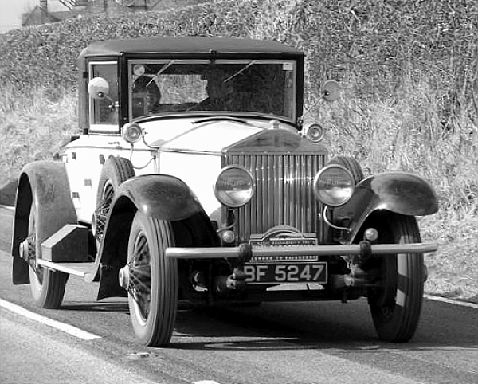
HISTORY OF CARS
Motoring through History2.ppt
Watch the slide show of the some of the developments of cars over the last 130 years

Slide 45
THINK OUT OF THE BOX!

Slide 46
There is a saying among road safety professionals that ‘the safest car is the one with a spike sticking out of the steering wheel’
Could this be true?
Are there any disadvantages to making cars safer?

Slide 47
TASK
Summarise this introduction

