Slide 1
LOCKERBIE ACADEMY TRANSPORT UNIT
GROUPWORK

Slide 2
folder, jotters, planners out, sitting in teams, hand in teacher team sheet

Slide 3
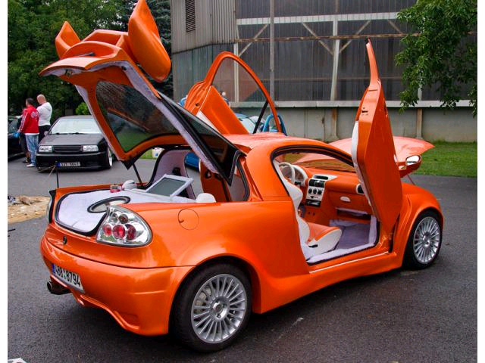
TEAM- CHALLENGES
Tigra
WORK in Groups.
Tigers
Notes:
Much of the work will be in groups.
Choose your group now and decide on a team name and logo.
Make the logo simple and something you all agree

Slide 4
Teams
Rules
1. Each team member must have a say
2. No decision can be reached unless everyone in the team agrees
3. No member agrees to a group decision if they have a serious objection 4.No one is to talk to a member of another team.

Slide 5
Rules for doing investigations
1. No one is to talk to any member of another group.
I will not answer individual questions. Discuss problems with your group members first.
3. If a group has a question then every member of that group is to raise their hand.

