Slide 1
LOCKERBIE ACADEMY
TRANSPORT UNIT
VELOCITY
S1-S3 Road Safety & PHYSICS

Slide 2






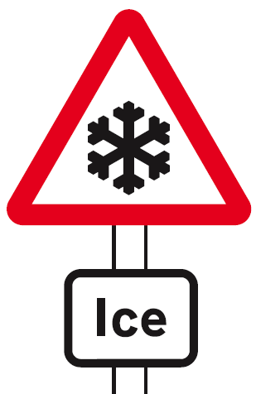


LOCKERBIE ACADEMY TRANSPORT UNIT
Notes:
All of these road signs relate to Physics in some way, whether mention of speed, force, acceleration or other physics terms. We are going to use the topic of road safety to teach you about MECHANICS. DYNAMICS and KINEMATICS (there are some big words for you to find out about)
We will use the upside down car, which we made up as our logo for this topic. It is meant to represent no road accidents here as we know about the Physics behind driving and we should know how to be safe.

Slide 3
LOCKERBIE ACADEMY
TRANSPORT UNIT
Part 2- Scalars Vectors and examples
S1-S3 Road Safety & PHYSICS

Slide 4
LOCKERBIE ACADEMY TRANSPORT UNIT
WORDBANK
Scalar
A quantity that is fully described by a value and unit
Vector
A quantity that is fully described by a value, a direction and unit.

Slide 5
Scalars and Vectors
We’ll explain all of these terms in the next few lessons.
Scalars | Vectors
4. Acceleration
1. Distance
2. Speed
8. Displacement
3. Force
5. Time
6. Resistance
7. Velocity

Slide 6
So what’s this DISPLACEMENT thing physicists love?
S1 Physics Transport
02/10/2011
JAH
Back to mind map

Slide 7
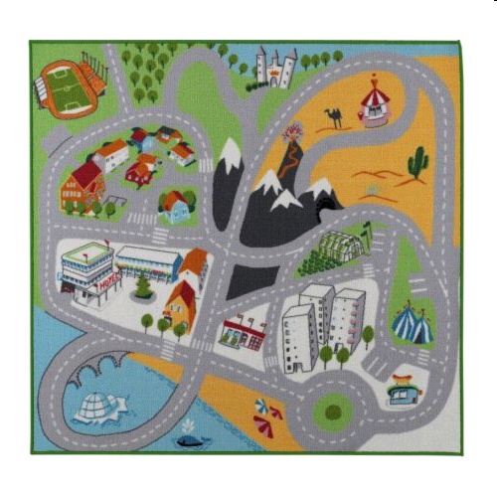

Slide 8
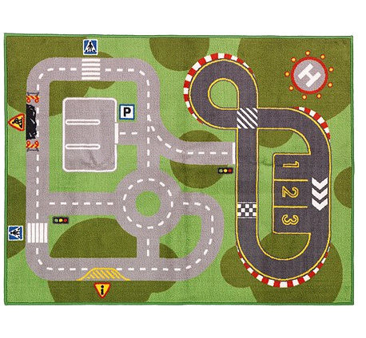
LOCKERBIE ACADEMY TRANSPORT UNIT

Slide 9
The String Walk
Measure the length of the string used (distance travelled)
Use a steel tape measure to find out how far you are from the start(displacement). Here though your direction matters! It is a VECTOR quantity.

Slide 10
The String Walk
The distance travelled is the length of the string. The displacement is the distance travelled from the start to the finish but the direction is vital. You wont find X if you walk the right length but in the wrong direction!

Slide 11
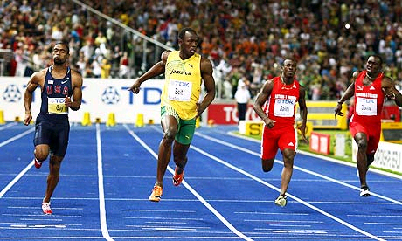
LOCKERBIE ACADEMY TRANSPORT UNIT
Displacement is how far you have travelled in a straight line. We would say “as the crow flies”
Notes:
Displacement
Often in Physics we can be quite careless in the way we use terms and expect our pupils to understand. This is not very helpful to you. We do it because we want to give you correct information but sometimes we are worried that you cannot understand the work. From the beginning we are going to give you all the information so that we try not to muddle up terms but you will need to be responsible for learning these different terms.
Displacement and Velocity are 2 terms that we need to explain carefully in Physics.
Displacement is how far you have travelled in a straight line. We would say “as the crow flies”
Usain Bolt is the fastest man on earth. He can run 100m in a time of 9.58s (adjust as this changes).
The distance that Usain runs is 100m. This is also his displacement as Usain Bolt runs in a straight line. He is exactly 100m from where he started the race.

Slide 12
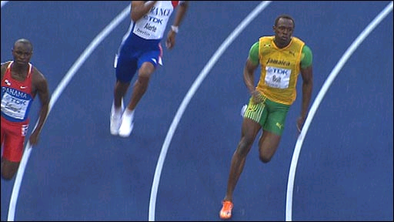
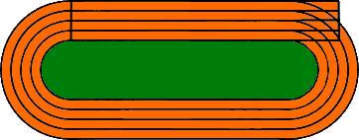
LOCKERBIE ACADEMY TRANSPORT UNIT
Displacement is how far you have travelled in a straight line. We would say “as the crow flies”
(400m in 45.86s)
http://news.bbc.co.uk/sport1/hi/athletics/8210700.stm
http://www.telegraph.co.uk/sport/sportvideo/7236169/Usain-Bolt-blasts-to-400m-victory.html
Notes:
In the 200m race when Usain Bolt crosses the finishing line he is not 200m from the start in a straight line. He has run 200m but he is only (X- work it out Jennie) from his starting point. This direct distance is called his displacement.
In this 400m race Usain Bolt has run once around the track. He ended up exactly where he started from. Do the distance he ran is 400m but his displacement (where he is in relation to where he started is 0m). When objects travel in straight lines then the distance and displacement are the same size but as soon as an object changes direction the distance and displacement are different.

Slide 13
N
end
E
S
T
A
I
C
N
D I S P L A C E M E N T
D
START

Slide 14
Distance = “how far we’ve travelled”
    ⇒ symbol d
    ⇒ units metres, m
And later we’ll show distance is….
    ⇒ (scalar quantity)

Slide 15
Displacement = “how far we’ve travelled in a straight line (from A to B)” (include your direction)
    ⇒ symbol s
    ⇒ units, metres, m
    ⇒ Vector quantity
    ⇒ Must quote the direction

Slide 16
LOCKERBIE ACADEMY
TRANSPORT UNIT velocity
S1-S3 Road Safety & PHYSICS

Slide 17
VELOCITY, Displacement & Time
S1 Physics Transport
Back to mind map

Slide 18
So what’s this VELOCITY thing physicists love?
S1 Physics Transport
02/10/2011
JAH
Back to mind map

Slide 19
VELOCITY = Displacement
Time
S1 Physics Transport
But what the heck is velocity?
02/10/2011
JAH
Back to mind map

Slide 20
Velocity
s
v
t
Displacement
Velocity
=
Time
s
v
=
t
02/10/2011
JAH

Slide 21
1193 miles
26½ hours
What was the average speed for the journey?
615 miles
26½ hours
What was the average velocity for the journey?

Slide 22
452 miles²
6 miles from school
54º west of north
Lockerbie

Slide 23
Adding VECTORS
S1 Physics Transport
02/10/2011
JAH
Back to mind map

Slide 24
When scalar quantities are added it is just the sum of all the individual parts. For example when I run 3 miles and 4 miles I have run a total distance of 7 miles
Adding vectors together is much more difficult.
If they act in the same direction then we can add them like scalar quantities. For example a force of 4N to the right is added to 3N to the right giving a RESULTANT of 7N to the right.
+
=
4cm
3cm
7cm
This can be represented by scale lines. For example a line of 4cm is added to one of 3cm. The total is 7cm to the right

Slide 25
This is a little more tricky is the vectors are in opposite directions, for example a force of 4N to the right is added to one of 3N to the left.
If we represent this as a line and we know that vectors have direction. This is like adding a line in one direction to the line in the other.
Decide which way you will call positive.
+
+
=
4cm
3cm
1cm to the right
4N + (-3N) = +1N
The + means to the right
+

Slide 26
The DIRECTION of the line MUST be parallel to the vector direction AND point in the correct DIRECTION. In the previous case the -3N vector is shown as an arrow to the left.
When giving the answer to a vector problem you MUST give a size, unit AND a DIRECTION

Slide 27
Adding Vectors
The line from the tail of the first vector to the head of the last vector is the resultant (or final vector)
The resultant of two or more forces which act at an angle can be found by drawing a vector diagram. Consider the example below where two forces act on an object as shown.
A vector diagram is drawn but taking each of the vectors in turn and joining them head to tail
Use a protractor to measure the angle of the vector from a reference point

Slide 28
Adding Vectors
The size and direction of the resultant can be found by drawing vectors to scale, for example 1N can be represented by a line 1cm long. The size of the resultant can be measured with a rules and measure the angle with a protractor.
10 N=
10 cm
14 cm=
14 N=
10 N=
10 cm

Slide 29
The VELOCITY OF MY CAR
TASK- Find the average velocity during your playmat journery.
We need to know the
1. displacement of your vehicle.
2. the time for the whole journey
3 the AVERAGE VELOCITY of the vehicle for the journey

Slide 30
YOUR TASK.
Working in teams you need to:
Measure the DISPLACEMENT that the car will travel following the pre-defined course.
Record this value on your worksheet.
Time how long each person in the group takes to complete the course.
Record this value on your worksheet
Time how long your journey takes and note down
Record as tally marks on your worksheet every time each person in the group leaves the track
Find the DIRECTION of travel from START to FINISH.

Slide 31
CHECK OUT MORE ON VELOCITY & VECTORS
http://www.physicsclassroom.com/class/1dkin/U1L1a.cfm
Check out the material in DESK TOOLS ->Physics -> Virtual Nat 5 or Virtual Int 2 for more on Scalars and Vectors

Slide 32
Instantaneous Velocity
The instantaneous velocity of an object is its velocity at a particular instant. For example, a police speed camera measures the instantaneous velocity of the car.
Instantaneous velocity is difficult to measure. One way is to use a light gate. The length of the object divided by the time it takes to pass gives its instantaneous speed.
Length of object
Light gate measures time to pass
Ramp

Slide 33
Task
Answer the speed and velocity questions from the sheet and from the Postman Pat task
S1 Physics Transport
Back to mind map

Slide 34
THE POST VAN AND AVERAGE SPEED.
Post Office
400 m / 32 s
Library
350 m / 35 s
Shop
450 m / 60 s
900 m / 45 s
200 m / 25 s
Church
Post Box
750 m / 120 s

Slide 35
Postman Pat travels from the Post Office to the church via the library and shops.
What is the distance Pat has travelled?
What is Pat’s displacement?
What was Pat’s average speed during this journey?
What was Pat’s average velocity during this journey?
On his way back Pat drives directly to the Post Office from the church
What is the distance Pat has travelled?
What is Pat’s displacement?
What was Pat’s average speed during this journey?
What was Pat’s average velocity during this journey?

Slide 36
Vectors and Scalars
1. A man walks from X to Y along a winding road.
What is his displacement at the end of his walk?
What distance has he walked?
2. If the walker in question 1 above took 40 minutes for his walk, what was
his average speed
his average velocity?

Slide 37
Repeat this question for a runner in the 800 m race whose winning time was 1 min 54 s.
One complete lap of a running track is 400m.
An athlete completes one lap in 48 s in the 400 m race. What is his
a) distance travelled
b) displacement
c) average speed
d) average velocity.

Slide 38
REVIEW
S1 Physics Transport
Back to mind map

Slide 39
DYNAMIC WORD BINGO- REVISION

Slide 40
REVIEW
WHAT ARE DISTANCE AND DISPLACEMENT?
Distance is length. How far you’ve travelled (e.g. 100 metres)
Displacement is direct distance in a particular direction (e.g. 100 metres to the right)
WHAT ARE SPEED AND VELOCITY?
Speed is the rate of covering a distance (e.g. 50km/h)
Velocity is rate of displacement in a particular direction (e.g. 50 km/h north)

Slide 41
Work out the average speeds for the following journeys. Make sure you set out your working in the same way as the example above.
1. A boat travels 30 km in 3 hours.
2. A tractor drives 18 km in 6 hours.
3. A frog jumps 25 metres in 5 seconds.
(Take care with the units.)
4. A plane flies 600 km in 3 hours.
Now attempt the average speed tutorial.

Slide 42
SCALAR QUANTITY
VECTOR QUANTITY
QUOTE DIRECTION

Slide 43
1992 Higher Paper 1, Q 4
A competitor completes the following sequence of displacements in 10 minutes during part of an orienteering event.
500 m
1100 m
800 m
Which entry in the table gives the competitor’s total displacement, average speed and average velocity for this part of the event?
 | Total displacement (m) | Average speed (m s⁻¹) | Average velocity (m s⁻¹)
A | 1000 | 1.7 | 4.0
B | 1000 | 1.7 | 1.7
C | 1000 | 4.0 | 1.7
D | 2400 | 4.0 | 4.0
E | 1000 | 10 | 10
1000 m
800 m
600 m

Slide 44
Vectors and Scalars
What is the difference between a vector quantity and a scalar quantity?
Use your answer to question 1 to explain the difference between distance and displacement.

Slide 45
Average speed Questions
A car travels 40 km north, then turns back south for 10 km. The journey takes 1 hour.
What is
a) the displacement of the car
b) the distance the car has travelled
c) the average velocity of the car }use km h-1
d) the average speed of the car? }

Slide 46
Average speed Questions
A car drives 60 km north, then 80 km east, as shown in the diagram. The journey takes 2 hours.
Calculate the
a) distance travelled
b) displacement
c) average speed
d) average velocity.

Slide 47
LOCKERBIE ACADEMY TRANSPORT UNIT
WORDBANK
At rest- in Physics we use this term to mean not moving. We can also say the object is stationary.
It is not the same word as pens and pencils which are stationery!

