Slide 1

Before you start this…
Make sure that you have completed the section on WHAT IS PHYSICS? on the ACTIVINSPIRE page.

Slide 2

Energy & Sound
Physics Topic

Slide 3
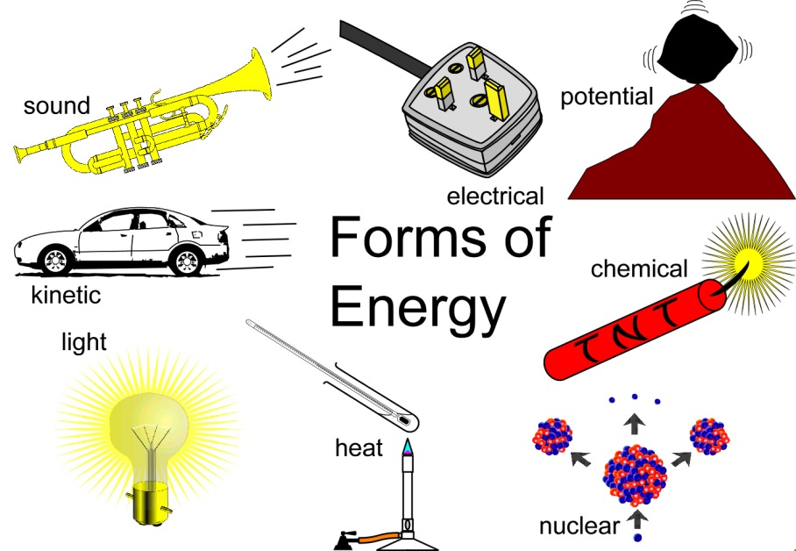
Energy & Sound
Lessons Group 1
Forms of Energy and Conservation of Energy
At the end of these lessons, I will know some different forms of energy and understand conservation of energy.

Slide 4

Forms of Energy
What is energy?
What unit is energy measured in?
Watch the film on TWIG to find the answers
twigonglow/ forms-of-energy

Slide 5

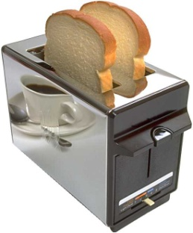
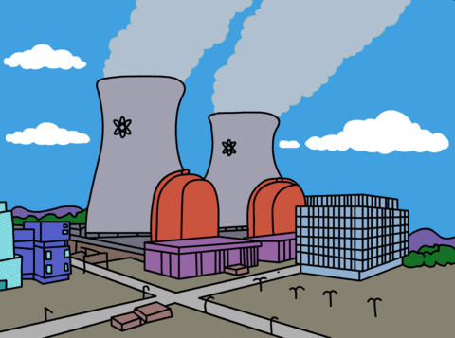


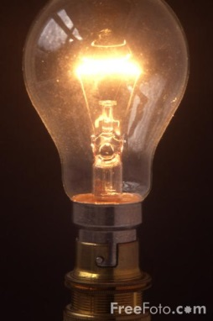
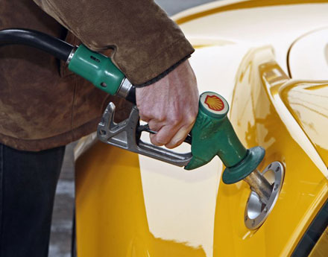
Forms of Energy
1. Write down as many types of energy as you can remember from the video clip
Questions
2. Copy and complete this sentence:
Energy is measured in ___________. This is sometimes abbreviated as the letter, _____.

Slide 6
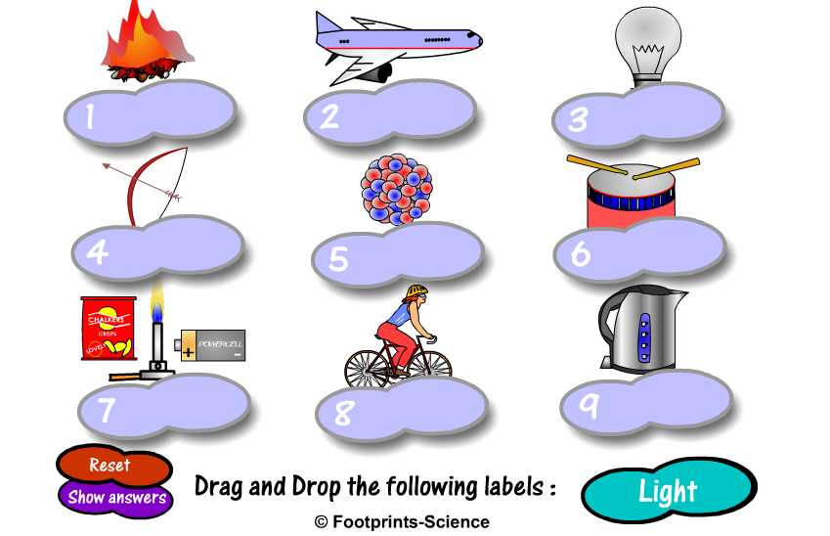
Forms of Energy
Forms of Energy

Slide 7
What is Energy?
Energy is needed to get jobs done, or make things work.
To get a job done, energy must be transferred from one place to another.

Slide 8
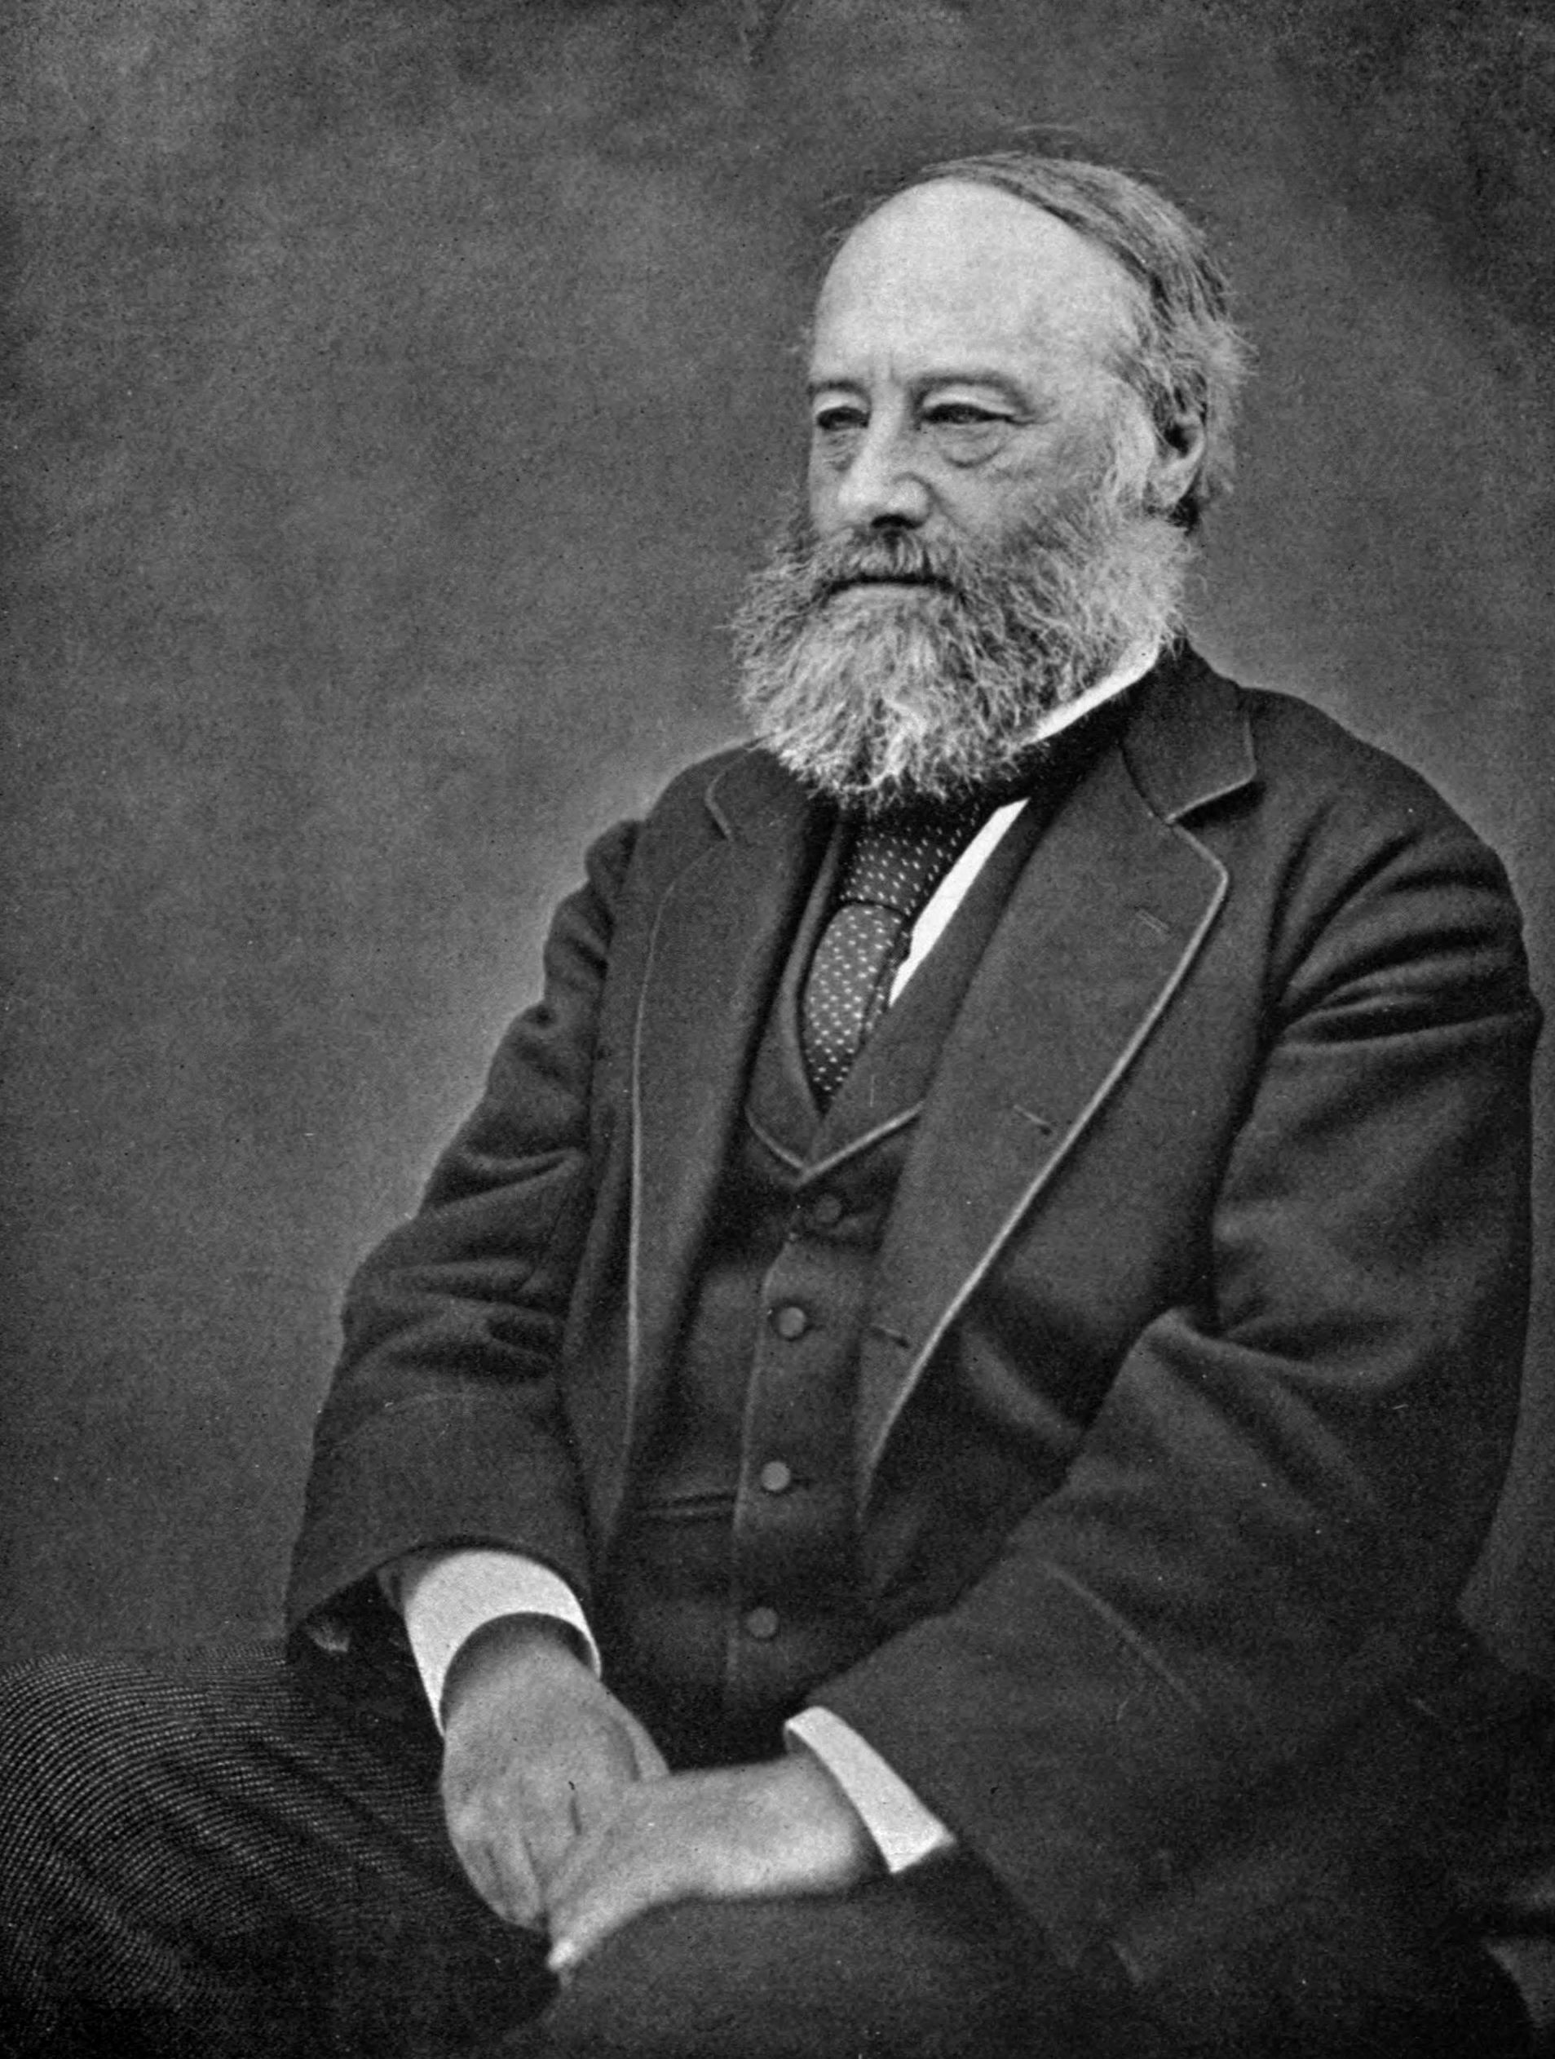
Joule- the unit of energy
Energy is measured in units called JOULES (J) named after the famous scientist called James Prescott Joule, a Physicist and Brewer.
By Henry Roscoe - The Life & Experiences of Sir Henry Enfield Roscoe (Macmillan: London and New York), p. 120, Public Domain, https://commons.wikimedia.org/w/index.php?curid=3119134

Slide 9

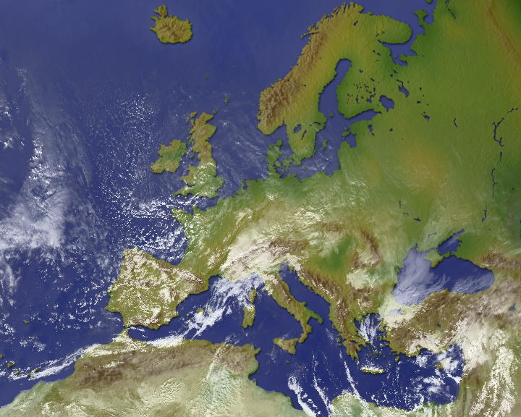
Energy Crisis? What Energy Crisis?
Hypothesise/ Express view
Have you heard people talking about the Energy Crisis?
It concerns us all.
But there is EXACTLY the same amount of energy now as there was at the beginning of life on Earth.
Can you think of a reason these two statements seem to be in conflict?

Slide 10
Forms of Energy
A machine is any object that converts one type of energy in to another.
The total energy that goes in to a machine is equal to the total energy that is given out by it. This principle is called the conservation of energy and it’s a rule that applies all over the universe!

Slide 11
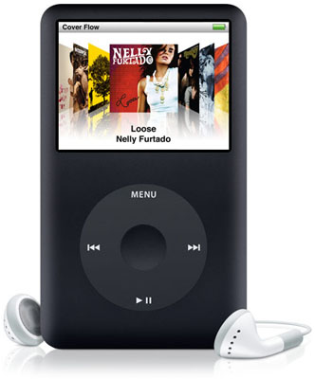
Forms of Energy
The sound energy being given off by an IPod has not been created. It has been converted from electrical energy.
The heat energy is a ‘waste’ energy because it is unwanted.

Slide 12
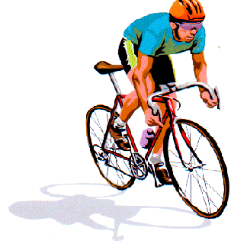
Forms of Energy
Energy is all around us but we can’t create or destroy it.
The only thing that we can do with energy is change it from one form to another or transfer it from one object to another.

Slide 13
ENERGY LAW!
Energy cannot be created or destroyed we can only move it around. Eventually energy turns into heat which heats up our surroundings.
….in summary
Energy is converted or transferred it is never lost!

Slide 14
Forms of Energy
An IPod takes in electrical energy and turns it in to sound and light energy.
(Other brands of mp3 players are available!)
So, the energy change in an IPod is:
Electrical → Sound + Light + Heat

Slide 15
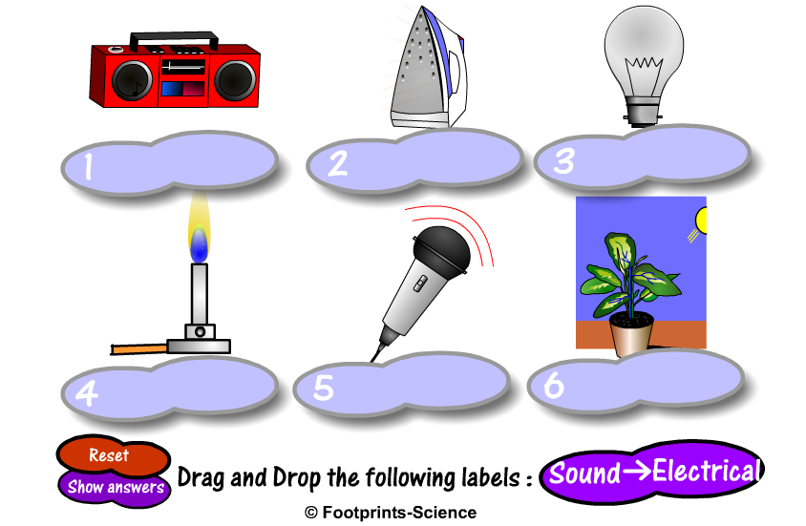
Energy transfers
Energy transfers

Slide 16

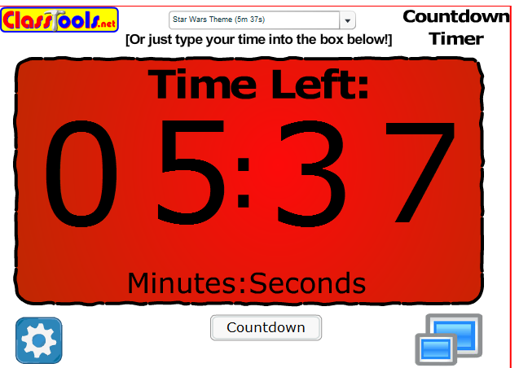
Energy Circus
All practical activities
Complete the energy circus. You have 5 minutes to complete and write up each task so get to it
Star Wars theme music
At the end of each star wars theme move around to the next station

Slide 17
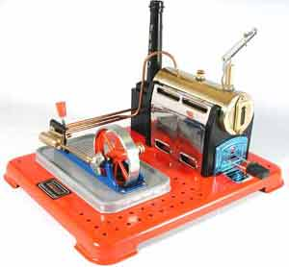
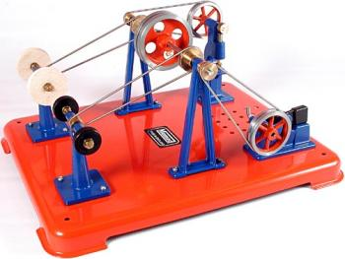
Steam Engine & workshop
Risk Assessment

Slide 18
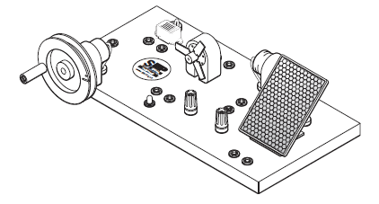

Energy Transfer Unit
As a class look at the energy Transfer Unit.
Complete the work on the worksheet.
Practical Activities
Hypothesising

Slide 19
Here is a picture of a racing car. In the diagram 100 Joules of energy is stored in the fuel. This produces 30 Joules of energy to move the car forward. This means 70 Joules of energy has been wasted as heat. We can represent this in a diagram
100 J 30 Joules kinetic energy
potential energy
in fuel 70 Joules heat

Slide 20
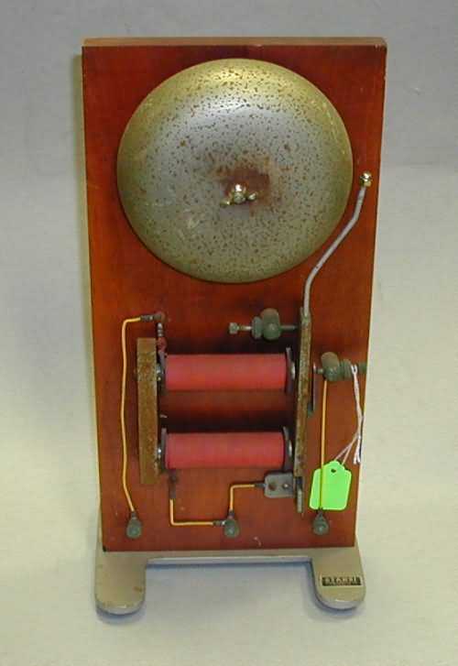
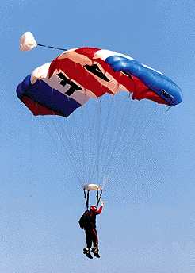
Energy Transfers (continued)
More examples –
Electrical Bell
→ +
Parachutist
→ +

Slide 21
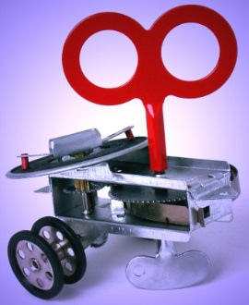
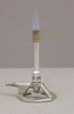


Energy Transfers (continued)
Write out energy transfer diagrams for the following
situations, clearly showing what energy types are wasted in the transfer.
Clockwork toy
Bunsen Burner
Vacuum cleaner
Clapping hands

Slide 22
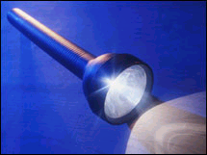
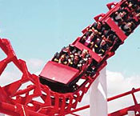
Energy Transfers (continued)
Energy transfers can have many stages too. A torch is a good example.
→ → + ( )
(battery) (wires) (lamp)
Roller coasters have lots of transfers too.
→ → +
(winch) (at top) (moving cars)

Slide 23
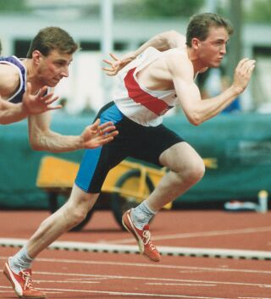
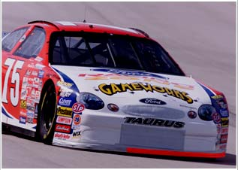
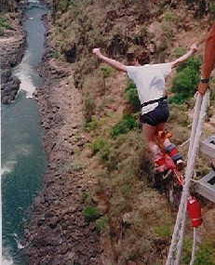
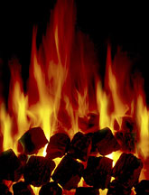
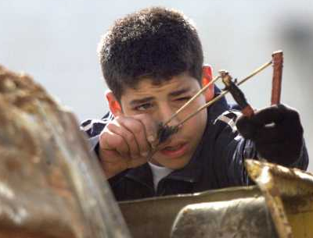
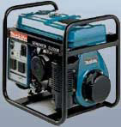
Energy Transfers (continued)
Draw energy transfer diagrams for the following situations –
runner racing car bungee jumper
coal fire catapult generator

Slide 24
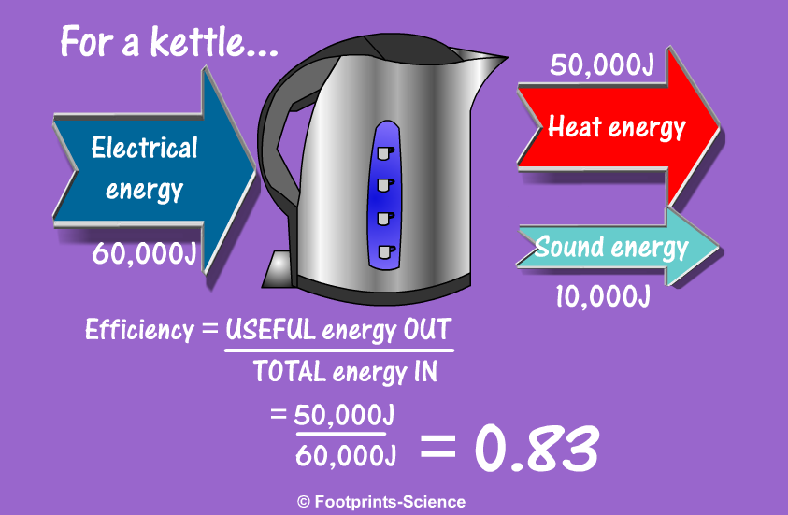
Energy efficiency
Energy efficiency
Only for the smart
Processing Data

Slide 25
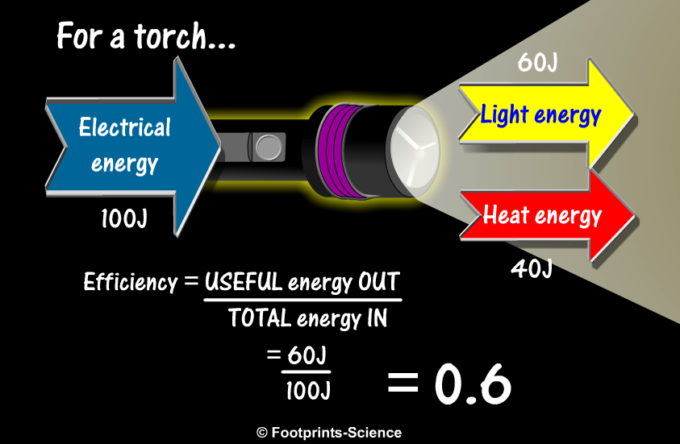
Energy efficiency
Energy efficiency
Only for the smart
Processing Data

Slide 26
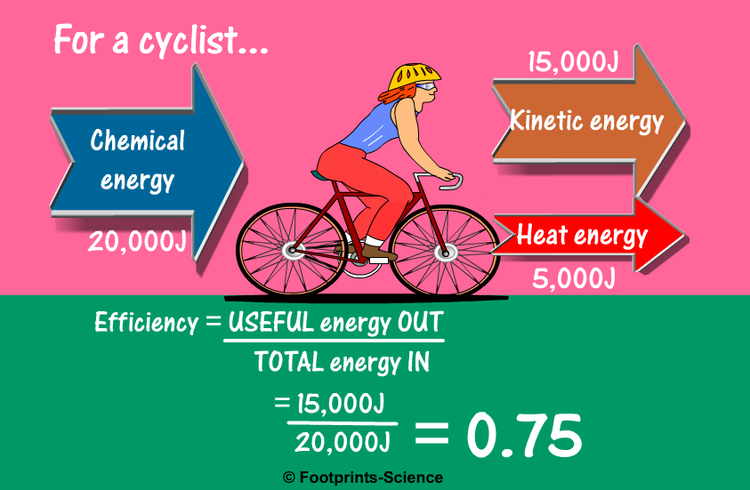
Energy efficency
Energy efficiency
Only for the smart
Processing Data

Slide 27
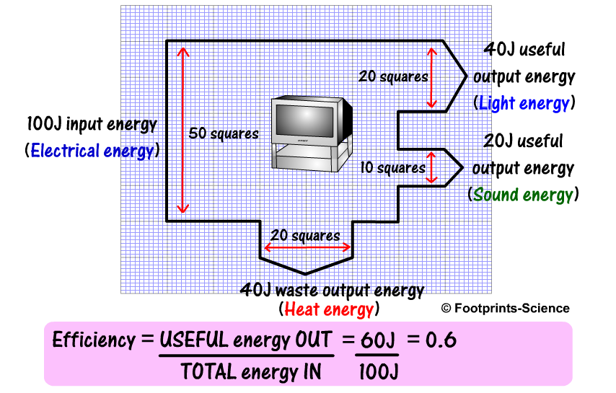
Sankey diagram
Sankey diagram
Only for the smart
Processing Data

Slide 28
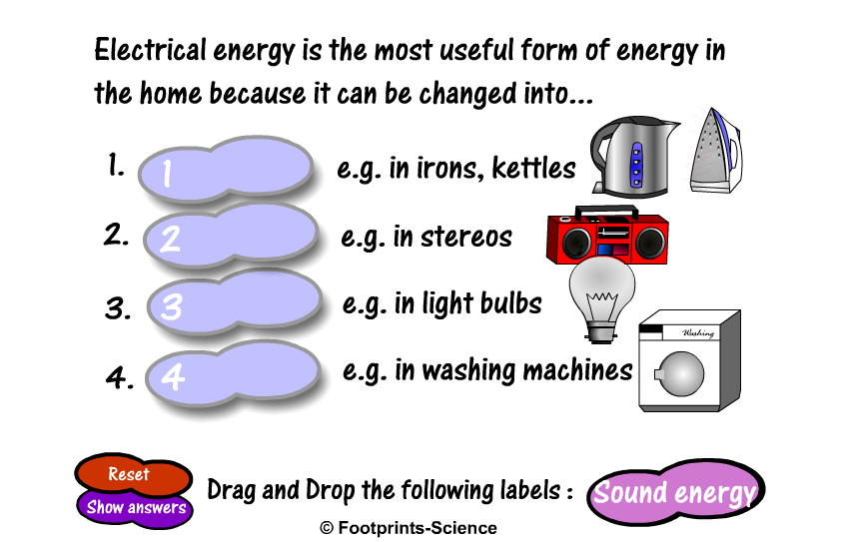
Electrical energy
REVISION
Electrical Energy

Slide 29
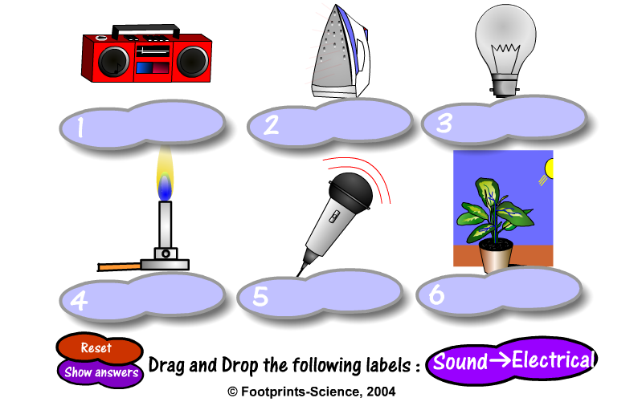
Forms of Energy
REVISION

Slide 30
Forms of Energy
REVISION
Copy and complete this table to show the energy changes that takes place in different machines.
Questions
Machine | Energy Change
Power Station
Catapult
Loudspeaker
Toaster
Bulb
Car
Human

Slide 31
Forms of Energy
ANSWERS
Copy and complete this table to show the energy changes that takes place in different machines.
Questions
Machine | Main Energy Change
Power Station | Nuclear/Chemical To Electrical
Catapult | Potential to Kinetic (+ sound)
Loudspeaker | Electrical to Sound (+ heat)
Toaster | Electrical to Heat (+ light)
Bulb | Electrical to Light (+ heat)
Car | Chemical to Kinetic (+ heat, sound, etc)
Human | Chemical to Heat + Kinetic + Sound

Slide 32
Forms of Energy
Learning Intention:
I know some different types of energy and understand conservation of energy.

Slide 33

WAVES
Part 2
At the end of this section you should know about the two types of waves and give examples. You should be able to use the correct words to describe waves

Slide 34
waves
What do you know about waves?
Express views Written

Slide 35
Waves
What is a wave?
How do you describe waves?
Watch the films on Brainpop to find the answers
brainpop waves
Brainpop sound

Slide 36
Slinky demonstration
Move into the corridor and complete the slinky demonstration
What is a transverse wave? Watch one piece of the slinky, which way does it move?
What is a longitudinal wave? Watch one piece of the slinky, which way does it move?
Do waves catch each other?
How do the waves reflect?
Do the waves pass through each other or join each other?
What happens when the wave reflects?
What happens to the amplitude (height of the wave) as the wave moves along?
Can a longitudinal wave and transverse wave pass?
Can you make a standing wave? How is this done?
slinky (not brill)
slinky harder

Slide 37
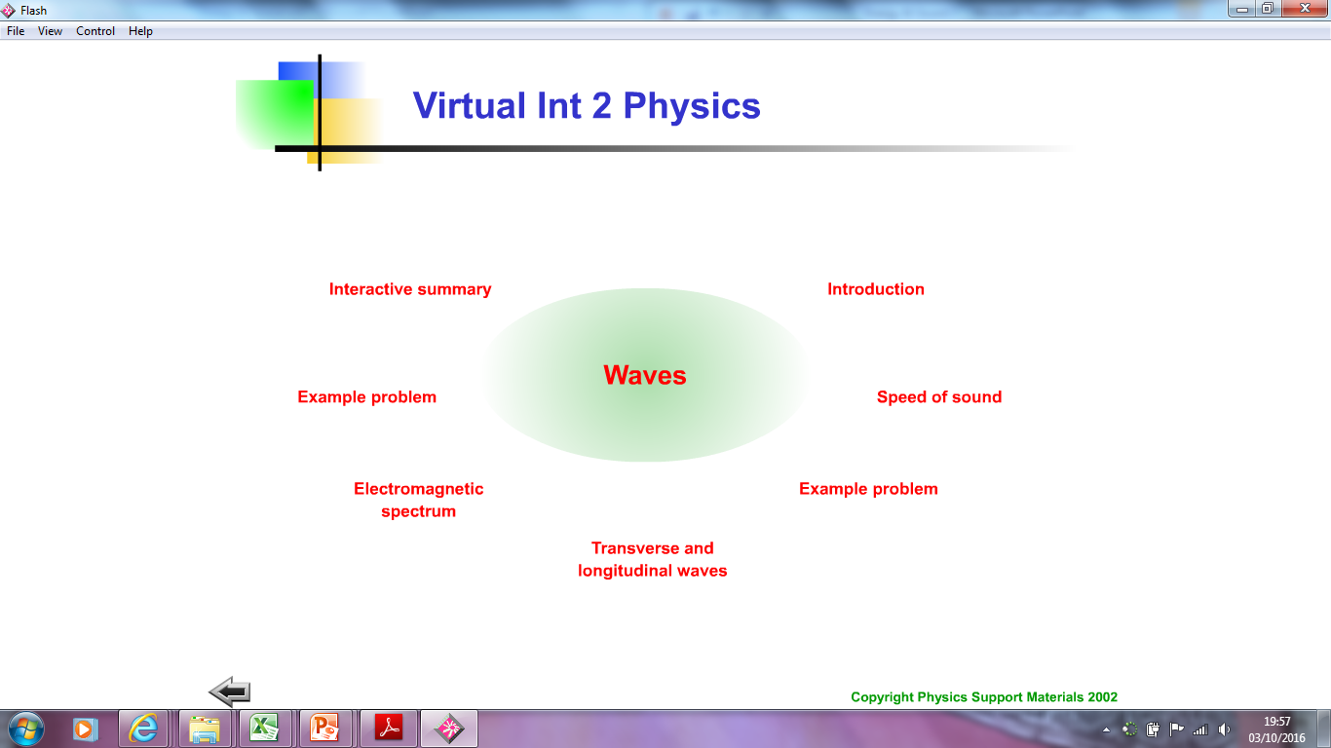
Find out about Transverse and Longitudinal waves

Slide 38
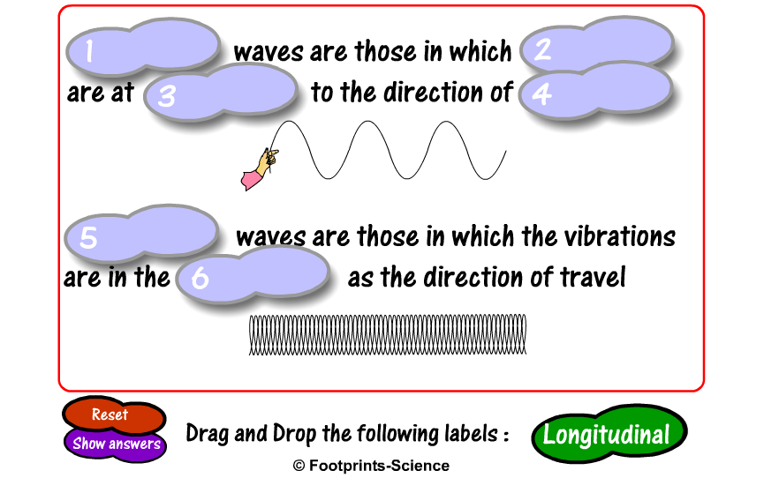
Transverse & Longitudinal
Transverse & Longitudinal

Slide 39
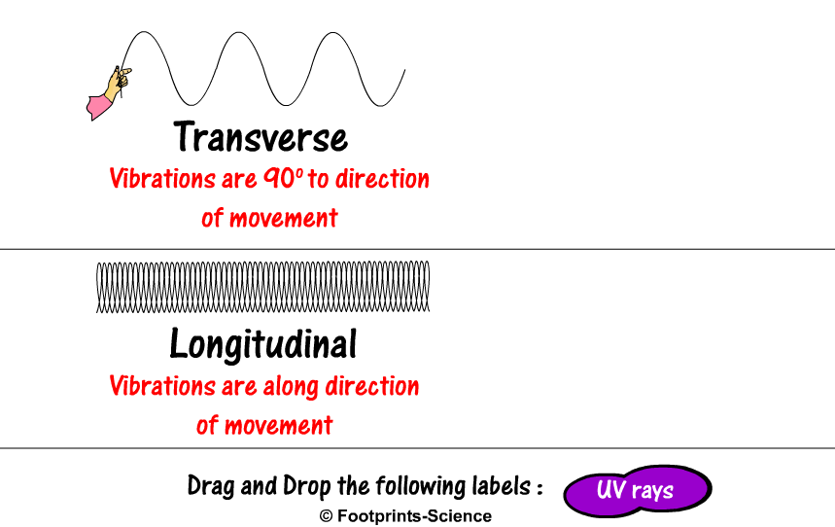
Transverse & Longitudinal
Transverse & Longitudinal

Slide 40
Describing waves
Draw a diagram
crest
a
trough

Slide 41
Amplitude, A, the height of the wave from the middle to the top, measured in metres.
(The amplitude is the distance from the undisturbed position to the crest.)
Wavelength, λ the distance between the same point on successive waves (next to each other)
Frequency, f is measured in Hertz. Frequency is the number of waves produced or passing a point per second.

Slide 42
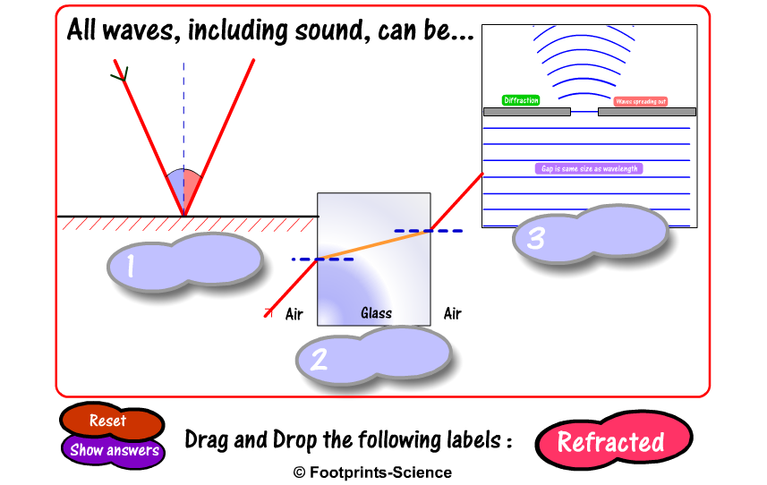
Properties of Waves
Properties of Waves

Slide 43
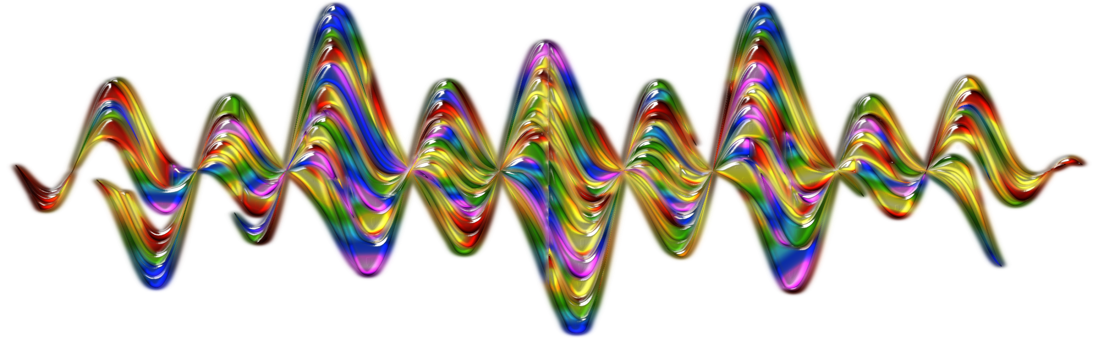
We know all waves
Carry energy
Are either transverse or longitudinal
All have crests troughs and an amplitude

Slide 44
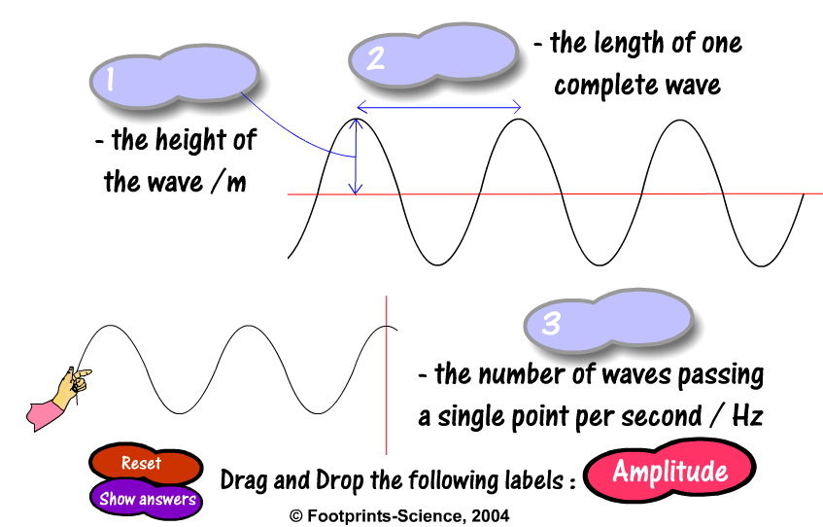
Describing Sound Waves

Slide 45

Wave Equations
For the super clever amongst you see if you can go through the material on
Speed = frequency x wavelength
$$v=fλ$$
If this is too hard, research one type of wave
Processing Data

Slide 46

Waves
Learning Intention:
I understand what is meant by waves.

Slide 47
Sound
Express an
opinion
What is sound?
Watch the films on Brainpop to find the answers
Brainpop sound

Slide 48
What is Sound?
Sound demonstration

Slide 49
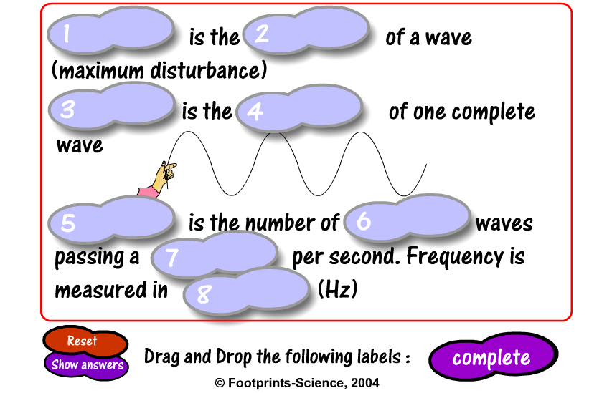
Describing Sound Waves

Slide 50
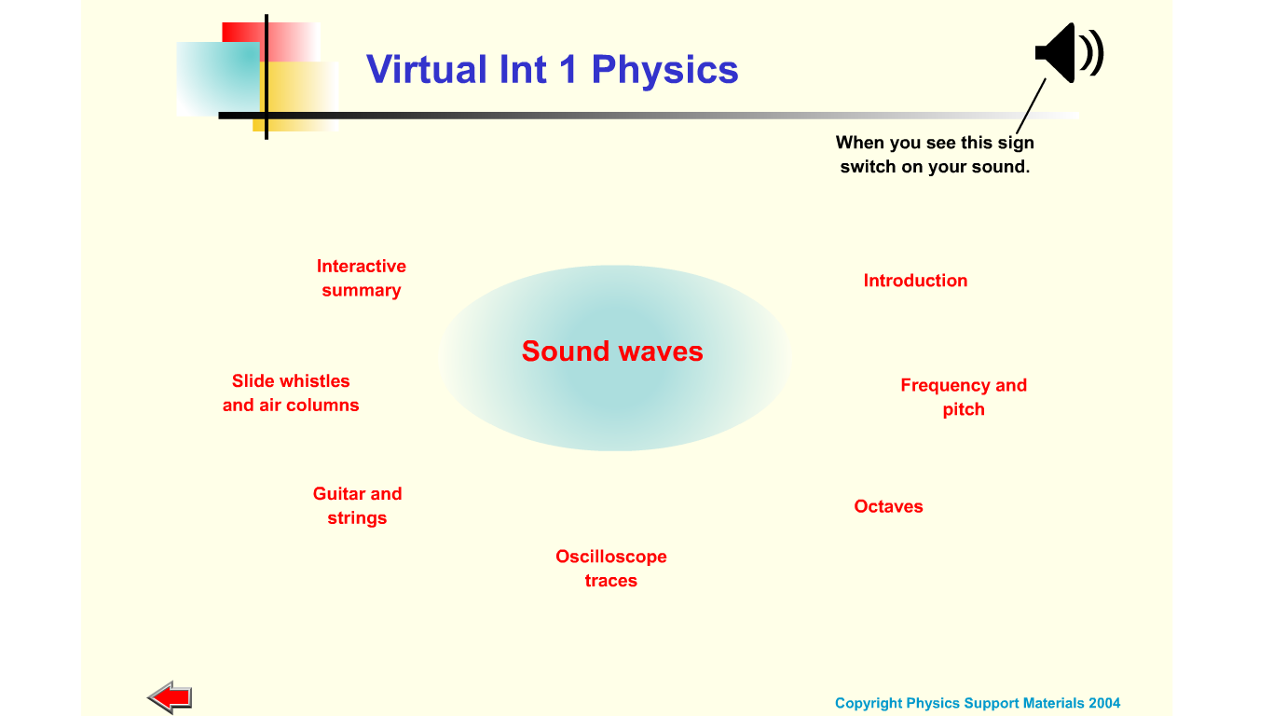
Find out about sound
Research

Slide 51
Sound is a wave
Research
Observing
Reubens Tube
Complicated explanation of Reuben's Tube
Get a sound playing from the smart board, walk across the room and you should hear places where the sound is loud and places where the sound is quiet. This is the waves from the two speakers interfering.
If you want to be a sound engineer you would have to sort this out for a concert!

Slide 52
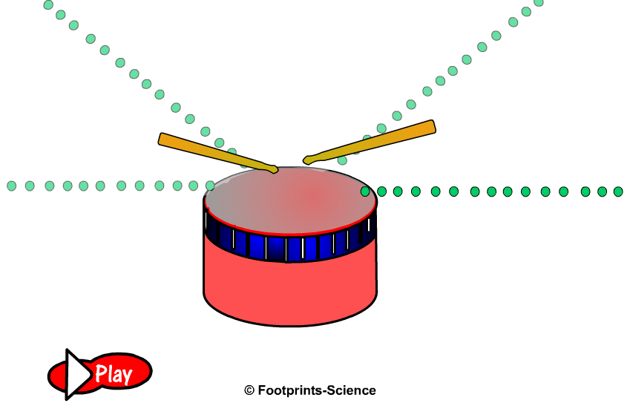
Vibrations to the Ear
Vibrations to the Ear

Slide 53
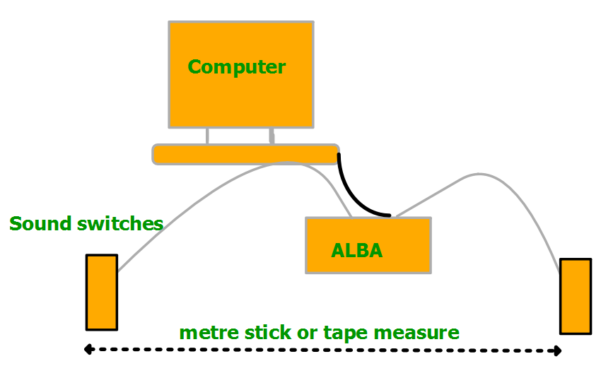
Measuring the speed of sound
ALBA

Slide 54
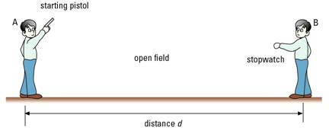
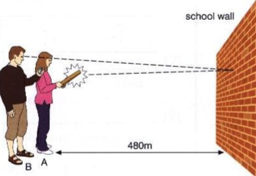
Measuring the speed of sound
Pop a balloon or clap
If the weather is good go and measure the speed of sound in air outdoors
Practical Activities/ Processing data

Slide 55
Calculations
IESSUU
Try some calculations on
speed = distance ÷ time
Please use
v = d / t
For the most able try answering the sound questions for the others try something simpler,

Slide 56


Slide 57
Does sound travel through a gas?
Does sound travel through a liquid?
Does sound travel through a solid?
What evidence is there for this?
Express views-V

Slide 58
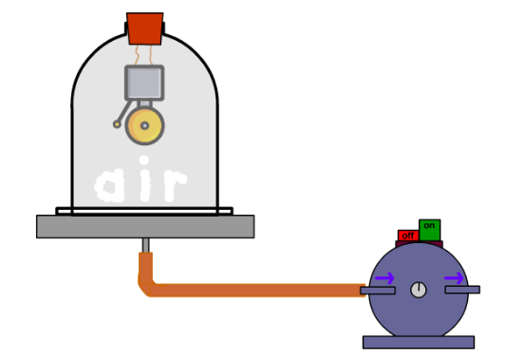
Does sound travel through a vacuum?
What evidence is there for this?
no sound doesn’t travel through a vacuum and can’t travel in space. (The films are all wrong!)
STAR WARS
Bell Jar Experiment
Virtual Animations

Slide 59
What kinds of materials can sound travel through?
What can sound not travel through?
Sound can travel through
solids,
liquids, and
gases.
Sound cannot travel through empty space (a vacuum).

Slide 60
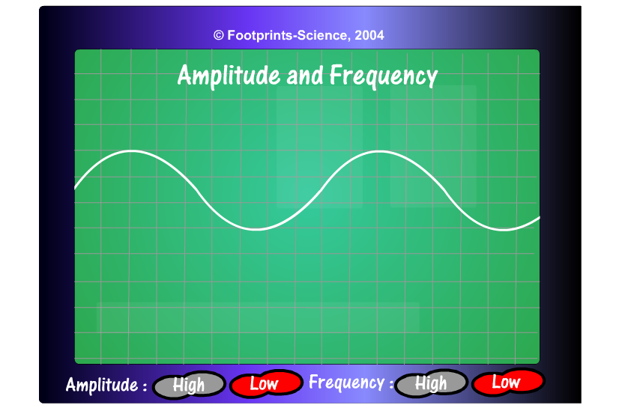
Amplitude & Frequency
Sound Energy
Amplitude and Frequency

Slide 61
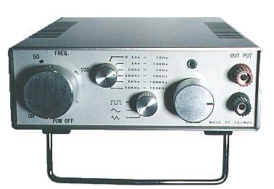
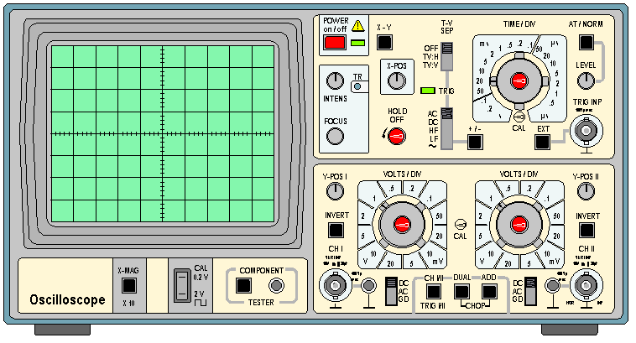
Describing Sound Waves
Research
Collect a ‘Describing Sound Waves’ worksheet.
Fill in the different oscilloscope screens to show what happens to sound waves as they are changed.
http://www.youtube.com/watch?v=TLNSknAMsbI

Slide 62
Describing Sound Waves
Observing
We can use an oscilloscope to help get an image of sound waves.
The frequency of a sound wave is the number of waves that are produced every second. The closer together (or more bunched up) the waves are, the higher the frequency is.
Frequency is measured in hertz (Hz).

Slide 63
Describing Sound Waves
We can use an oscilloscope to help us visualise sound waves.
Frequency is the scientific word for pitch.
Wavelength is the distance from the top of one wave to the top of the next.

Slide 64
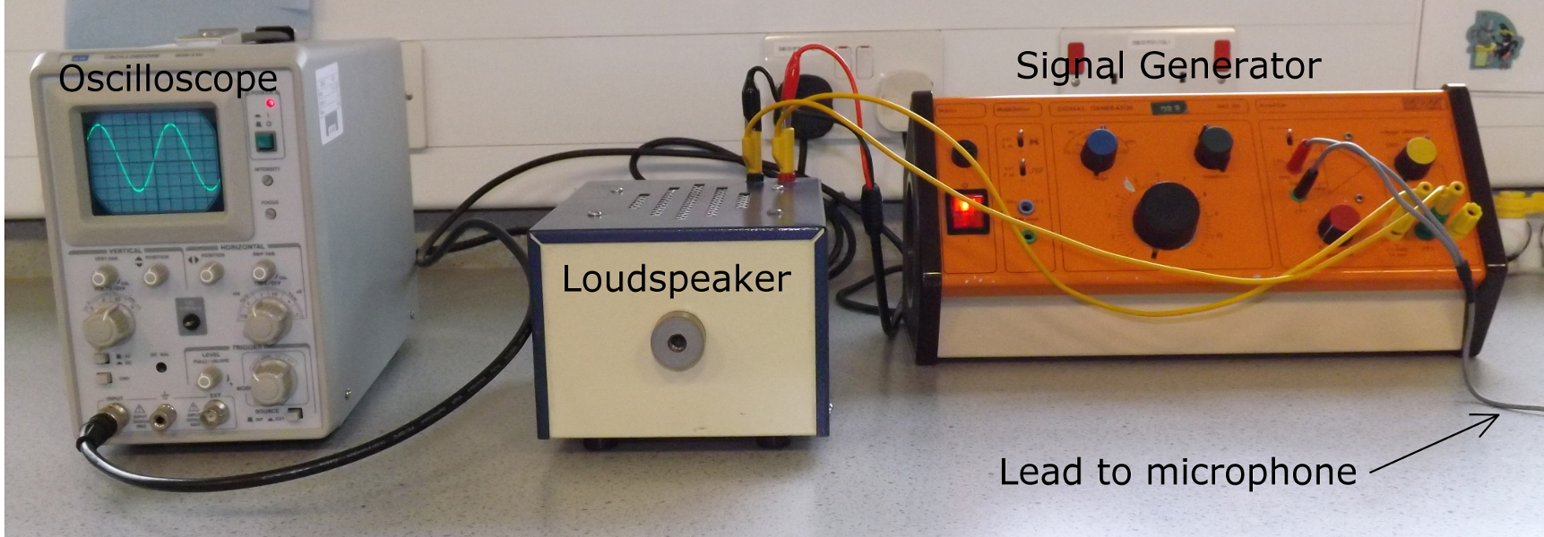
Observing. RA

Slide 65

This switch
Up for signal generator
Down for the microphone

Slide 66


Slide 67
Low frequency vibrations and polystyrene beads
ADD IN DIAGRAM WITH POLYSTYRENE BEADS
Low frequency sounds are called INFRASOUNDS. Research uses of Infrasound or do the v=fλ calculations

Slide 68
Sound waves
Sound waves
Sound is made whenever an object vibrates
Amplitude is given by the height of the vibrations
The greater the amplitude, the more energy a wave has.
The greater the amplitude, the louder the sound
Frequency is the number of complete vibrations per second
The greater the frequency, the higher the pitch of the sound
Frequency is measured in Hertz, Hz
Amplitude is measured in metres m

Slide 69
Measuring sound levels
Practical Activities
Evaluating
Task | Distance (m) | Sound Level dB
Loud sounds can permanently damage hearing

Slide 70


Moral ethical reflection

Slide 71

Describing Sound Waves
Learning Intention:
I can draw the effect that volume and pitch have on oscilloscope traces of sound waves.

Slide 72

OUR EARS
Diagram
Structure of ear
Using Brainpop
Stick in a diagram & label it
What some parts of the ear do (function)
How good is our hearing?
If we’ve time, how do ears help us balance?
Using devices to improve hearing

Slide 73
Our Ears
Inner Ear
Outer Ear
Middle Ear

Slide 74


Ear
drum
Semi circular
canals
pinna
Small
bones
(auditory)
nerves
Cochlea
Ear canal
Tube to
throat

Slide 75

View the ear model- which bits are missing?

Slide 76

The Ear
The Ear

Slide 77
Human Ear Answers
Part of Human Ear | What It Does
Pinna | Collects as many sound waves as possible.
Ear Drum | Detects sound waves by vibrating.
Stirrup, Anvil and Hammer | Amplifies the vibrations.
Cochlea | Has a liquid that vibrates which makes cilia create an electrical signal.
Auditory Nerve | Passes electrical signals to the brain.

Slide 78

Physics of Hearing

Slide 79
Amplitude, Frequency & Wavelength
Amplitude, Frequency & Wavelength
Amplitude is the height of a wave (maximum disturbance)
Wavelength is the length of one complete wave
Frequency is the number of complete waves passing a single point per second. Frequency is measured in Hertz (Hz)
Wave speed = Frequency x Wavelength
Energy is transferred in a wave but never particles

Slide 80

LET’S TEST OUR EARS!
Sound Files
Risk Assessment
15000Hz
19000Hz
8000Hz
16000Hz
18000Hz
10000Hz
22000Hz
21000Hz
12000Hz
17400Hz
17000Hz
20000Hz
14000Hz

Slide 81
Human Ear
childrensuniversity.manchester.ac.uk/ear/
Watch the video on how the ear works

Slide 82

Hearing Sounds- Our ears are the detectors of SOME sound
We have already found out that waves travel by vibrations through any medium that has particles in it – solids, liquids and gases.
Read
When sound reaches the human ear, the pinna (outside of the ear) is specially shaped to ensure that as much sound as possible makes in to the ear itself.
pinna
cochlea
ear drum
stirrup
auditory nerve
hammer
anvil

Slide 83
Hearing Sounds
The sound then passes in to the ear canal to the ear drum. The sound causes the ear drum to vibrate just like the skin of a drum.
Read
These vibrations are then amplified (made stronger) by the three smallest bones in the human body – the hammer, the anvil and the stirrup.
pinna
cochlea
ear drum
stirrup
auditory nerve
hammer
anvil

Slide 84
Hearing Sounds
The larger vibrations then pass to the cochlea. The cochlea is shaped like a snail’s shell and is filled up partially with a liquid. The vibrations make the liquid vibrate which are picked up by special little hairs (cilia).
Read
pinna
cochlea
ear drum
stirrup
auditory nerve
hammer
anvil

Slide 85
Hearing Sounds
The auditory nerve detects the movement of the cilia and creates an electrical signal to the brain.
Read
The brain then recognises the electrical signal as sound, and we can hear.
pinna
cochlea
ear drum
stirrup
auditory nerve
hammer
anvil

Slide 86
Research
Hypothesizing
Planning
Measuring
Evaluating
Do all sounds seem the equally loud??
Test it and see!

Slide 87
CHECK KNOWLEDGE!
1.The names of the smallest bones
2. What collects the sound waves?
3. What part(s) vibrate?
4. How are the waves translated?
5.What part is for balance? (ext)
6. What part has the sense cells?

Slide 88
Investigate our ears
What happens if we make our pinnas larger? Can we hear more or less or doesn’t it make a difference to what we can hear?
What happens if we cup our hands in front of our pinnas? Can we hear more or less or doesn’t it make a difference to what we can hear?

Slide 89

Making your ears more efficient
Observing
Evaluating
Describe how cupping your hand over your ears works to make sounds appear louder

Slide 90

Reducing sounds in your ears
Why is cupping your ear better than putting your fingers in your ears to reduce noise levels?
NB Your hands should “reflect” the sound away, not cover your ears.

Slide 91



Slide 92
Reflection and Curved Reflectors

Slide 93
Are you damaging your ears?
iphone earbuds
Research
Literacy task
Sound level apps for your phone
There are two levels of exposure at which specific action must be taken, the first action level of 85dB and the second action level of 90dB. When the first action level is reached, employers must give their employees information and training, and offer them ear protection (for example, earplugs) but the employees don’t have to wear the protection if they don’t want to. However when the second action level is reached, the employees are breaking the law if they don’t wear the ear protection; and the employer must also do what they can to reduce the noise level.
Of course some sounds, such as close gunfire, can cause damage almost instantaneously, so the regulations also limit the instantaneous maximum sound that people can be exposed to. Luckily music on earphones is extremely unlikely to reach this level1, although it is not impossible under fault conditions which could apply a high voltage to the earphones.

Slide 94

Why do we need two ears?
Why do we need two ears?
We need two ears to be able to detect the direction the sound is coming from. When one ear is covered it is much harder to tell where the sound is coming from although you can still detect the sound. Some people are better at detecting direction than others. With two ears it is still hard to detect some directions especially around the sides.

Slide 95
Conclusions
We use our __________ for hearing
Our ears are divided into this number of sections.
The sections are called…….
Our ears contain the smallest WHAT!
Humans can hear sounds that vibrate between…...

Slide 96

Hearing Sounds

Slide 97
Hearing Sounds
Learning Intention:
I know how the human ear picks up sound.

Slide 98
Ultrasonic waves
Ultrasonic waves
A signal generator can produce electrical signals which can be converted to sound waves by a speaker. The sound waves can be greater than the hearing range for humans (ultrasonic waves).
2. Ultrasonic waves can be used in industry for cleaning, quality control, and for pre-natal scanning

Slide 99
Ultrasound- RESEARCH
Research
Literacy Task
What is ULTRASOUND?
Uses for ultrasound

Slide 100

Ultrasound Energy

Slide 101

Sound Energy
REVISION

