Slide 1
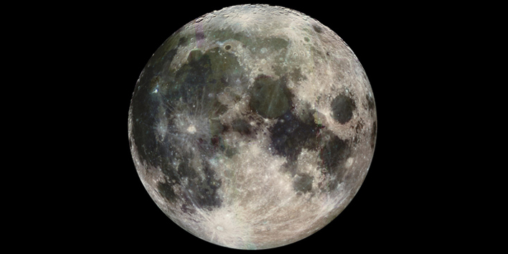
Espace
MOON TASK

Slide 2
MOON TASK
You are a member of a space crew originally scheduled to rendezvous with a mother ship on the lighted surface of the moon. However, due to mechanical difficulties, your ship was forced to land at a spot some 200 miles from the rendezvous point.

Slide 3
Where am I?
https://www.youtube.com/watch?v=nzkns8GfV-I
http://www.google.co.uk/moon/

Slide 4
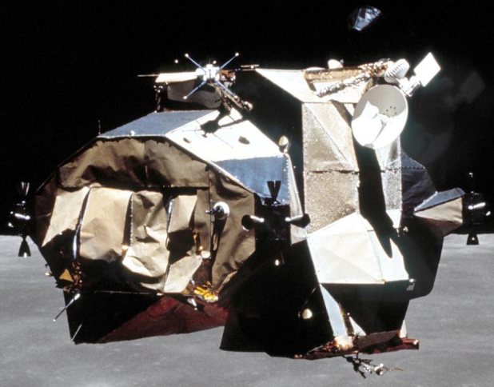
MOON TASK
During re-entry and landing, much of the equipment aboard was damaged and, since survival depends on reaching the mother ship, the most critical items available must be chosen for the 200-mile trip.

Slide 5
MOON TASK
Below are listed the 15 items left intact and undamaged after landing. Your task is to rank order them in terms of their importance for your crew in allowing them to reach the rendezvous point.
Place the number 1 by the most important item, the number 2 by the second most important, and so on through number 15 for the least important.

Slide 6
Translation
Use a dictionary to find out the what you have available.
Now choose which items you would take and what to leave, ranking your items 1-15

Slide 7
1. Une boîte d’allumettes
2. Des aliments concentrés
3. 50 mètres de corde en nylon
4. Un parachute en soie
5. Un appareil de chauffage fonctionnant sur l’énergie
solaire
6. Deux pistolets calibre 45
7. Une caisse de lait en poudre
8. Deux réservoirs de 50 kg d’oxygène chacun
9. Une carte céleste des constellations lunaires
10. Un canot de sauvetage auto-gonflable
11.Un compas magnétique
12. 25 litres d’eau
13. Une trousse médicale avec seringues hypodermiques
14. Des signaux lumineux
15. Un émetteur-récepteur fonctionnant sur l’énergie
solaire (fréquence moyenne)

Slide 8
Caja de cerillas | 9) Mapa de estrellas (constelación lunar)
2)Comida concentrada | 10) Balsa salvavidas
3) 25 mtr de cuerda de nylon | 11) Compas magnético (brújula)
4)Seda de paracaídas | 12) 10 l. de agua
5)Unidad calentamiento portátil | 13) Luces de llama para señalar
6) Dos pistolas del calibre 45 | 14) Botiquín de urgencias con agujas para inyecciones
7) Una caja de leche deshidratada | 15) Transmisor-receptor de fm, que funciona con energía solar
8) Dos tanques de oxígeno 100 l. Cada uno

Slide 9
Box of matches
Food concentrate
50 feet of nylon rope
Parachute silk
Portable heating unit
Two .45 caliber pistols
One case of dehydrated milk
Two 100 lb. tanks of oxygen
Stellar map
Self-inflating life raft
Magnetic compass
25 litres of water
Signal flares
First aid kit, including injection needle
Solar-powered FM receiver-transmitter

Slide 10
Scoring:
For each item, mark the number of points that your score differs from the NASA ranking, then add up all the points. Disregard plus or minus
differences. The lower the total, the better your score.

Slide 11
0 - 25 excellent
26 - 32 good
33 - 45 average
46 - 55 fair
56 - 70 poor –
- suggests use of Earth-bound logic
71 - 112 very poor
– you’re one of the casualties of the space program!

Slide 12
Scoring
How well did you translate the words?
Score 10 points for every word or phrase correctly translated.

