Slide 1
TRANSPORT UNIT
FORCES/dyanmics
LOCKERBIE ACADEMY
S1-S3 Road Safety & PHYSICS

Slide 2
WHAT IS A FORCE?

Slide 3
ASK A STUDENT!
WHAT IS A FORCE?
Think
Pair
Share
Timer- Dr WHO

Slide 4
WHAT YOU THOUGHT

Slide 5
Forces
A FORCE is a PUSH or a PULL.
Forces can’t be seen, but the effect of a force can be seen.
They are measured in newton – N
They always act in a certain direction
A newtonbalance , spring balance or forcemeter is used to measure forces.

Slide 6
EFFECTS OF A FORCE?

Slide 7
TASK
CAREFULLY, DO NOT DESTROY THE OBJECTS
Take one of the objects from the tray and apply FORCES to it.
Record the effect on the object.
Object | Force | Effect

Slide 8
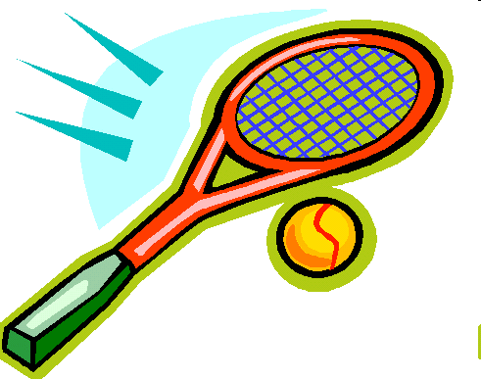
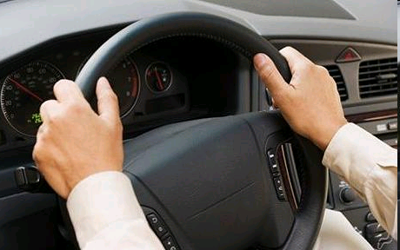
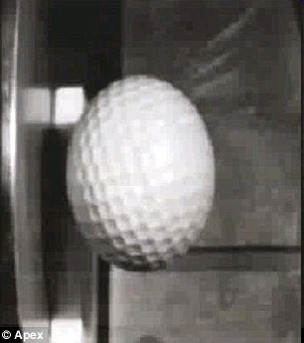
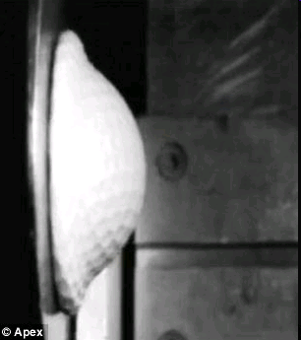
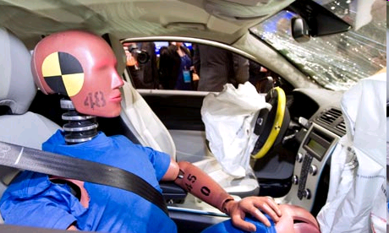
BEWARE
It seems amazing but you cannot see Forces. You can only see their effects.
Notes:
8
http://www.dailymail.co.uk/sciencetech/article-1284051/Incredible-slow-motion-picture-golf-ball-flattens-hits-steel-plate-150mph.html
t looks like a rubber ball that has been squashed after being flung at a wall.
But these images actually show what happens during a high speed impact - to a golf ball. The slow motion close-up of the smash reveals the incredible forces at play when a golf ball is fired at a piece of steel at 150mph. Internet picture of a golf ball hitting a piece of steel at 150mph in slow motion The video stills show what happens when a golf ball slams into a steel plate at high speed The clip reveals the unbelievable distortion it undergoes and its flexibility - even under the extreme stress of going from 150mph to zero in a split second.
The whole ball is flattened like a pancake against the steel before bouncing off and instantly reforming into its original shape as the energy from the impact is transferred across the ball to the opposite end in a wave.

Slide 9
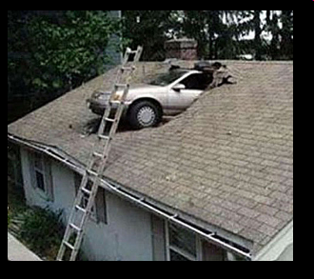
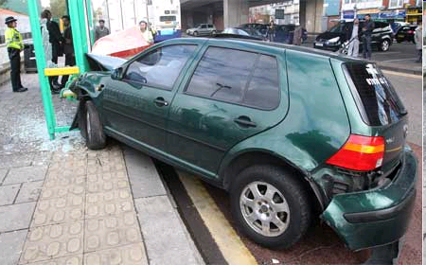
Forces
Forces change an object’s
  speed,
  shape,
  direction of movement.

Slide 10
Examples of forces
Weight, friction, upthrust

Slide 11
Measuring FORCES?

Slide 12
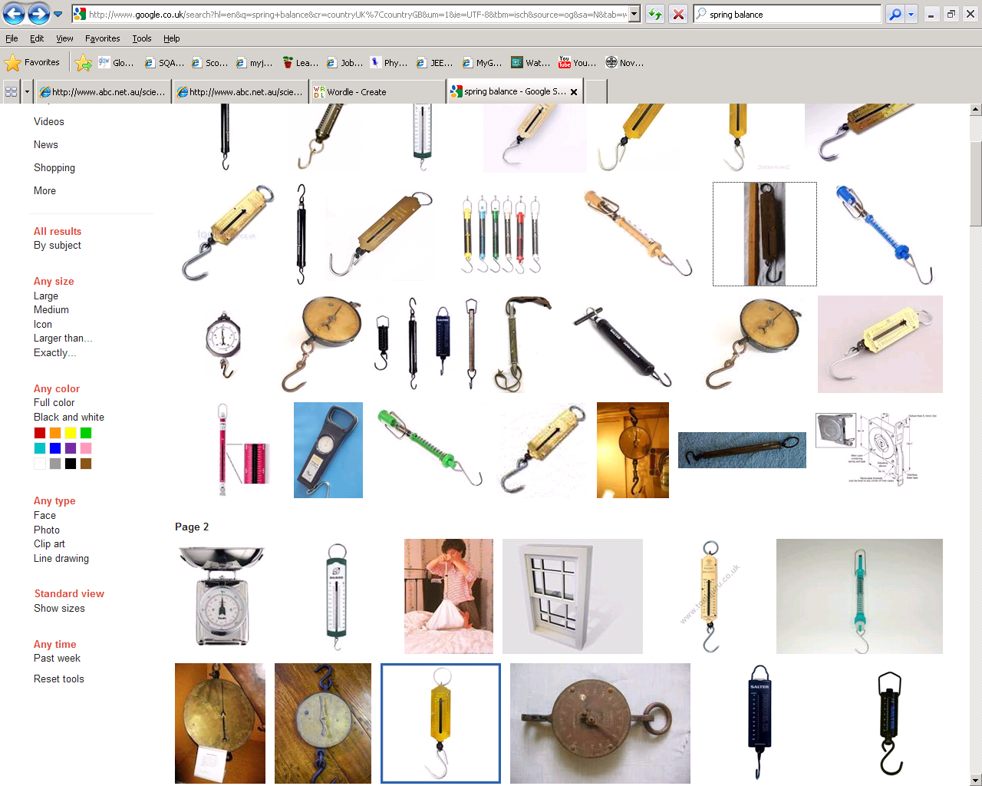
Measuring forces
We can use one of the effects of a force to measure forces.
This is called HOOKES LAW

Slide 13
Hookes law

Slide 14
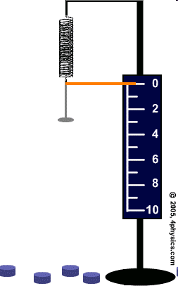
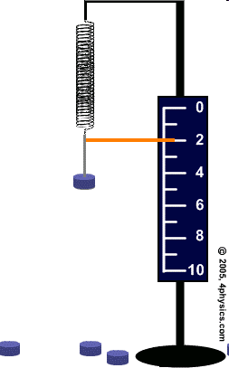
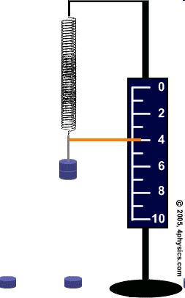

Slide 15
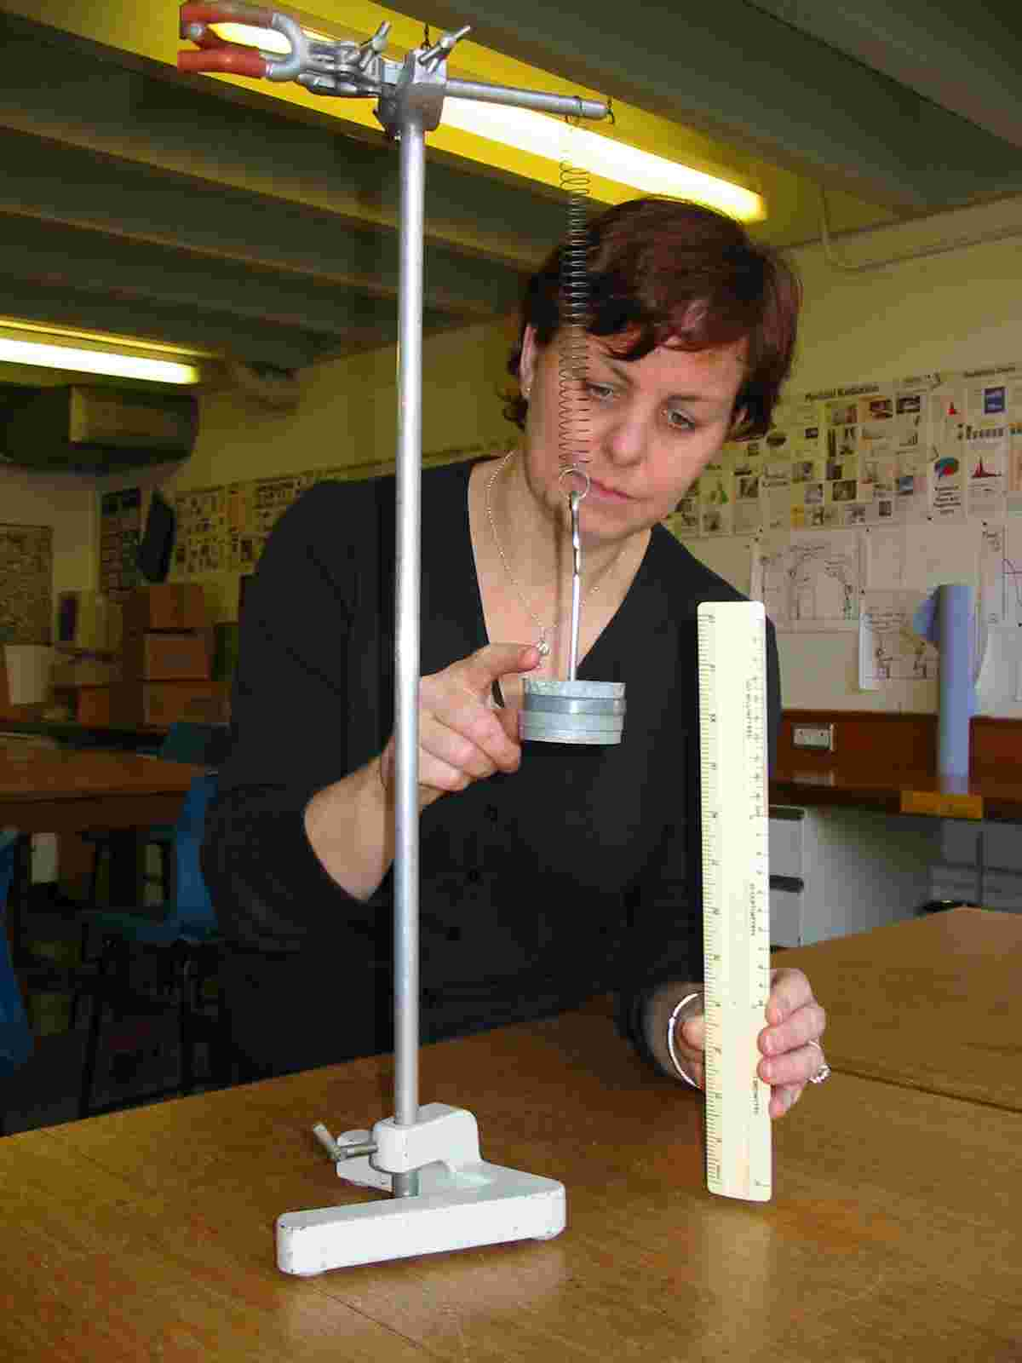

The spring exerts a force upwards on the mass.
The Force of gravity exerts a force downwards on the mass.
1.9

Slide 16
Procedure
Hang a spring from a clamp stand make sure it cannot fly off.
Clamp the metre stick vertically in the clamp, alongside the spring.
Record the metre rule reading level with the bottom of the spring. The number of masses hanging from the spring is 0 and the extension of the spring is 0 cm.
Hang a mass hanger from the bottom of the spring. Record the new metrestick reading, the number of masses (1) and the extension of the spring.

Slide 17
Procedure
Repeat this for 5 masses
Plot the number of masses on the horizontal axis, since it is the input (or independent) variable. The extension of the spring is the output (or dependent) variable and you should plot it on the vertical axis.

Slide 18
extension
Repeat the experiment with sweet laces and see if the experiment gives the same results.
DO NOT EAT THE LACES!
AVOID SUGAR COATED LACES

Slide 19
Homework: Spring experiment
Weight | Extension (cm)
(N) | Spring 1 | Spring 2
0 | 0.0 | 0.0
1 | 2.4 | 1.7
2 | 4.8 | 3.4
3 | 7.2 | 5.1
4 | 9.6 | 6.8
5 | 12.0 | 8.5
6 | 14.4 | 10.2
7 | 16.8 | 11.9
8 | 19.2 | 13.6
9 | 21.6 | 15.3
10 | 24.0 | 17.0
This data is in the homework sheets. Draw a graph using the data in this table so you will be able to compare the two springs.

Slide 21
HOOKE’S LAW CONCLUSION
Double the force and you double the stretch.
Hmm- we can use this!

Slide 23
Chart wizard
Title
Key:
object 1
object 2
object 3

Slide 24
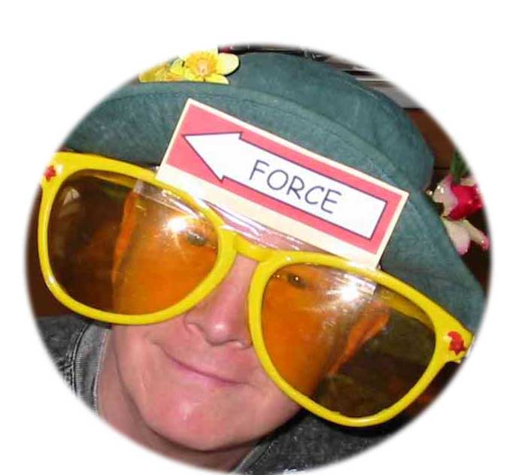
OK, let’s consider the forces acting on the mass. Look through forces spectacles and simplify this situation.

Slide 25
Spring balance / newton meter

Slide 26
The instrument for measuring forces is the Newton Balance, spring balance or Forcemeter.
Forces are measured in units of NEWTONS (N)

Slide 27
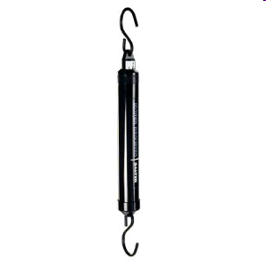
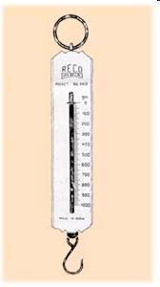
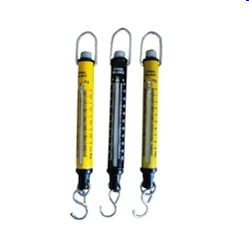
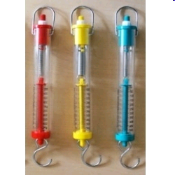
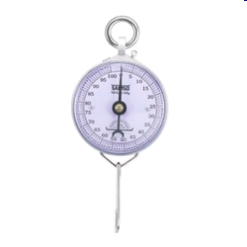
Newton Balance, spring balance or Forcemeter

Slide 28
Mass & weight

Slide 29
Mass and Weight- LEVEL 3
The mass of an object is the amount of matter that is in the object
the weight of an object is the force of gravity that acts on that object
➔Mass is related to how much stuff in an object and weight is related to the pull of the Earth

Slide 30
Mass and Weight- LEVEL 4
Mass is a measure of the amount of matter in an object.
Mass is caused by the number of particles in an object. Particles are too small to be seen so we deal with larger bundles called kilograms.
To be honest mass isn’t really understood by scientists. Maybe it could be something you could win a NOBEL PRIZE for!
ADD PICTURE
02/10/2011
JAH

Slide 31
Level 3
Mass is measured in kilograms (kg).
Wherever you go your mass remains the same.

Slide 32
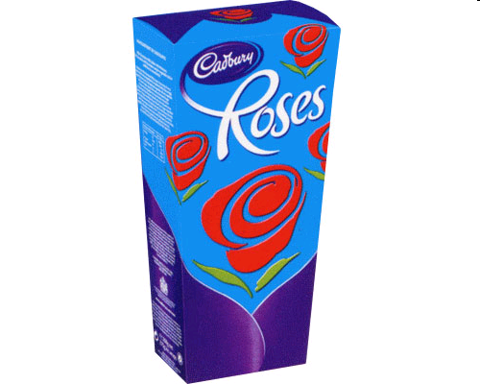
Mass and Weight- LEVEL 3
E.g if you had a big (1 kg) box of Roses chocolates on the Earth the amount and number of chocolates would be the same wherever you took those chocolates.
There would still be a 1 kg box of chocolates with the same number of mini dairy milks etc., providing that you don't eat the chocolates!

Slide 33
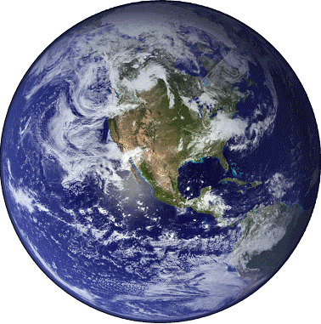
Mass and Weight- LEVEL 3
In the same way if a girl has a mass of 40 kg (about 6 stone 4 pounds) on the Earth, her mass is still 40 kg up in a plane, on the moon or out in space. Her mass stays the same.

Slide 34
Weight not gravity
Mass and Weight- LEVEL 3/4

Slide 35
What’s the difference? Mass and Weight- LEVEL 3/4
What’s the difference?
We often say things like:
“My weight is 55 kilograms”
“This bag weighs 2 kilograms”
The problem is, we’re using the wrong word – at least as far as Physics is concerned.

Slide 36
CONFUSING NOTES- Level 3/4
WEIGHT & MASS causes problems in the lab.
What you call your weight, measured in kilograms should really be called mass. This can be confusing.
All we ask is that when you are being scientific try to remember that it is mass that is measured in kilograms.
This is like the confusion that happens when you use the word battery to mean cell.

Slide 37
Measuring WEIGHT/ FORCE

Slide 38
WEIGHING really is FINDING YOUR WEIGHT!
When we “weigh” something, either hanging an object from the scales or placing the object on a scale, we are actually measuring the force of gravity on that object. The object is pulled down by the Earth and we measure that force. HOWEVER we record the answer in units of MASS.
The following experiment shows you how!

Slide 39
Weight and mass – what’s the link?
In this experiment, you’ll find out the link between weight and mass
Copy the table below to record your readings.
Hang different masses from newton balances.
Record the weight from the newton balance.
Mass hung on newton balance (kg) | Weight on newton balance (N)
0.1
0.2
0.3
0.4
0.5
0.6

Slide 40
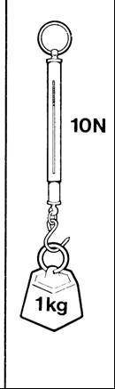
Weight is a force which is caused by the pull of gravity.
You have found that on Earth the pull of gravity on a kilogram is about 10 newtons.
The weight of 1kg is 10 N
The ratio of weight to mass is given the symbol g
  g = 10 N/kg

Slide 41
www.brainpop.co.uk

Slide 42
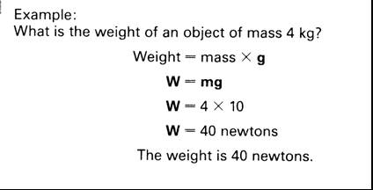
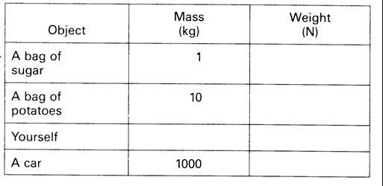

Slide 43
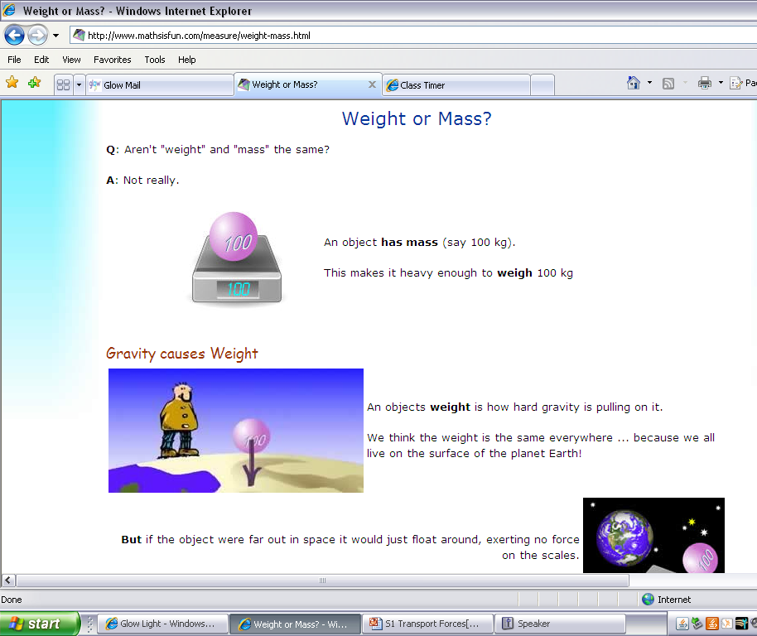
Losing – and gaining – weight
://www.mathsisfun.com/measure/weight-mass.html

Slide 44
Weight and Mass –
This is still the pull of the Earth
Making the 1kg mass stay on the scales.
The scales are calibrated to take this force and display a value 10 times LESS than this Force
The Earth is pulling the mass downwards giving it weight. The spring balance displays units of Force
1 Kg
a WEIGHT of 10N

Slide 45
Measuring force & Weight
What causes weight?
What is the relationship between weight and mass?
Would this be different on other planets?
Write a formula relating weight to mass.

Slide 46
HOMEWORK/ RESEARCH
a) Find out about some aspect of space travel. For example training astronauts, eating in space etc.
OR
b) Find out more about gravity. For example, what causes it, does it change on other planets, what are black holes.
OR
c) Try to describe a room or an activity without gravity. (ignore the lack of air)

Slide 47
SUMMARY
Weight is the force due to gravity on an object.
An object with a very large mass, eg the Earth, the moon, pulls other objects eg humans, towards it. This pull is called the force of gravity or WEIGHT.

Slide 48
TRY THESE EXAMPLES- What to do –Level 3
In these sentences, the underlined words are wrong. Rewrite the sentences and correct the mistakes.
My weight is 50 kilograms.
Mass is caused by the pull of the Earth.
Because mass is a force, it is measured in kilograms.
This box has a mass of 70 newtons.

Slide 49
What’s the difference? Level 3/4
Mass is the amount of stuff that makes up an object. It’s measured in kilograms.
Weight is the force of gravity acting on an object. It’s caused by the Earth pulling down on the object. Because weight is a force, we measure it in newtons.
Mass is measured in kilograms.
Weight is force caused by the pull of the Earth. It is measured in newtons.

Slide 50
Measuring MASS and WEIGHT
Use scales to measure the MASS of some SMALL objects
Now use a spring balance to find the weight of the same objects.
What conclusion can you make about an object’s weight compared to it’s mass?

Slide 51
Write your results into a table like this:
Object | Mass (kg) | Weight (N)
Eg Pencil case

Slide 52
Losing – and gaining – weight
People often say they want to lose weight. What they really mean is that they want to lose some of their mass.
One of the best ways of losing weight is to travel to the Moon. This is because the Moon’s gravity is weaker, and doesn’t pull you down with such a big force. This is why astronauts on the Moon can jump quite high, even though they are wearing big spacesuits.
What other things would be easier on the moon and are there any other forces that would be different?

Slide 53
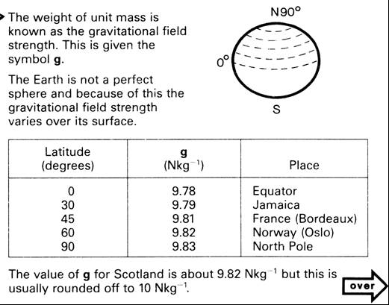
GOING FURTHER LEVEL 4/5

Slide 54
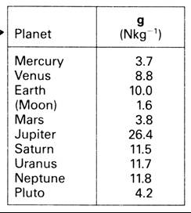
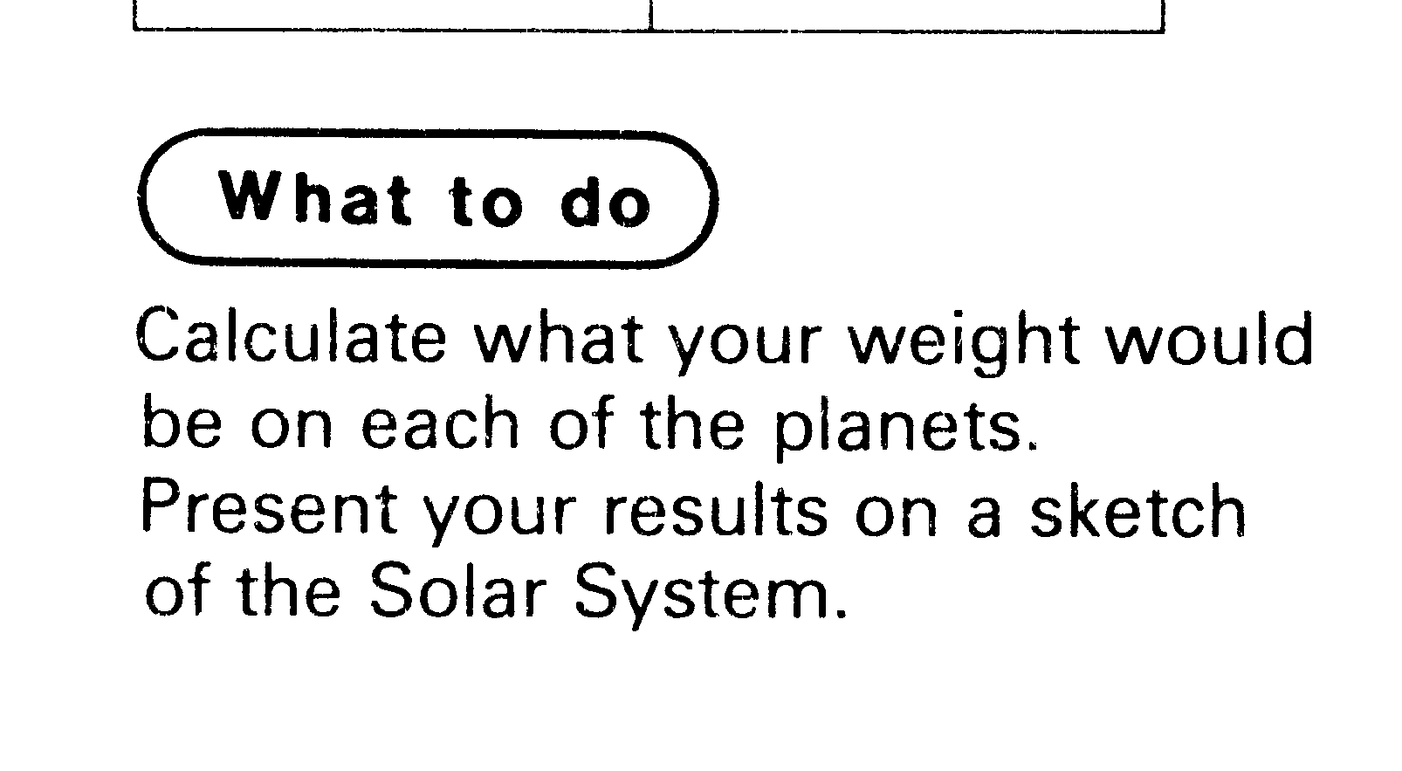
GOING FURTHER LEVEL 4/5
Other planets also have gravitational fields which exert forces.
The gravitational field strength at the surface of some objects in our solar system are shown in the table.

Slide 55
Losing – and gaining – weight
But when you’re on the Moon, your mass doesn’t change. Remember, mass is the amount of stuff there is in you – travelling to the Moon doesn’t change that.
://www.mathsisfun.com/measure/weight-mass.html

Slide 56
WHAT YOU THOUGHT

Slide 57
Revisions quiz
1. What three things can forces do?
2. What unit are forces measured in?
3. Who is the unit named after? Give his full name.
4. What do you measure forces with?
5 What force is needed to lift an apple – 1 N, 20 N or 100 N?
6. Is mass or weight measured in kilograms?
7. Weight is a force. This means it is measured in:
8. What causes weight?
9. If you travel to the Moon, does your mass change?
10 If you travel to the Moon, does your weight change?

Slide 58
Revisions quiz - My score out of 18: _____
On which planet is your weight greatest?
On Earth, how many newtons are there for each kilogram of mass?
A dog has a mass of 7 kg. What is its weight?
A girl has a mass of 42.5 kg. What is her weight?
A train has a mass of 12,500 kg. What is its weight?
A bag has a mass of 500 grammes. What is its weight?
What’s wrong with these sentences?
  “The bag of apples “weighs 3 kg.”
  And this sentence? “In deep space, astronauts
have no mass.”

Slide 59
WEIGHTLESS

Slide 60
When I go over a bump I can feel my stomach in my mouth, or so it seems.
People say I am weightless
How can I be weightless when I am still able to fall to the Earth?
FREEFALL

Slide 61
Newton’s 3 laws of motion

Slide 62
Forces and Isaac Newton
Newton’s first law of motion: An object’s speed will only change if a force is applied.
Newton’s second law of motion: Speed or acceleration is proportional to the force.
Newton’s third law of motion: Every action has an equal and opposite reaction.

Slide 63
NEWTONS THREE LAWS OF MOTION
Newton’s First Law states:
A body will remain at rest or travel at a constant speed in a straight line, unless acted upon by an unbalanced force.
A body will remain at rest or travel at constant velocity, unless acted upon by an unbalanced force.

Slide 64


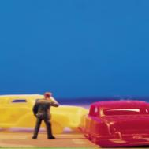
All Complicated Forces Explained
1. Balanced forces cause objects to stay at rest or travel at a constant speed.
A bullet travelling through space just keeps
on going.
2. Unbalanced Forces cause objects to speed up or slow down.
I’d rather push a Mini than a 4X4!
3. To every Action Force there is an equal and opposite Reaction Force.
If you shove me I’ll shove you back
(at the same time)!

Slide 65
Newton’s 1st law of motion

Slide 66
The BEST IDEA EVER
http://www.youtube.com/watch?v=jwPc0kK9VHU&feature=endscreen&NR=1

Slide 67

Common Pupil Myth
An object which does not move has no forces acting on it.

Slide 68
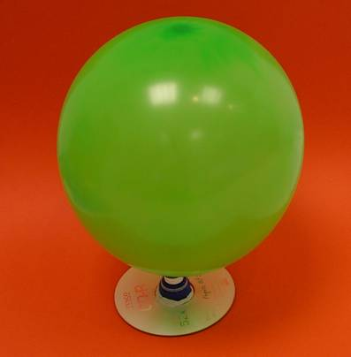
Why is Newton’s first law difficult to understand?
Friction?

Slide 69
Starting point:
Forces can produce changes in
Speed
Direction
Shape

Slide 70
Starting point:
Forces can produce changes in
Speed
Direction
Shape
start, stop, speed up, slow down

Slide 71
Forces “starting and stopping” is OK with most people.
Change in speed is bit a little trickier….

Slide 72
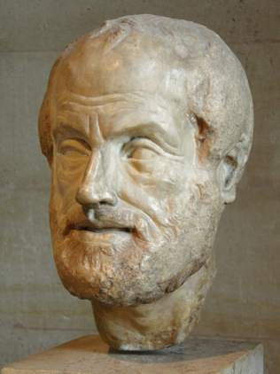
Some wrong ideas:
Nothing moves unless you push it. [it is moved by a mover]
Speed is proportional to motive force.
Men have more teeth than women.

Slide 73
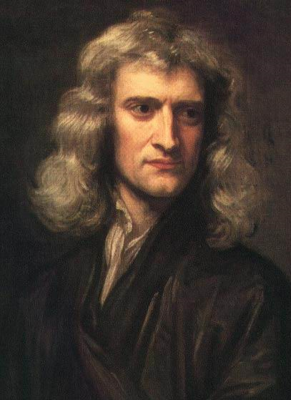
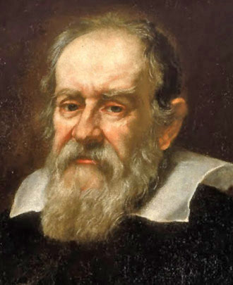
Newton’s First Law
An object will remain at rest or continue at a steady speed in a straight line unless an (unbalanced) force acts on it.

Slide 74
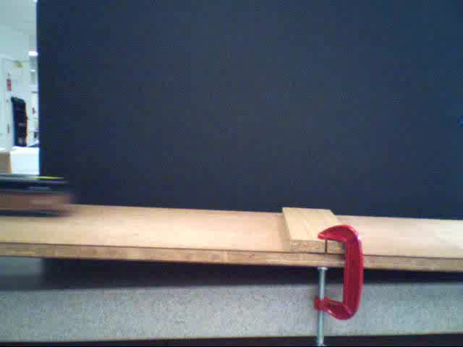
play

Slide 75
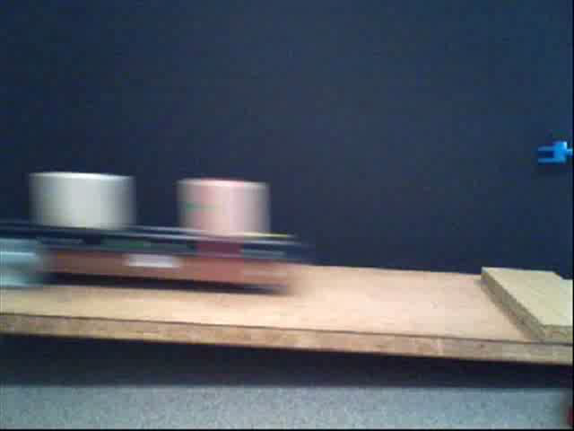
play

Slide 76
Newton’s First Law
An object will remain stationary or move at a constant speed in one direction unless an unbalanced force acts upon it.
Balanced forces
When there are two or more forces acting on an object and they add up to a total force of zero, we say the forces are balanced.
Unbalanced forces
When an object is acted on by a force which will cause it to accelerate or change direction.

Slide 77
Newton’s First Law
In each of the following calculate the unbalanced force and its direction.
(a)
(d)
60N
30N
50N
10N
50N
(b)
(e)
20N
10N
60N
10N
50N
(c)
(f)
10N
90N
50N
45N
60N
110N

Slide 78
Newton’s First Law
In each of the following calculate the unbalanced force and its direction.
(a)
(d)
60N
20N
30N
50N
10N
50N
20N
(b)
(e)
20N
10N
50N
10N
60N
50N
20N
(c)
(f)
10N
90N
50N
30N
110N
5N
45N
60N

Slide 79
What do forces do?
Lets assume we have an object to which we are going to apply forces.
With no forces acting on it, our object is stationary.
If we apply a force to the right for a short time, it will accelerate
But even when we stop applying the force, it will keep going at a constant speed
If we want the object to slow down again, we need to apply a braking force in the opposite direction.

Slide 80
What do forces do?
Lets assume we have an object to which we are going to apply forces.
With no forces acting on it, our object is stationary.
If we apply a force to the right for a short time, it will accelerate
But even when we stop applying the force, it will keep going at a constant speed
If we want the object to slow down again, we need to apply a braking force in the opposite direction.

Slide 81
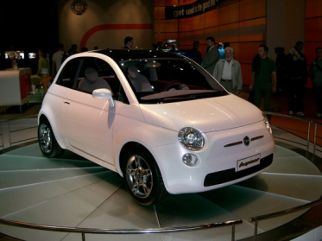
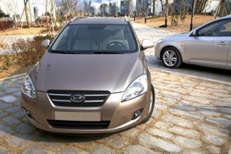
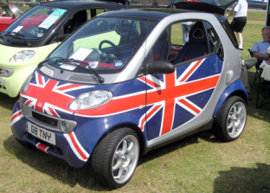
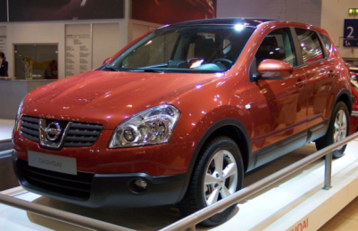
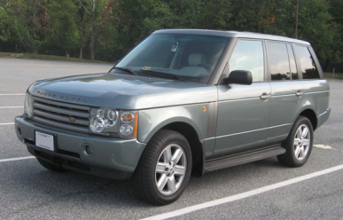
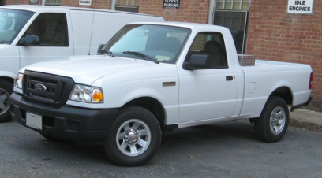
Starter: Which car is the safest?

Slide 82
Newton’s second law
Speeding up/ slowing down

Slide 83
Newton’s Laws of motion
Isaac Newton wrote 3 laws about the motion of objects.
An object will remain stationary or move at a constant speed in a straight line unless acted on by an unbalanced force.
The unbalanced force on an object is equal to the product of its mass and its acceleration.
For every action or force there is an equal and opposite reaction and force.

Slide 84
Initial FORCES RESEARCH PROJECT
What have you learned?
02/10/2011
JAH

Slide 85
TASK
We need to know the
1. distance your vehicle will travel
2. the average speed over the whole journey
3. the instantaneous speed of the vehicle as it goes round the roundabout (or alternative)
02/10/2011
JAH

Slide 86
02/10/2011
JAH

Slide 87
Newton’s Second Law
Newton’s 2nd law allows us to analyse the motion of objects. Any unbalanced force causes an object to change velocity, or to change direction. This cannot happen without an unbalanced force.
F_{un}= Unbalanced Force (N)
m = Mass (kg)
a = Acceleration (m/s²)
F_{un}
m
a

Slide 88
Check Your Answers
F=ma = 10 x 180 = 1800 N
  W=mg = 100 x 10 = 1000 N
  a=F/m = 1000/100 = 10 m/s
  v=u+at = 0 + 10 x 15 = 150m/s
  a=(v-u)/t = (20-0)/18 = 1.11 m/s
  F=ma = 1350 x 1.11 = 1498.5 N
Now try yellow textbook pXX QX-X

