Slide 1
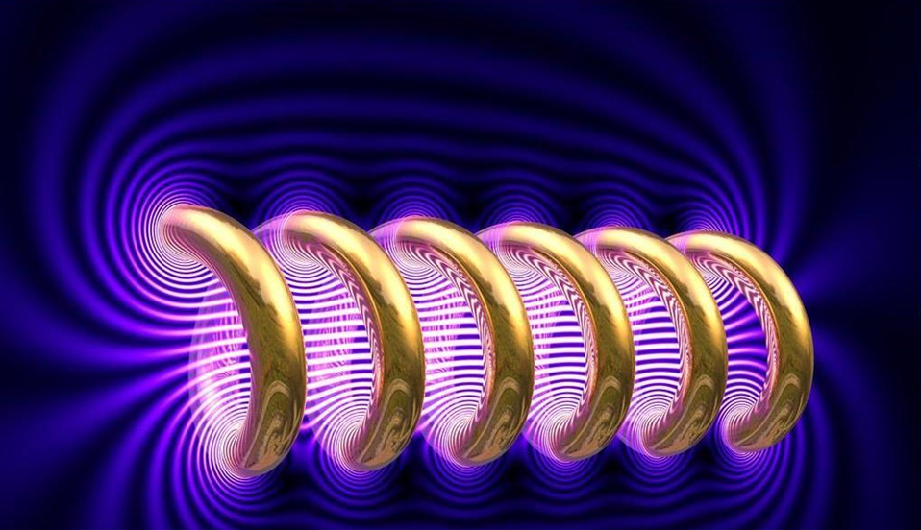
Electromagnets

Slide 2
Investigating Electromagnets
I understand that passing an electrical current through a wire creates a magnetic field.
I can use electromagnets to plan and carry out an investigation.

Slide 3
What are the characteristics of magnets?
They can attract some materials
They can also repel other magnets
They are usually made of iron
They have two ends called magnetic poles
Magnet Video

Slide 4
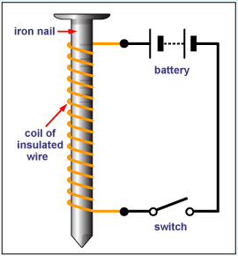
How to make an electromagnet...
Wrap the wire around the iron nail.
Connect a crocodile clip to each end of the wire
Plug the other end of the wires into the Power pack.
Turn the Power Pack on.

Slide 5

Your Investigation...
Mr T. Has given up his career in acting and has decided to buy a scrap-yard in Eastbourne! He’s only been there a month and already the giant magnet he uses for moving scrap cars around has broken. Mr T. wants you to carry out an investigation into electromagnets to help him decide whether it’s worth buying one.
These are the questions I want answered fool;
Do more coils in the wire make an electromagnet stronger?
How many cars (paper clips) can your electromagnet attract with 10 coils.
What happens if you add more?

Slide 6
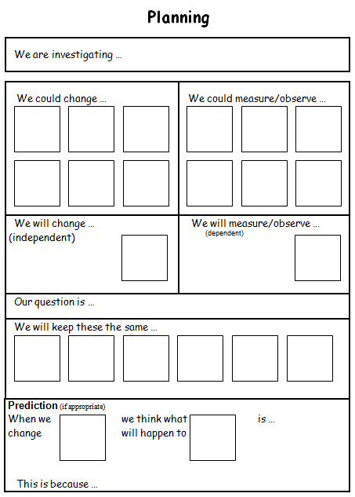
We are investigating how increasing the number of coils in an electromagnet affects the strength of the electromagnet.
Variables – What could we change?
Variables – What could we change?
FAIR TEST!

Slide 7
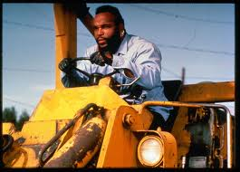
Results Table
I pity the fool who doesn’t record their results!
Draw a table like this one in your books ready to carry out your investigation;
Number of Coils | Number of Paperclips

Slide 8
Class Results
No. Coils | Group 1 | Group 2 | Group 3 | Group 4 | Group 5 | Group 6 | Group 7 | Average
10
12
14
16
18
20
22

Slide 9

Showing your Results...
Draw a line graph showing how the number of coils affects the strength of the electromagnet.
Write a title for your graph
The x axis (horizontal) should show the number of coils on the electromagnet
The y axis (vertical) should show the number of paper clips it picked up.
Graph Title
Paperclips Lifted
Number of Coils

