Slide 1
S1 Survey 2008
nicked and used for my purposes!

Slide 2
How to make a Table in Excel
Shoe sizes | Frequency
13 | 1
1 | 1
2 | 12
3 | 18
4 | 22
5 | 43
6 | 30
7 | 11
8 | 8
9 | 2
10 | 2
11 | 1
First you copy the table into Excel
If you want to make a chart put headings and units at the top NOT next to the numbers

Slide 3
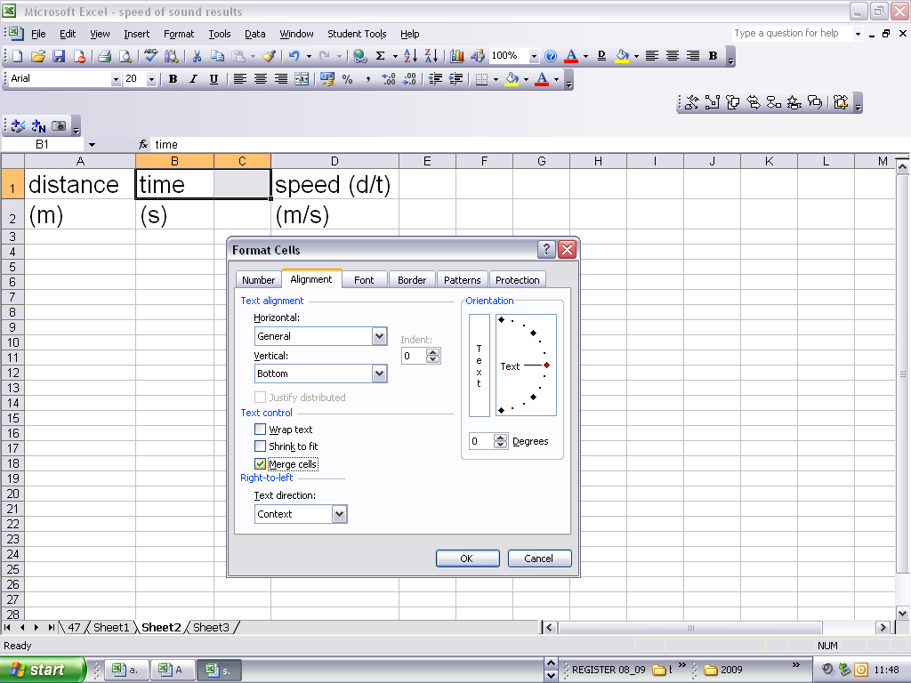
To merge cells if they have the same title
Go to format ->format cells-> alignment->
Merge cells (see below)

Slide 4
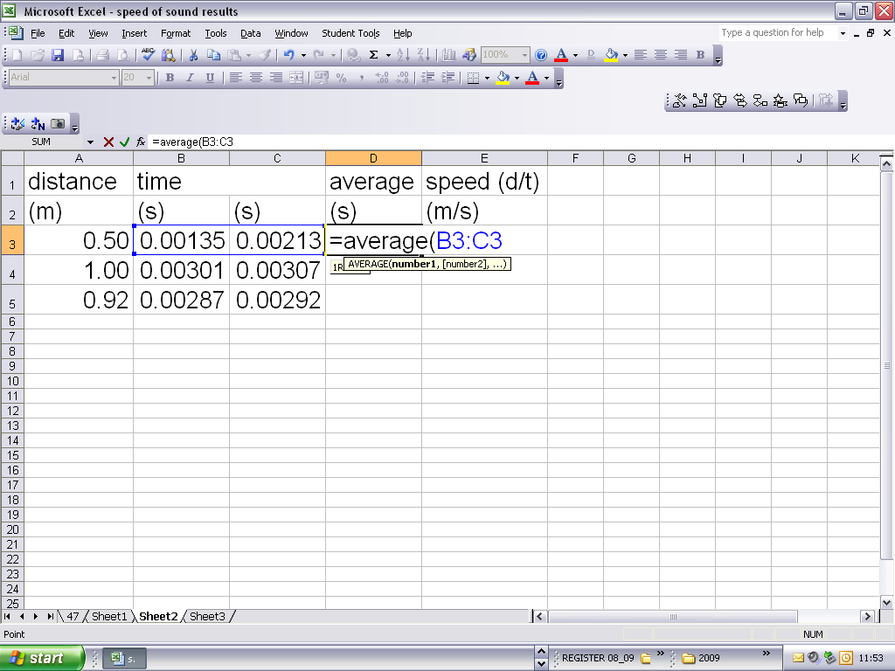
To find the average of values in more than one cell
Type in the box =average
Then open a bracket and highlight the cells to average and then close bracket and press return
YOU NEED TO SPELL AVERAGE CORRECTLY!

Slide 5
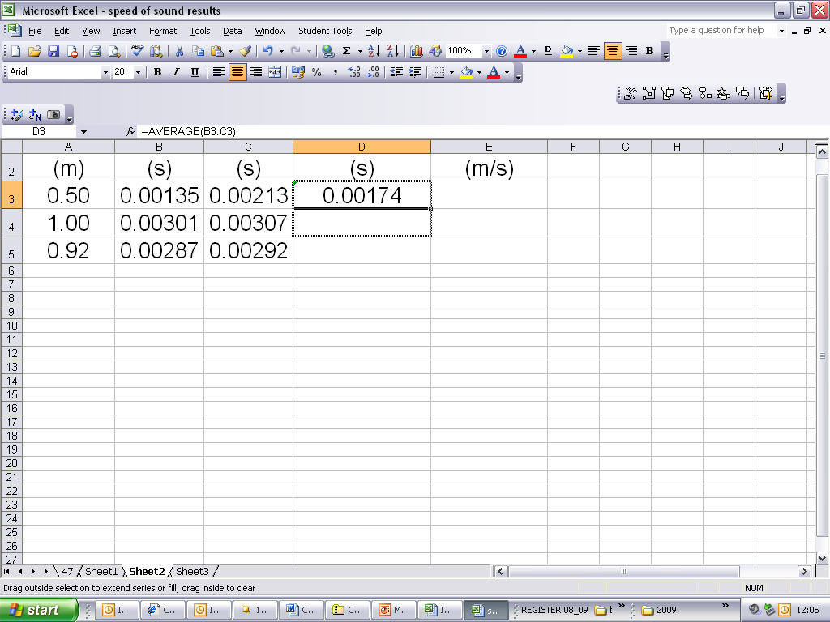
+
A quick way to get all the averages is to copy the formula. Go to the edge of the box until the fat cross turns to a + sign, then drag down

Slide 6
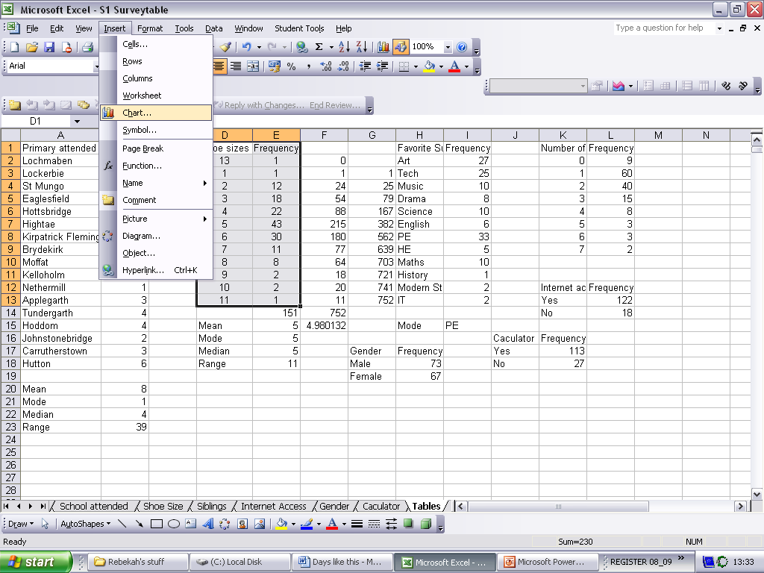
How to make a Chart in Excel
Highlight the data you want to graph
Then click on Insert and choose Chart

Slide 7
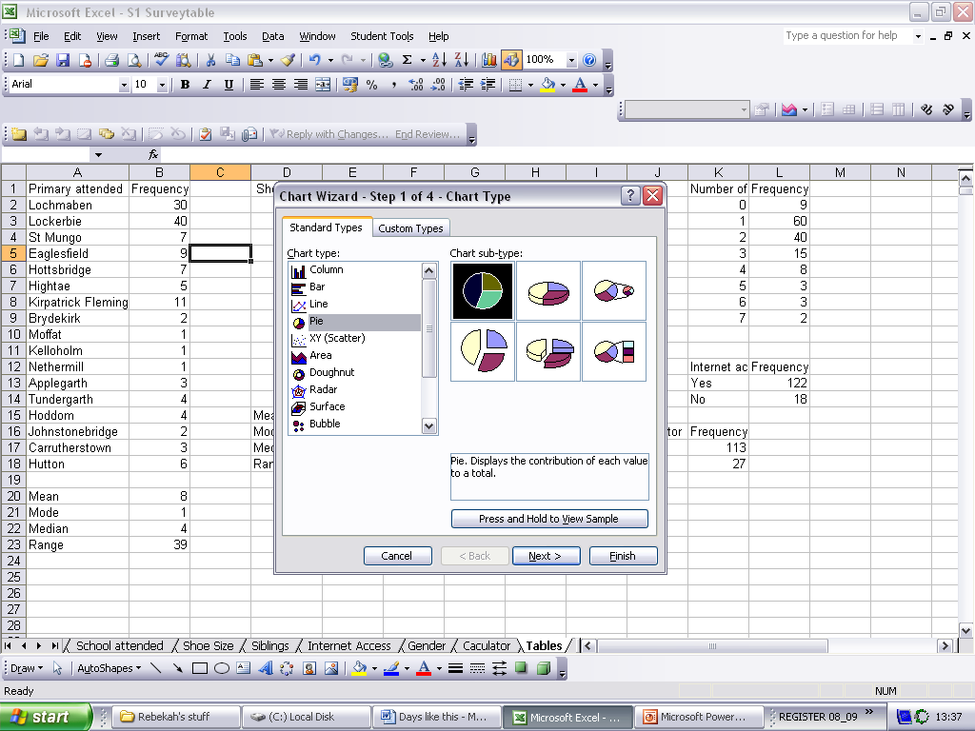
How to make a chart in Excel
Next choose the type of chart you want
In Physics we usually want a scatter graph
As I’ve nicked this power point it will show a pie graph
Which we never want but the idea is the same!

Slide 8
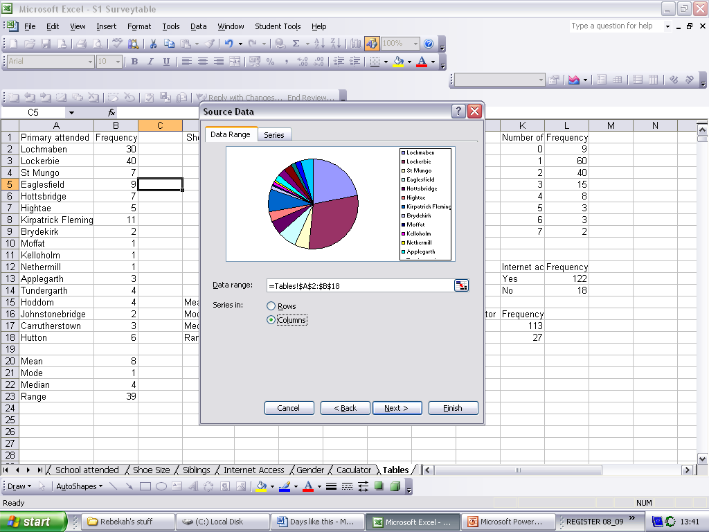
How to make a chart in Excel
Then choose the boxes you want to turn into a table

Slide 9
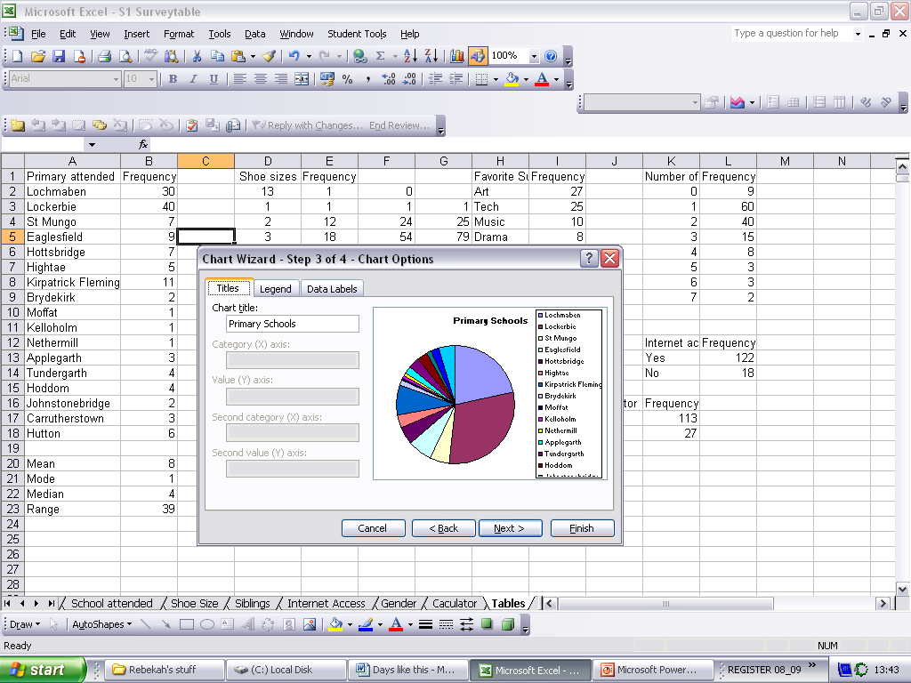
How to make a chart in Excel
Next choose a name for your chart

Slide 10
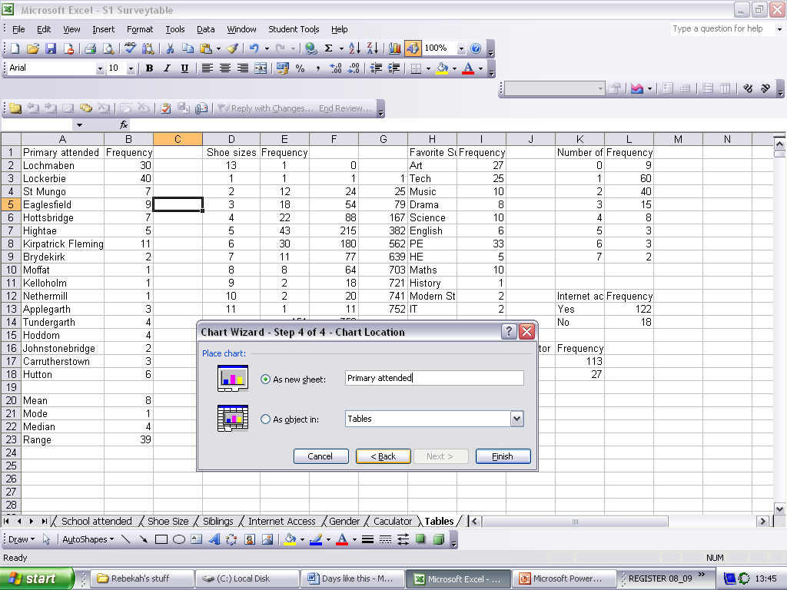
How to make a chart in Excel
Then give it it’s own sheet and admire the finished product

Slide 11
School Attended
Pupils coming to Lockerbie Academy in S1come from
17 Primaries
Over 50% of
S1 pupils come from
Lockerbie and Lochmaben
Primaries

Slide 12
S1 Shoe size

Slide 13
Favourite Subject
PE, Art & Tech are most popular
History, Mod Studs & IT are least popular

Slide 14
Favourite Subject

Slide 15
Number of Siblings

Slide 16
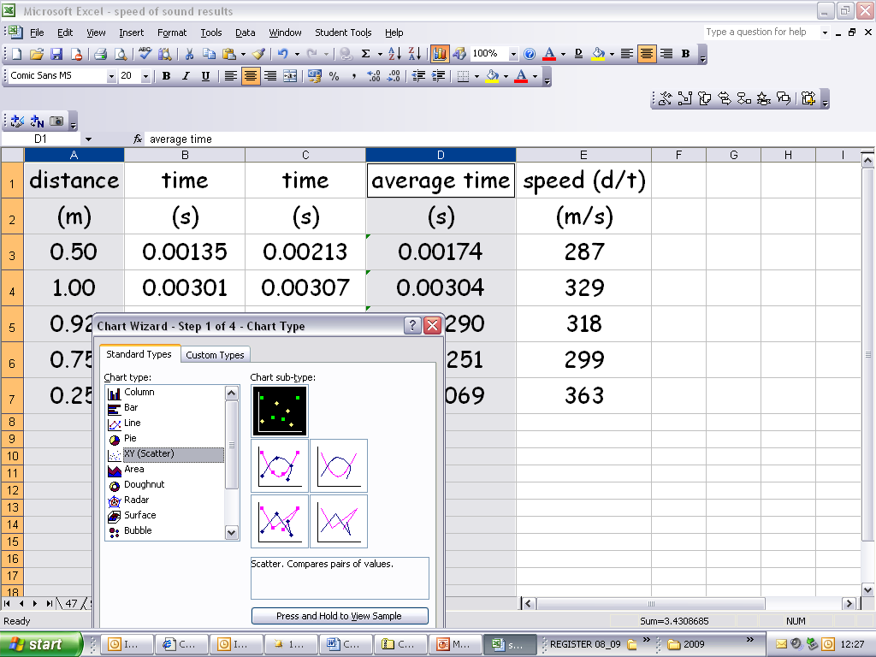

Slide 17
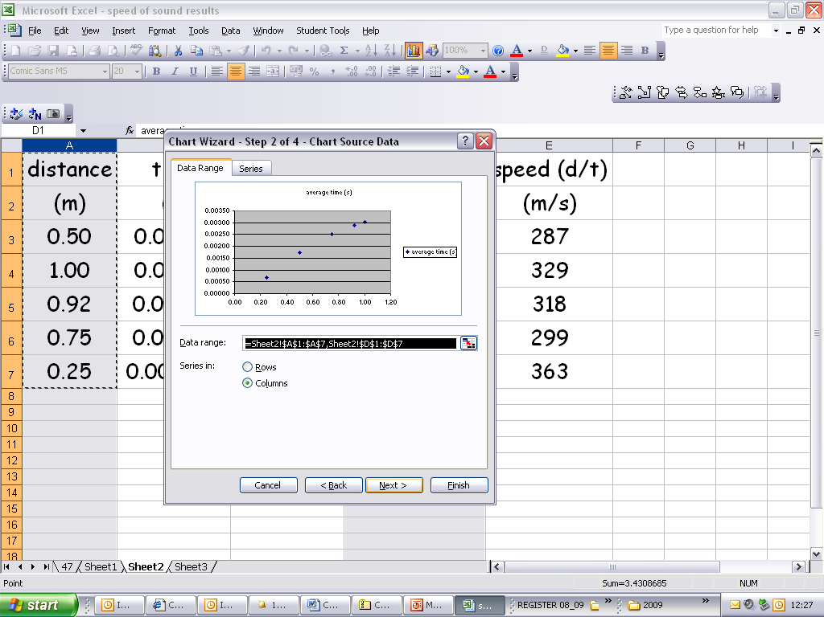

Slide 18
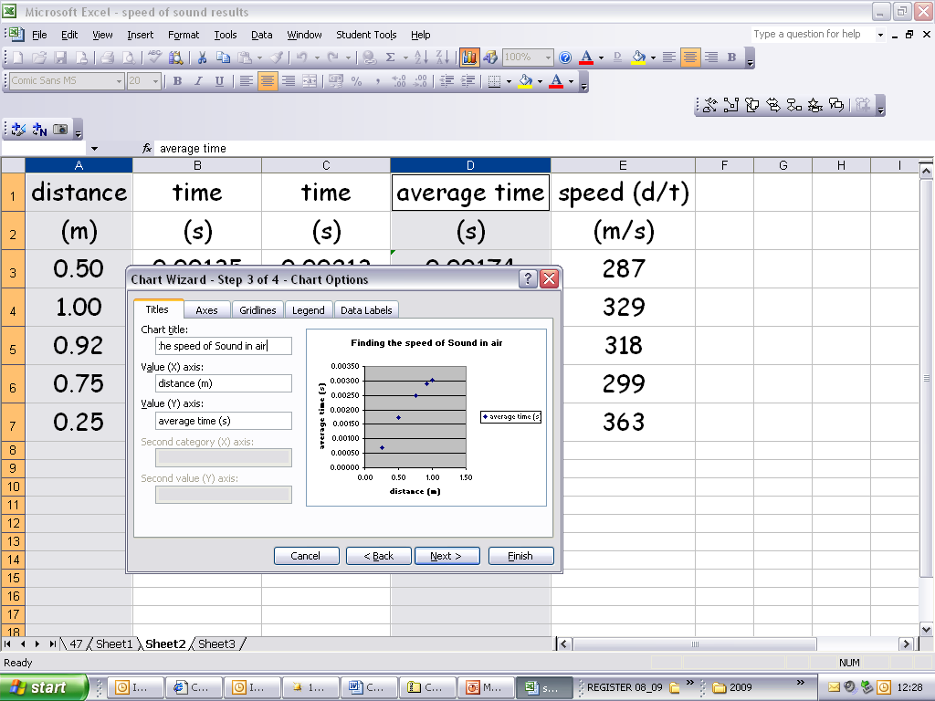

Slide 19
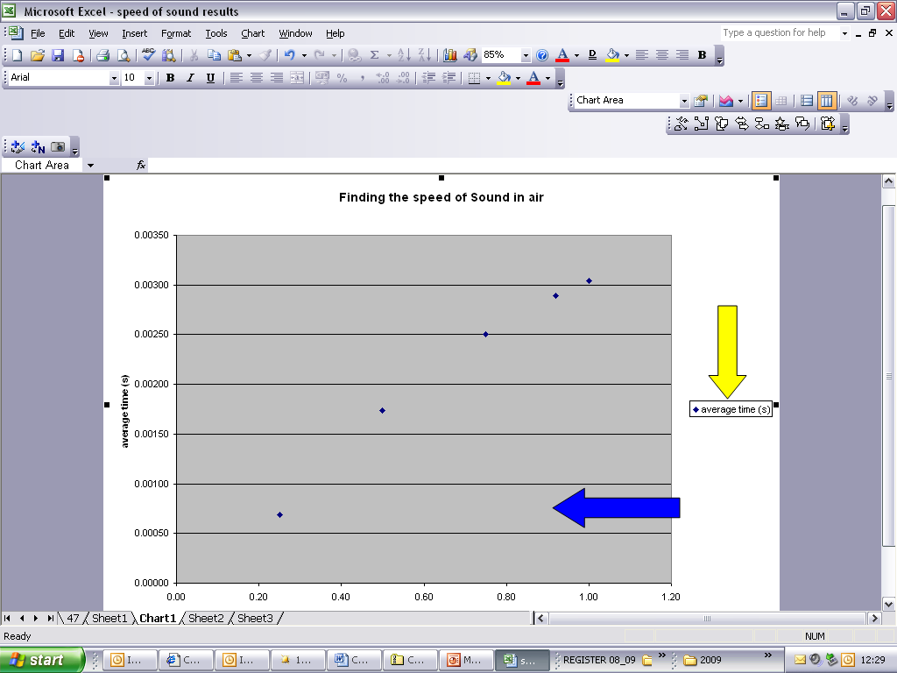
Delete this
Make this plot
Area WHITE

Slide 20
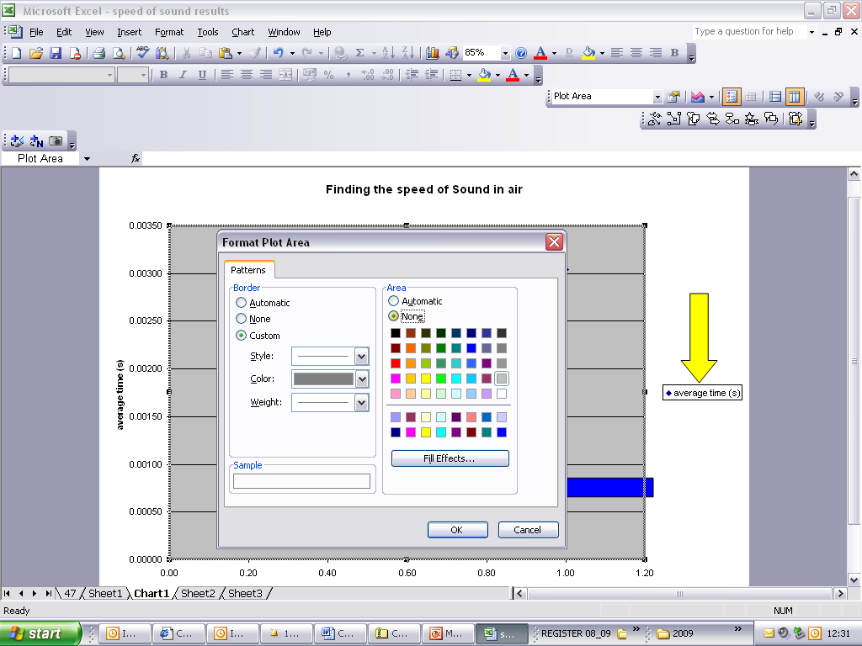

Slide 21
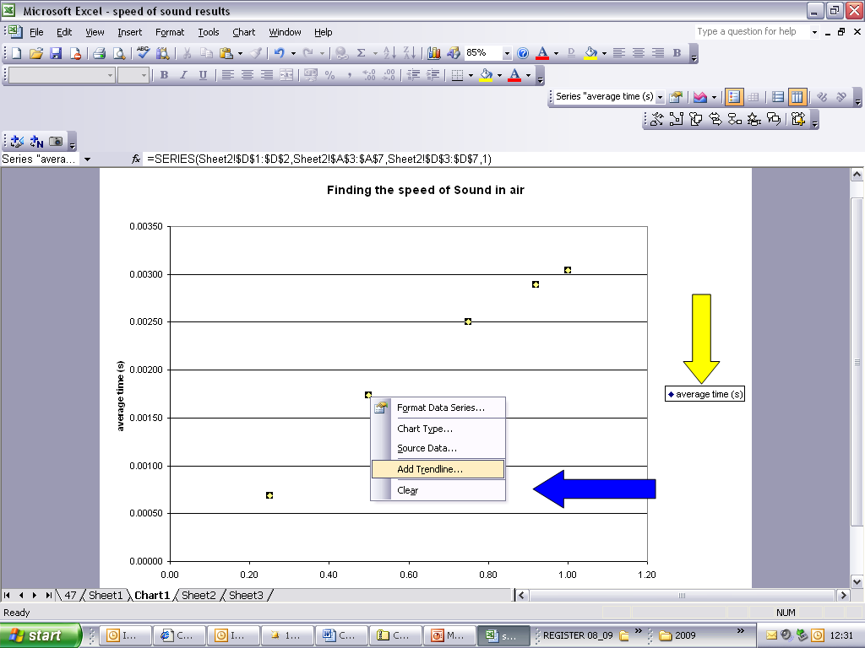
Add a treadline
In chart
Add trendline

Slide 22
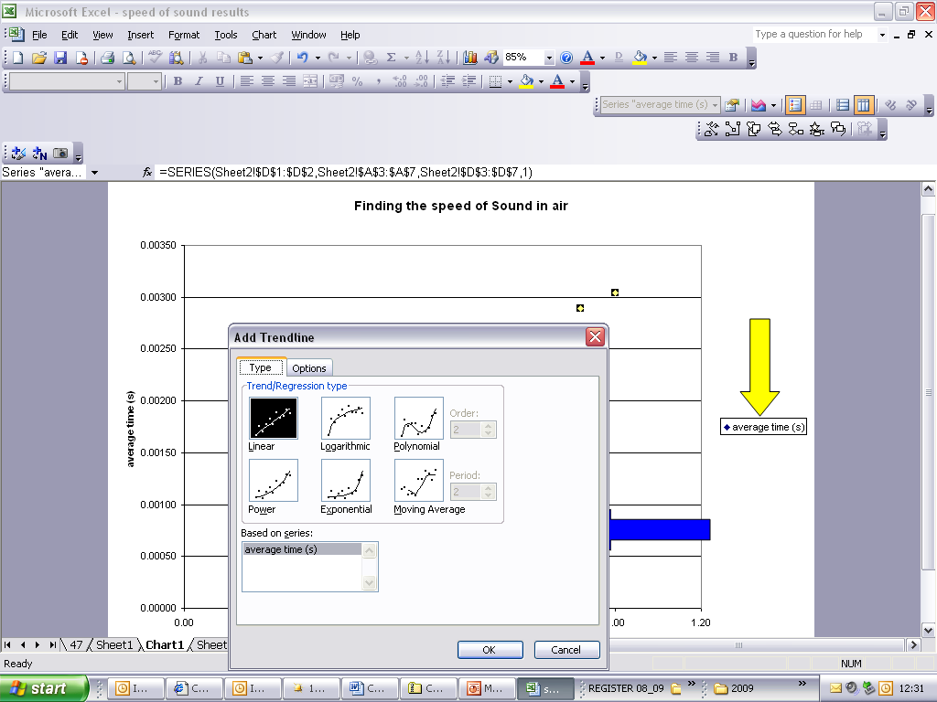

Slide 23
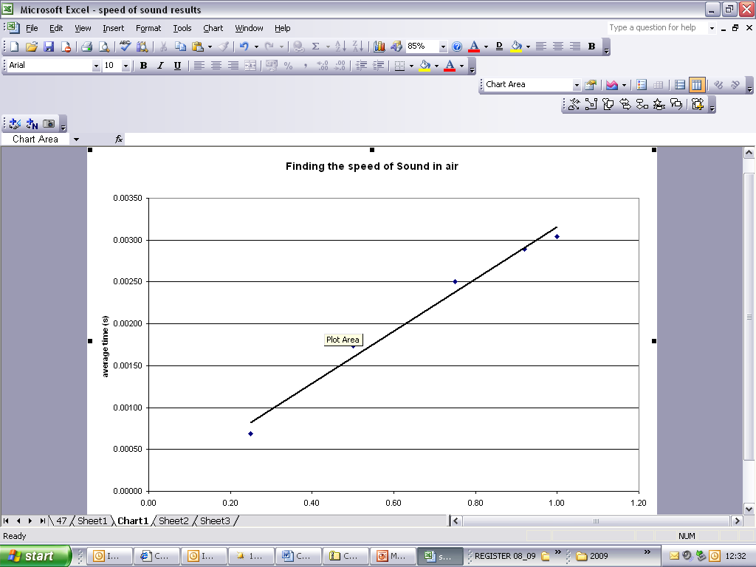

Slide 24
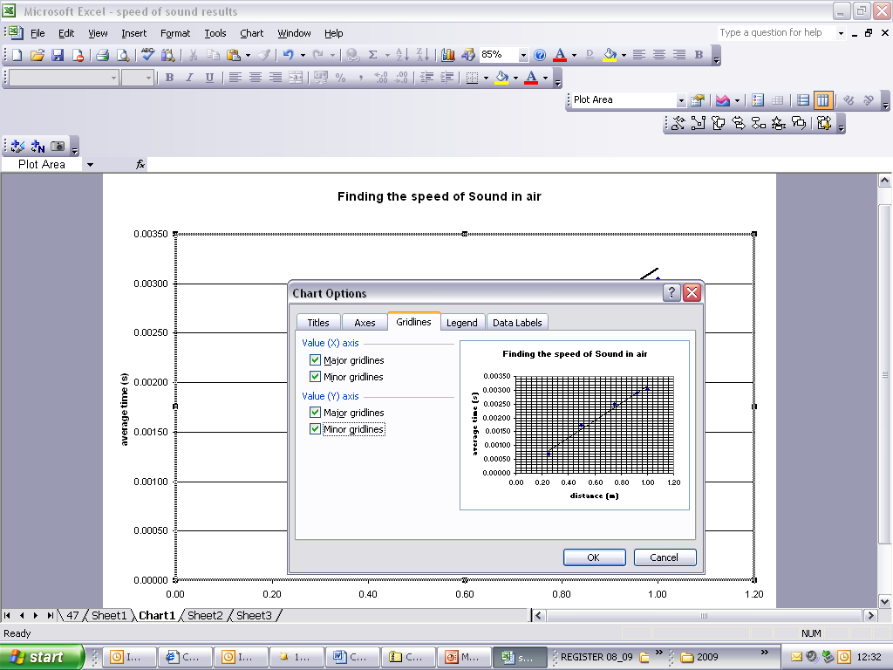
Add gridlines
Chart options

Slide 25
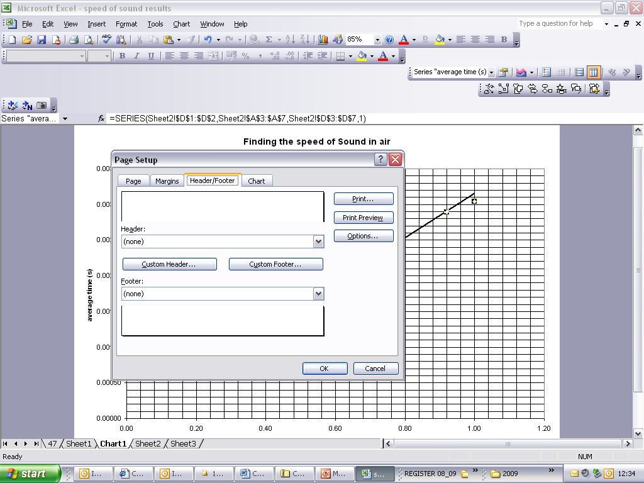
Add your name in a header/footer
Under file->page set up-> header/footer
You must click on custom header or footer
To insert text

Slide 26
…and finally
Copy the beautiful work into your hand in file and print a copy off so I can be impressed and you can display them on the board in my room
ENJOY! And I’ll see you tomorrow
Only 2 more periods left

