Slide 1

Differentiation and Integration
AH Physics

Slide 2
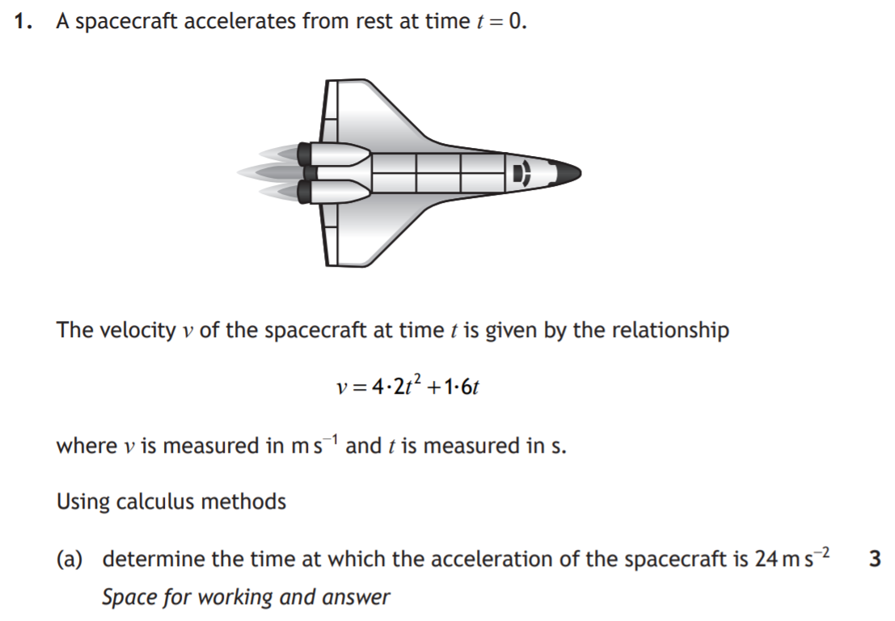
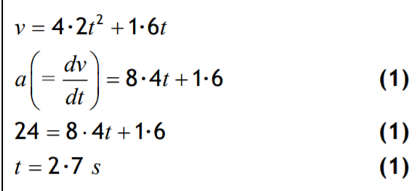
2019
Differentiation or integration?
v-a -> gradient -> Differentiation

Slide 3
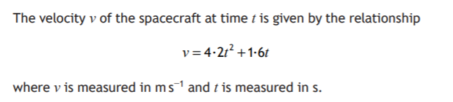

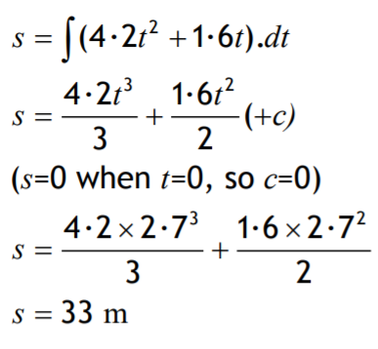

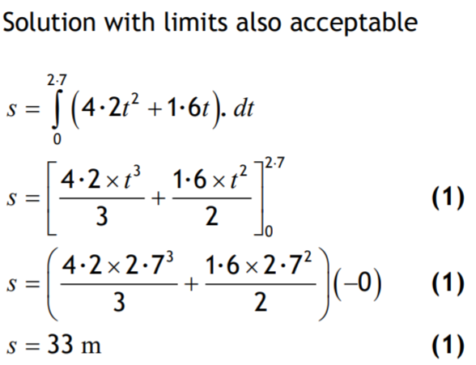
2019
Differentiation or integration?
v-s -> area -> integration

Slide 4
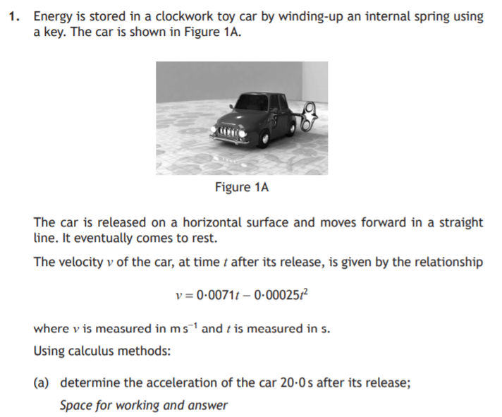
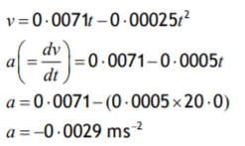
2018
Differentiation or integration?
v-a -> gradient -> Differentiation

Slide 5
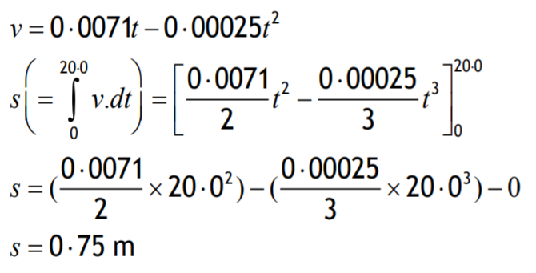

2018
Differentiation or integration?
v-d -> area -> integration

Slide 6
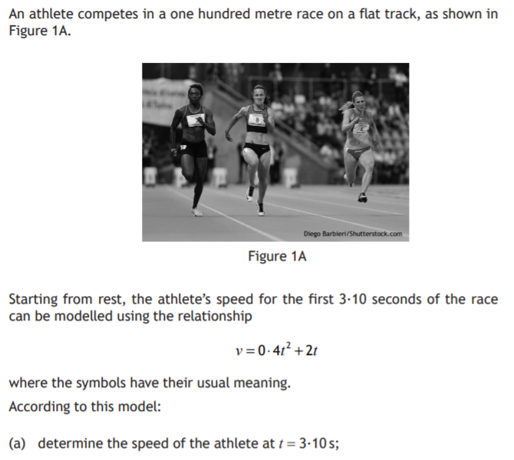
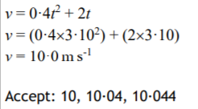
2017

Slide 7
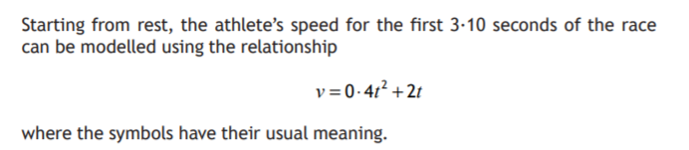

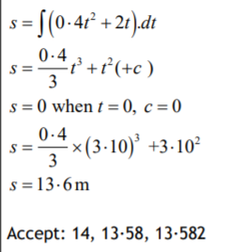
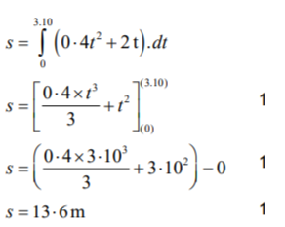
2017
Differentiation or
integration?
v-d -> area -> integration

Slide 8
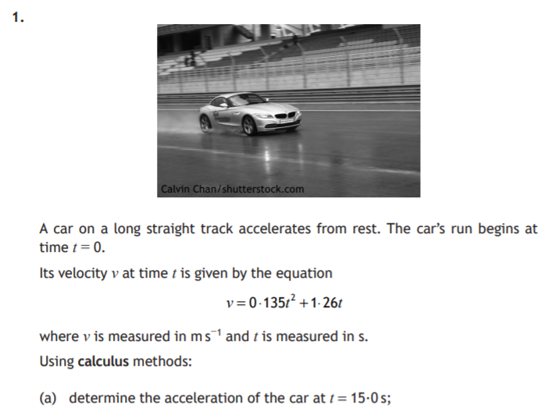
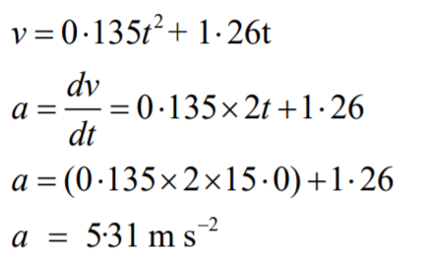
2016
Differentiation or integration?
v-a -> gradient -> Differentiation

Slide 9
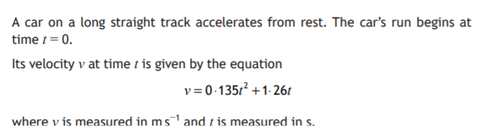
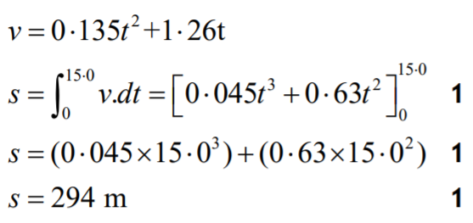
2016
Differentiation or integration?
v-d -> area -> integration

Slide 10
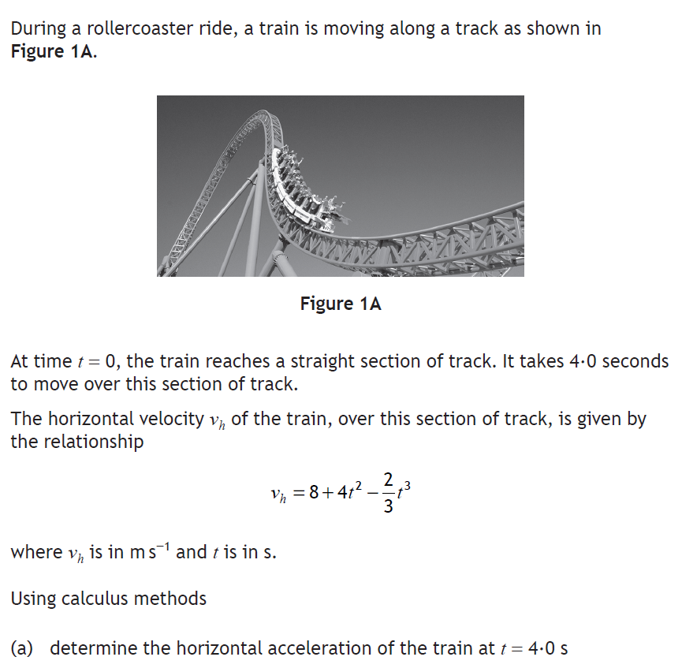
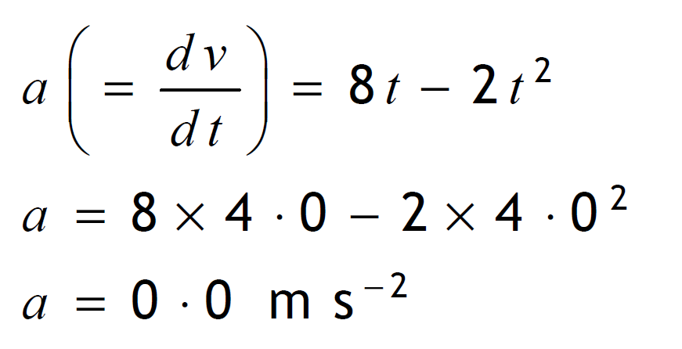
2020/2021
Differentiation or integration?
v-a -> gradient -> Differentiation

Slide 11
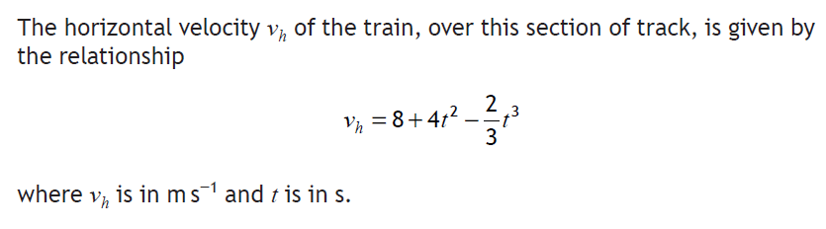
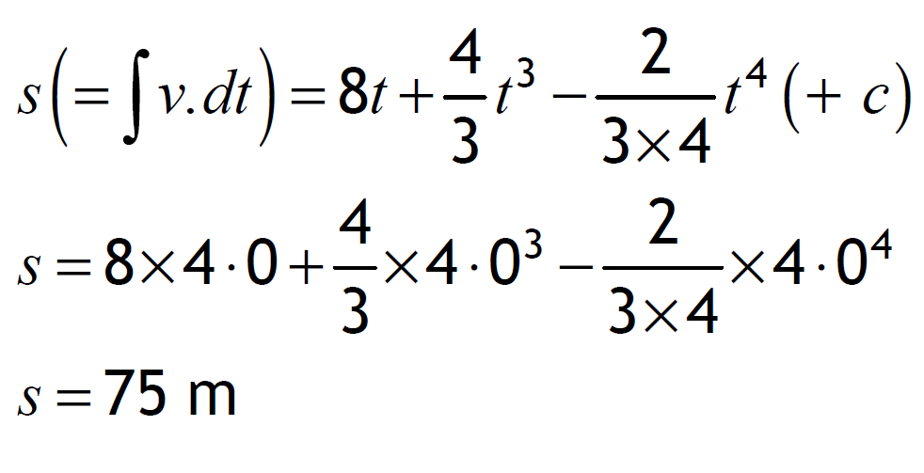
2020/2021

Slide 12
Deriving the Equations- still an outcome!
2002

Slide 13
2012

Slide 14
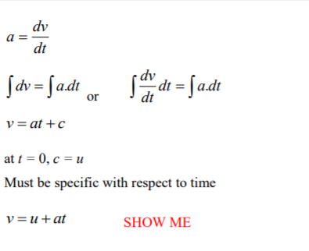
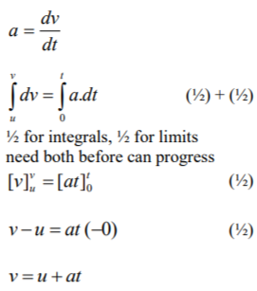

Slide 15
2007

Slide 16
Learn It!

