Slide 1
LOCKERBIE ACADEMY
TRANSPORT UNIT
SPEED
S1-S3 Road Safety & PHYSICS

Slide 2



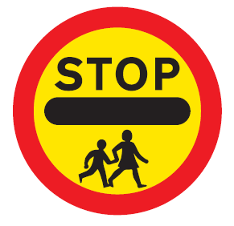


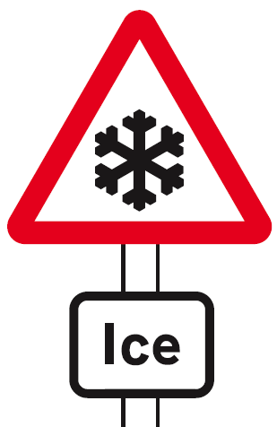


LOCKERBIE ACADEMY TRANSPORT UNIT
Notes:
All of these road signs relate to Physics in some way, whether mention of speed, force, acceleration or other physics terms. We are going to use the topic of road safety to teach you about MECHANICS. DYNAMICS and KINEMATICS (there are some big words for you to find out about)
We will use the upside down car, which we made up as our logo for this topic. It is meant to represent no road accidents here as we know about the Physics behind driving and we should know how to be safe.

Slide 3
LOCKERBIE ACADEMY TRANSPORT UNIT
We plan to find out and understand about the following terms
P distance
P displacement
P speed
P velocity
P instantaneous/ average/ uniform/ speed
P time & at rest
Notes:
We are going to learn about some vital and basic parts of Physics through a unit on ROAD SAFETY (catchy name needed over to Mr Bowles). We will be looking at road accidents and safe driving. If you have a problem with this YOU MUST tell your teacher who will ensure that you are not given work that makes you upset.
We plan to find out and understand about the following terms
P distance
P displacement
P speed
P velocity
P instantaneous speed
P forces, including weight, and friction
P time
P acceleration
If we have time we might mention momentum.

Slide 4
Speed, Distance & Time
S1 Physics Transport
Back to mind map

Slide 5
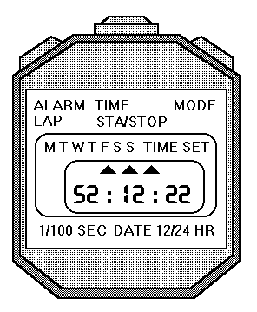
Reading the stopclock
The stopclock display can be a bit confusing.
A number that looks like this: 0:0234 means 2.34 seconds.
Reset
Start & Stop

Slide 7
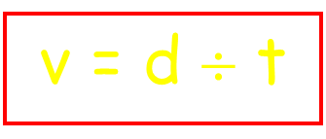

Speed
d
v
t
Examples using the Speed Formula (Showing full working):
1. The sprinter ran 100 metres in 10 seconds. What was his speed ?

Slide 8
LOCKERBIE ACADEMY TRANSPORT UNIT
In Physics we show the divide by sign as a line and say “over”
where v=speed, d=distance and t=time
Notes:
We must be careful as we can look at different speeds. During a journey from Lockerbie Car Park to Tesco car park we would not travel at the same speed (Possibly go through the journey or part of it on Google maps
http://maps.google.co.uk/maps?q=google+street+map+DG11+2AT&oe=utf-8&cr=countryUK|countryGB&um=1&ie=UTF-8&sa=N&hl=en&tab=wl
We would have to slow down over the speed bumps and stop if there were people crossing the (PROPER NAME FOR LIGHT CONTROLLED CROSSING) but at some points we might get close to 30 mph but unlikely as it is a busy route unless we went via ***** Therefore over this journey we can look at 2 types of speed- our instantaneous speed and our average speed. Can anyone think what these terms mean?

Slide 9
The SPEED OF MY CAR
Your Team Challenge
Each member of your team must drive the course with their vehicle. They must NOT stray off the track or they have to return to the start.
Notes:
VEHICLE- add to wordbank

Slide 10
The SPEED OF MY CAR
Your Team Challenge
You must time how long it takes each member to complete the journey and measure the distance travelled along the track.
Record each team member’s time and calculate the average speed for each journey.
Notes:
VEHICLE- add to wordbank

Slide 11
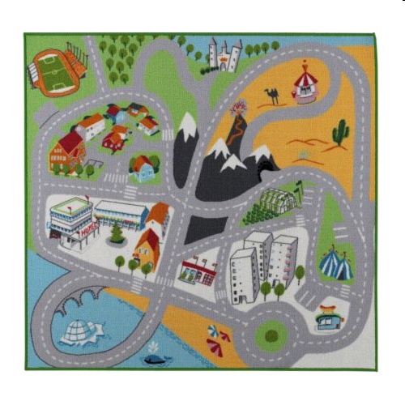
LOCKERBIE ACADEMY TRANSPORT UNIT

Slide 12
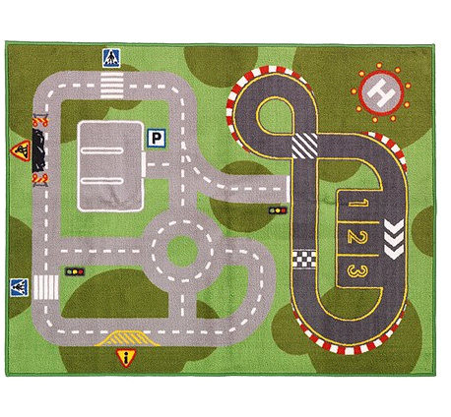
LOCKERBIE ACADEMY TRANSPORT UNIT

Slide 13
YOUR TASK.
TASK
Working in teams you need to:
Measure the DISTANCE that the car will travel along the pre-defined course.
Record this value on your worksheet.
Time how long each person in the group takes to complete the course.
Record this value on your worksheet
Record as tally marks on your worksheet every time each person in the group leaves the track

Slide 14
LOCKERBIE ACADEMY TRANSPORT UNIT
WORDBANK
Vehicle
A thing used for transporting people or goods, especially on land, such as a car, truck, or cart.

Slide 15
LOCKERBIE ACADEMY TRANSPORT UNIT
WORDBANK
Distance- is how far you have travelled. It is another name for length. It is measured in metres or during our road safety topic miles.
Time- is how long your journey took. It is measured in seconds or during our road safety topic hours.

Slide 16
Additional Notes- For Printing only if repeat measurements required
To find the average speed from your results
Find the average time for the 3 runs (if the race was run 3 times)
  Do this by adding the times for the three runs in the calculator, PUSH the = button on the calculator and then divide this answer by 3 (as there were 3 runs). Add this number to your table where it says average time)
Find the speed using the formula
  Speed = distance ÷ time
Add this value of speed to your table.
DO NOT give your average speed to more than 1 decimal place unless the value is very small.

Slide 17
LOCKERBIE ACADEMY TRANSPORT UNIT
WORDBANK
Speed – how far you travel every second.
OR
Speed is the distance travelled in unit time.
In the lab our distances are measured in metres and our time is measured in seconds so our units of speed would be metres per second.
In road safety we look at miles travelled every hour or miles per hour.
Notes:
In Physics this would be metres travelled every second so our units would be metres per second. In road safety we look at miles travelled every hour or miles per hour. To work this out you must use the formula

Slide 18
LOCKERBIE ACADEMY TRANSPORT UNIT
WORDBANK
At rest- in Physics we use this term to mean not moving. We can also say the object is stationary.
It is not the same word as pens and pencils which are stationery!

Slide 19
Let’s try some examples
Matt’s time for the course was 00:01:55. The course was 1.78m. What was Matt’s speed around the course?

Slide 20
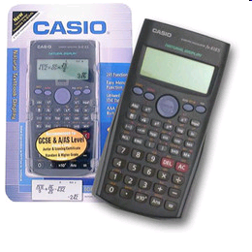
AND THE WINNING TEAM IS
FIXING your calculators
FIX allows you to fix how many figures after the decimal point should be displayed i.e. it fixes the number of decimal places you quote a value to. This is really useful if you suffer from calculator diarrhoea, but be careful you could end up with zero!

Slide 21
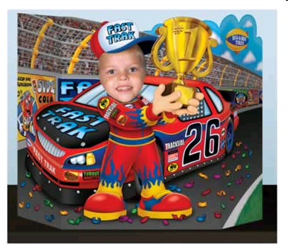
AND THE WINNING TEAM IS
Calculate the average speed for each of your team drivers.

Slide 22
AND THE WINNING TEAM IS
And the winner is………

Slide 23
Let’s try some examples
Let’s try some more examples of speed distance and time and then in your groups we can do the domino challenge.
But first let’s look at how to set out equations

Slide 24
HOW TO LAY OUT EQUATIONS IN PHYSICS
http://www.youtube.com/watch?v=u7akhlAS5Ck
Check before you play!

Slide 25
IESSUU
Information
Equation
Substitution
Solution
Units
Underline
& remember no SECS in PHYSICS

Slide 26
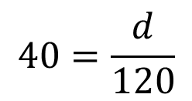
2. The Porsche travelled at 40 m/s for 2 minutes. How far did it go ?
speed=40m/s
Time = 2 minutes (2×60)= 120 second
Information
Equation
Substitution
$$40=\frac{d}{120}$$
Solution
Units
=4800 m
Underline

Slide 27
Let’s try some examples
Work out the average speeds for the following journeys. Make sure you set out your working in the same way as the example above.
1. A boat travels 30 km in 3 hours.
2. A tractor drives 18 km in 6 hours.
3. A frog jumps 25 metres in 5 seconds.
(Take care with the units.)
4. A plane flies 600 km in 3 hours.

Slide 28
Let’s try some examples
1. A boat travels 30 km in 3 hours.
d= 30km
t= 3h
v=?
I
E
S
S
U
U

Slide 29
Let’s try some examples
2. A tractor drives 18 km in 6 hours.
d= 18km
t= 6h
v=?
E
S
S
U
U
I

Slide 30
Let’s try some examples
3. A frog jumps 25 metres in 5 seconds.
(Take care with the units.)
d= 25m
t= 5s
v=?
E
S
S
U
U
I
v=5m/s

Slide 31
Let’s try some examples
4. A plane flies 600 km in 3 hours.
d= 600km
t= 3h
v=?
E
S
S
U
U
I

Slide 32
IN YOUR MATHS SECTION WRITE OUT THE FOLLOWING EXAMPLE
Tony walks 40m in 30s what is his average speed?
v=?, t=30s, d=40m
speed=distance/time
speed=40/30 = 1m/s

Slide 33
IN YOUR MATHS SECTION WRITE OUT THE FOLLOWING EXAMPLE
You could write 1.3m/s, 1.33m/s or 1.333m/s and get the mark. If you write 1.33. m/s or 1 1/3 m/s or 1.333333m/s you lose the mark for the answer! This is because you have used TOO MANY SIGNIFICANT FIGURES.
Mrs Hargreaves calls this “calculator diarrhoea”! and you can FIX it!!!!

Slide 34
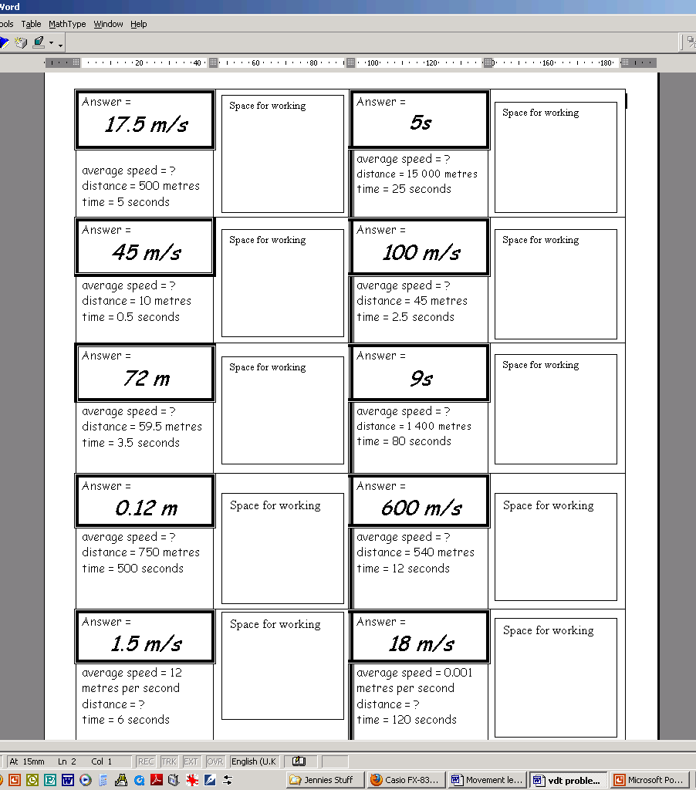
Speed Dominoes

Slide 35
THE POST VAN AND AVERAGE SPEED.
Post Office
400 m / 32 s
Library
350 m / 35 s
Shop
450 m / 60 s
900 m / 45 s
200 m / 25 s
Church
Post Box
750 m / 120 s

Slide 36
Journey | Average Speed
Post Office → Post Box
Post Office → Church
Post Box → Church
Library → Shop → Church
Post Office → Post Box → Church
Post Office → Church → Shop → Library

Slide 37
INSTANTANEOUS
Speed
S1 Physics Transport
Back to mind map

Slide 38
LOCKERBIE ACADEMY TRANSPORT UNIT
WORDBANK
Instantaneous speed is the speed at which you are travelling over a very short distance. It is measured in metres per second or miles per hour.

Slide 39
Instantaneous Velocity
WORDBANK
The instantaneous speed for an object is its speed at a particular point in time. For example, a police speed camera measures the instantaneous velocity of the car.
Length of object
Light gate measures time to pass
Ramp

Slide 40
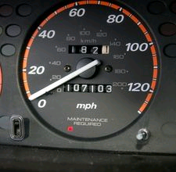
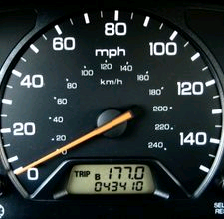
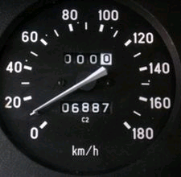
LOCKERBIE ACADEMY TRANSPORT UNIT
A speedometer is a gauge that measures and displays the instantaneous speed of a land vehicle.
Notes:
Instantaneous speed is the speed at which you are travelling over a very short distance. It is measured in metres per second or miles per hour.

Slide 41
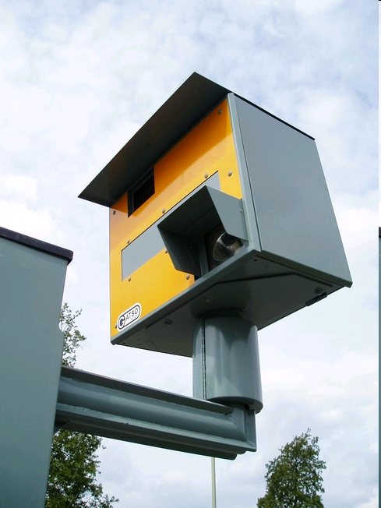
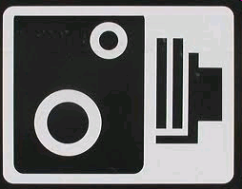
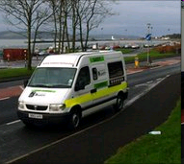
INSTANTANEOUS SPEED
Speed Cameras in D&G

Slide 43
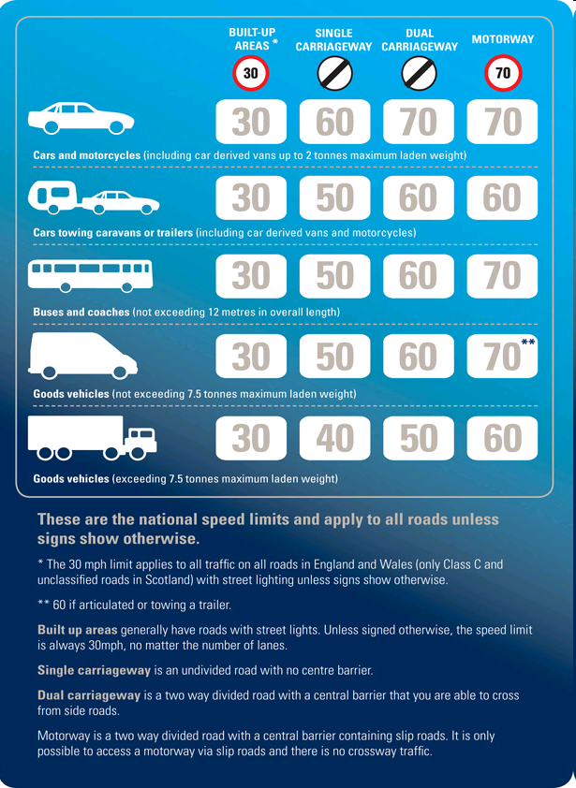

Slide 45
Instantaneous Velocity
Instantaneous speed is difficult to measure.
WHY?
Let’s try it!

Slide 46

An investigation to measure reaction time and calculate stopping distances
Using the Reaction Timer box you will find out:
Your reaction time.
How your reaction time changes if you are chatting or texting.
You will calculate stopping distances for different speeds.
Image: Wikipedia: This work is licensed under the Creative Commons Attribution 2.0 License.

Slide 47
MEASURING
INSTANTANEOUS Speed
S1 Physics Transport
Back to mind map

Slide 48
MEASURING INSTANTANEOUS SPEED- get the instruction sheets
USING A STOPWATCH
What you need:
Model vehicle, ruler, chalk, stopclock, instruction sheet

Slide 49
MEASURING INSTANTANEOUS SPEED USING A STOPWATCH
What you need
Model vehicle, ruler, chalk, stopclock.
What to do
Mark one chalk line on the bench. (Don’t forget to rub it out when you have finished!).
Measure the length of the model vehicle. Record this in your jotter.

Slide 50
MEASURING INSTANTANEOUS SPEED USING A STOPWATCH
Start the stopclock when the front edge of the vehicle reaches the chalk line.
Stop the stopclock when the end of the car reaches the chalk line.
Note the time from the stopclock in your jotter.
Calculate the speed using the formula:

Slide 51
MEASURING
INSTANTANEOUS Speed
(let’s not worry about reaction time!)
S1 Physics Transport
Back to mind map

Slide 52
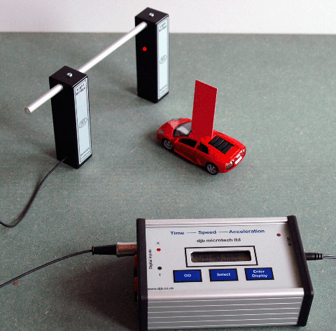
MEASURING INSTANTANEOUS SPEED- get the instruction sheets
USING ALBA & LIGHT GATES
What you need:
Model vehicle, ruler, mask, lightgates + laptop, instruction sheet

Slide 53
Instantaneous Velocity
Instantaneous speed
One way is to use a light gate. The length of the object divided by the time it takes to pass gives its instantaneous speed.
Length of object
Light gate measures time to pass
Ramp

Slide 54
MEASURING YOUR INSTANTANEOUS SPEED
GROUP TASK- back to the PLAYMATS!
We need to know the
1. length of your vehicle or the mask on top.
2. the time for the vehicle to pass through the light gates
3. the instantaneous speed of the vehicle as it goes round the roundabout (or alternative)

Slide 55
YOUR TASK.
Working in teams you need to:
Using the ALBA package record the instantaneous speed of the vehicle at the specific place in the track (see the additional worksheet)
ALBA-MOTION
Introduction to SPEED

Slide 56
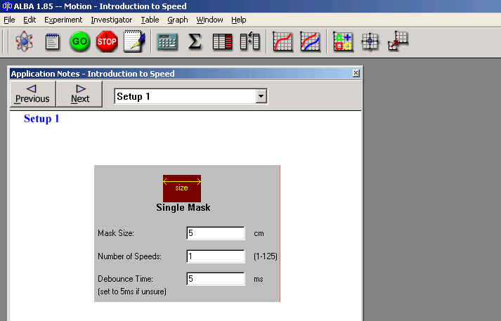

Slide 57
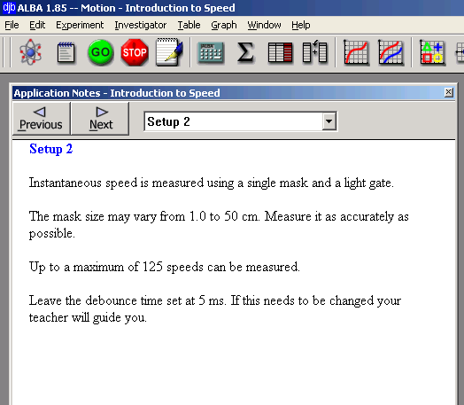

Slide 58
LOCKERBIE ACADEMY TRANSPORT UNIT
“Speed camera”
Measure instantaneous speed here

Slide 59
LOCKERBIE ACADEMY TRANSPORT UNIT
“Speed camera”
Measure instantaneous speed here

Slide 60
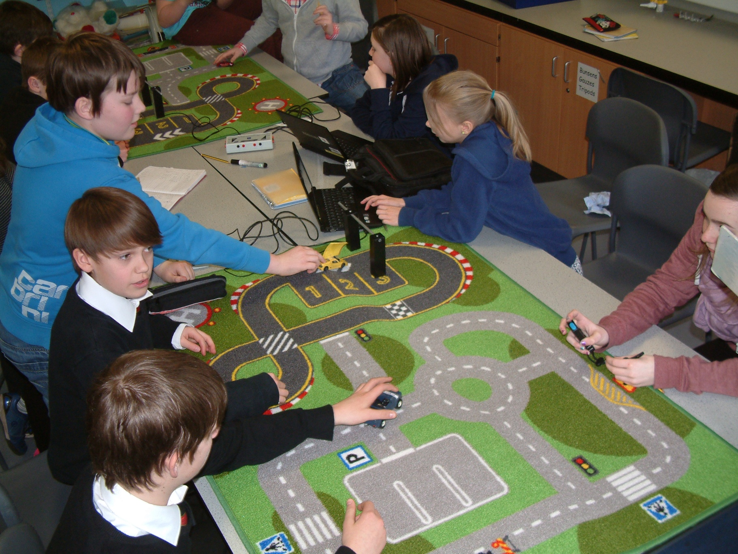

Slide 62
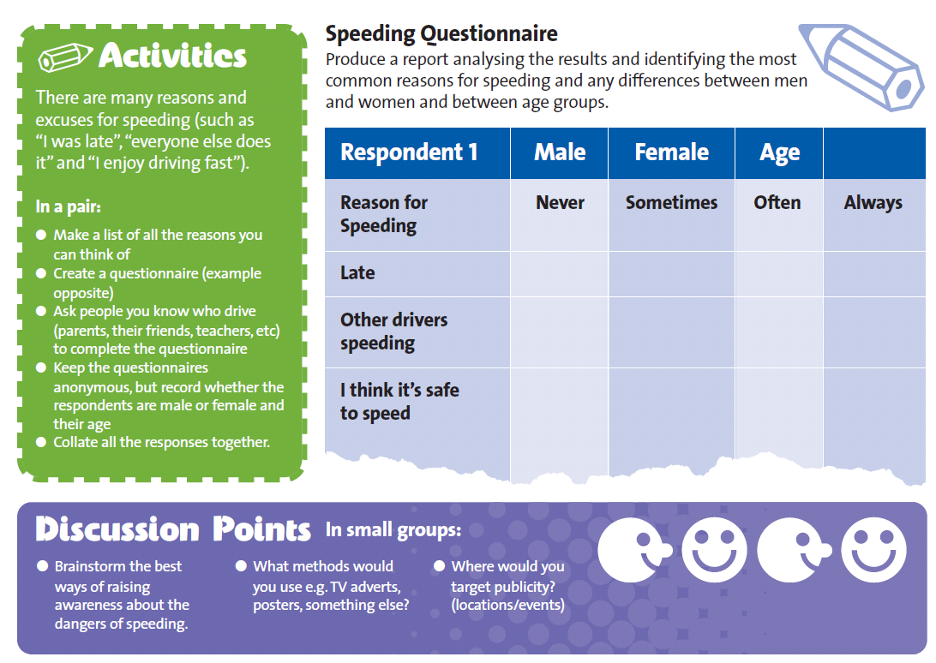

Slide 64
REACTION TIME
S1 Physics Transport
Back to mind map

Slide 65
Let’s measure YOUR REACTIONS
MEASURING REACTION TIME USING A COMPUTER
Sheep Dash
5 min road test
Red dot yellow dot
On the internet try some of the experiments for finding your reaction time.
MEASURING REACTION TIME USING A RULER
Collect the helpsheet for the instructions on how to find
REACTION TIME using a RULER.
Notes:
Experiment sheets provided

Slide 66
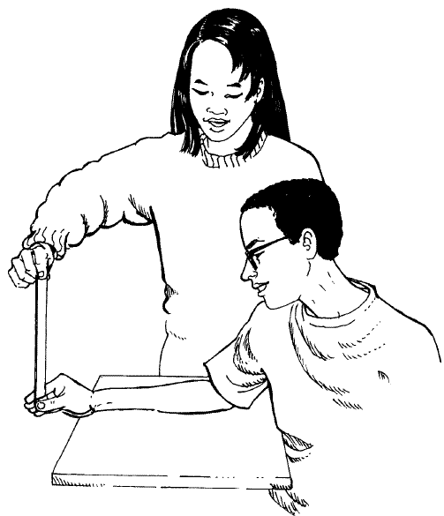
REACTION TIME
MEASURING REACTION TIME USING A RULER
To measure your reaction time you will need a 30 cm ruler, an instruction sheet and a partner.
Notes:
MEASURING REACTION TIME USING A RULER
To measure your reaction time you will need a 30 cm ruler and a partner. What to do
i. Your partner holds a ruler at the top. The 0 cm mark should be pointing towards the ground, the 30 cm mark should be pointing towards the ceiling.
ii. Place your finger and thumb either side of the 0 cm mark, but do not hold the ruler.
iii. Your partner should let the ruler go, at the same time you should try to grab the ruler between your finger and thumb.
iv. Record the distance the ruler has fallen in your jotter, from the 0 cm to where you are holding it. The distance must be recorded in metres.
v. Repeat this five times.
vi. Your partner now tries to grab the ruler as you let it go.
To find the time:
i. Find the average distance the ruler dropped before you grabbed it.
ii. Multiply your average distance by 0.2 and then square root your answer.
To do this using your calculator
Average reaction time =
average distance × 0.2 =√=
(metres)
What to do
i. Your partner holds a ruler at the top. The 0 cm mark should be pointing towards the ground, the 30 cm mark should be pointing towards the ceiling.
ii. Place your finger and thumb either side of the 0 cm mark, but do not hold the ruler.
iii. Your partner should let the ruler go, at the same time you should try to grab the ruler between your finger and thumb.
iv. Record the distance the ruler has fallen in your jotter, from the 0 cm to where you are holding it. The distance must be recorded in metres.
v. Repeat this five times.
vi. Your partner now tries to grab the ruler as you let it go.
To find the time:
i. Find the average distance the ruler dropped before you grabbed it.
ii. Multiply your average distance by 0.2 and then square root your answer.
To do this using your calculator
Average reaction time =
average distance × 0.2 =√=
(metres)

Slide 67
LOCKERBIE ACADEMY TRANSPORT UNIT
WORDBANK
At rest- in Physics we use this term to mean not moving. We can also say the object is stationary.
It is not the same word as pens and pencils which are stationery!

Slide 68
STOPPING DISTANCE
The STOPPING DISTANCE of a car is made up of TWO parts
THINKING DISTANCE
BRAKING DISTANCE
Thinking distance is the distance a car will travel in the time it takes you to react to the situation.
The distance the car will travel as the brakes are applied

Slide 69
LOCKERBIE ACADEMY TRANSPORT UNIT
WORDBANK
Stopping distance = thinking + braking
distance distance
Stopping distance the distance it takes a car to stop.

Slide 70
LOCKERBIE ACADEMY TRANSPORT UNIT
WORDBANK
thinking distance
the distance moved whilst you are reacting to the hazard.
braking distance
the distance that the car moves whilst braking.

Slide 71
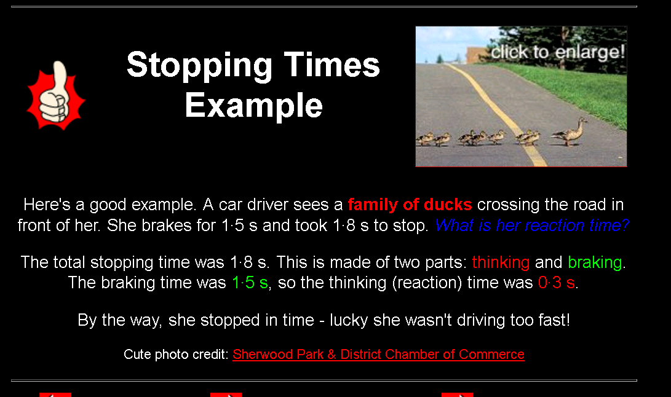

Slide 72
An investigation to measure reaction time and calculate stopping distances
Using the Reaction Timer box you will find out:
Your reaction time.
How your reaction time changes if you are chatting or texting.
You will calculate stopping distances for different speeds.
Image: Wikipedia: This work is licensed under the Creative Commons Attribution 2.0 License.

Slide 73
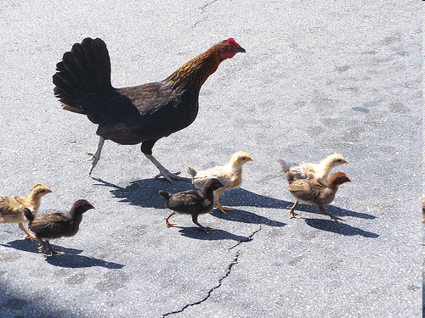
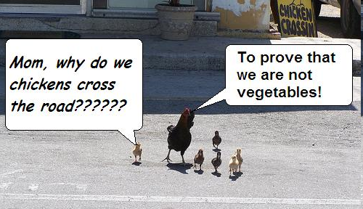


[Original photo credit: lonecellotheory]
By, Hannah, Charlotte, Robert and Kieran + Emma, Sophie, Phoebe, Sweez & Faye edited by Mrs H

Slide 74
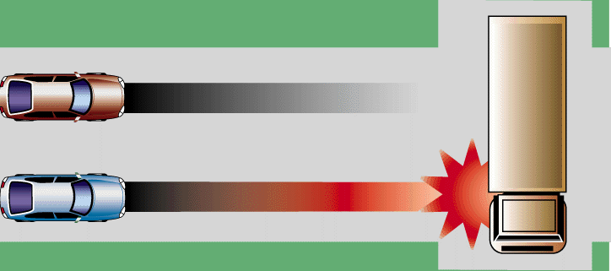
What chicken is for?
To get you to learn about the stopping distances of cars and lorries
To be aware of road safety.
To appreciate stopping distances.
Braking in different weather conditions.

Slide 75
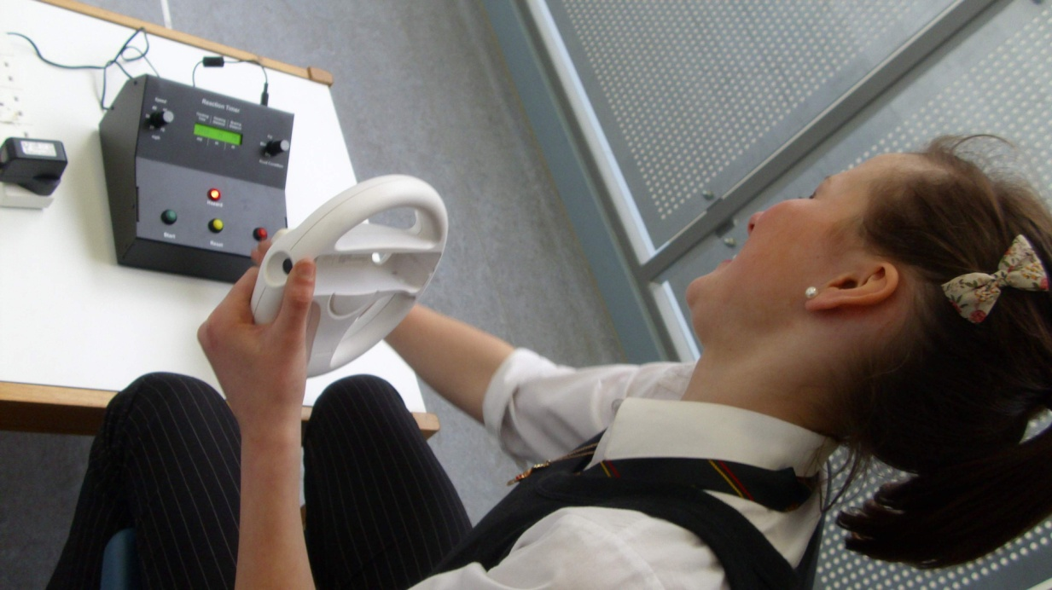
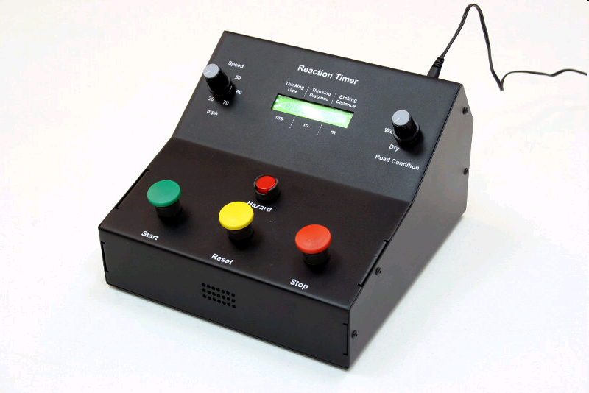
Equipment
Car controls
(reaction timer)
A driver
Measuring tape
Mario kart wheel
People to be chickens

Slide 76
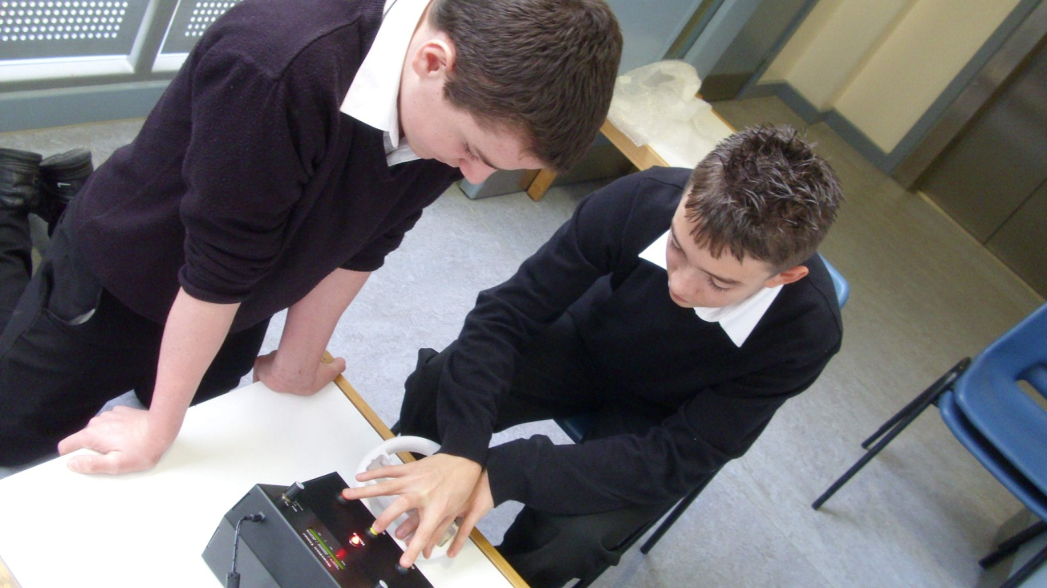
What is it.
Chicken run is an experiment that tests your reaction time and people’s appreciation of stopping distances.
You choose
    weather condition
    speed
    driver ability
    driver distractions

Slide 77
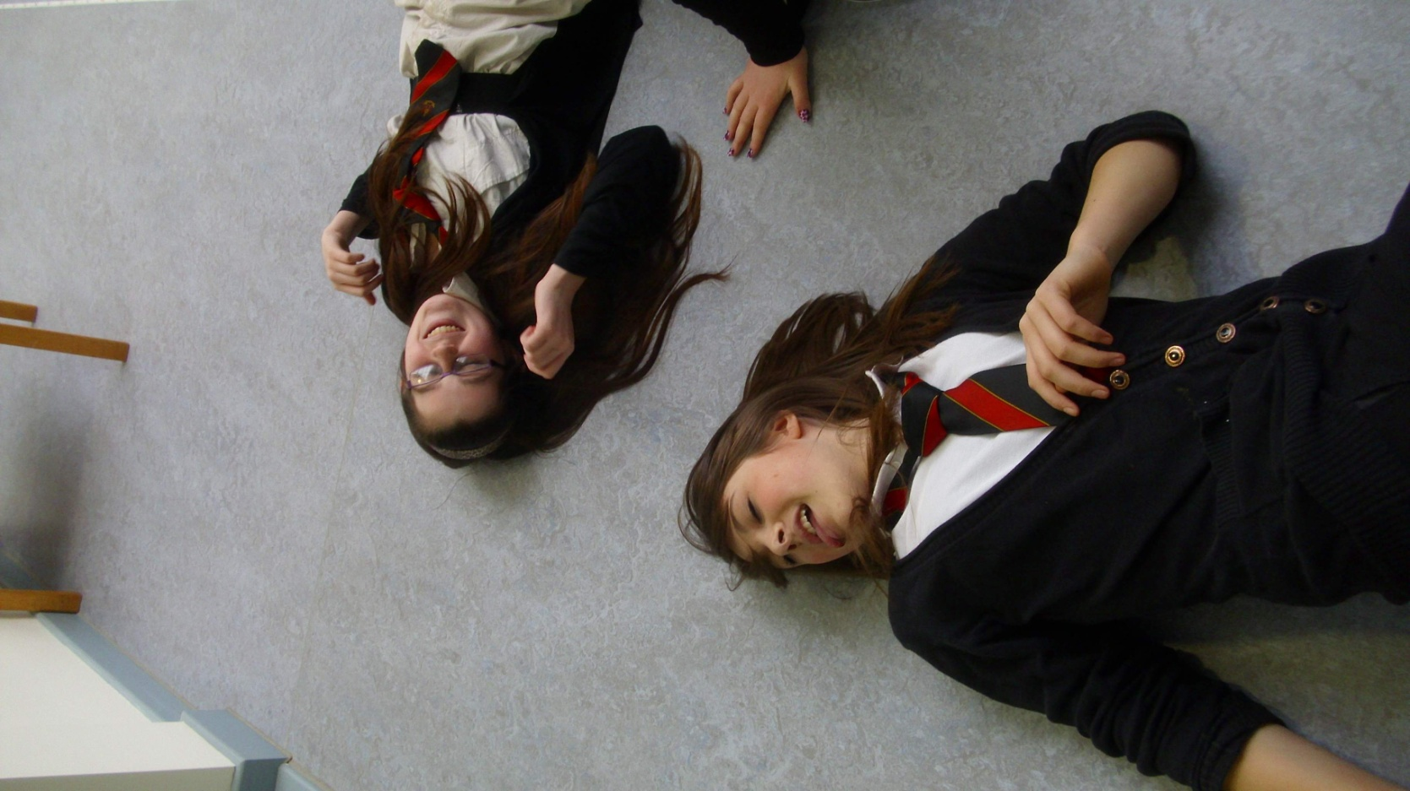
The Winner
Not these then!
is the person closest to stopping position of “the car” without being “hit”

Slide 78
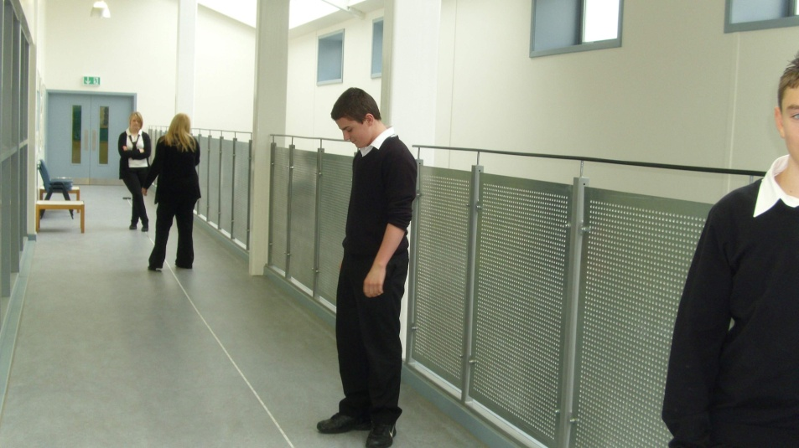
Rules
Drive carefully
Do not break Mario kart wheel
Don’t have your hand hovering over the stop button
Don’t look at the light whilst you’re driving
Think of the control box as a proper car
DO NOT GET HURT

Slide 79
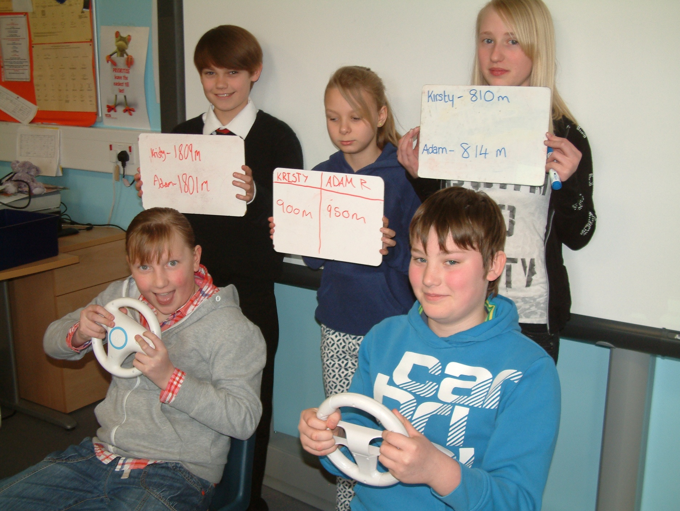

Slide 80
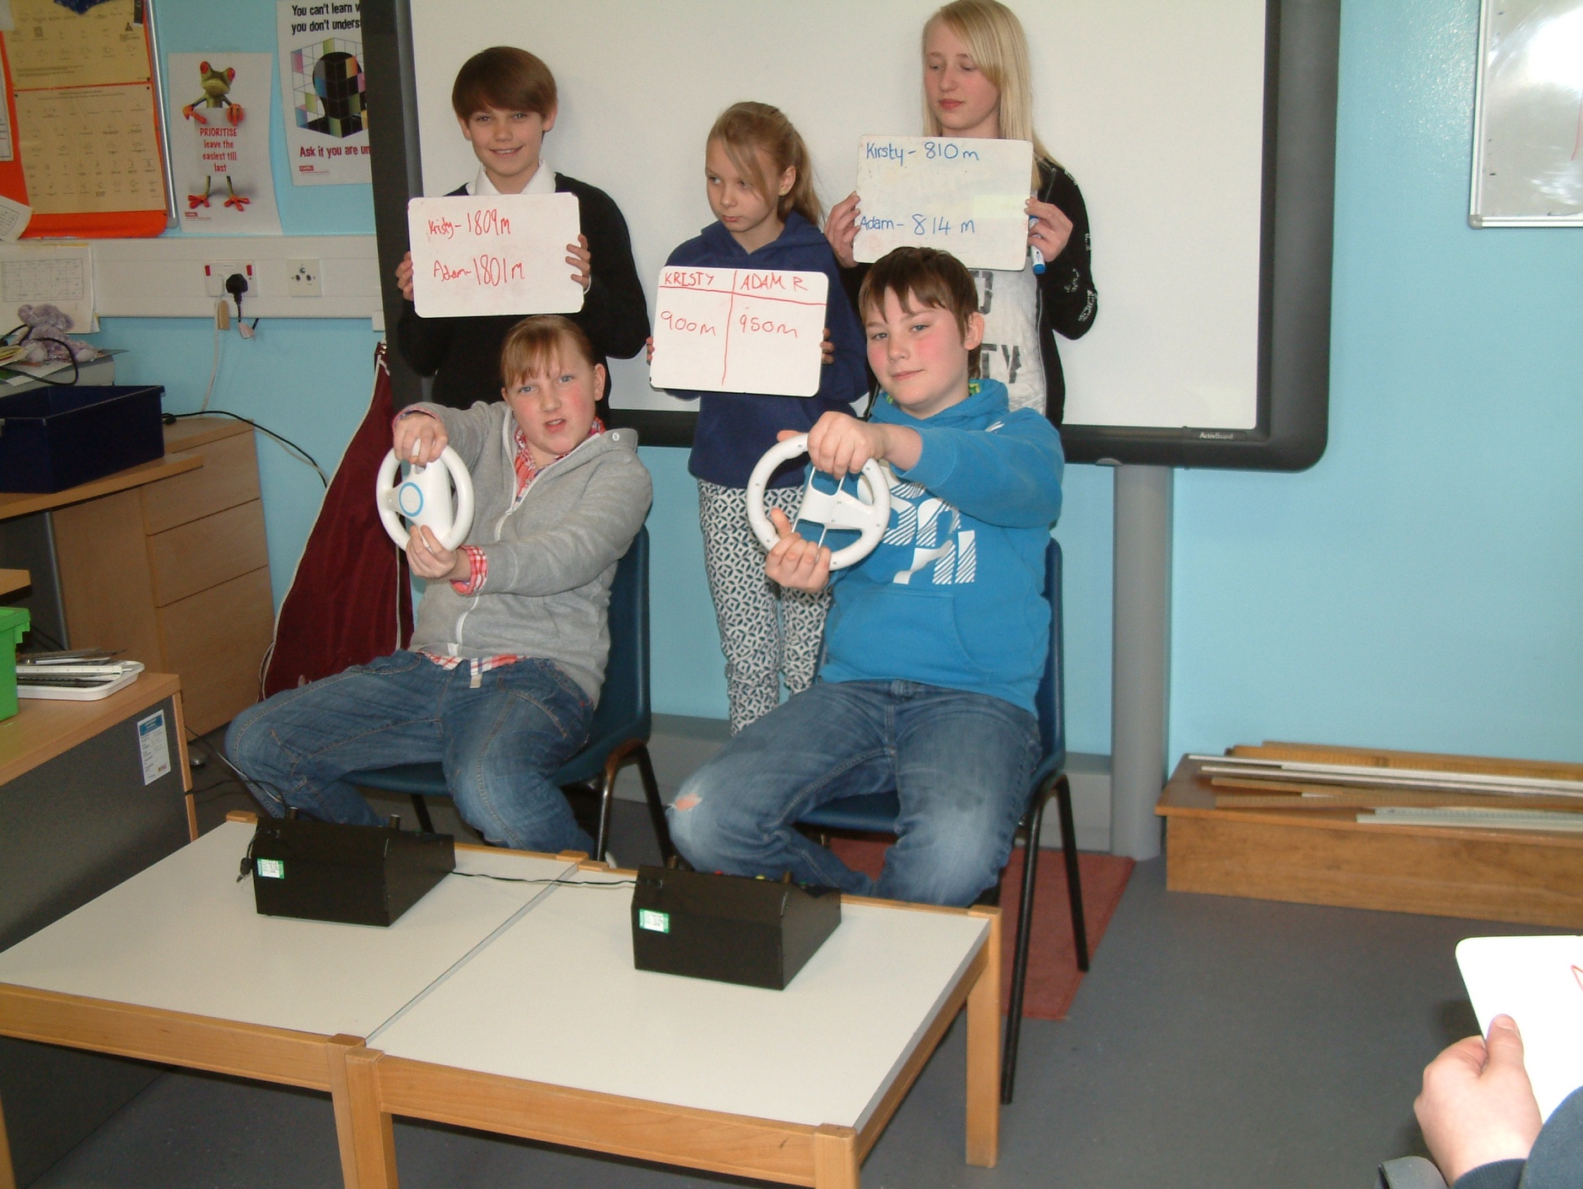

Slide 81
Cross Curricular Links
Literacy
Q: Why did the chicken run across the road?
A: There was a car coming.
Q: Why did the chicken cross the road halfway?
A: She wanted to lay it on the line.
Q: Why did the rubber chicken cross the road?
A: She wanted to stretch her legs.
Q: Why did the Roman chicken cross the road?
A: She was afraid someone would caesar!
Q: Why did the chicken cross the road?
A: To prove to the possum it could actually be done!

Slide 82
Cross Curricular Links
Literacy
http://www.miketheheadlesschicken.org/story.php
Numeracy
Speed, distance, measuring, unit conversions
H&W

Slide 83
UNIFORM Speed
S1 Physics Transport
Back to mind map

Slide 84
LOCKERBIE ACADEMY TRANSPORT UNIT
Uniform Speed
Sometimes through the whole journey your speed will not change. This could be because you have cruise controls on. We would say that your speed is UNIFORM when your speed isn’t changing. It remains constant.

Slide 85
LOCKERBIE ACADEMY TRANSPORT UNIT
WORDBANK
Uniform Speed
When your speed is uniform we mean that your speed isn’t changing. It remains constant.

Slide 86
Uniform speed
Do you think people often travel at a uniform speed?
Discuss times when the speed might be uniform and when it might not be uniform.
WHY?

Slide 87
LOCKERBIE ACADEMY TRANSPORT UNIT

Slide 88
SPEED AND ROAD SAFETY
Speed is given as the MAIN cause of FATAL ACCIDENTS on Scotland’s Roads
Road Accident Report

Slide 89
SPEED AND ROAD SAFETY
Causes of road traffic accidents
In Great Britain, data collected⁶ about road traffic accidents in 1999 to 2002 examined the factors involved in each accident. Excessive speed was the most common contributory factor in fatal accidents, playing a part in 28% of all fatal accidents examined in the trial. Careless, thoughtless or reckless behaviour was next, being a contributory factor in 21% of all fatal accidents examined.
In accidents resulting in any severity of casualty, inattention was the most common contributory factor, found in 25% of all accidents examined in the trial. Failing to judge another person's path or speed was the next most common contributory factor, playing a part in 23% of all accidents examined.
road_traffic_accident.html

Slide 90
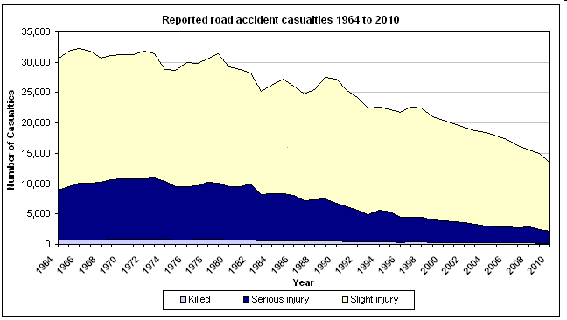
THINKING TASK!- More CARS less deaths- WHY?
Crash Figures

Slide 91


Slide 92
ADVANCED QUESTIONS
Questions – Speed
1. What is the speed of a motorbike if it travels 100 metres in 2.5 seconds?
2. what is the speed of a rocket if it can move 32 kilometres in 4 seconds?
3. At what speed in m/s is a skateboarder moving if he can skate 6 kilometres in 10 minutes?
4. A red Ferrari zooms over 500 metres in 4 seconds. What is its speed?
5. How long would it take a snail to slither 20 metres at 5 metres per hour?

