Slide 1
LOCKERBIE ACADEMY acceleration
S1-S3 Road Safety & PHYSICS

Slide 2
MINDMAP OF ROAD TRANSPORT MATERIAL
Practicals
Fun &Games
Velocity
Displacement
Distance
Momentum
(advanced only)
ACCELERATION
REVIEW
Measuring ‘a’
The Physics
behind
Acceleration
F=ma
INVESTIGATION
Newtons
2nd Law
ANALYSIS
calculations
Studying Accidents
Practicals
Measure

Slide 3
REVIEW
S1 Physics Transport
Back to mind map

Slide 4
REVIEW
WHAT ARE DISTANCE AND DISPLACEMENT?
Distance is length. How far you’ve travelled (e.g. 100 metres)
Displacement is direct distance in a particular direction (e.g. 100 metres to the right)
WHAT ARE SPEED AND VELOCITY?
Speed is the rate of covering a distance (e.g. 50km/h)
Velocity is rate of displacement in a particular direction (e.g. 50 km/h north)

Slide 5
We might not have covered this it depends on the order that your teacher chooses
Force
A force is a push or a pull. Forces are measured in units called Newtons. A force is always present if an object does at least one of the following
P change speed
P change direction
P change shape.
Notes:
There are many words that we use to describe forces but they can all be simplified to pushes or pulls. Many of the words seem to represent violence! Can you list some
eg twist, turn hit, punch, knock, kick etc. Balanced versus unbalanced?

Slide 6
What is a force? What does it do?
In the back of your jotter try to:
give 5 examples of a force.
as best you can to write a definition of what a force is.

Slide 7
The instrument for measuring forces is the Newton Balance or Forcemeter. Forces are measured in units of NEWTONS (N)

Slide 8
DYNAMIC WORD BINGO- REVISION

Slide 9
acceleration

Slide 10
Putting your foot down
Have you ever looked closely at advertisements for cars? Most of them will say something like this:
0 – 60 mph in 8 seconds
What does this tell you?
It’s not how fast the car can go – cars can manage more than 60 miles per hour.

Slide 11
What does this tell you?
It’s not how fast the car can go – cars can manage more than 60 miles per hour.
It’s how quickly the car gains speed – the car’s acceleration. The less time a car takes to gain speed, the greater its acceleration.

Slide 12



Vauxhall Nippy:
Top speed: 115 mph
Engine size: 1.2 litres
0 – 60 mph: 10 seconds
Ferrari Flyer:
Top speed: 130 mph
Engine size: 2.4 litres
0 – 60 mph: 5 seconds
Ford Speeda:
Top speed: 125 mph
Engine size: 1.6 litres
0 – 60 mph: 7.5 seconds
Mazda Vroom:
Top speed: 135 mph
Engine size: 2.0 litres
0 – 60 mph: 6 seconds

Slide 13
1. Which car has the highest top speed?
2. Which car has the greatest acceleration?
3. Which car would you prefer to drive? Why?

Slide 14
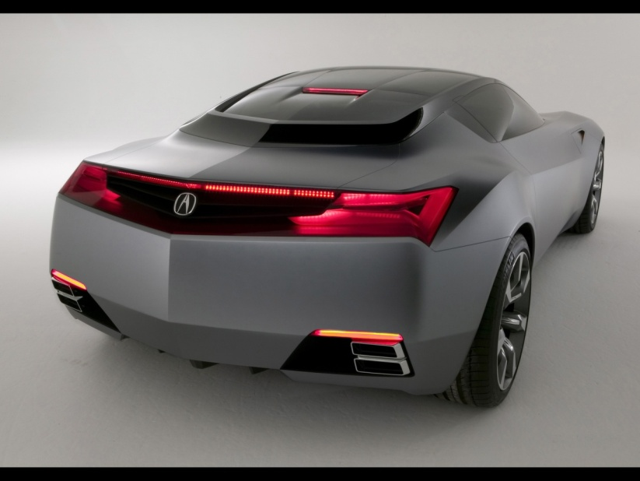
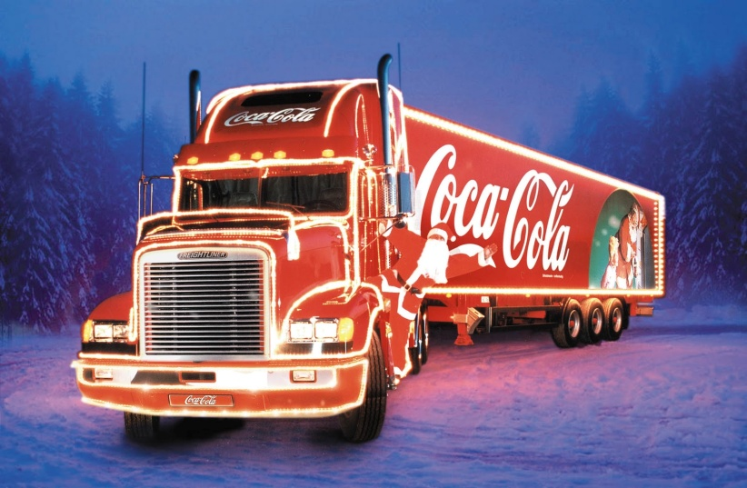
ACCELERATION
When a driver of a car puts her foot down on the accelerator (throttle or right pedal), the car goes faster - it accelerates!

Slide 15
ACCELERATION
Imagine two drivers side by side at a set of traffic lights, the lights are on red. Angus is in a very fast sports car, and Caitlin is sitting in her lorry. The lights turn green and both vehicles set off. Both vehicles accelerate, the speed of both vehicles increases.
After a while both vehicles reach the same speed. But we can tell that the sports car will accelerate faster than the lorry. Acceleration is not just about the increase in your speed, it takes account of how quickly your speed changes. The time it takes your speed to change must be in the equation.

Slide 16
Acceleration
When your velocity is changing you are accelerating.
Acceleration is the rate of change of velocity. (how quickly you change your velocity).
If you change your velocity quickly you have a high acceleration.

Slide 17
Acceleration is given by:
a= Δv
t
a | acceleration
Δ | change in
v | velocity
v | final velocity
u | initial velocity
t | time
a= v-u
t

Slide 18
WORDBANK
Physics Transport
Copy the following words into your jotter and literacy logs
Back to mind map

Slide 19
Acceleration
Acceleration is the rate of change of velocity.
(how quickly you change your velocity).
Or
change of velocity per second
If you change your velocity quickly you have a high acceleration.

Slide 20



Slide 21
ACCELERATION
If the change in velocity is measured in metres per second (m/s) and the time is measured in seconds, then the acceleration is measured in metres per second per second (m/s²).
For example, if a car accelerates at 2 m/s²,then its speed increases by 2 metres per second every second.
If it was stationary when the clock is started, then after the first second it will be going at 2 m/s, after the second second it will be travelling at 4m/s, and after ten seconds the car will be travelling at 20m/s. what will be the speed of the car after sixty seconds?

Slide 22
ACCELERATION
When you buy a new car, figures are given to indicate the acceleration car companies often only quote the time it takes for vehicles to speed up from 0 mph to 60 mph. From this information the customer can work out whether it is a sporty or slow car. As a customer, wanting to purchase a new sporty car, would you want a long time or a short time for the change in speed to occur?
lf a car is slowing down then it is said to be decelerating or has a negative acceleration.

Slide 23
Acceleration
A Jaguar can reach 27 m/s from rest in 9.0 s. What is its acceleration?
The space shuttle reaches 1000 m/s, 45 s after launch. What is its acceleration?
A car reach 30 m/s from a speed of 18 m/s in 6 s. What is its acceleration?
A train moving at 10 m/s increases its speed to 45 m/s in 10 s. What is its acceleration?
A bullet travelling at 240 m/s hits a wall and stops in 0.2 s. What is its acceleration?
A car travelling at 20 m/s brakes and slows to a halt in 8 s. What is the deceleration?

Slide 24
LOCKERBIE ACADEMY TRANSPORT UNIT
Describe how you would measure the acceleration of a small vehicle as it runs down a slope in the laboratory.
On approaching the speed limit signs, a car slows from 30 m/s to 12 m/s in 5 s. What is its deceleration?
A bowling ball is accelerated from rest at 3 m/s² for 1.2 s. What final speed will it reach?

Slide 25
LOCKERBIE ACADEMY TRANSPORT UNIT
How long will it take a car to increase its speed from 8 m/s to 20 m/s if it accelerates at 3 m/s²?
A cyclist can accelerate at 0.5 m/s² when cycling at 4 m/s. How long will she take to reach 5.5 m/s ?
The maximum deceleration a car’s brakes can safely produce is 8 m/s². What will be the minimum stopping time if the driver applies the brakes when travelling at 60 mph (27 m/s).

Slide 26
LOCKERBIE ACADEMY TRANSPORT UNIT
The proper unit for acceleration is
metres per second per second,
metres per second squared.
(miles per hour per second).
m/s ²
mph/s
Notes:
If the change in speed is measured in metres per second (m/s) and the time is measured in seconds, then the acceleration is measured in metres per second per second (m/s²).
For example, if a car accelerates at 2 m/s²,then its speed increases by 2 metres per second every second. If it was stationary when the clock is started, then after the first second it will be going at 2 m/s, after the second second it will be travelling at 4m/s, and after ten seconds the car will be travelling at 20m/s. what will be the speed of the car after sixty seconds?
When you buy a new car, figures are given to indicate the acceleration car companies often only quote the time it takes for vehicles to speed up from 0 mph to 60 mph. From this information the customer can work out whether it is a sporty or slow car. As a customer, wanting to purchase a new sporty car, would you want a long time or a short time for the change in speed to occur?
lf a car is slowing down then it is said to be decelerating or has a negative acceleration.

Slide 27
LOCKERBIE ACADEMY TRANSPORT UNIT
WORDBANK
At rest- in Physics we use this term to mean not moving. We can also say the object is stationary.
It is not the same word as pens and pencils which are stationery!

Slide 28
Acceleration
Acceleration is a way of saying that an objects velocity is changing. It is a measure of the change in velocity every second.
a = acceleration (m/s²)
Δv = change in velocity (m/s)
t = time taken (s)
Δv
a
t
a = acceleration (m/s²)
v = final velocity (m/s)
u = initial velocity (m/s)
t = time taken (s)
Notes:
When a driver of a car puts her foot down on the accelerator, the car goes faster - it accelerates!
Imagine two drivers side by side at a set of traffic lights, the lights are on red. David is in a very fast sports car, and Louise is sitting in her lorry. The lights turn green and both vehicles set off. Both vehicles accelerate, the speed of both vehicles increases. After a while both vehicles reach the same speed. But we can tell that the sports car will accelerate faster than the lorry. Acceleration is not just about the increase in your speed, it takes account of how quickly your speed changes. The time it takes your speed to change must be in the equation.

Slide 29
MEASURING acceleration
Practical

Slide 30
Measuring Acceleration
You can measure acceleration in the lab with EITHER one single mask and two light gates or a double mask and one light gate.
Whichever way the experiment is conducted the measurements that need to be made are:
  Width of the mask or masks.
  Time for first light beam to be broken.
  Time for second light beam to be broken.
  Time between the breaks in the light beam to be measured.

Slide 31
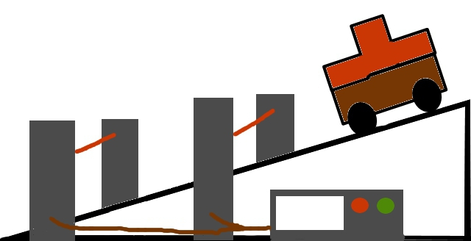

Measuring acceleration with two light gates

Slide 32
We don’t measure v and u we calculate
them from
u=s/t
  Where
    s = length of the card
    t= time for the vehicle to pass through the top light gates.
  v=s/t
  Where
    s = length of the card
    t= time for the vehicle to pass through the bottom light gates.
    We also need to know the time it took the car to go between the light gates.

Slide 33
Does it matter how far apart the light gates are?
Surely the further apart the light gates the greater the value of v.
Yes the further apart the light gates the greater
the value of v but the longer it takes to go between the light gates. If a=v-u/t then v is greater but also t so these two cancel and a remains constant

Slide 34
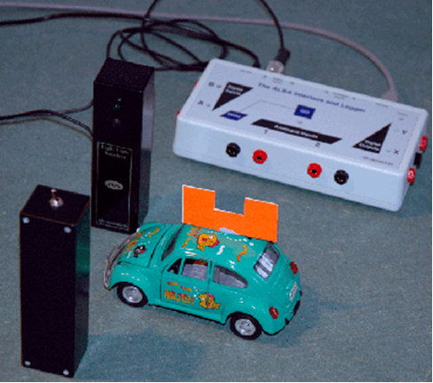

Slide 35
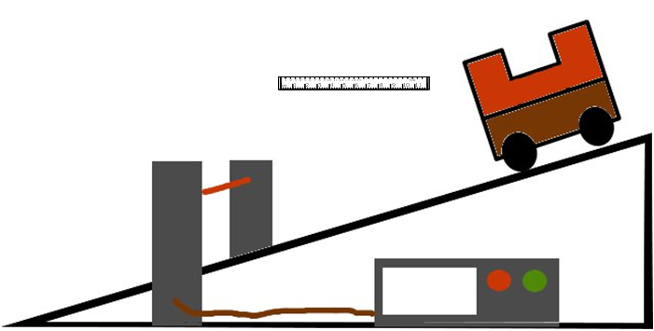
Measuring acceleration with only one light gate

Slide 36
How can we only use 1 light gate to find acceleration?
Yes the vehicle has a double MASK. u and v are still taken from the time it takes the mask to pass through the light gate and we need to measure the length of the mask

Slide 37
Measurements | Calculations
t₁ time to pass first light gate
t₂ time to pass second light gate
t₃ time between light gate
Length of mask

Slide 38
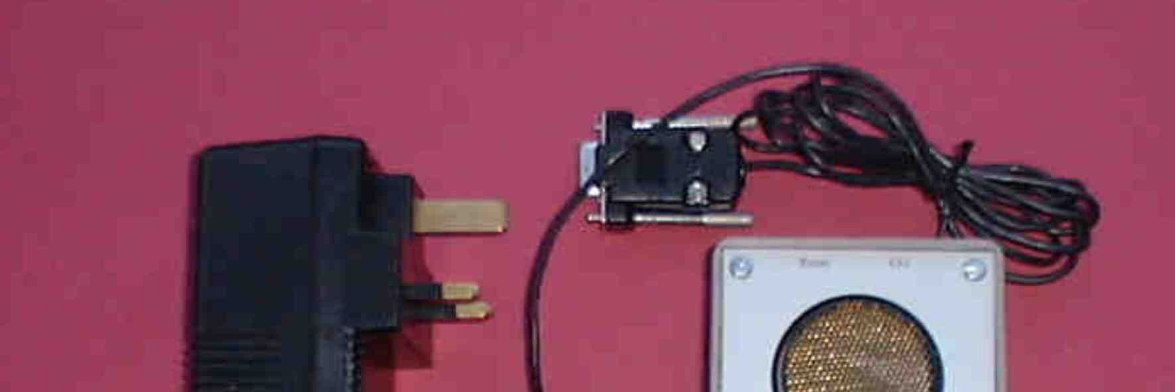
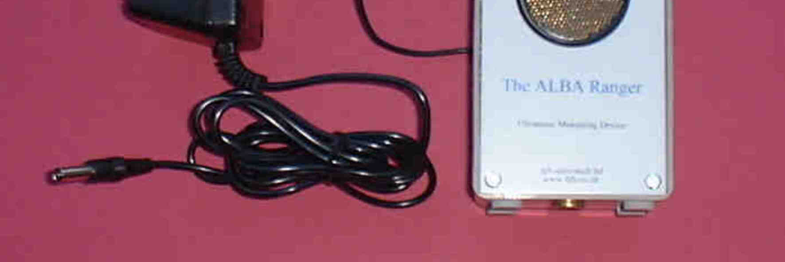

Slide 39
Measuring acceleration with the ALBA RANGER
Here the Ranger sends out pulses of ultrasound. The waves reflect off the object and returns them to the ranger.
If the pulses are returning after a longer time what does this tell you about the vehicle?
What about the pulses reflecting in a sorter time?

Slide 41
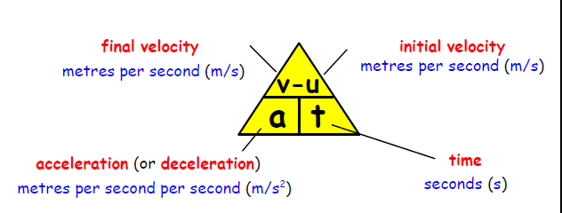
Calculating Acceleration

Slide 42
TASK
Using equipment of your choice investigate the effect of the angle of a slope on acceleration.

Slide 43
In each case, calculate the acceleration of the vehicle:
(a) Farmer Jones' tractor starts from rest and increases its velocity to 8 m/s to the right in 10 s.
(b) In their go-kart, Jill and her Mum increase their velocity from rest to 6 m/s to the right in 12 s.
(c) On her motor scooter, Dominique takes 5 s to increase her velocity from 3 m/s to 13 m/s to the right.
(d) Mike's motorbike takes 5 s to increase in velocity from 10 m/s to 30 m/s to the right.

Slide 44
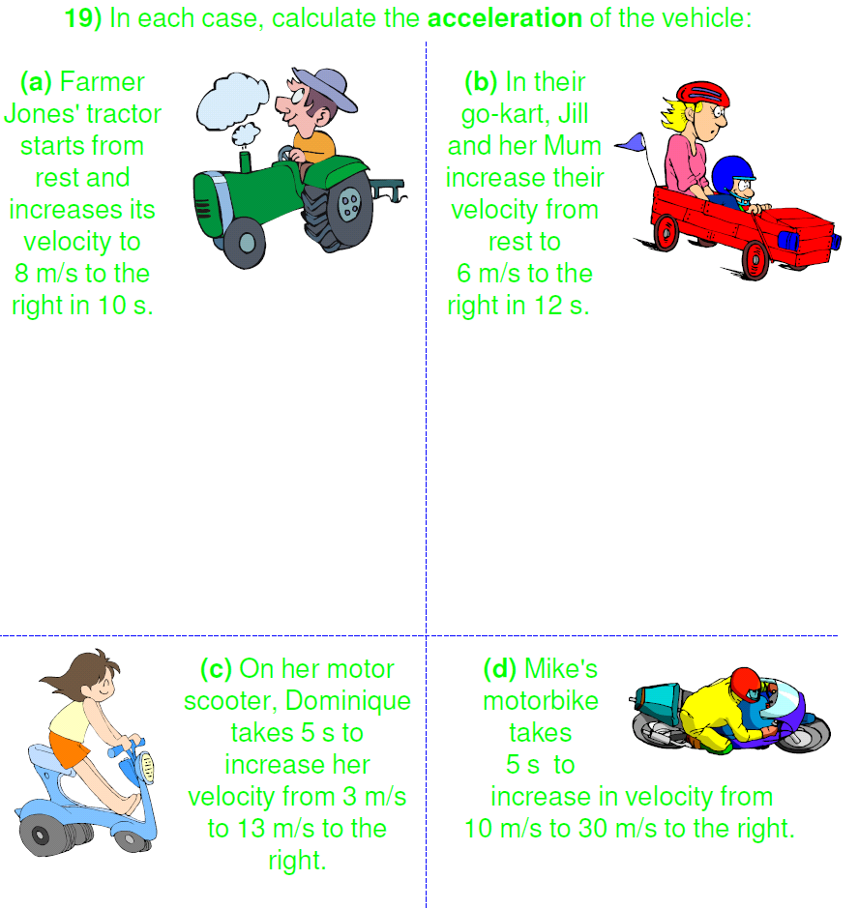

Slide 49
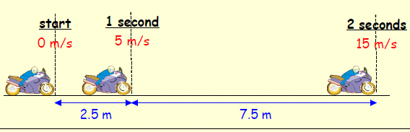

Slide 50
Acceleration linked to Force
We will find out later that the acceleration of an object is related to the FORCE applied to it.
Any unbalanced force causes an object to change velocity or accelerate.
The size of the acceleration will depend on the force and the mass of the object.
F_{un}= unbalanced Force (N)
m = mass (kg)
a = acceleration (m/s²)
F_{un}
m
a

