Slide 1
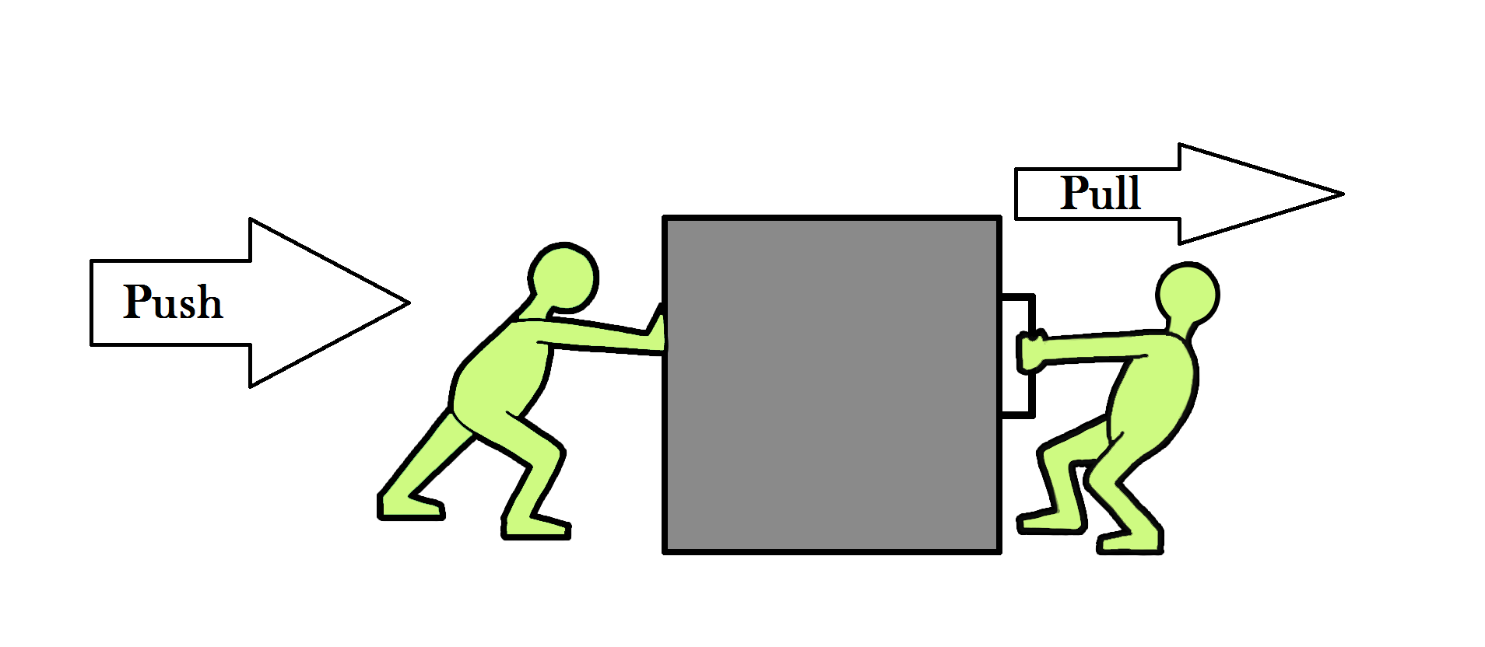
TRANSPORT UNIT
FORCES/dynamics
LOCKERBIE ACADEMY

Slide 2

The five rules of the Physics Department are for pupils follow to ensure a pleasant and safe environment.
1. Follow the teacher’s instructions.
2. Raise your hand, and wait for permission before speaking.
3. Allow people to get on with their work.
4. Follow the laboratory rules
5. No Put Downs

Slide 3
ROUTINES TO FOLLOW WHILST IN THE PHYSICS DEPARTMENT
In addition to the core rules the following routines are expected of pupils during their time in this department.
Pupils should:

Slide 4
1. Enter the room quietly, calmly and on time;
2. Come prepared for the work with jotters and pen or pencil etc.
3. Complete all homework and hand it in on time;
4. Not deface jotters, desks folders, etc.;
5. Pay attention;
6. At the end of a lesson, when told to do so, pack away quietly, place stools under the desk and leave in an orderly manner.

Slide 5
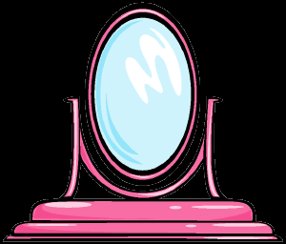
THIS PERSON is responsible for your LEARNING!

Slide 6
Homework
Forces title Page What I learned about myself in S1 Science

Slide 7
MINDMAP OF FORCES
Hookes Law
Full Expt
Write up
Changing
Friction
measuring
FORCES?
Contact v
Non-contact
Friction
FORCES
Types of
FORCES
What are
FORCES?
WEIGHT
Mass v
Weight
The Effects

Slide 8
WHAT WE WILL BE COVERING
WHAT IS A FORCE?
Forces around us
EFFECTS OF A FORCE?
Contact versus non contact forces
MEASURING FORCES
The Effect of Forces investigation
Mass v Weight
Frictions investigation

Slide 9
Mass & Weight
Before we deal with Forces, we near to clear up an important confusion in Physics/ Science.

Slide 10
ASK A STUDENT!
What is Mass?
What is Weight?
Timer- Dr WHO
Think
Pair
Share

Slide 11
Mass and Weight- LEVEL 3
The mass of an object is the amount of matter that is in the object
the weight of an object is the force of gravity that acts on that object.
➔Mass is related to how much stuff in an object and weight is related to the pull of the Earth

Slide 12
Mass and Weight- LEVEL 4
Mass is a measure of the amount of matter (stuff) in an object.
Mass is caused by the number of particles in an object. Particles are too small to be seen so we deal with larger bundles called kilograms.
To be honest mass isn’t fully understood by scientists. Maybe it could be something you could win a NOBEL PRIZE for!
ADD PICTURE
02/10/2011
JAH

Slide 13
Level 3
Mass is measured in kilograms (kg).
Wherever you go your mass remains the same.

Slide 14
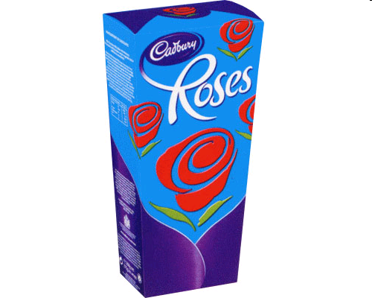
Mass and Weight- LEVEL 3
E.g. if you had a big (1 kg) box of Roses chocolates on the Earth the amount and number of chocolates would be the same wherever you took those chocolates.
There would still be a 1 kg box of chocolates with the same number of mini dairy milks etc., providing that you don't eat the chocolates!

Slide 15
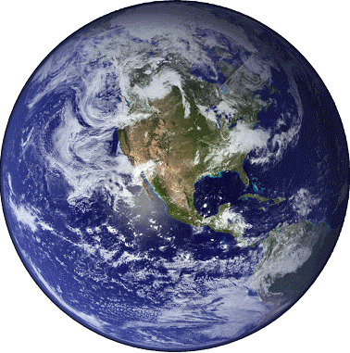
Mass and Weight- LEVEL 3
In the same way if a girl has a mass of 40 kg (about 6 stone 4 pounds) on the Earth, her mass is still 40 kg up in a plane, on the moon or out in space. Her mass stays the same.

Slide 16

WHAT IS A FORCE?
Express Views (Written)
Express Views (Verbal)

Slide 17
ASK A STUDENT!
WHAT IS A FORCE?
Think
Pair
Share
Timer- Dr WHO

Slide 18
WHAT YOU THOUGHT

Slide 19
Forces
A FORCE is a PUSH or a PULL.
Forces can’t be seen, but the effect of a force can be seen.
They are measured in newton – N
They always act in a certain direction
A newtonbalance , spring balance or forcemeter is used to measure forces.

Slide 20
ASK A STUDENT!
NAME SOME FORCE WORDS?
Think
Pair
Share
Timer- Countdown

Slide 21
WHAT YOU THOUGHT

Slide 22
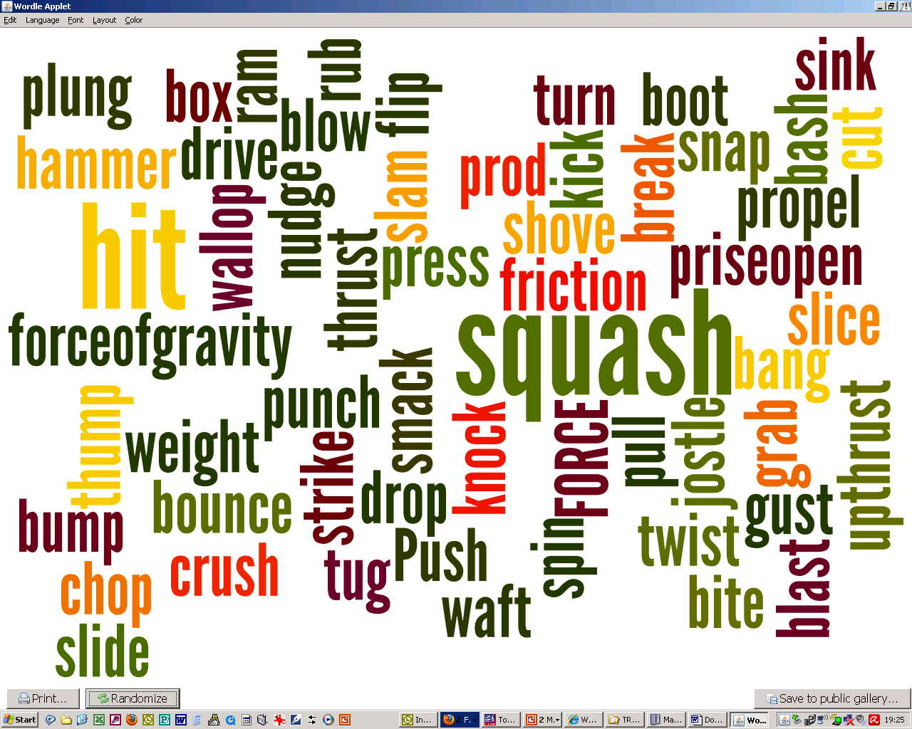
e

Slide 23
EFFECTS OF A FORCE?

Slide 24


TASK
- the effects of a Force
CAREFULLY, DO NOT DESTROY THE OBJECTS
Take one of the objects from the tray and apply different FORCES to it.
List the force word that you would use to explain the force.
Record the effect on the object.
Object | Force | Effect
timer- the avengers

Slide 25
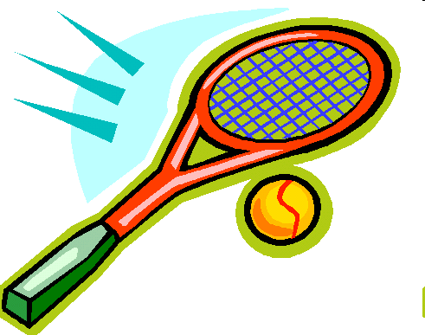
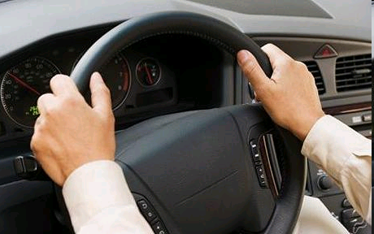
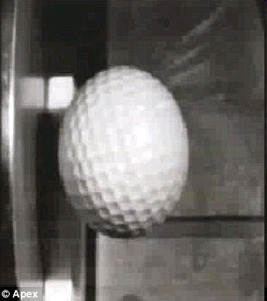
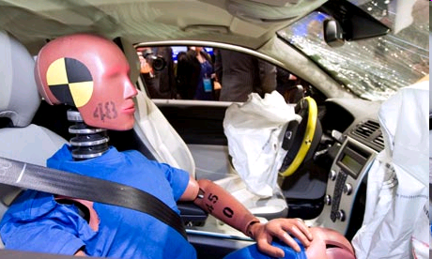
BEWARE
It seems amazing but you cannot see Forces. You can only see their effects.
Squash that golf ball
Notes:
25
http://www.dailymail.co.uk/sciencetech/article-1284051/Incredible-slow-motion-picture-golf-ball-flattens-hits-steel-plate-150mph.html
t looks like a rubber ball that has been squashed after being flung at a wall. Not sure if it is real!
But these images actually show what happens during a high speed impact - to a golf ball. The slow motion close-up of the smash reveals the incredible forces at play when a golf ball is fired at a piece of steel at 150mph. Internet picture of a golf ball hitting a piece of steel at 150mph in slow motion The video stills show what happens when a golf ball slams into a steel plate at high speed The clip reveals the unbelievable distortion it undergoes and its flexibility - even under the extreme stress of going from 150mph to zero in a split second.
The whole ball is flattened like a pancake against the steel before bouncing off and instantly reforming into its original shape as the energy from the impact is transferred across the ball to the opposite end in a wave.

Slide 26
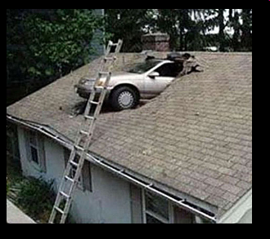
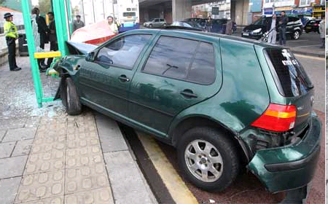
Forces change an object’s
  speed, (cause an acceleration)
  shape,
  direction of movement.
Squash that golf ball

Slide 27
Write down some FORCES that act on a car when driving or in a car crash.

Slide 28
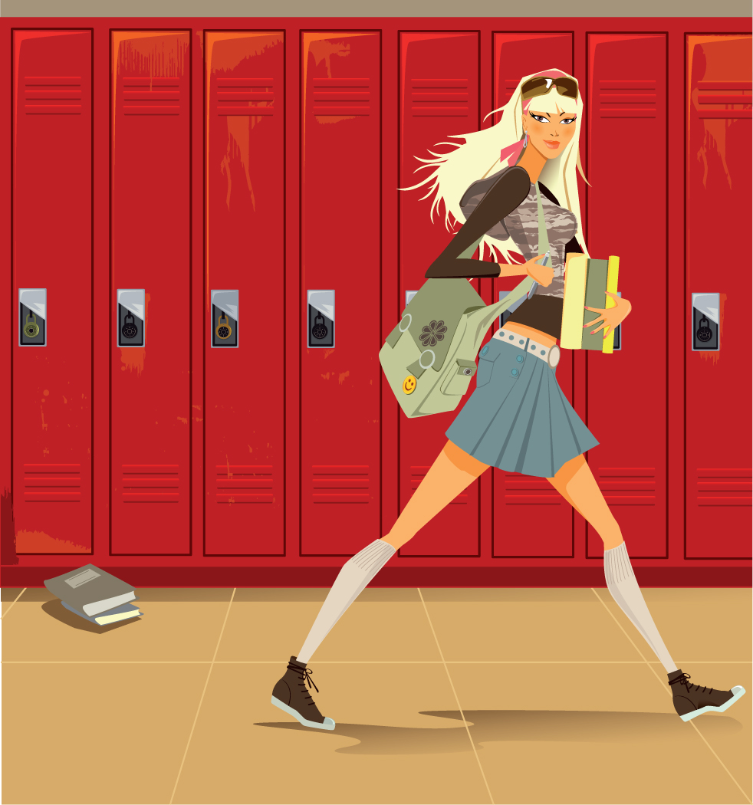
GO ON A FORCE WALK WITH YOUR TEACHER
Make a table in your jotter and record when you come across a force, how do you know? What are the effects of this force?

Slide 29
Force Walk
What | Force | Effect | Comment
Flushing the loo | Push on handle

Slide 30
Forces
Forces change an object’s
  speed,
  shape,
  direction of movement.

Slide 31
ASK A STUDENT!
LIST SOME FORCES and NAME THE EFFECT?
Think
Pair
Share
Timer- Hawaii-5-0

Slide 32
Examples of forces
Weight, friction, upthrust

Slide 33
We can divide forces into 2 groups
Think
Pair
Share
CONTACT FORCES
NON CONTACT FORCES

Slide 34
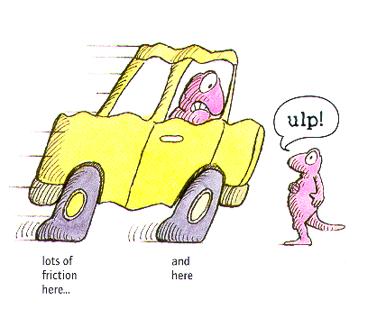
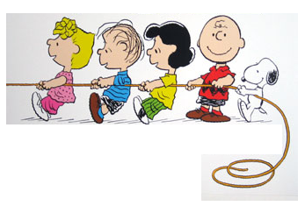
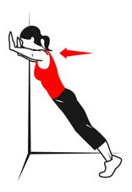
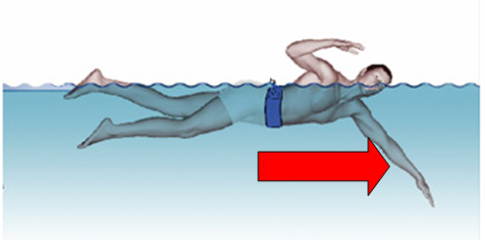
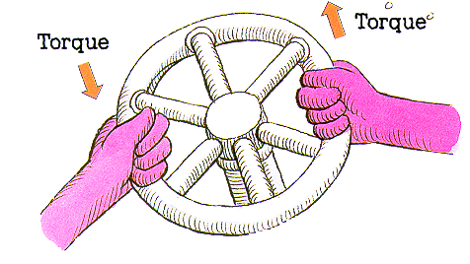
Contact Forces
Friction
Tension (Pull)
Air Resistance
Applied Force (Push)
Spring Force (Twist)
Water resistance

Slide 35
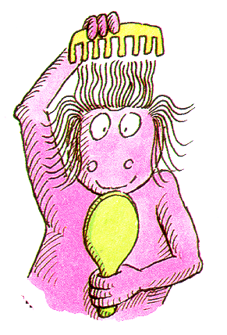

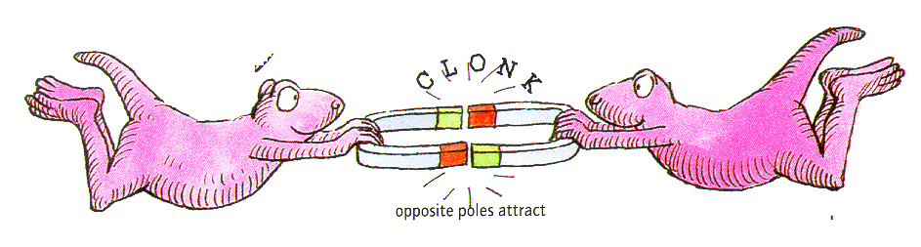
Non Contact Forces
Weight
Static Electricity
Magnetic force

Slide 36
What type of force can you think of?
Non- Contact Forces
Contact Forces
Force of Gravity (WEIGHT)
Magnetic Force
Electrical Force
Friction
Tension (Pull)
Air Resistance
Applied Force (Push)
Spring Force (Twist)
http://www.physicsclassroom.com/class/newtlaws/u2l2b.cfm

Slide 37
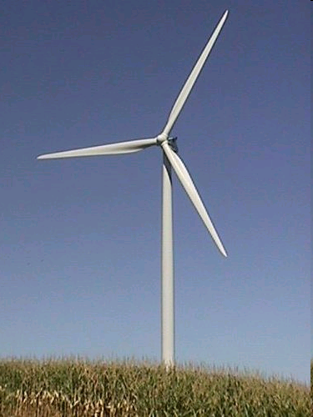
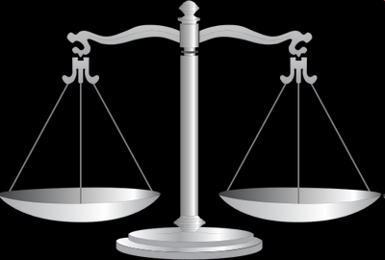
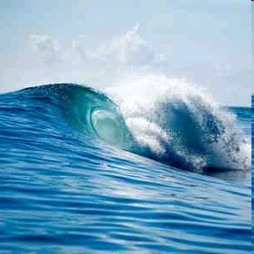
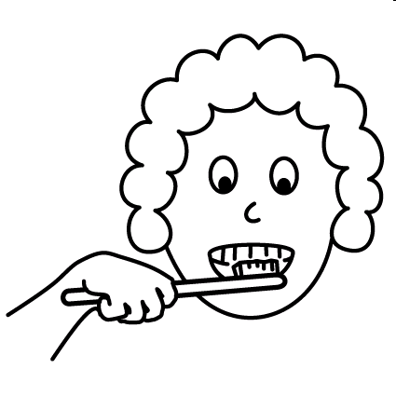
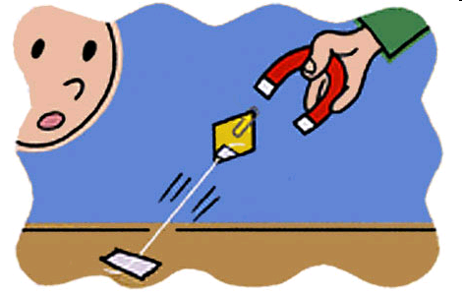
WHAT CAUSES THESE FORCES?

Slide 38
Activity: Write out which force fits with each picture
Use the white board and write the force that acts on the picture and state whether they are CONTACT or NON CONTACT
Weight Air resistance Pull
Upthrust Friction
Water resistance Push

Slide 39
Weight

Slide 40
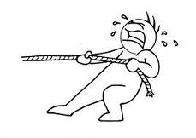
PULL

Slide 41
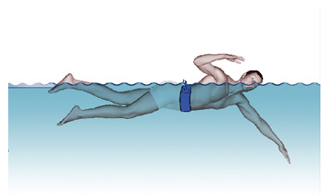
PULL
Water Resistance

Slide 42
Air
Resistance

Slide 43
FRICTION

Slide 44
Upthrust

Slide 45
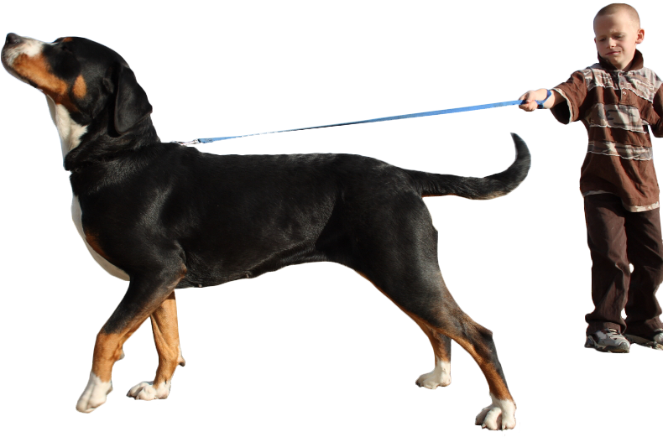

Slide 46
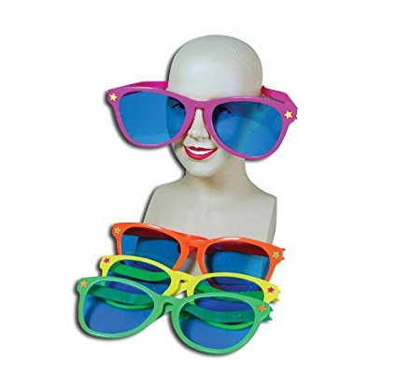
FORCES
Specs!

Slide 47
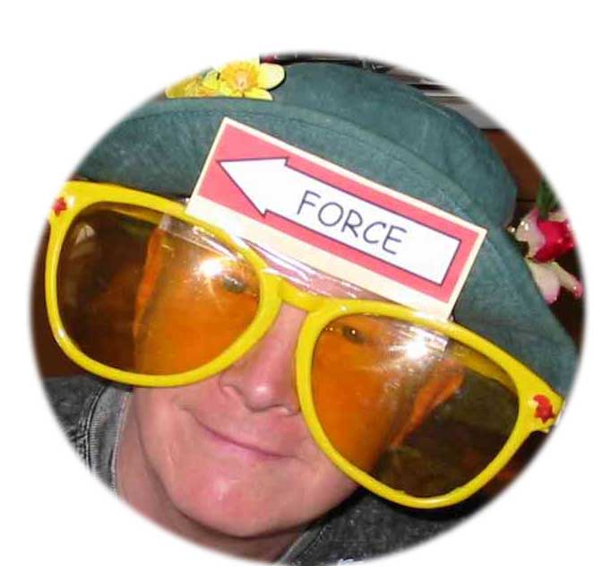
FORCES SPECS
View forces through the special Forces Specs!

Slide 48
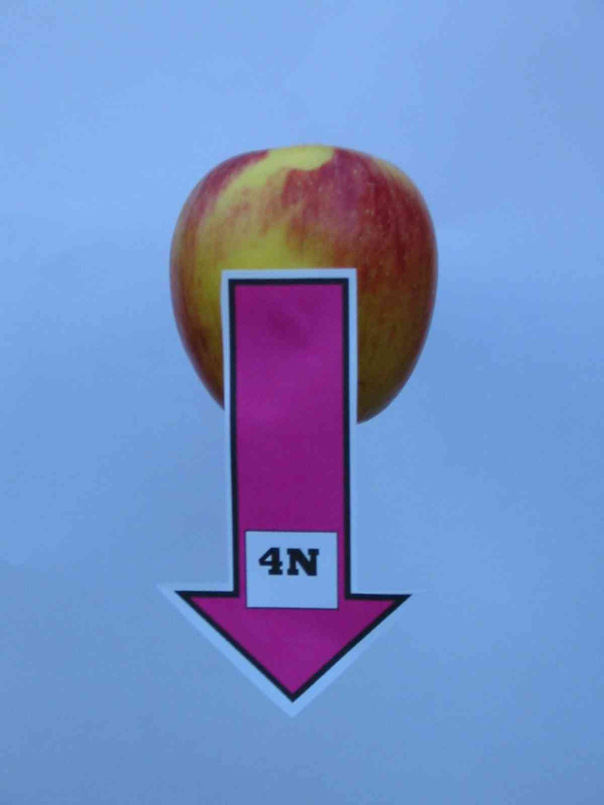
If forces came ready-labelled science might be easier.
1.1

Slide 49
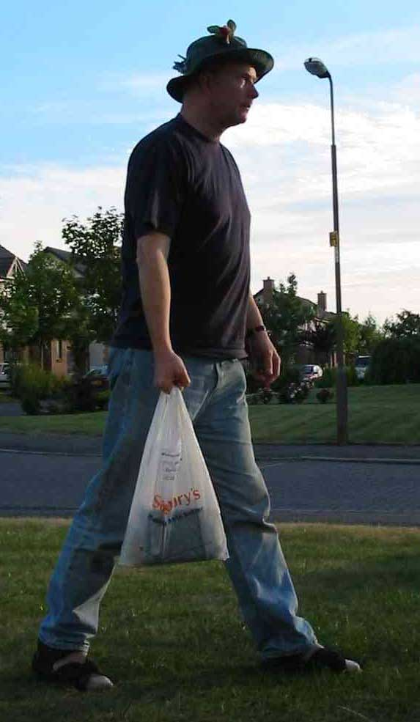
A shopper carries his shopping home.
How does this situation appear through forces spectacles?
1.2

Slide 50
There are forces acting everywhere. Here are just a few of them.
1.3

Slide 51
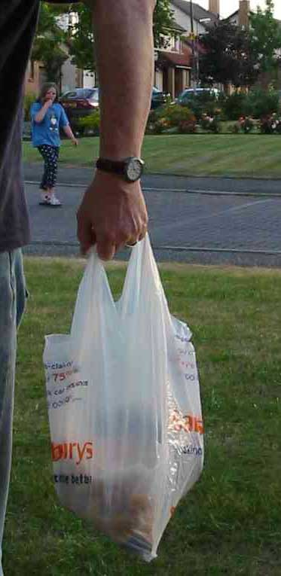
Let’s consider the forces acting on the hand.
Can you identify the forces which act on the hand?
1.4

Slide 52
A support force from the arm muscles acts on the hand
A force (the weight of the bag) acts on the hand
1.5

Slide 53
Now consider the forces acting on the shopping.
1.6

Slide 54
The simplest model shows the shopping as a single mass.
1.7
The stretched plastic bag supports the shopping with an upward force.
The Force of Gravity acts on the shopping with a downward force.

Slide 55
Measuring FORCES?

Slide 56
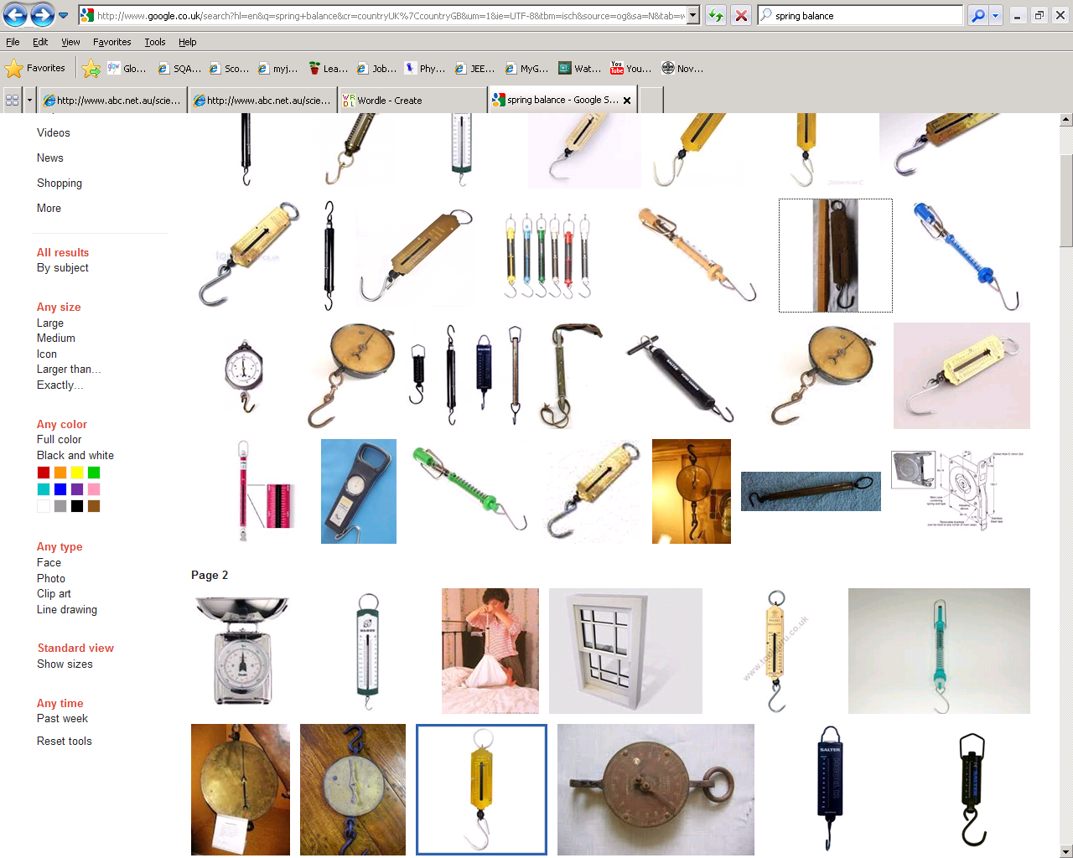
Measuring forces
We can use one of the effects of a force to measure forces.
This is called HOOKES LAW

Slide 57
Hookes law

Slide 58
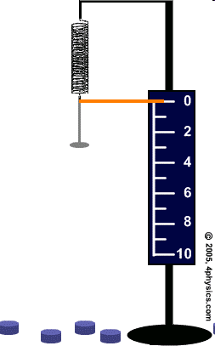
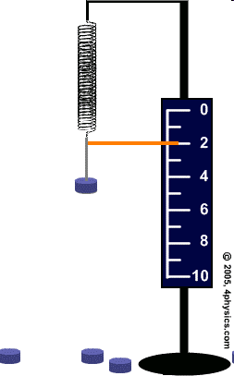
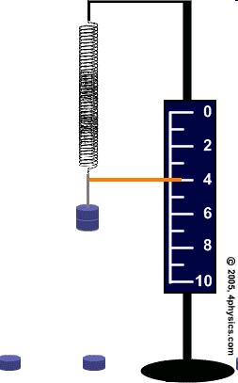

Slide 59
Procedure
Hang a spring from a clamp stand make sure it cannot fly off.
Clamp the metre stick vertically in the clamp, alongside the spring.
Record the metre rule reading level with the bottom of the spring. The number of masses hanging from the spring is 0 and the extension of the spring is 0 cm.
Hang a mass hanger from the bottom of the spring. Record the new metre stick reading, the number of masses (1) and the extension of the spring.

Slide 60
Procedure
Repeat this for 5 masses
Plot the number of masses on the horizontal axis, since it is the input (or independent) variable. The extension of the spring is the output (or dependent) variable and you should plot it on the vertical axis.

Slide 61
extension
Repeat the experiment with sweet laces and see if the experiment gives the same results.
DO NOT EAT THE LACES!
AVOID SUGAR COATED LACES

Slide 62
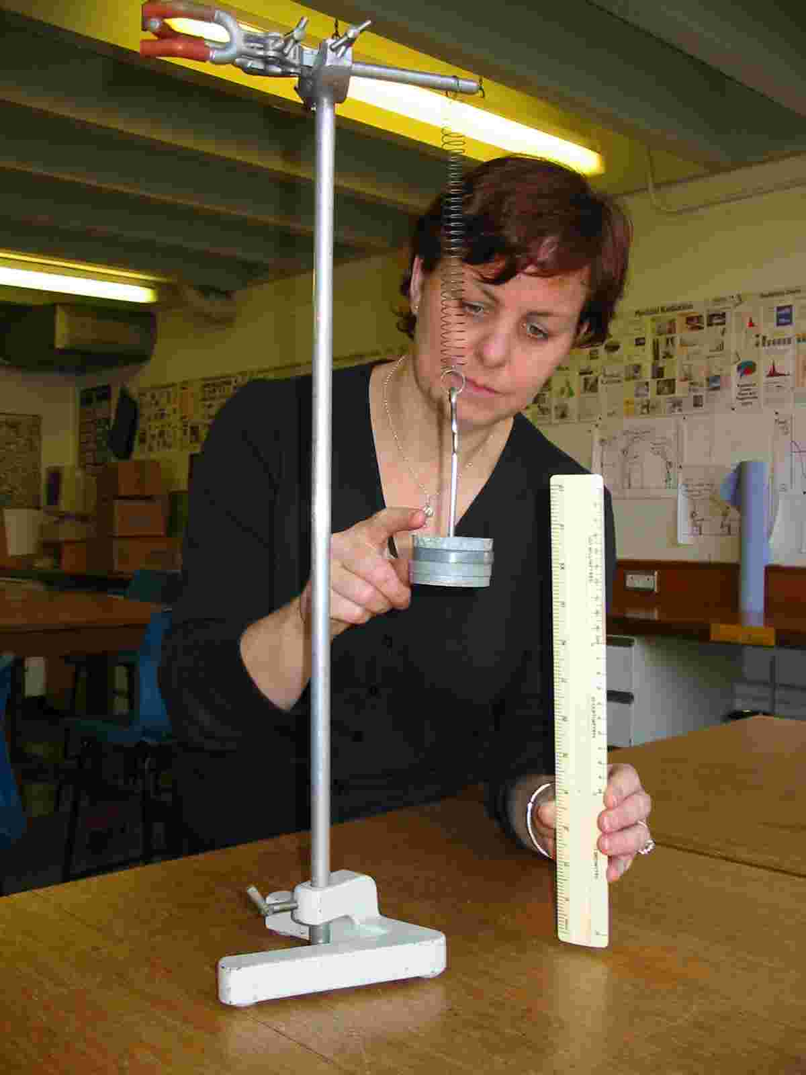

The spring exerts a force upwards on the mass.
The Force of gravity exerts a force downwards on the mass.
1.9

Slide 63
Homework: Spring experiment
Weight | Extension (cm)
(N) | Spring 1 | Spring 2
0 | 0.0 | 0.0
1 | 2.4 | 1.7
2 | 4.8 | 3.4
3 | 7.2 | 5.1
4 | 9.6 | 6.8
5 | 12.0 | 8.5
6 | 14.4 | 10.2
7 | 16.8 | 11.9
8 | 19.2 | 13.6
9 | 21.6 | 15.3
10 | 24.0 | 17.0
This data is in the homework sheets. Draw a graph using the data in this table so you will be able to compare the two springs.

Slide 65
HOOKE’S LAW CONCLUSION
Double the force and you double the stretch.
Hmm- we can use this!

Slide 67
Chart wizard
Title
Key:
object 1
object 2
object 3

Slide 68
OK, let’s consider the forces acting on the mass. Look through forces spectacles and simplify this situation.

Slide 69
model
The two forces act on the mass. They have a cancelling effect and the result is a mass ‘in equilibrium’.
This is as simple as the modelling process can get.
reality
1.10

Slide 70
Spring balance / newton meter

Slide 71
The instrument for measuring forces is the Newton Balance, spring balance or Forcemeter.
Forces are measured in units of NEWTONS (N)

Slide 72
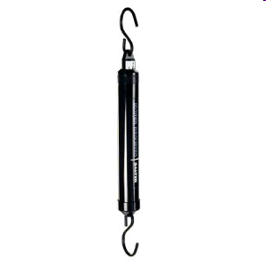
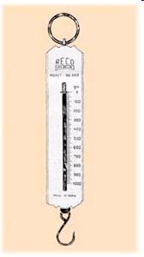
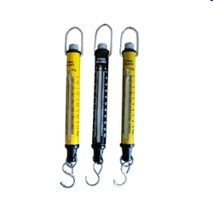
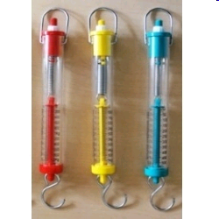
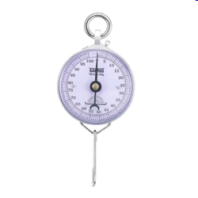
Newton Balance, spring balance or Forcemeter

Slide 73
Measuring WEIGHT/ FORCE

Slide 74
WEIGHING really is FINDING YOUR WEIGHT!
When we “weigh” something, either hanging an object from the scales or placing the object on a scale, we are actually measuring the force of gravity on that object. The object is pulled down by the Earth and we measure that force. HOWEVER we record the answer in units of MASS.
The following experiment shows you how!

Slide 75
Weight and mass – what’s the link?
In this experiment, you’ll find out the link between weight and mass
Copy the table below to record your readings.
Hang different masses from newton balances.
Record the weight from the newton balance.
Mass hung on newton balance (kg) | Weight on newton balance (N)
0.1
0.2
0.3
0.4
0.5
0.6

Slide 76
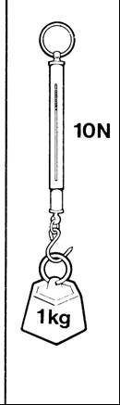
Weight is a force which is caused by the pull of gravity.
You have found that on Earth the pull of gravity on a kilogram is about 10 newtons.
The weight of 1kg is 10 N
The ratio of weight to mass is given the symbol g
  g = 10 N/kg

Slide 77
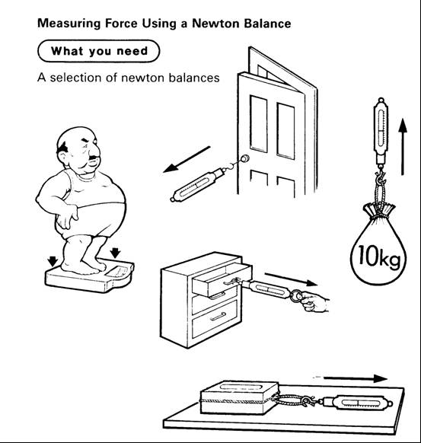
Measuring forces-- Using a NEWTON BALANCE to measure Forces.
Find the force to lift your bag
Find the force to open a door /drawer / zip /
Find the force to pull the toy cars.
Record your results in a table

Slide 78
MEASURING FORCES –use these or find some of your own
TASK | Predicted force | Measured force
 | (N) | (N)
Lifting a school bag
Opening a door
Pulling up a zip
Opening a cupboard
starting a planned moving
pulling an empty shoe

Slide 79
Estimating the size of FORCES?

Slide 80
Estimating forces
Match these different situations to the most likely force.
Write these nos. in your jotter
Choose from:
0.1 N
2 N
20 N
650 N
1800 N
10,000 N
1,500,000 N
200,000,000 N
e.g PULLING A TRAIN

Slide 81
0.1 N , 2 N , 20 N, 650 N, 1800 N , 10,000 N, 1,500,000 N, 200,000,000 N
How much can an ant lift?
Force =
Engine force in a sports car
Force =
Weightlifter
Force =
Lifting your own weight
Force =
Space Shuttle engines
Force =
Force to keep a small bird in the air
Force =
Weight of a chicken
Force =

Slide 82
Measuring MASS and WEIGHT
Use scales to measure the MASS of some SMALL objects
Now use a spring balance to find the weight of the same objects.
What conclusion can you make about an object’s weight compared to it’s mass?

Slide 83
Write your results into a table like this:
Object | Mass (kg) | Weight (N)
Egg Pencil case

Slide 84
Weight not gravity
Mass and Weight- LEVEL 3/4

Slide 85
What’s the difference? Mass and Weight- LEVEL 3/4
What’s the difference?
We often say things like:
“My weight is 55 kilograms”
“This bag weighs 2 kilograms”
The problem is, we’re using the wrong word – at least as far as Physics is concerned.

Slide 86
CONFUSING NOTES- Level 3/4
WEIGHT & MASS causes problems in the lab.
What you call your weight, measured in kilograms should really be called mass. This can be confusing.
All we ask is that when you are being scientific try to remember that it is mass that is measured in kilograms.
This is like the confusion that happens when you use the word battery to mean cell.

Slide 87
Weight is a force which is caused by the pull of gravity.
You have found that on Earth the pull of gravity on a kilogram is about 10 newtons.
The weight of 1kg is 10 N
The ratio of weight to mass is given the symbol g
  g = 10 N/kg

Slide 88
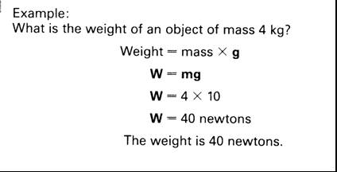
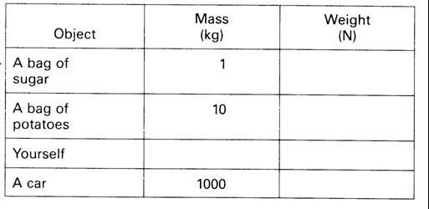

Slide 89
Practice Questions
A bag of sugar has a mass of 1kg, what is the weight?
A bag of potatoes has a mass of 5kg, what is the weight of the potatoes?
A loaf of bread has a mass of 0.5kg, what is its weight?
An apple has a weight of 1N, what is the mass of the apple?

Slide 90
Practice Questions
A small car has a weight of 8000N what is the mass of the car?
What is the mass of a small S1 pupil who has a weight of 450N?
What is the weight of Ruaridh’s pen if it has a mass of 200g

Slide 91
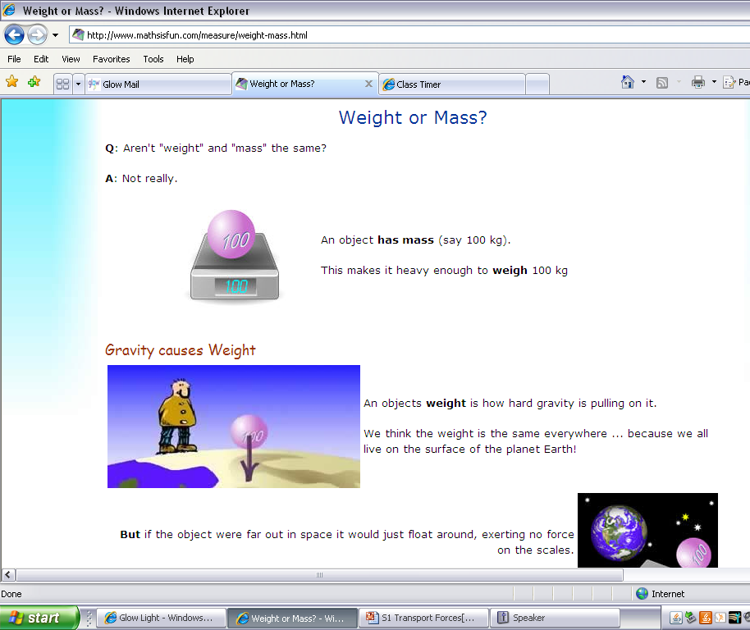
Losing – and gaining – weight
://www.mathsisfun.com/measure/weight-mass.html

Slide 92
Weight and Mass –
This is still the pull of the Earth
Making the 1kg mass stay on the scales.
The scales are calibrated to take this force and display a value 10 times LESS than this Force
The Earth is pulling the mass downwards giving it weight. The spring balance displays units of Force
1 Kg
a WEIGHT of 10N

Slide 93
Measuring force & Weight
What causes weight?
What is the relationship between weight and mass?
Would this be different on other planets?
Write a formula relating weight to mass.

Slide 94
HOMEWORK/ RESEARCH
a) Find out about some aspect of space travel. For example training astronauts, eating in space etc.
OR
b) Find out more about gravity. For example, what causes it, does it change on other planets, what are black holes.
OR
c) Try to describe a room or an activity without gravity. (ignore the lack of air)

Slide 95
SUMMARY
Weight is the force due to gravity on an object.
An object with a very large mass, e.g. the Earth, the moon, pulls other objects egg humans, towards it. This pull is called the force of gravity or WEIGHT.

Slide 96
TRY THESE EXAMPLES- What to do –Level 3
In these sentences, the underlined words are wrong. Rewrite the sentences and correct the mistakes.
My weight is 50 kilograms.
Mass is caused by the pull of the Earth.
Because mass is a force, it is measured in kilograms.
This box has a mass of 70 newtons.

Slide 97
What’s the difference? Level 3/4
Mass is the amount of stuff that makes up an object. It’s measured in kilograms.
Weight is the force of gravity acting on an object. It’s caused by the Earth pulling down on the object. Because weight is a force, we measure it in newtons.
Mass is measured in kilograms.
Weight is force caused by the pull of the Earth. It is measured in newtons.

Slide 98
Losing – and gaining – weight
People often say they want to lose weight. What they really mean is that they want to lose some of their mass.
One of the best ways of losing weight is to travel to the Moon. This is because the Moon’s gravity is weaker, and doesn’t pull you down with such a big force. This is why astronauts on the Moon can jump quite high, even though they are wearing big spacesuits.
What other things would be easier on the moon and are there any other forces that would be different?

Slide 99
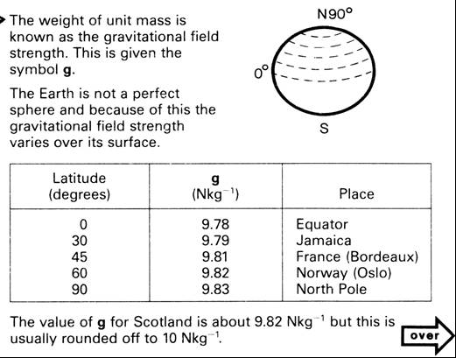
GOING FURTHER LEVEL 4/5

Slide 100
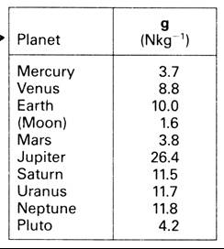
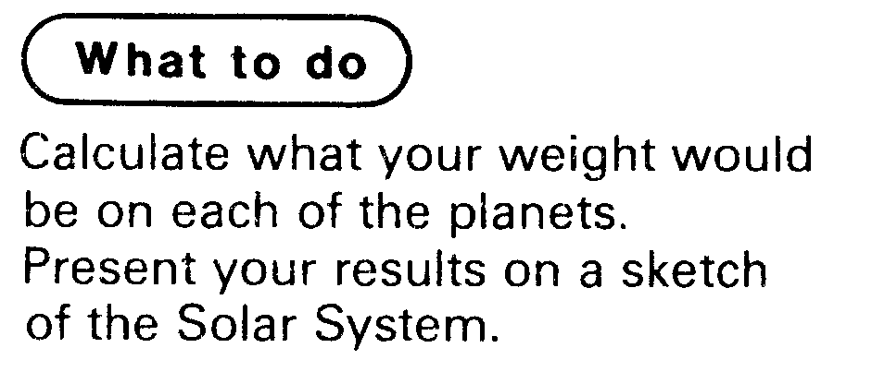
GOING FURTHER LEVEL 4/5
Other planets also have gravitational fields which exert forces.
The gravitational field strength at the surface of some objects in our solar system are shown in the table.

Slide 101
Losing – and gaining – weight
But when you’re on the Moon, your mass doesn’t change. Remember, mass is the amount of stuff there is in you – travelling to the Moon doesn’t change that.
://www.mathsisfun.com/measure/weight-mass.html

Slide 102
WHAT YOU THOUGHT

Slide 103
Revision quiz
1. What three things can forces do?
2. What unit are forces measured in?
3. Who is the unit named after? Give his full name.
4. What do you measure forces with?
5 What force is needed to lift an apple – 1 N, 20 N or 100 N?
6. Is mass or weight measured in kilograms?
7. Weight is a force. This means it is measured in:
8. What causes weight?
9. If you travel to the Moon, does your mass change?
10 If you travel to the Moon, does your weight change?

Slide 104
Revisions quiz -
My score out of 18: _____
On which planet is your weight greatest?
How many newtons of force are there caused by Earth, for each kilogram of mass?
A dog has a mass of 7 kg. What is its weight?
A girl has a mass of 42.5 kg. What is her weight?
A train has a mass of 12,500 kg. What is its weight?
A bag has a mass of 500 grammes. What is its weight?
What’s wrong with these sentences?
  “The bag of apples “weighs 3 kg.”
  “In deep space, astronauts have no mass.”

Slide 105
friction

Slide 106
Friction
Friction is a very specific type of force which opposes motion. There are many types of friction, but all are caused by a moving object rubbing against something else. Frictional forces will always act in the opposite direction to the direction of motion.

Slide 107

Air friction/ resistance is the force of air being pushed out of the way of a moving object.
e.g. When you put your hand out the window of a moving car you feel a force pushing your hand. Be careful! DANGER

Slide 108
Air resistance
It is the force that slows things down when they are moving through air.
It pushes against a moving car or against the body of a person falling from the sky.
Go through the powerpoint on PARACHUTES (Physics)

Slide 109

Friction Surface friction
When an object is dragged across a surface, there is a strong frictional force. This is affected by the surfaces. Generally, smoother or wetter surfaces will have less friction.
E.g. Pushing a box along a carpet or along ice.

Slide 110
Friction- ANSWER THESE IN A TABLE IN YOUR JOTTER
With the person next to you
Think of two examples where we try to minimise friction.
Think of one example where we try to increase friction.
With the other people at your table…
Discuss how we reduce or increase friction in the examples you used
Can you think of any situations where an object can be moving, but not be affected by any friction?

Slide 111
LABEL THE places where there is FRICTION

Slide 112
Friction
-good or bad
02/10/2011
JAH

Slide 113

Useful or Not so useful?
Walking or running
113

Slide 114

Useful or Not so useful?
Brake pads rubbing against a wheel
114

Slide 115

Useful or Not so useful?
Using a parachute when Sky diving
115

Slide 116

Useful or Not so useful?
Gloves for goalkeeping

Slide 117

Useful or Not so useful?
Spacecraft re-entering the Earth's atmosphere making heat.
117

Slide 118

Useful or Not so useful?
Friction between a boat and the water
118

Slide 119

Useful or Not so useful?
Friction causing car tyres to become bald
119

Slide 120


Useful or Not so useful?
In all moving parts in machinery making heat
120

Slide 121
Friction good
braking
walking
space craft re-entry
running
writing
sky-diving (drag)
opening bottles
cutting things
putting spin on an object
rock climbing
steering wheel
striking matches
cats using to drink
slugs
conveyor belts
sports
sharpening knives
holding things
grip for tyres/shoes
Friction bad
sledging
skiing
ice skating????
shooting (drag slows the bullet)
snowboarding
putting on clothes (chaffing)
swimming
wears down tyres
engines wear away
slide
F1 racing !!!!
ceramic brakes!!!
in space things don’t stop easily
boats
rotating machinery slowed down and wears away

Slide 122
REDUCING FRICTION
Look at different ways to reduce Friction
  Lubricants
  Rollers
  Small ball-bearings
  Cushions of Air
Investigate

Slide 123

Try some experiments to change friction
02/10/2011
JAH

Slide 124

Try some experiments to change friction

Slide 125
Decreasing Friction
lubrication egg oil, wax, grease, soap
streamlining
more aerodynamic
reduce mass
rollers
layer of air
polystyrene beads
smooth surface
ice
water on road
LORRY BOARD
Increasing Friction
less aerodynamic
greater surface area
spoilers
increase mass
surface rough e.g. sand
gritting roads
stickier surface
rougher tyres

Slide 126
The Force of Friction
When we move one surface over another, the rough, uneven parts rub together.
This creates a force which tries to slow down or stop the movement. This force is called friction.
The smoother the surfaces rubbing together, the l _ _ _ _ the friction – Movement is
e _ _ _ _ _. The rougher the surfaces rubbing together, the h _ _ _ _ _ the friction - Movement is more d _ _ _ _ _ _ _ _.

Slide 127
Measuring Frictional Forces
Aim
To measure the force required to overcome friction on two different surfaces.
Method
A Newton balance is used to measure the horizontal force required to pull a schoolbag along a surface. The force applied is steadily increased until the bag moves.
Results Conclusion
Which surface caused the least friction?
How else do you think you could reduce friction in this case?
How could you increase it?
Surface | Force (N)
Carpet
Desk

Slide 128
Measuring friction
02/10/2011
JAH

Slide 129



Investigation on friction

Slide 130


Slide 131

Literacy Extension - Summarise this passage
Friction is the force that helps you to walk along without sliding about as if you were on ice. It is the force that resists things rubbing against each other. There is less friction between smooth surfaces so things slide easily across a polished table or on surfaces such as ice.
Rough surfaces like sandpaper will not slide together unless they are pushed hard as there is more friction. Friction is useful because it makes feet and car tyres grip the road. However, it can be a nuisance in machines where the moving parts rub against each other and wear away the machine, such as in a bike. Oil reduces the friction and allows the touching part to move more easily

Slide 133
FRICTION and CAR CRASH TESTS
After any accident the police test the road surface to find out the COEFFICIENT of FRICTION.

Slide 134
Friction
What is friction?
Give 3 examples where it is annoying:
Give 3 examples where it is useful:
What effect does friction have on the surfaces?

Slide 135
Weight

Slide 136
FORCES as a VECTOR
02/10/2011
JAH

Slide 137
Forces
Two things make up a force
1. its size, how strong a push or pull is, and
2. its direction, which way it pushes or pulls.
We draw forces as arrows.
1. The length of the arrow shows how strong the force is and
2. The way it points shows the direction of the force.

Slide 138
What do forces do?
Here is my object
The size of the arrow represents the size of the force.
We apply a force
This object has a bigger force acting on it.
HOW WILL WE CHANGE WHAT WE SEE?
If we want the object to slow down again, we need to apply a braking force in the opposite direction.

Slide 139
BALANCED & Unbalanced FORCES?

Slide 140
For the effects of a force to be seen the forces must be unbalanced.

Slide 141
Balanced Forces
Forces are balanced if they are the same size but in opposing directions:
40N
40N

Slide 142
Unbalanced Forces
When forces working in opposite directions are unequal they are unbalanced:
Which direction will the box move?
100N
20N

Slide 143
Resultant Force
If two forces are unbalanced there is a resultant force.
It could replace all the others to give the same effect.
The difference between two forces is the resultant force.

Slide 144
What is the resultant force?
Hint: work out the difference between the two forces.
The resultant force is 100N – 20N = 80N
100N
20N

Slide 145


