Slide 1

Energy and Sound
Physics 2

Slide 2
Lesson 1
Introduction

Slide 3
Learning intentions
By the end of this lesson I can..
Define what energy is
State the unit of energy
Give examples of the different forms of energy
Discuss the conservation of energy

Slide 4

Energy
What is energy?
What unit is energy measured in?
Watch the film on TWIG to find the answers
twigonglow/ forms-of-energy

Slide 5

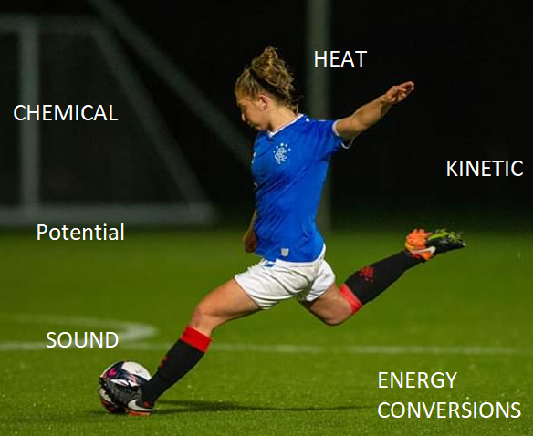
What is energy?
Energy is allows us to get jobs done, or make things work.
To get a job done, energy must be transferred from one form to another.
Former pupil Ellis Dalgleish

Slide 6
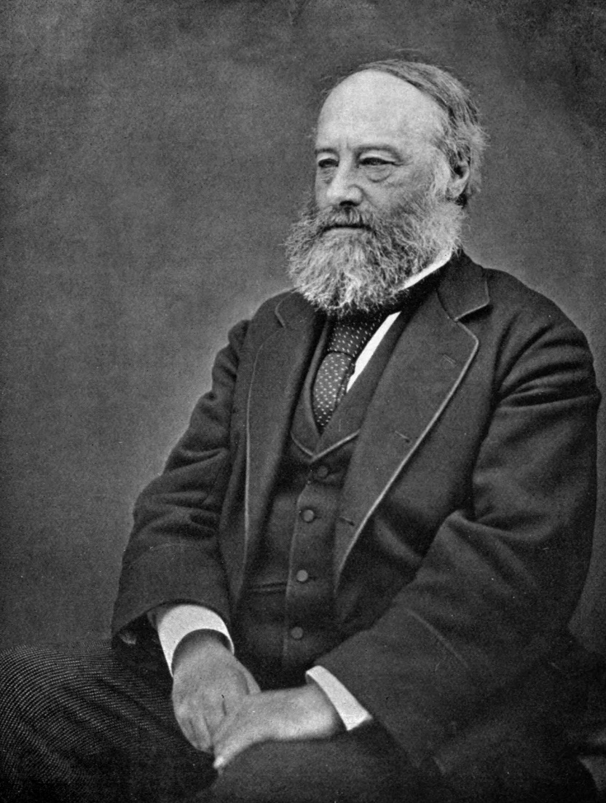
Units
Energy is measured in units called JOULES (J)
They are named after the famous scientist called James Prescott Joule, a Physicist and Brewer.
By Henry Roscoe - The Life & Experiences of Sir Henry Enfield Roscoe (Macmillan: London and New York), p. 120, Public Domain, https://commons.wikimedia.org/w/index.php?curid=3119134

Slide 7
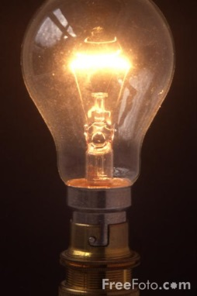
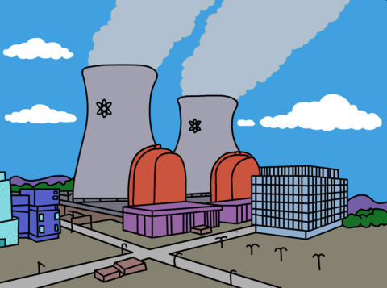



Forms of energy
Write down as many forms of energy as you can remember from the video clip
Video - energy transformations roadrunner

Slide 8
Two groups
allow things to happen
Kinetic (movement)
Light
Heat
Sound
Electrical
Waiting to happen
POTENTIAL ENERGY (store)
Gravitational
Elastic /Strain
Chemical

Slide 10

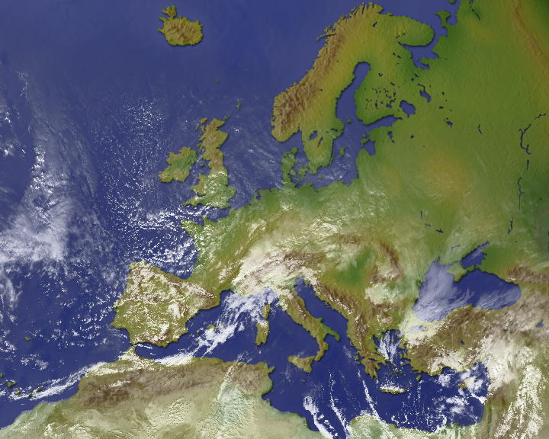
Energy crisis
Hypothesise/ Express view
Have you heard people talking about the Energy Crisis?
It concerns us all.
But there is EXACTLY the same amount of energy now as there was at the beginning of life on Earth.
Can you think of a reason these two statements seem to be in conflict?

Slide 11
Energy crisis
People talk about the ‘energy crisis’ as energy is being transferred into different forms – e.g. as heat. We are running out of fossil fuels to be used as an energy source and these are being burnt.
In this example, the energy has been transferred from chemical potential energy (as the fuel) to heat energy (to make steam for the turbines) .

Slide 12
Energy law
There is exactly the same energy in the Universe as the start of the world. We say there is an energy crisis as we are using up useful energy and transferring into less useful forms. Eventually it will all become heat.
Energy is converted or transferred it is never lost!

Slide 13
Homework
Due date __/__/2019
Create a cover page for the Energy and Sound topic

Slide 14
Exit questions
What are the units for energy?
What is energy needed for?
Name 4 different forms of energy
What is the law of energy? (can it be created?)

Slide 15
Lesson 2
Energy transformations

Slide 16
Learning Intentions
By the end of this lesson you should be able to…
Give examples of energy transformations in common household objects
Suggest where energy may be lost in these transformations

Slide 17

Forms of energy
A phone takes in electrical energy and turns it into sound and light energy.
So, the energy change in a phone is:
Electrical → Sound + Light + Heat

Slide 20
Energy circus
All practical activities
Complete the activities in the energy circus
Write the energy transfer for each activity

Slide 21
Does the energy all get transferred?
Think of a racing car. Do you think all of the stored energy in the fuel is transferred into kinetic energy?
If not, what form might this energy take?

Slide 22
Here is a picture of a racing car. In the diagram 100 Joules of energy is stored in the fuel. This produces 30 Joules of energy to move the car forward. This means 70 Joules of energy has been wasted as heat. We can represent this in a diagram
100 J 30 Joules kinetic energy
potential energy
in fuel 70 Joules heat

Slide 23
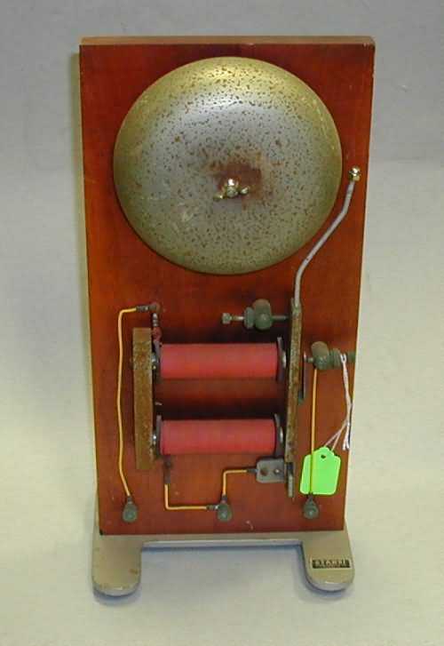
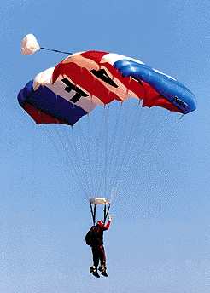
Energy Transfers (continued)
More examples –
Electrical Bell
→ +
Parachutist
→ +

Slide 24
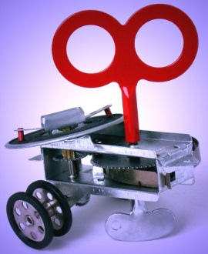
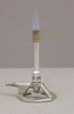


Energy Transfers (continued)
Write out energy transfer diagrams for the following
situations, clearly showing what energy types are wasted in the transfer.
Clockwork toy
Bunsen Burner
Vacuum cleaner
Clapping hands

Slide 25
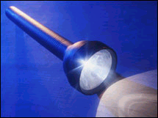
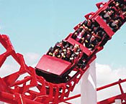
Energy Transfers (continued)
Energy transfers can have many stages too. A torch is a good example.
→ → + ( )
(battery) (wires) (lamp)
Roller coasters have lots of transfers too.
→ → +
(winch) (at top) (moving cars)

Slide 26
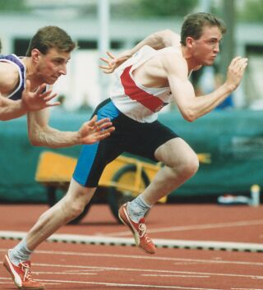
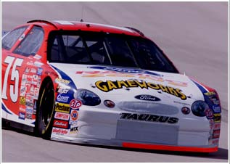
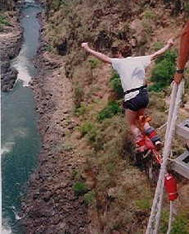
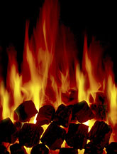
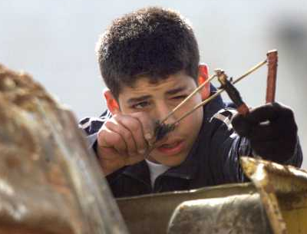
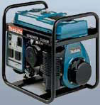
Energy Transfers (continued)
Draw energy transfer diagrams for the following situations
runner racing car bungee jumper
coal fire catapult generator

Slide 27
When energy is not useful
Often energy can be converted into a form that is not very useful
This less useful form is often heat via friction, for example when bouncing a ball

Slide 28
Exit questions
What is the energy transfer in a clockwork toy?
What would the energy transfer be in a game of snooker?
What way is energy often ‘wasted’

Slide 29
Lesson 3
The Steam Engine

Slide 30
By the end of this lesson you will be able to..
State the energy transfers in a steam engine
Identify the energy transfers in other machines

Slide 31
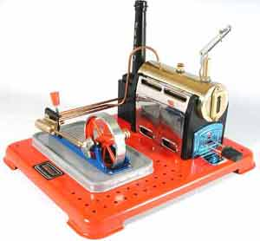
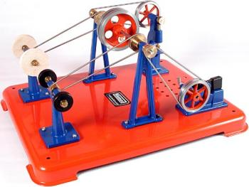
The Steam Engine
Risk Assessment

Slide 32
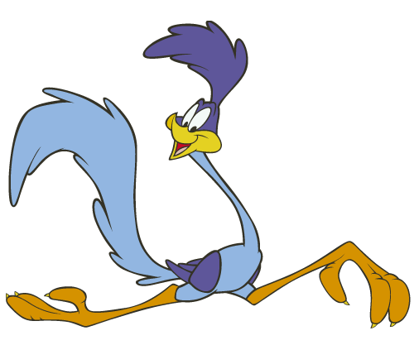
Energy transfers in cartoons
Watch the youtube video showing energy transfers with Roadrunner and Wile E. Coyote
https://www.youtube.com/watch?v=IHrUXyTCr8Y

Slide 33
Machines
Copy and complete this table to show the energy transfer that takes place in different machines
Machine | Energy Change
Power Station
Catapult
Loudspeaker
Toaster
Bulb
Car
Human

Slide 34
Machine | Main Energy Change
Power Station | Nuclear/Chemical To Electrical
Catapult | Potential to Kinetic (+ sound)
Loudspeaker | Electrical to Sound (+ heat)
Toaster | Electrical to Heat (+ light)
Bulb | Electrical to Light (+ heat)
Car | Chemical to Kinetic (+ heat, sound, etc)
Human | Chemical to Heat + Kinetic + Sound

Slide 35
Homework
Due date __/__/2019
Complete the Energy Efficiency Homework task

Slide 36

Exit questions
Name the first energy form in a steam engine (from the fuel)
What tasks can be completed with a steam engine
In cartoons when a character runs off a cliff, what is the energy transformation?

Slide 37
Lesson 4
Introduction to Waves

Slide 38
Starter – Bingo
Create a 3x3 Bingo grid containing 9 of the following words:
Waves gravitational sound
Electrical nuclear kinetic
light
Heat Joules chemical
energy

Slide 39
By the end of this lesson you should be able to..
State the two types of waves
Give examples of the two types of waves
Use the correct words to describe waves

Slide 40
What are waves?
What is a wave?
How do you describe waves?
Watch the films on Brainpop to find the answers
brainpop waves
Brainpop sound

Slide 41
Transverse and longitudinal

Slide 42
Transverse waves
Longitudinal waves
The particles move up and down – at right angles to the direction of the waves
This video shows a military drill that shows a transverse wave – the soldiers white hats move up and down, but the wave travels side to side – think TRANSverse like the soldiers in TRAINing (a bit of a tenuous link)
The particles move side-to-side in the same direction as the wave

Slide 44
Describing waves
crest
axis
trough

Slide 45
Wave definitions
Crest: top point of a wave
Trough: bottom point of a wave
Wavelength (λ): crest to crest or trough to trough
Amplitude: distance from zero position (axis) to crest

Slide 46
We know all waves…
Carry energy
Are transverse or longitudinal
All have crests, troughs and an amplitude

Slide 48
Exit questions
What are the two types of wave?
What kind of wave is a sound wave?
What kind of wave is a light wave?
What is wavelength?
What is amplitude?
What is a crest?
What is a trough (of a wave)?

Slide 49
Lesson 5
Sound waves

Slide 50
By the end of this lesson you should be able to…
Explain what sound is
Identify the type of wave sound is

Slide 51
What is sound?
Watch the films on Brainpop to find the answers
Brainpop sound

Slide 52
Speed, Distance and time
Watch the youtube video to show how to set out questions in Physics
https://www.youtube.com/watch?v=u7akhlAS5Ck

Slide 53
IESSUU
Information
Equation
Substitution
Solution
Units
Underline
This is used from S1 to Advanced Higher

Slide 54
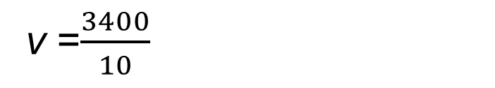
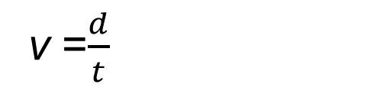
Example
A sound wave travels 3400m in 10s. Calculate the speed of the sound wave.
v =$\frac{d}{t}$
a
v = ?
d = 3400m
t = 10s
I
E
S
S
U
U
a
a
v =$\frac{3400}{10}$
a
a
a
v = 340
m/s

Slide 55
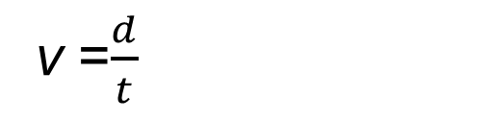
Calculating the speed of sound
We use the formula:
v =$\frac{d}{t}$
Where:
v = speed (measured in m/s)
d = distance (measured in m)
t = time (measured in s)
The speed of sound in air is 340 m/s

Slide 56
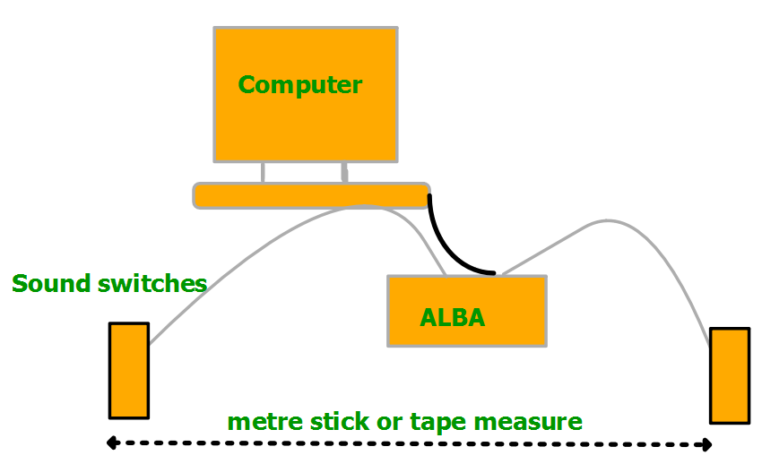
Measuring the speed of sound
ALBA

Slide 57
Practice questions
There are practice questions on page 7 of the homework booklet

Slide 58
Exit questions
What are the units for speed?
What are the units for distance?
What are the units for time?
What equation do we use to calculate the speed of sound?
What is the speed of sound in air?

Slide 59
Lesson 6
Speed of Sound experiment outside

Slide 60
By the end of this lesson you should be able to …
Complete an experiment measuring the speed of sound
Discuss what measurements must be taken
Plan a safe experiment
Discuss why the result found may not match the accepted value for the speed of sound

Slide 61
Measuring the speed of sound
Planning
In your tables discuss an experiment to measure the speed of sound. Think about:
What you need to measure
How will you measure it?
What equipment might you need?

Slide 62
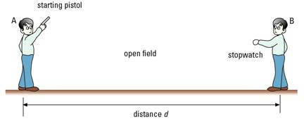
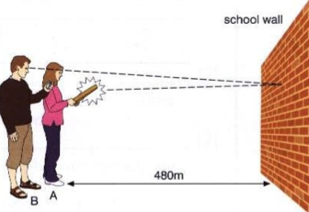
Experiment- measuring the speed of sound in air
Balloon popped
Remember:
Start the timer when you see the pupil make the sound
Stop the timer when you hear the sound

Slide 63
Experimental write up
Write this experiment up as a scientific report. Remember to include:
Aim: what were you trying to investigate?
Hypothesis: what did you expect to happen? (remember the speed of sound is 340 m/s)
Diagram: a labelled diagram of the experimental set up
Method: what you did (include the variables kept constant)
Results: what did you find? (this should have a v = d/t calculation)
Conclusion: Did your results match 340m/s? if not, why not?

Slide 64
Lesson 7
How do we hear?

Slide 65
By the end of this lesson you should know…
How humans can hear
What range humans can hear
The danger level for human hearing

Slide 66
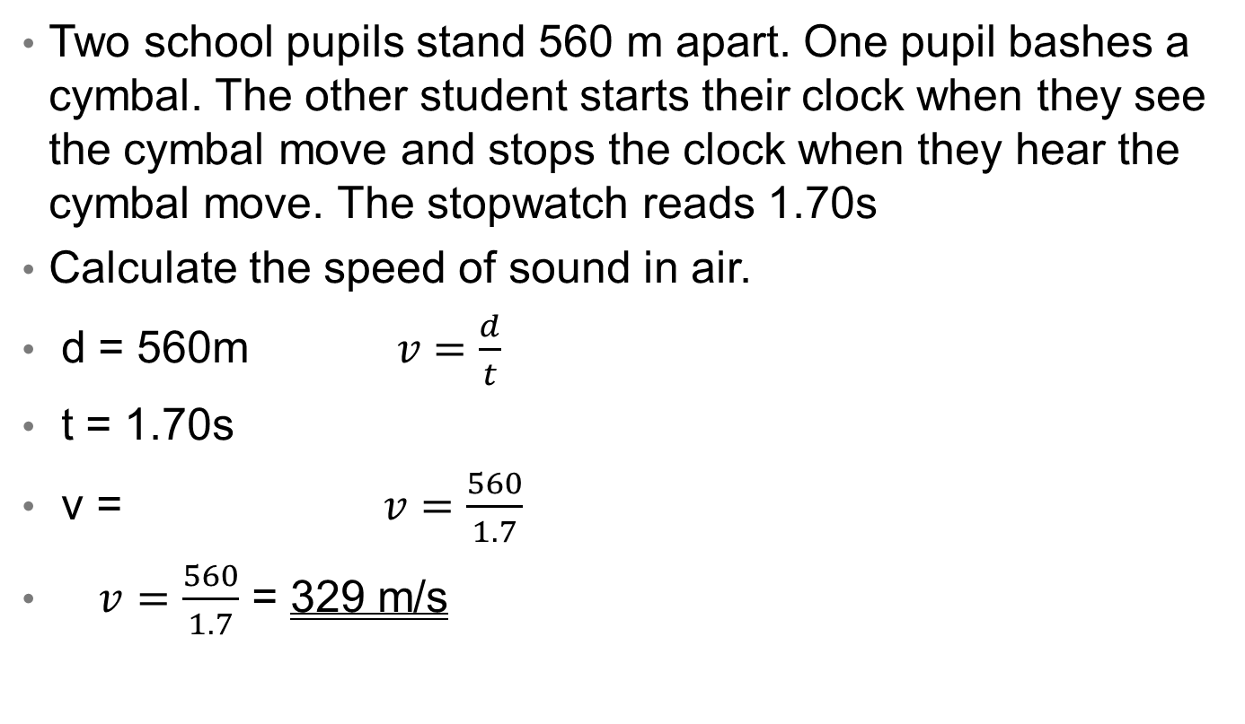
Example
Two school pupils stand 560 m apart. One pupil bashes a cymbal. The other student starts their clock when they see the cymbal move and stops the clock when they hear the cymbal move. The stopwatch reads 1.70s
Calculate the speed of sound in air.
d = 560m$v=\frac{d}{t}$
t = 1.70s
v = $v=\frac{560}{1.7}$
$v=\frac{560}{1.7}$ = 329 m/s

Slide 67
What can sound travel through?
Sound can travel through:
Solids
Liquids
Gases
But it CANNOT travel through a vacuum.
What do you think sound travels best through?

Slide 68

Sound in a vacuum
Sound cannot travel in a vacuum
‘In space, no one can hear you scream…’
Watch the video to see what happens when the air is removed in a bell jar
Bell Jar Experiment

Slide 69
How we can hear..

Slide 70
Range of human hearing
Humans can hear sounds between 20Hz and 20,000 Hz.
Some animals can hear frequencies higher than these – can you think of an example?
Range of human hearing test- put your hand up when you start to hear the signal and put it down when you cant.
https://www.youtube.com/watch?v=qNf9nzvnd1k

Slide 71
What did you notice..
About how much you could hear compared to your teacher
About the wavelength of the waves as the frequency (pitch) increased?

Slide 72

For next time…
If you can, download an app on your phone that will measure decibel level
DeciBel is a good one

Slide 73
Exit Questions…
Which state of matter does sound travel fastest through?
What can sound NOT travel through?
How can we hear?
What range of frequency can humans hear?

Slide 74
Lesson 9
Volume

Slide 75
By the end of this lesson you should be able to..
State the units of volume
Know the volume at which loud sounds can damage our ears
Explain how to protect our hearing

Slide 76
What is a decibel?
A decibel (dB) is the unit used to describe the intensity of a sound
What is a decibel?

Slide 77
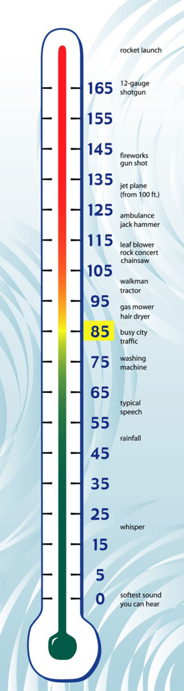
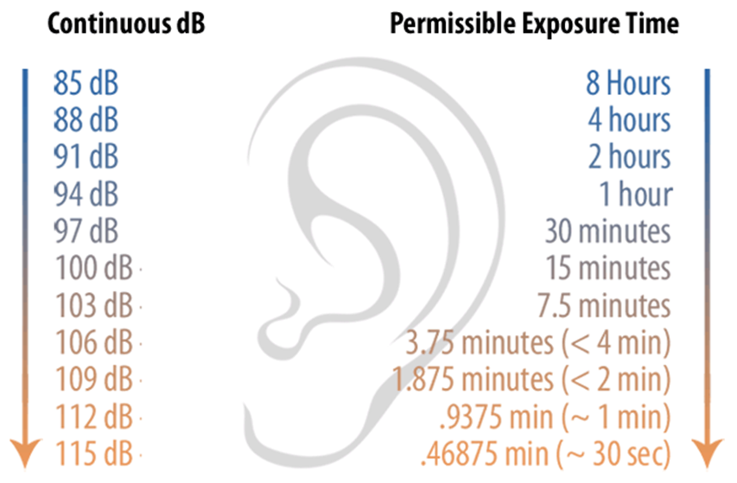

Slide 78
How loud are these sounds?
Decibel Comparison

Slide 79
Use an app to measure the sound level of certain everyday tasks
Make sure to record the distance from the source
Task | Distance (m) | Sound Level dB

Slide 80
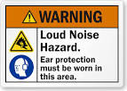


Can loud noises be dangerous?

Slide 81

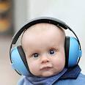
What’s the danger level?
With extended exposure, noises that reach a decibel level of 85 can cause permanent damage to the hair cells in the inner ear, leading to hearing loss.
How can we protect our hearing?

Slide 82
For next lesson…
Please take some headphones/earphones and your device that you listen to music on

Slide 83
Exit questions
What is the unit we use when describing volume?
What is the danger level that can damage our ears?
How can we protect our hearing?

Slide 84
Lesson 10
How to protect yourself from harm

Slide 85
By the end of this lesson you should be able to…
Be aware of what volume you listen to your music at
Explain why this could be dangerous (if it is over 85 dB)
Communicate how the public can protect their hearing

Slide 86
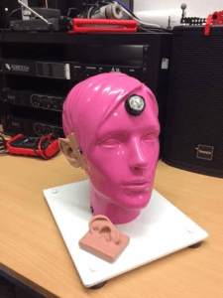
Meet Rosie…
Rosie can be used to measure the volume that you are listening to your music at
Be careful, she’s very expensive!

Slide 87
What happens if my music is too loud?
Listening to music at too high a volume can affect the hair cells in your ears.
"Repeated exposure damages your hair cells. It would be like walking on blades of grass and you step on the grass and the grass flattens, but it comes back up. And the more you do it, the more it stays down. And eventually it doesn’t come back up, so it becomes permanent.” - Michele Abrams, clinical audiologist at Southern Connecticut State University
Ear hair cell video

Slide 88
Task..
Create a poster or leaflet that you might see in a Doctor’s waiting room telling patients how to protect their hearing
Your poster should include:
How hearing works
The danger level of dB
How you can protect your hearing

Slide 89
Exit questions
What is the dangerous volume for our hearing?
How can listening to loud music damage our hearing?
How should we protect our ears/our hearing?

Slide 90
Lesson eleven
Describing sound waves

Slide 91
By the end of this lesson you should be able to…
Name the equipment used to measure sound traces
State what happens to the amplitude of a wave as the volume increases
State what happens to the frequency of a wave as the pitch increases
Draw traces for different sounds

Slide 92
Recap
Label this wave with:
Crest, trough, amplitude, axis

Slide 93
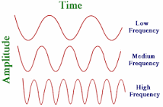
Frequency
Frequency is the number of waves per second. Frequency is measured in hertz (Hz)
The higher the frequency of the wave, the more frequently we see a wave

Slide 94
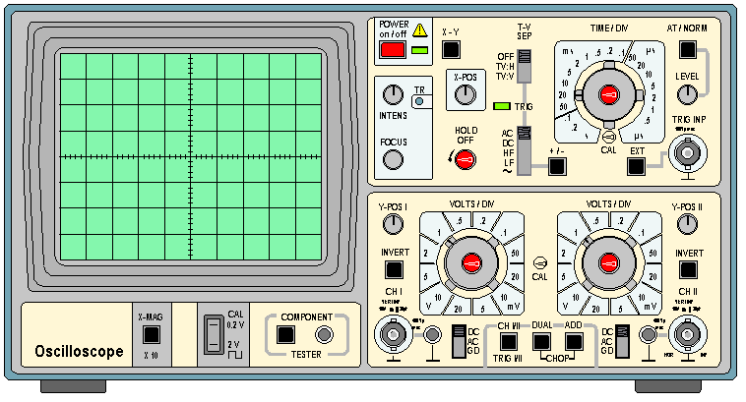
Oscilloscopes

Slide 95
We can use an oscilloscope to help get an image of sound waves.
We can also use a picoscope connected to a microphone to show the same thing as an oscilloscope

Slide 96
On your sound waves worksheet…
Draw the trace for…
Higher volume, same pitch,
Same volume, higher pitch
Speech
Waves an octave apart (What is an octave?)
Lower volume, same pitch
Same volume, lower pitch

Slide 97
In summary..
As volume increases, the amplitude of the wave increases
As pitch increases, the frequency increases
The frequency doubles when a note is played an octave higher

Slide 98
Exit questions
What is frequency?
What are the units for frequency?
What can we use to show a sound trace?
As the volume of a sound increases, what happens to the sound trace?
As the pitch of a sound increases, what happens to the sound trace?

Slide 99
Lesson twelve
The ear

Slide 100
By the end of this lesson you should be able to…
Name the parts of the ear
Explain the function of each part

Slide 101
The ear
Brainpop - The Ear

Slide 103
Ear
drum
Semi circular
canals
pinna
Small
bones
(auditory)
nerves
Cochlea
Ear canal
Tube to
throat

Slide 104
Part of Human Ear | What It Does
Pinna | Collects as many sound waves as possible.
Ear Drum | Detects sound waves by vibrating.
Stirrup, Anvil and Hammer | Amplifies the vibrations.
Cochlea | Has a liquid that vibrates which makes cilia create an electrical signal.
Auditory Nerve | Passes electrical signals to the brain.

Slide 105
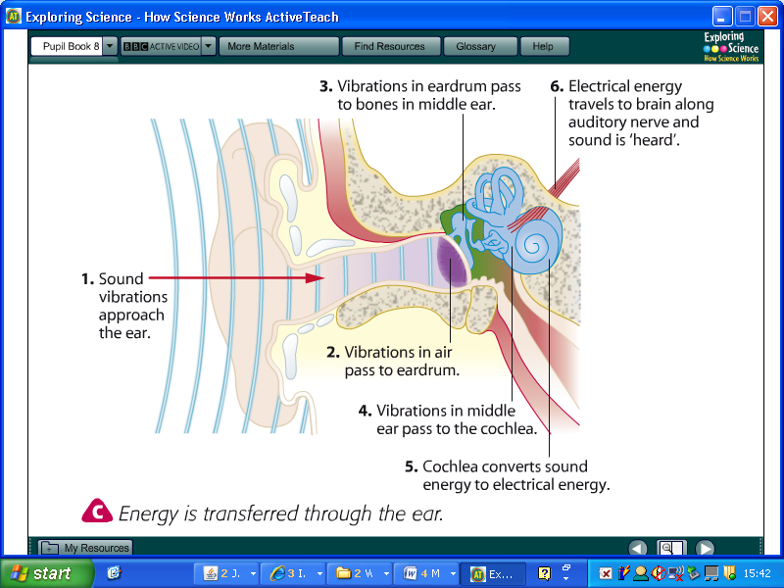

Slide 106
Exit questions
What is the pinna?
What is the name for the tube that the sound waves travel through before they reach the eardrum?
What is the name of the part that sends signals to the brain?
Name a bone in the ear

Slide 107
Lesson 13
Human Hearing vs Animal Hearing

Slide 108
By the end of this lesson you should know..
How some animals ears are different
Why this can help them hear better
How this relates to physics (as adaptations are part of biology too!)

Slide 109

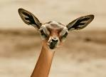


What is different about these animals?
These animals all use their large ears to help them hear. Other animals have large ears for other purposes (e.g. elephants for cooling)

Slide 110
Animal hearing
Animal Hearing video (20 mins)

Slide 111
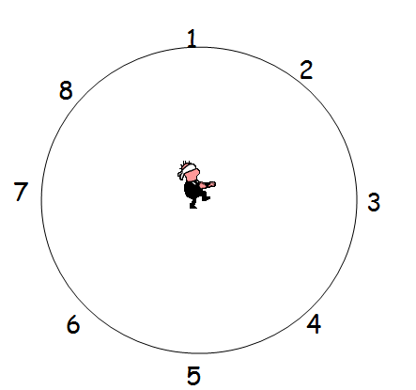
Why do we need two ears?
We need two ears to hear. We need two ears to be able to detect the direction the sound is coming from. When one ear is covered it is much harder to tell where the sound is coming from although you can still detect the sound.
Some people are better at detecting direction than others. With two ears it is still hard to detect some directions especially around the sides.

Slide 112

Think about what hand gesture someone would use to make you speak up…
WHY?

Slide 113
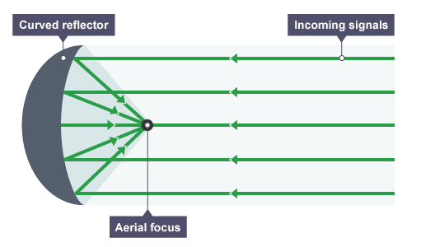
Curved reflectors
A curved reflector reflects the signal to a focus – in this case sound
This is why out ears have a vaguely curved shape, and we ‘cup’ our ears to hear better
Animals with large ears are often prey – they can use this advanced hearing to detect predators

Slide 114

Tin can phones
How do you think tin can phones work?
Use your knowledge of everything so far, including longitudinal waves and curved reflectors

Slide 115
Tin can phones
Artsy video of longest can phone
Talking causes little vibrations in the air in front of your mouth, as you can tell by speaking into your hand. When you send those vibrations into the can, they cause the back end to vibrate.
This vibration is passed along the string and into the other can. When that can vibrates, it creates vibrations in the air once again — and you can hear the other person’s voice!

Slide 116
Think of other things that might use a curved reflector
Hint: there could be one on the side of your house!
Notes:
Shaving mirrors, satellite dishes

Slide 117
Exit questions
How do humans ears compare to some animals?
Which is better for hearing?
Why do we ‘cup’ our ears to hear better?
How does a tin can phone work?

