Slide 1
LOCKERBIE ACADEMY
TRANSPORT UNIT
Part 1
S1-S3 Road Safety & PHYSICS

Slide 2
MINDMAP OF ROAD TRANSPORT MATERIAL
Velocity
Displacement
Distance
ACCELERATION
SPEED
Measuring ‘a’
Practicals
Fun &Games
The Physics
of
Car Crashes
measuring
FORCES?
INVESTIGATION
FORCES
ANALYSIS
Types of
FORCES
Studying Accidents
History of
Cars
What are
FORCES?

Slide 3
WARNING
If you have problems with learning about Physics through CAR CRASHES then PLEASE let your TEACHER KNOW a.s.a.p
car crash compilation (ouch!)

Slide 4

Too many of our former students and teachers
Have lost their lives due to traffic incidents.

Slide 5

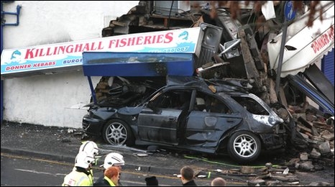
BACKGROUND
bbc news background
For an everyday activity, travelling by road is probably the riskiest thing many of us do on a regular basis.
On average, some seven people are killed every day on the roads in Great Britain. Hundreds more are injured, many of them seriously, often with life changing consequences.
In the past 10 years, the death toll has amounted to 32,298. As such road crashes are the largest single cause of accidental death for people aged between 5 and 35 years.

Slide 6
CRASH TEST VIDEOS
https://www.youtube.com/watch?v=gph2nqDWk7A
http://www.youtube.com/watch?v=AMrSxi1Ooro&feature=related
Baby seats
https://www.theguardian.com/money/video/2010/jun/18/crash-test-child-car-seats
http://www.youtube.com/watch?v=Q8gU9zzCGA8
NEWTON 1st Law
http://www.youtube.com/watch?v=8zsE3mpZ6Hw&feature=related

Slide 7



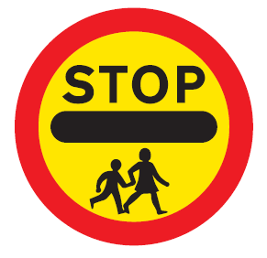


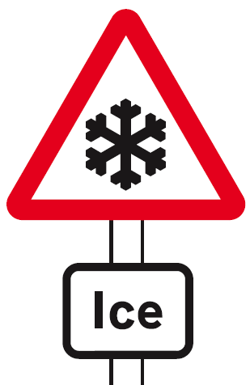


LOCKERBIE ACADEMY TRANSPORT UNIT
Notes:
All of these road signs relate to Physics in some way, whether mention of speed, force, acceleration or other physics terms. We are going to use the topic of road safety to teach you about MECHANICS. DYNAMICS and KINEMATICS (there are some big words for you to find out about)
We will use the upside down car, which we made up as our logo for this topic. It is meant to represent no road accidents here as we know about the Physics behind driving and we should know how to be safe.

Slide 8
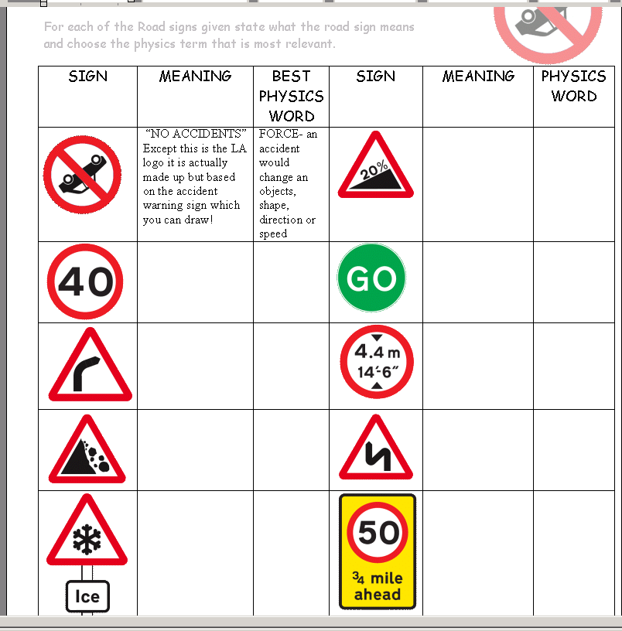
HOMEWORK
HOMEWORK
Collect one of the ROAD SIGN SHEETS
Put your name on the top
Find out what each of your road signs means.
Only fill in the “Meaning Column”

Slide 9
THINK OUT OF THE BOX!

Slide 10
There is a saying among road safety professionals that ‘the safest car is the one with a spike sticking out of the steering wheel’
Could this be true?
Are there any disadvantages to making cars safer?

Slide 11
LOCKERBIE ACADEMY
TRANSPORT UNIT
SPEED part 1
S1-S3 Road Safety & PHYSICS

Slide 12
Speed, Distance & Time
S1 Physics Transport
Back to mind map

Slide 14
LOCKERBIE ACADEMY TRANSPORT UNIT
Notes:
All of these road signs relate to Physics in some way, whether mention of speed, force, acceleration or other physics terms. We are going to use the topic of road safety to teach you about MECHANICS. DYNAMICS and KINEMATICS (there are some big words for you to find out about)
We will use the upside down car, which we made up as our logo for this topic. It is meant to represent no road accidents here as we know about the Physics behind driving and we should know how to be safe.

Slide 15





Slide 16
Speed
d
v
t
Examples using the Speed Formula (Showing full working):
1. The sprinter ran 80 metres in 10 seconds. What was his speed ?

Slide 17
LOCKERBIE ACADEMY TRANSPORT UNIT
In Physics we show the divide by sign as a line and say “over”
where v=speed, d=distance and t=time
Notes:
We must be careful as we can look at different speeds. During a journey from Lockerbie Car Park to Tesco car park we would not travel at the same speed (Possibly go through the journey or part of it on Google maps
http://maps.google.co.uk/maps?q=google+street+map+DG11+2AT&oe=utf-8&cr=countryUK|countryGB&um=1&ie=UTF-8&sa=N&hl=en&tab=wl
We would have to slow down over the speed bumps and stop if there were people crossing the (PROPER NAME FOR LIGHT CONTROLLED CROSSING) but at some points we might get close to 30 mph but unlikely as it is a busy route unless we went via ***** Therefore over this journey we can look at 2 types of speed- our instantaneous speed and our average speed. Can anyone think what these terms mean?

Slide 18
Let’s try some examples
1. A boat travels 30 km in 3 hours.
d= 30km
t= 3h
v=?
E
I
S
I
E
S
S
U
U
S
U
U

Slide 20
Let’s try some examples
Let’s try some more examples of speed distance and time and then in your groups we can do the domino challenge.

Slide 21
HOW TO LAY OUT EQUATIONS IN PHYSICS
http://www.youtube.com/watch?v=u7akhlAS5Ck
Check before you play!

Slide 22
IESSUU
Information
Equation
Substitution
Solution
Units
Underline
& remember no SECS in PHYSICS

Slide 23
Let’s try some examples
Work out the average speeds for the following journeys. Make sure you set out your working in the same way as the example above.
1. A boat travels 30 km in 3 hours.
2. A tractor drives 18 km in 6 hours.
3. A frog jumps 25 metres in 5 seconds.
(Take care with the units.)
4. A plane flies 600 km in 3 hours.

Slide 25
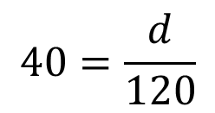
2. The Porsche travelled at 40 m/s for 2 minutes. How far did it go ?
speed=40m/s
Time = 2 minutes (2×60)= 120 second
Information
Equation
Substitution
$$40=\frac{d}{120}$$
Solution
Units
=4800 m
Underline

Slide 26
IN YOUR MATHS SECTION WRITE OUT THE FOLLOWING EXAMPLE
Tony walks 40m in 30s what is his average speed?
v=?, t=30s, d=40m
speed=distance/time
speed=40/30 = 1m/s

Slide 27
Let’s try some examples
2. A tractor drives 18 km in 6 hours.
d= 18km
t= 6h
v=?

Slide 28
Let’s try some examples
3. A frog jumps 25 metres in 5 seconds.
(Take care with the units.)
d= 25m
t= 5s
v=?
v=5m/s

Slide 29
Let’s try some examples
4. A plane flies 600 km in 3 hours.
d= 600km
t= 3h
v=?

Slide 30
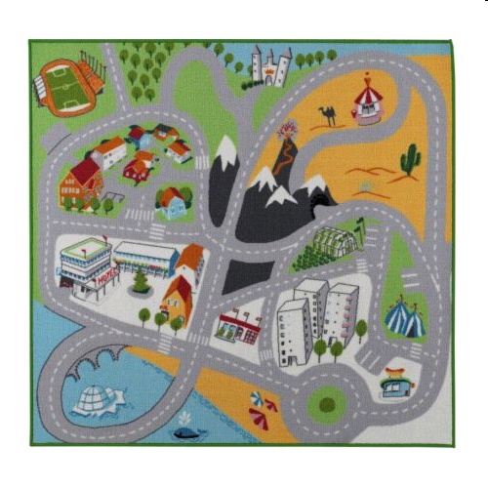
LOCKERBIE ACADEMY TRANSPORT UNIT

Slide 31
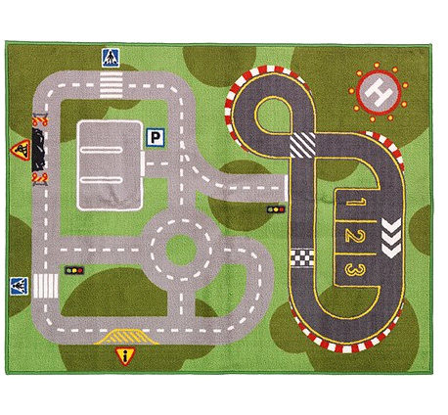
LOCKERBIE ACADEMY TRANSPORT UNIT

Slide 32
The SPEED OF MY CAR
TASK
We need to know the
1. distance your vehicle travelled.
2. Time for your journey.
3. The average speed over the whole journey for each team member.

Slide 34
The SPEED OF MY CAR
Your Team Challenge
Each member of your team must drive the course with their vehicle. They must NOT stray off the track.
Notes:
VEHICLE- add to wordbank

Slide 35
The SPEED OF MY CAR
Your Team Challenge
You must time how long it takes each member to complete the journey and measure the distance travelled along the track.
Record each team member’s time and calculate the average speed for each journey.
Record how many times the car goes off the track
Notes:
VEHICLE- add to wordbank

Slide 36
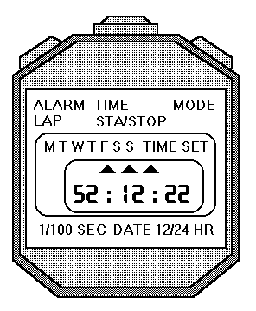
Reading the stopclock
The stopclock display can be a bit confusing.
A number that looks like this: 0:0234 means 2.34 seconds.
Reset
Start & Stop

Slide 37

AND THE WINNING TEAM IS
Calculate the average speed for each of your team drivers.

Slide 38
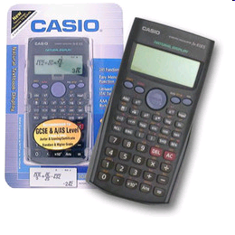
AND THE WINNING TEAM IS
FIXING your calculators
FIX allows you to fix how many figures after the decimal point should be displayed i.e. it fixes the number of decimal places you quote a value to. This is really useful if you suffer from calculator diarrhoea, but be careful you could end up with zero!

Slide 39
Additional Notes- For Printing only if repeat measurements required
To find the average speed from your results
Find the average time for the 3 runs (if the race was run 3 times)
  Do this by adding the times for the three runs in the calculator, PUSH the = button on the calculator and then divide this answer by 3 (as there were 3 runs). Add this number to your table where it says average time)
Find the speed using the formula
  Speed = distance ÷ time
Add this value of speed to your table.
DO NOT give your average speed to more than 1 decimal place unless the value is very small.

Slide 40
AND THE WINNING TEAM IS
And the winner is………

Slide 41
LOCKERBIE ACADEMY TRANSPORT UNIT
WORDBANK
Distance- is how far you have travelled. It is another name for length. It is measured in metres or during our road safety topic miles.
Time- is how long your journey took. It is measured in seconds or during our road safety topic hours.

Slide 42
LOCKERBIE ACADEMY TRANSPORT UNIT
WORDBANK
Speed – how far you travel every second.
OR
Speed is the distance travelled in unit time.
In the lab our distances are measured in metres and our time is measured in seconds so our units of speed would be metres per second.
In road safety we look at miles travelled every hour or miles per hour.
Notes:
In Physics this would be metres travelled every second so our units would be metres per second. In road safety we look at miles travelled every hour or miles per hour. To work this out you must use the formula

Slide 43
Eating Clock Cakes!
I eat 1 cake
I eat ¼ of the cake
I eat ½ the cake
I eat ¾ of the cake
I eat of the cake
I eat of the cake

Slide 44
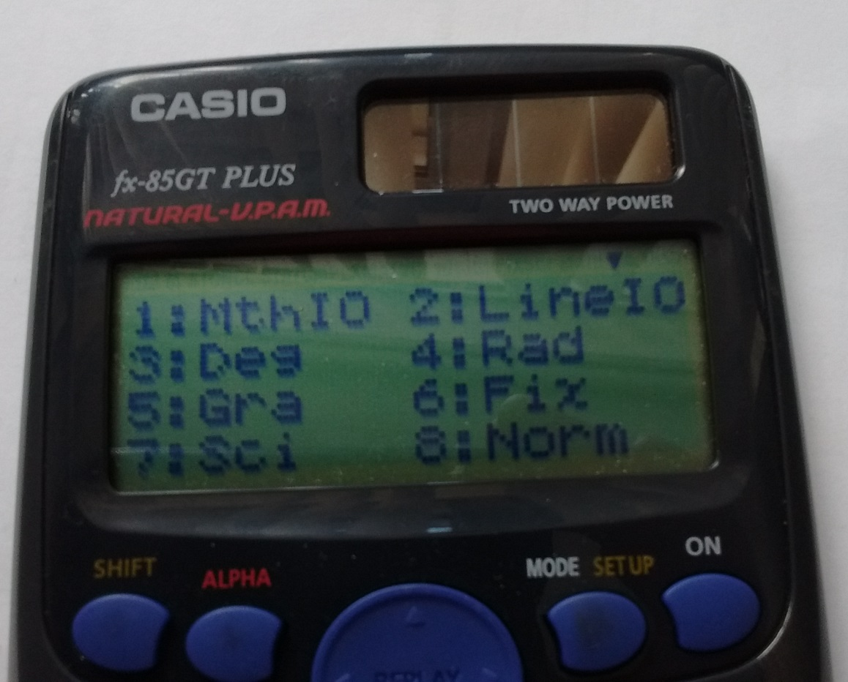
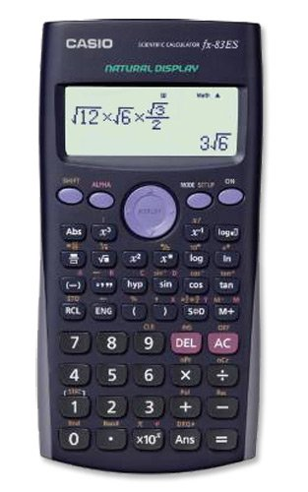
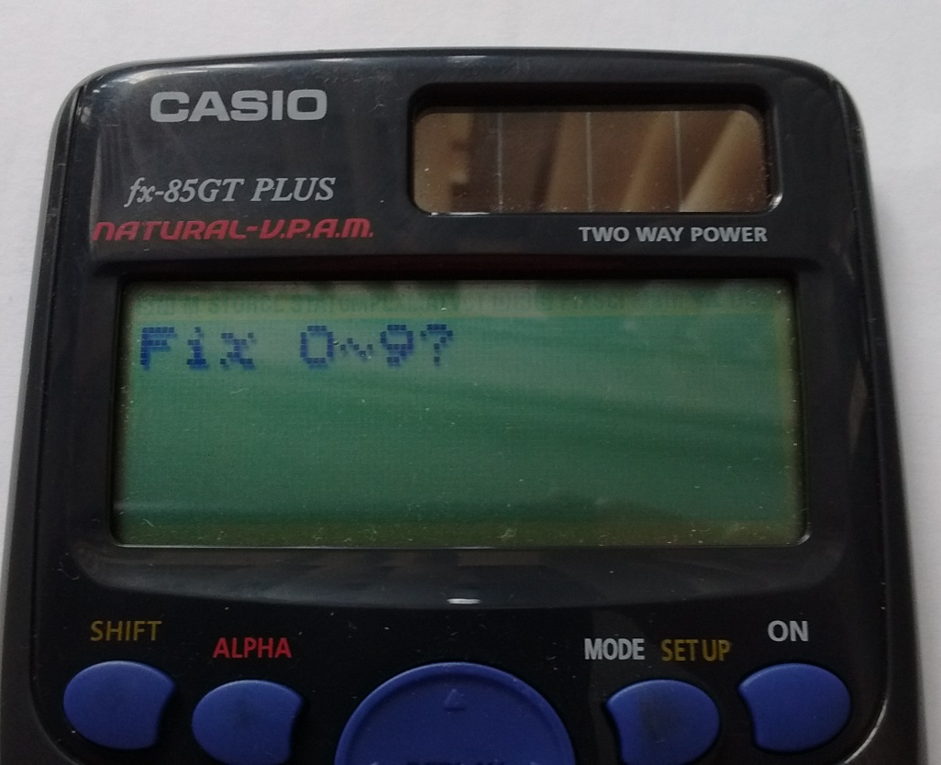

Slide 45
Let’s try some examples
Matt’s time for the course was 00:01:55. The course was 1.78m. What was Matt’s speed around the course?

Slide 47
Speed
d
Finding d and t (Showing full working):
v
t
2. The Porsche travelled at 40 m/s for 2 minutes. How far did it go ?

Slide 48
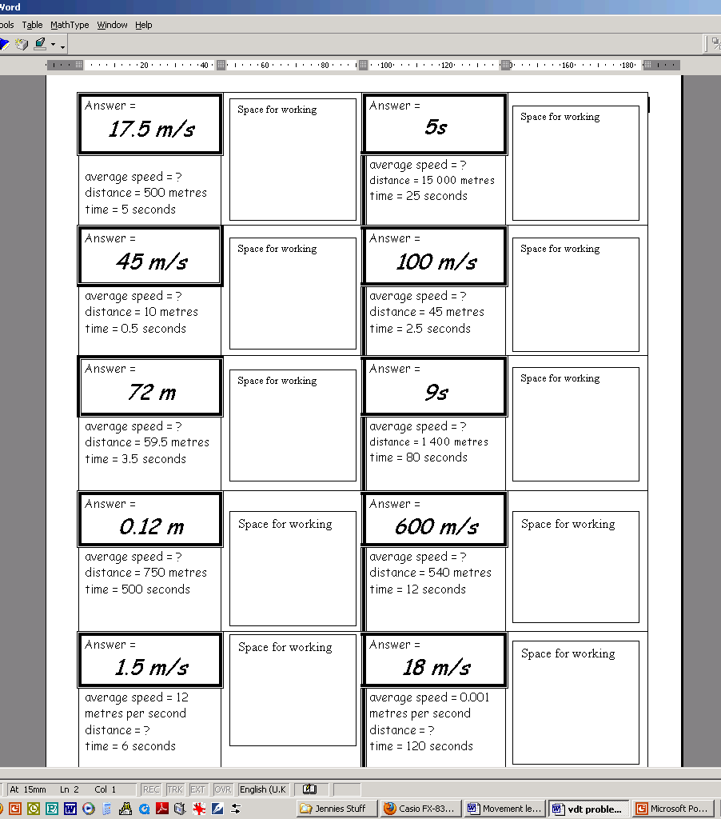
Speed Dominoes

Slide 49
THE POST VAN AND AVERAGE SPEED.
Post Office
400 m / 32 s
Library
350 m / 35 s
Shop
450 m / 60 s
900 m / 45 s
200 m / 25 s
Church
Post Box
750 m / 120 s

Slide 50
Journey | Average Speed
Post Office → Post Box
Post Office → Church
Post Box → Church
Library → Shop → Church
Post Office → Post Box → Church
Post Office → Church → Shop → Library

Slide 51
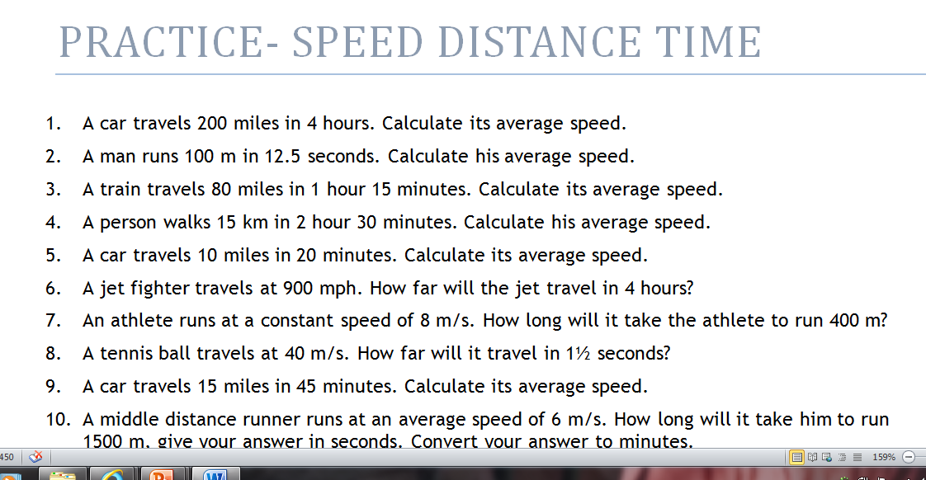
Try the additional questions to show what you can do.

Slide 52
REACTION TIME
S1 Physics Transport
Back to mind map

Slide 53
Let’s measure YOUR REACTIONS
MEASURING REACTION TIME USING A COMPUTER
Sheep Dash
Fetch fido
On the internet try some of the experiments for finding your reaction time.
MEASURING REACTION TIME USING A RULER
Collect the helpsheet for the instructions on how to find
REACTION TIME using a RULER.
Notes:
Experiment sheets provided

Slide 54
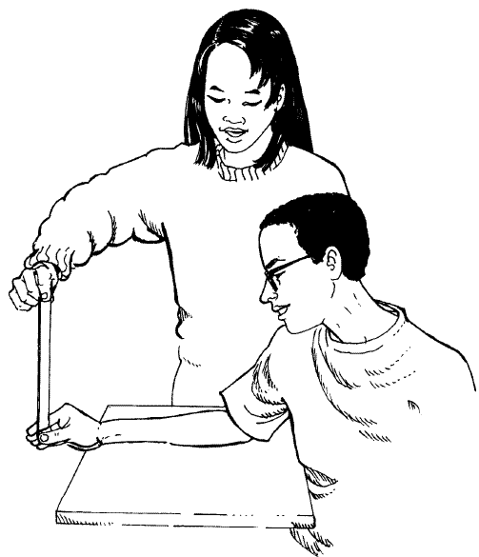
REACTION TIME
MEASURING REACTION TIME USING A RULER
To measure your reaction time you will need a 30 cm ruler, an instruction sheet and a partner.
Notes:
MEASURING REACTION TIME USING A RULER
To measure your reaction time you will need a 30 cm ruler and a partner. What to do
i. Your partner holds a ruler at the top. The 0 cm mark should be pointing towards the ground, the 30 cm mark should be pointing towards the ceiling.
ii. Place your finger and thumb either side of the 0 cm mark, but do not hold the ruler.
iii. Your partner should let the ruler go, at the same time you should try to grab the ruler between your finger and thumb.
iv. Record the distance the ruler has fallen in your jotter, from the 0 cm to where you are holding it. The distance must be recorded in metres.
v. Repeat this five times.
vi. Your partner now tries to grab the ruler as you let it go.
To find the time:
i. Find the average distance the ruler dropped before you grabbed it.
ii. Multiply your average distance by 0.2 and then square root your answer.
To do this using your calculator
Average reaction time =
average distance × 0.2 =√=
(metres)
What to do
i. Your partner holds a ruler at the top. The 0 cm mark should be pointing towards the ground, the 30 cm mark should be pointing towards the ceiling.
ii. Place your finger and thumb either side of the 0 cm mark, but do not hold the ruler.
iii. Your partner should let the ruler go, at the same time you should try to grab the ruler between your finger and thumb.
iv. Record the distance the ruler has fallen in your jotter, from the 0 cm to where you are holding it. The distance must be recorded in metres.
v. Repeat this five times.
vi. Your partner now tries to grab the ruler as you let it go.
To find the time:
i. Find the average distance the ruler dropped before you grabbed it.
ii. Multiply your average distance by 0.2 and then square root your answer.
To do this using your calculator
Average reaction time =
average distance × 0.2 =√=
(metres)

Slide 55
INSTANTANEOUS
Speed
S1 Physics Transport
Back to mind map

Slide 56
Instantaneous Velocity
WORDBANK
The instantaneous speed for an object is its speed at a particular point in time. For example, a police speed camera measures the instantaneous velocity of the car.
Length of object
Light gate measures time to pass
Ramp

Slide 57
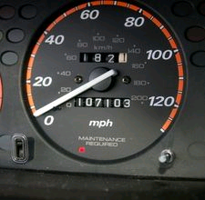
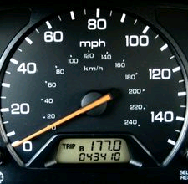
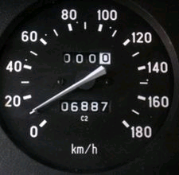
LOCKERBIE ACADEMY TRANSPORT UNIT
A speedometer is a gauge that measures and displays the instantaneous speed of a land vehicle.
Notes:
Instantaneous speed is the speed at which you are travelling over a very short distance. It is measured in metres per second or miles per hour.

Slide 58
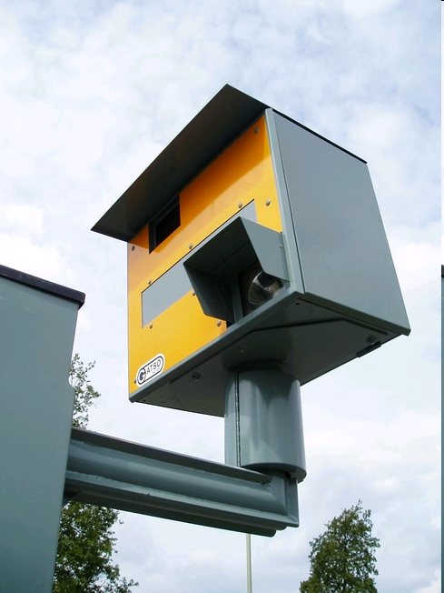

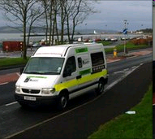
INSTANTANEOUS SPEED
Speed Cameras in D&G

Slide 60
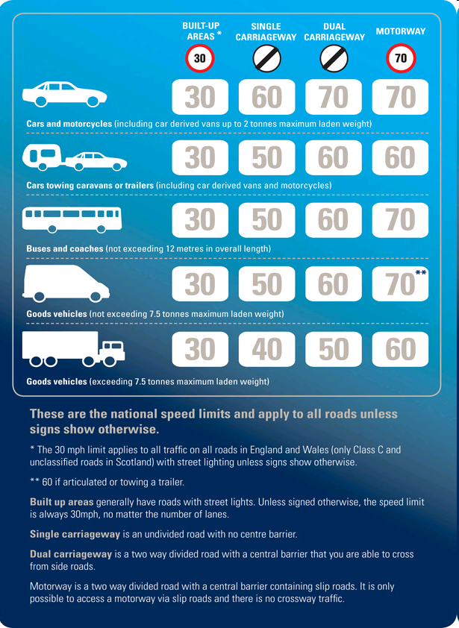

Slide 63
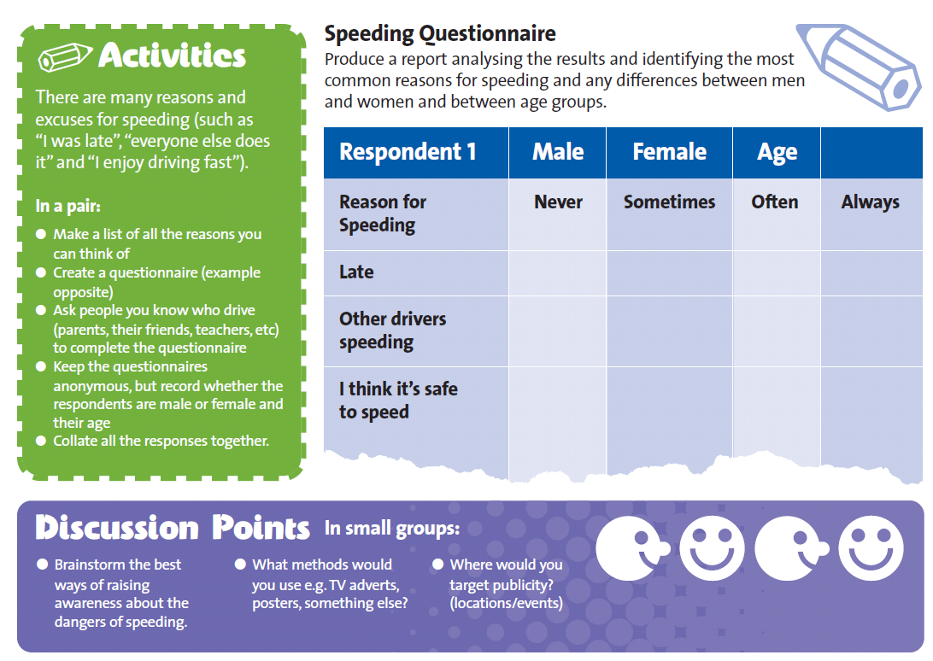

Slide 65
LOCKERBIE ACADEMY TRANSPORT UNIT
WORDBANK
Instantaneous speed is the speed at which you are travelling over a very short distance. It is measured in metres per second or miles per hour.

Slide 66
Instantaneous Velocity
Instantaneous speed is difficult to measure.
WHY?

Slide 67
MEASURING
INSTANTANEOUS Speed
S1 Physics Transport
Back to mind map

Slide 68
MEASURING INSTANTANEOUS SPEED- get the instruction sheets
USING A STOPWATCH
What you need:
Model vehicle, ruler, chalk, stopclock, instruction sheet
USING ALBA & LIGHT GATES
What you need:
Model vehicle, ruler, mask, lightgates + laptop, instruction sheet

Slide 69
Instantaneous Velocity
Instantaneous speed
One way is to use a light gate. The length of the object divided by the time it takes to pass gives its instantaneous speed.
Length of object
Light gate measures time to pass
Ramp

Slide 70
MEASURING INSTANTANEOUS SPEED USING A STOPWATCH
What you need
Model vehicle, ruler, chalk, stopclock.
What to do
Mark one chalk line on the bench. (Don’t forget to rub it out when you have finished!).
Measure the length of the model vehicle. Record this in your jotter.

Slide 71
MEASURING YOUR INSTANTANEOUS SPEED
GROUP TASK- back to the PLAYMATS!
We need to know the
1. length of your vehicle or the mask on top.
2. the time for the vehicle to pass through the light gates
3. the instantaneous speed of the vehicle as it goes round the roundabout (or alternative)

Slide 72
MEASURING INSTANTANEOUS SPEED USING A STOPWATCH
Start the stopclock when the front edge of the vehicle reaches the chalk line.
Stop the stopclock when the end of the car reaches the chalk line.
Note the time from the stopclock in your jotter.
Calculate the speed using the formula:

Slide 73
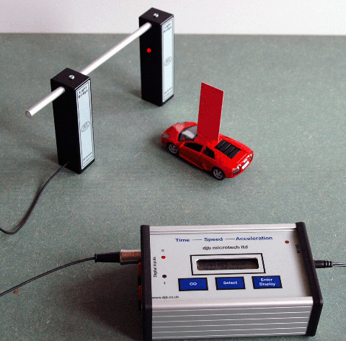
MEASURING INSTANTANEOUS SPEED- get the instruction sheets
USING ALBA & LIGHT GATES
What you need:
Model vehicle, ruler, mask, lightgates + laptop, instruction sheet

Slide 74
YOUR TASK.
Working in teams you need to:
Using the ALBA package record the instantaneous speed of the vehicle at the specific place in the track (see the additional worksheet)
ALBA-MOTION
Introduction to SPEED

Slide 75
YOUR TASK.
Working in teams you need to:
Using the ALBA package record the instantaneous speed of the vehicle at the specific place in the track (see the additional worksheet)

Slide 76
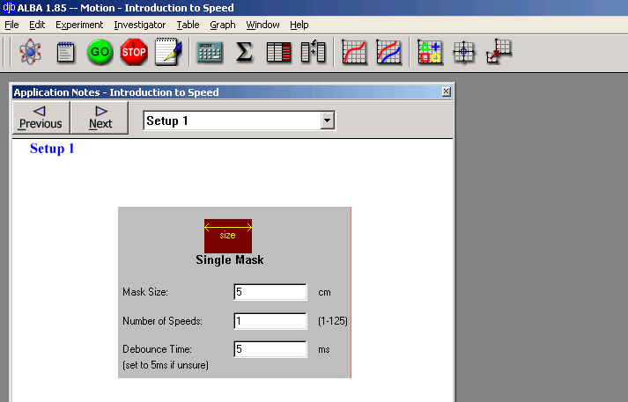

Slide 77
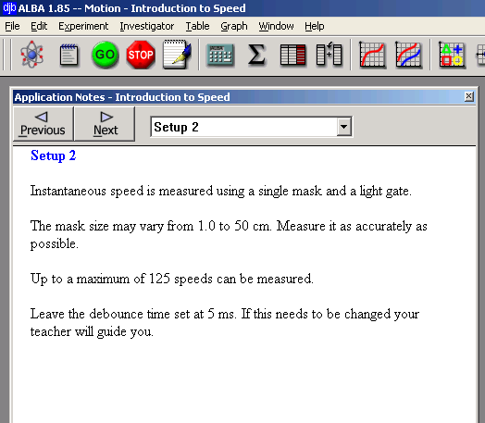

Slide 78
LOCKERBIE ACADEMY TRANSPORT UNIT
“Speed camera”
Measure instantaneous speed here

Slide 79
LOCKERBIE ACADEMY TRANSPORT UNIT
“Speed camera”
Measure instantaneous speed here

Slide 80
LOCKERBIE ACADEMY TRANSPORT UNIT
WORDBANK
At rest- in Physics we use this term to mean not moving. We can also say the object is stationary.
It is not the same word as pens and pencils which are stationery!

Slide 81
Stopping Distance
S1 Physics Transport
Back to mind map

Slide 82
STOPPING DISTANCE
The STOPPING DISTANCE of a car is made up of TWO parts
THINKING DISTANCE
BRAKING DISTANCE
Thinking distance is the distance a car will travel in the time it takes you to react to the situation.
The distance the car will travel as the brakes are applied

Slide 83
LOCKERBIE ACADEMY TRANSPORT UNIT
WORDBANK
Stopping distance = thinking + braking
distance distance
Stopping distance the distance it takes a car to stop.

Slide 84
LOCKERBIE ACADEMY TRANSPORT UNIT
WORDBANK
thinking distance
the distance moved whilst you are reacting to the hazard.
braking distance
the distance that the car moves whilst braking.

Slide 85
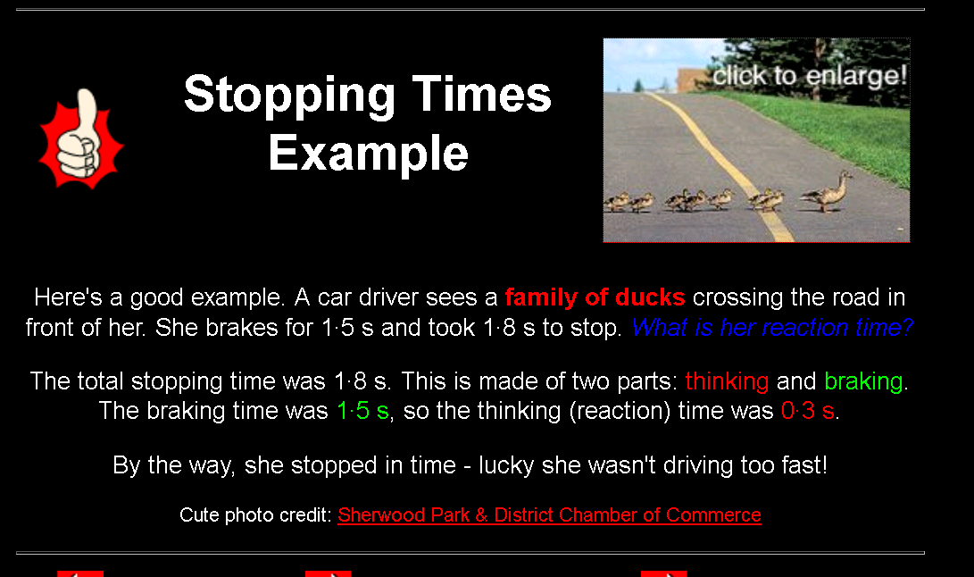

Slide 86

An investigation to measure reaction time and calculate stopping distances
Using the Reaction Timer box you will find out:
Your reaction time.
How your reaction time changes if you are chatting or texting.
You will calculate stopping distances for different speeds.
Image: Wikipedia: This work is licensed under the Creative Commons Attribution 2.0 License.

Slide 87
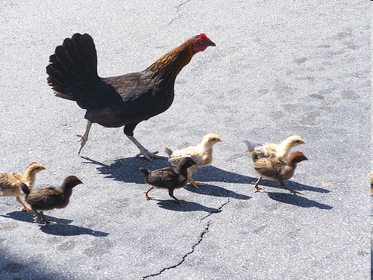
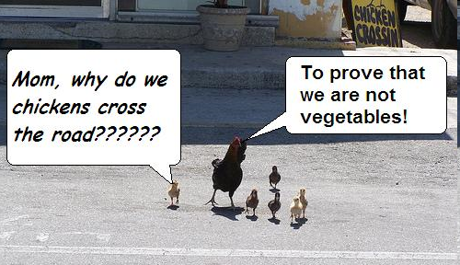


[Original photo credit: lonecellotheory]
By, Hannah, Charlotte, Robert and Kieran + Emma, Sophie, Phoebe, Sweez & Faye edited by Mrs H

Slide 88
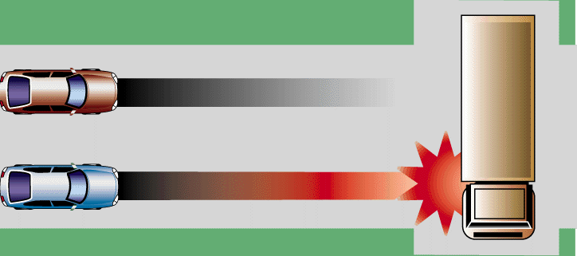
What chicken is for.
To get you to learn about the stopping distances of cars and lorries
To be aware of road safety.
To appreciate stopping distances.
Braking in different weather conditions.

Slide 89
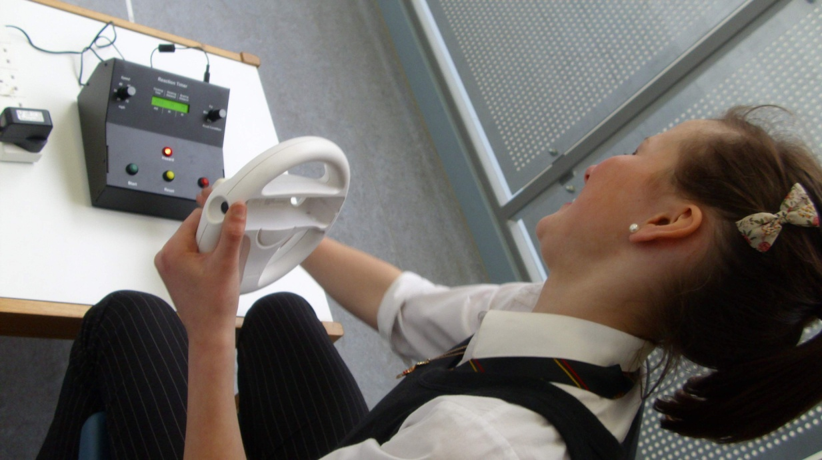
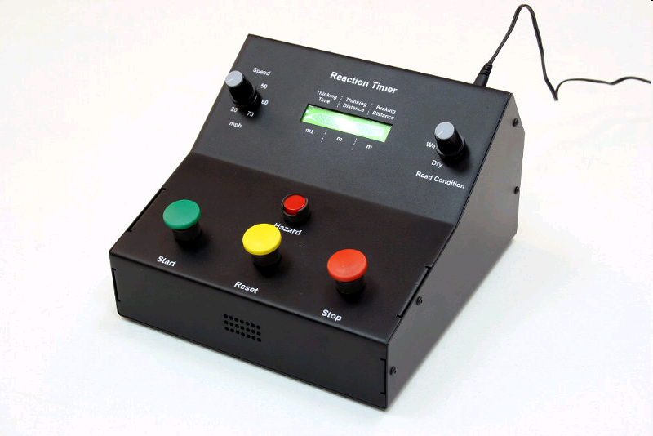
Equipment
Car controls
(reaction timer)
A driver
Measuring tape
Mario kart wheel
People to be chickens

Slide 90
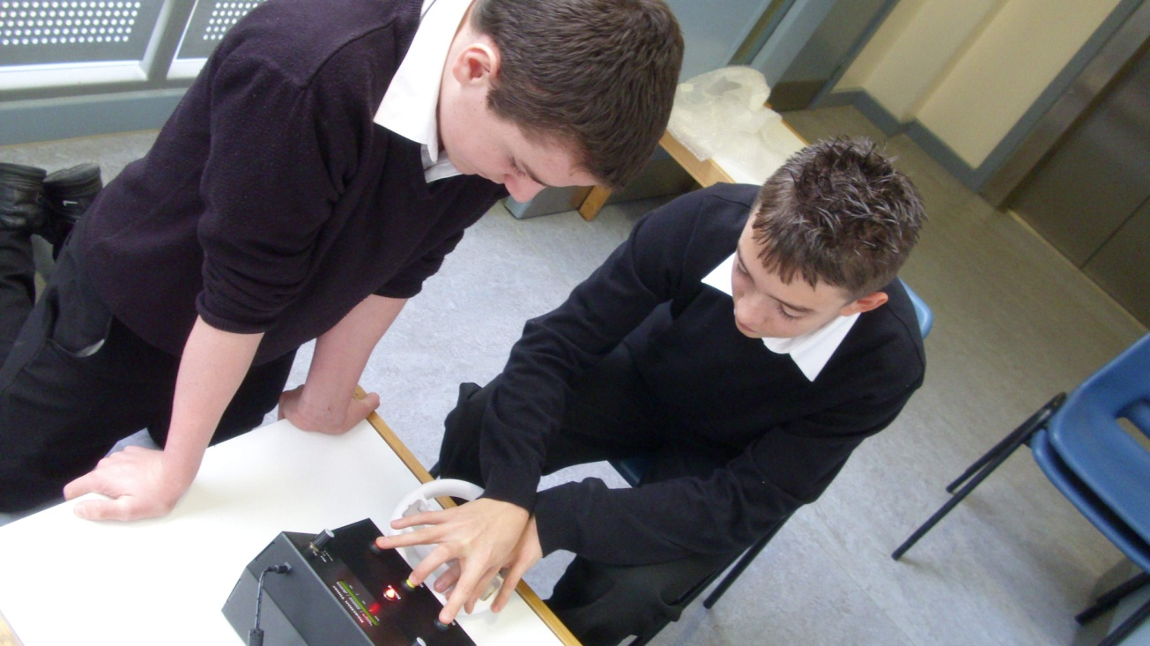
What is it.
Chicken run is an experiment that tests your reaction time and people’s appreciation of stopping distances.
You choose
    weather condition
    speed
    driver ability
    driver distractions

Slide 91
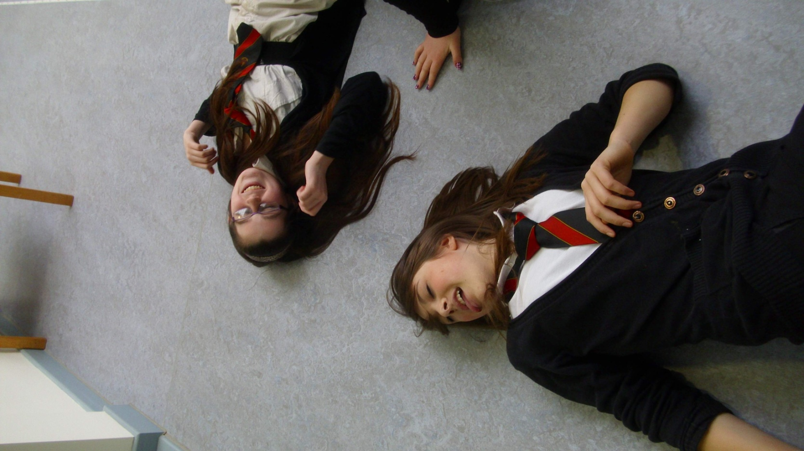
The Winner
Not these then!
is the person closest to stopping position of “the car” without being “hit”

Slide 92
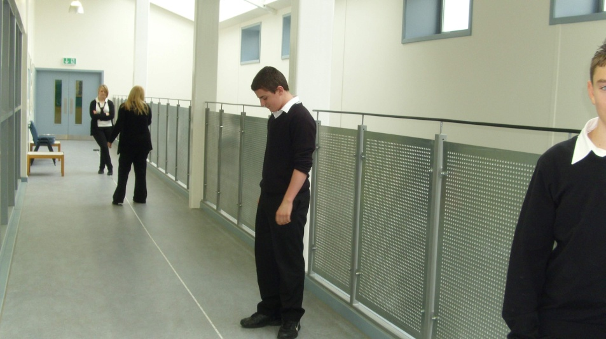
Rules
Drive carefully
Do not break Mario kart wheel
Don’t have your hand hovering over the stop button
Don’t look at the light whilst you’re driving
Think of the control box as a proper car
DO NOT GET HURT

Slide 93
UNIFORM Speed
S1 Physics Transport
Back to mind map

Slide 94
LOCKERBIE ACADEMY TRANSPORT UNIT
Uniform Speed
Sometimes through the whole journey your speed will not change. This could be because you have cruise controls on. We would say that your speed is UNIFORM when your speed isn’t changing. It remains constant.

Slide 95
LOCKERBIE ACADEMY TRANSPORT UNIT
WORDBANK
Uniform Speed
When your speed is uniform we mean that your speed isn’t changing. It remains constant.

Slide 96
Uniform speed
Do you think people often travel at a uniform speed?
Discuss times when the speed might be uniform and when it might not be uniform.
WHY?

Slide 97
LOCKERBIE ACADEMY TRANSPORT UNIT

Slide 98
SPEED AND ROAD SAFETY
Speed is given as the MAIN cause of FATAL ACCIDENTS on Scotland’s Roads
Road Accident Report

Slide 99
SPEED AND ROAD SAFETY
Causes of road traffic accidents
In Great Britain, data collected⁶ about road traffic accidents in 1999 to 2002 examined the factors involved in each accident. Excessive speed was the most common contributory factor in fatal accidents, playing a part in 28% of all fatal accidents examined in the trial. Careless, thoughtless or reckless behaviour was next, being a contributory factor in 21% of all fatal accidents examined.
In accidents resulting in any severity of casualty, inattention was the most common contributory factor, found in 25% of all accidents examined in the trial. Failing to judge another person's path or speed was the next most common contributory factor, playing a part in 23% of all accidents examined.
road_traffic_accident.html

Slide 100
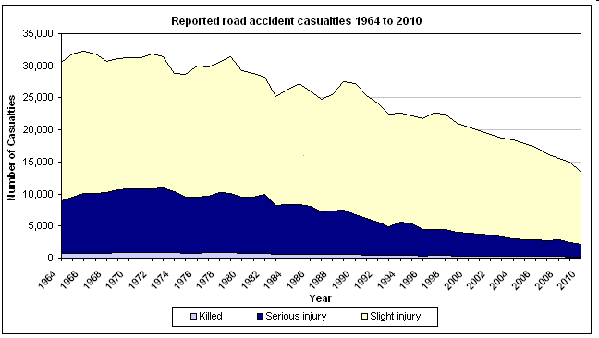
THINKING TASK!- More CARS less deaths- WHY?
Crash Figures

Slide 101


Slide 102
ADVANCED QUESTIONS
Questions – Speed
1. Calculate the speed of a motorbike if it travels 100 metres in 2.5 seconds?
2. Calculate the speed of a rocket if it can move 32 kilometres in 4 seconds?
3. Calculate the speed in m/s is a skateboarder moving if he can skate 6 kilometres in 10 minutes?
4. A red Ferrari zooms over 500 metres in 4 seconds, calculate its speed?
5. Calculate the time it would take a snail to slither 20 metres at 5 metres per hour?

Slide 103
An Advanced Puzzle- are you smart enough?
THE WEETABIX QUESTION
Bob and John are having a race from point A to point B and back again.
Bob runs the whole race at a speed of 5m/s.
John runs from A to B at 7m/s, but returns at 3m/s.
Who wins the race, or is it a draw?

Slide 104
LOCKERBIE ACADEMY
TRANSPORT UNIT velocity
S1-S3 Road Safety & PHYSICS

Slide 105
VELOCITY, Displacement & Time
S2 Physics Transport
Back to mind map

Slide 106
So what’s this VELOCITY thing physicists love?
S1 Physics Transport
02/10/2011
JAH
Back to mind map

Slide 107
LOCKERBIE ACADEMY TRANSPORT UNIT

Slide 108
LOCKERBIE ACADEMY TRANSPORT UNIT

Slide 109
VELOCITY = Displacement
Time
S1 Physics Transport
But what the heck is Displacement ?
02/10/2011
JAH
Back to mind map

Slide 110
Velocity
s
v
t
Displacement
Velocity
=
Time
s
v
=
t
02/10/2011
JAH

Slide 111
Distance = “how far we’ve travelled”
    ⇒ symbol d
    ⇒ units metres, m
And later we’ll show distance is….
    ⇒ (scalar quantity)

Slide 112
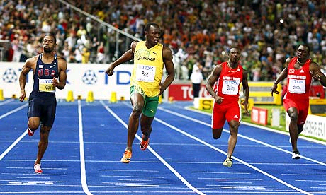
LOCKERBIE ACADEMY TRANSPORT UNIT
Displacement is how far you have travelled in a straight line. We would say “as the crow flies”
Notes:
Displacement
Often in Physics we can be quite careless in the way we use terms and expect our pupils to understand. This is not very helpful to you. We do it because we want to give you correct information but sometimes we are worried that you cannot understand the work. From the beginning we are going to give you all the information so that we try not to muddle up terms but you will need to be responsible for learning these different terms.
Displacement and Velocity are 2 terms that we need to explain carefully in Physics.
Displacement is how far you have travelled in a straight line. We would say “as the crow flies”
Usain Bolt is the fastest man on earth. He can run 100m in a time of 9.58s (adjust as this changes).
The distance that Usain runs is 100m. This is also his displacement as Usain Bolt runs in a straight line. He is exactly 100m from where he started the race.

Slide 113
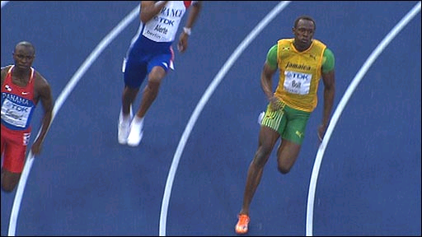
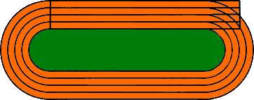
LOCKERBIE ACADEMY TRANSPORT UNIT
Displacement is how far you have travelled in a straight line. We would say “as the crow flies”
(400m in 45.86s)
http://news.bbc.co.uk/sport1/hi/athletics/8210700.stm
http://www.telegraph.co.uk/sport/sportvideo/7236169/Usain-Bolt-blasts-to-400m-victory.html
Notes:
In the 200m race when Usain Bolt crosses the finishing line he is not 200m from the start in a straight line. He has run 200m but he is only (X- work it out Jennie) from his starting point. This direct distance is called his displacement.
In this 400m race Usain Bolt has run once around the track. He ended up exactly where he started from. Do the distance he ran is 400m but his displacement (where he is in relation to where he started is 0m). When objects travel in straight lines then the distance and displacement are the same size but as soon as an object changes direction the distance and displacement are different.

Slide 114
E
S
T
A
I
C
N
D I S P L A C E M E N T
D

Slide 115
Displacement = “how far we’ve travelled in a straight line (from A to B)” (include your direction)
    ⇒ symbol s
    ⇒ units, metres, m
    ⇒ Vector quantity
    ⇒ Must quote the direction

Slide 116
Distance can have the same magnitude (size) as displacement but displacement can never be greater than distance
Speed and veloocity can have the same magnitude if you travel in a straight line
Velocity can never be greater than your speed.

Slide 117
The SPEED OF MY CAR
TASK
We need to know the
1. displacement of your vehicle.
2. the time for the whole journey
3 the AVERAGE VELOCITY of the vehicle for the journey

Slide 118
YOUR TASK.
Working in teams you need to:
Measure the DISPLACEMENT that the car will travel following the pre-defined course.
Record this value on your worksheet.
Time how long each person in the group takes to complete the course.
Record this value on your worksheet
Time how long your journey takes and note down
Record as tally marks on your worksheet every time each person in the group leaves the track
Find the DIRECTION of travel from START to FINISH.

Slide 119
LOCKERBIE ACADEMY TRANSPORT UNIT
WORDBANK
Scalar
A quantity that is fully described by a value and unit
Vector
A quantity that is fully described by a value, a direction and unit.

Slide 120
Take your teacher on a velocity walk in the playground
You need, teacher, books, tape measure, string, stopwatch and compass
Back to mind map

Slide 121
DYNAMIC WORD BINGO- REVISION

Slide 122
CHECK OUT MORE ON VELOCITY & VECTORS
http://www.physicsclassroom.com/class/1dkin/U1L1a.cfm

Slide 123
REVIEW
S1 Physics Transport
Back to mind map

Slide 124
REVIEW
WHAT ARE DISTANCE AND DISPLACEMENT?
Distance is length. How far you’ve travelled (e.g. 100 metres)
Displacement is direct distance in a particular direction (e.g. 100 metres to the right)
WHAT ARE SPEED AND VELOCITY?
Speed is the rate of covering a distance (e.g. 50km/h)
Velocity is rate of displacement in a particular direction (e.g. 50 km/h north)

Slide 125
SCALAR QUANTITY
VECTOR QUANTITY
QUOTE DIRECTION

Slide 126
1193 miles
26½ hours
What was the average speed for the journey?
615 miles
26½ hours
What was the average velocity for the journey?

Slide 127
Vectors and Scalars
What is the difference between a vector quantity and a scalar quantity?
Use your answer to question 1 to explain the difference between distance and displacement.

Slide 128
Vectors and Scalars
1. A man walks from X to Y along a winding road.
What is his displacement at the end of his walk?
What distance has he walked?
2. If the walker in question 1 above took 40 minutes for his walk, what was
his average speed
his average velocity?

Slide 129
Repeat this question for a runner in the 800 m race whose winning time was 1 min 54 s.
One complete lap of a running track is 400m.
An athlete completes one lap in 48 s in the 400 m race. What is his
a) distance travelled
b) displacement
c) average speed
d) average velocity.

Slide 130
Average speed Questions
A car travels 40 km north, then turns back south for 10 km. The journey takes 1 hour.
What is
a) the displacement of the car
b) the distance the car has travelled
c) the average velocity of the car }use km h-1
d) the average speed of the car? }

Slide 131
Average speed Questions
A car drives 60 km north, then 80 km east, as shown in the diagram. The journey takes 2 hours.
Calculate the
a) distance travelled
b) displacement
c) average speed
d) average velocity.

Slide 132
LOCKERBIE ACADEMY TRANSPORT UNIT
WORDBANK
At rest- in Physics we use this term to mean not moving. We can also say the object is stationary.
It is not the same word as pens and pencils which are stationery!

Slide 133
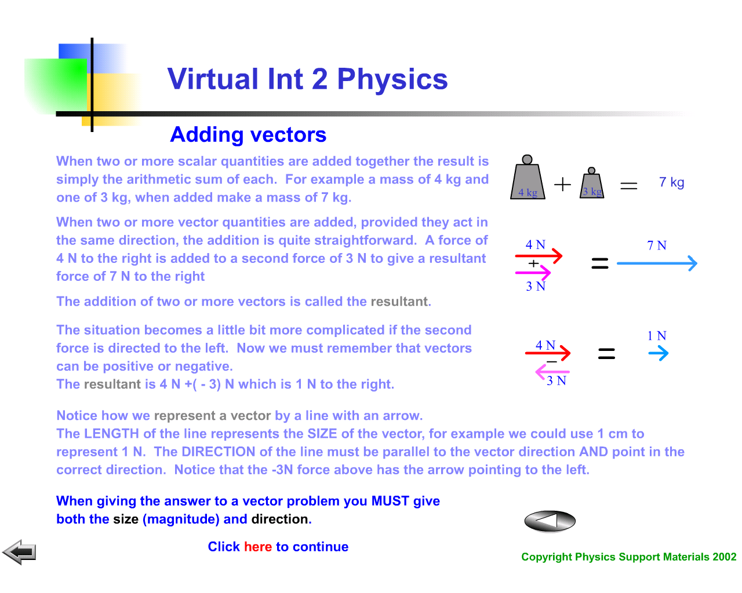

Slide 134
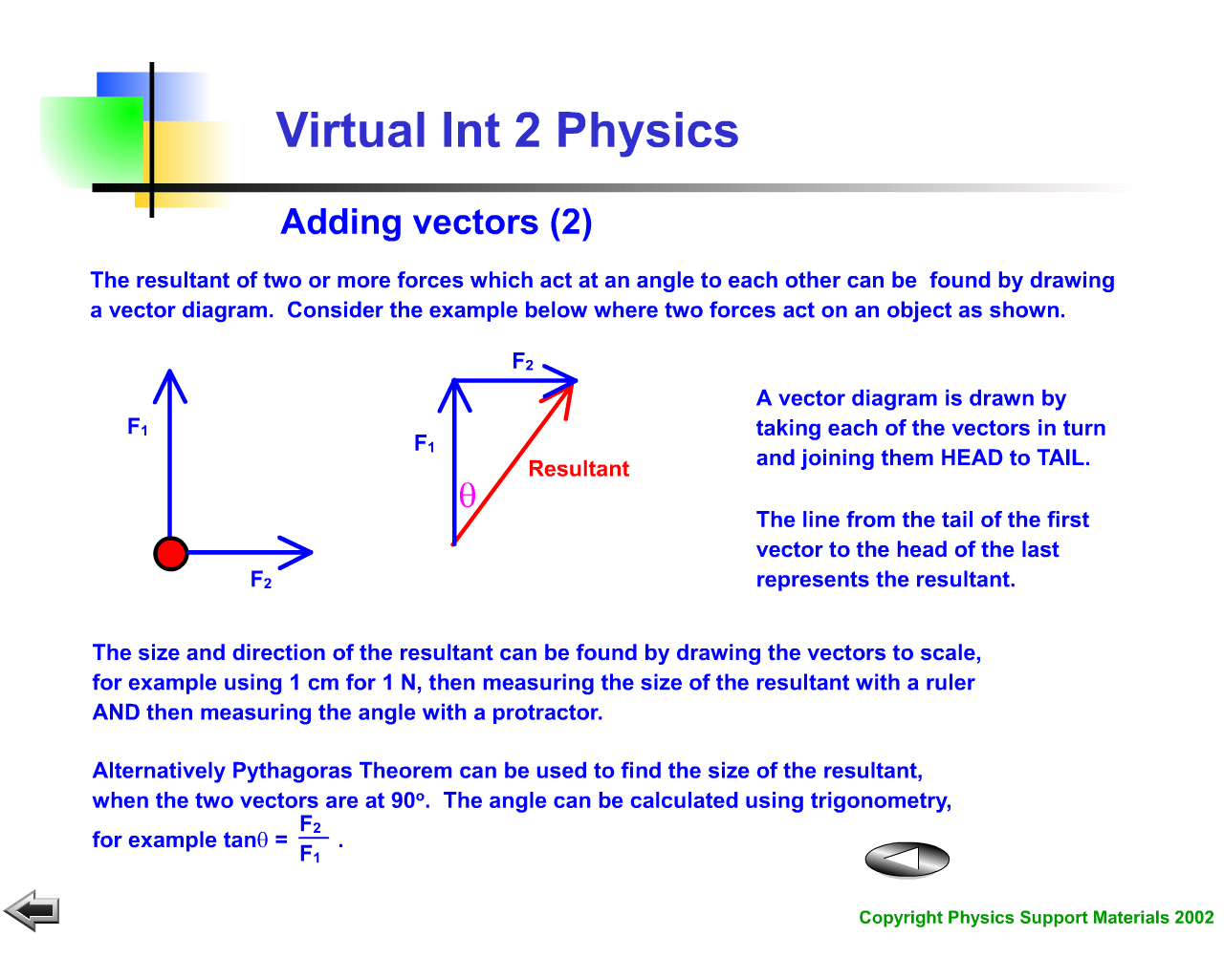

Slide 135
THE POST VAN & AVERAGE VELOCITY.
Post Office
400 m / 32 s
Library
350 m / 35 s
Shop
450 m / 60 s
900 m / 45 s
200 m / 25 s
Church
Post Box
750 m / 120 s

Slide 136
Journey | Average Velocity
Post Office → Post Box
Post Office → Church
Post Box → Church
Post Office → Library → Shop → Church
Post Office → Post Box → Church
Post Office → Church → Shop → Library

