Slide 1
Renewables
A covid recovery S3 Physics Unit
THINK LIKE A PHYSICIST

Slide 2
The tasks you will need to complete are
Revision of Variables
Revision of Variables
Choosing variables
Researching
Investigating
Plan an investigation
Thinking like a Physicist
How to reference correctly
Presenting an argument – your choice of renewables/ non renewables
Evaluating your investigation
Carrying out an investigation
Writing up fully and correctly your experiment
Presenting your findings as a Scientific poster.
Presenting your Results
Estimating
Predicting
Posing a Question
Controls
Input/output

Slide 3
THINK LIKE A PHYSICIST Model
So how does this work?

Slide 4
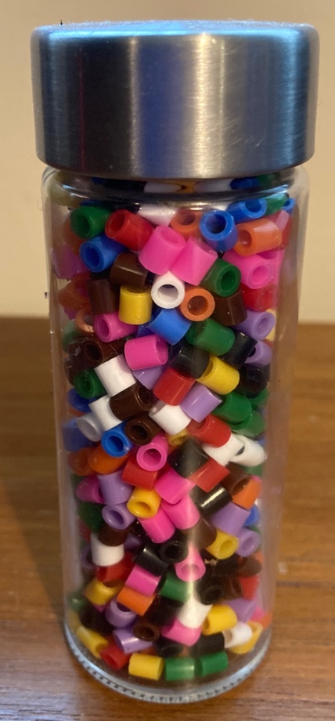
Think like a PHYSICIST
How would you go about ESTIMATING the number of beads in a jar?
If you can look at this jar and go “I don’t know how many there are exactly, but here’s how we could work it out roughly” then you are thinking like a physicist

Slide 5
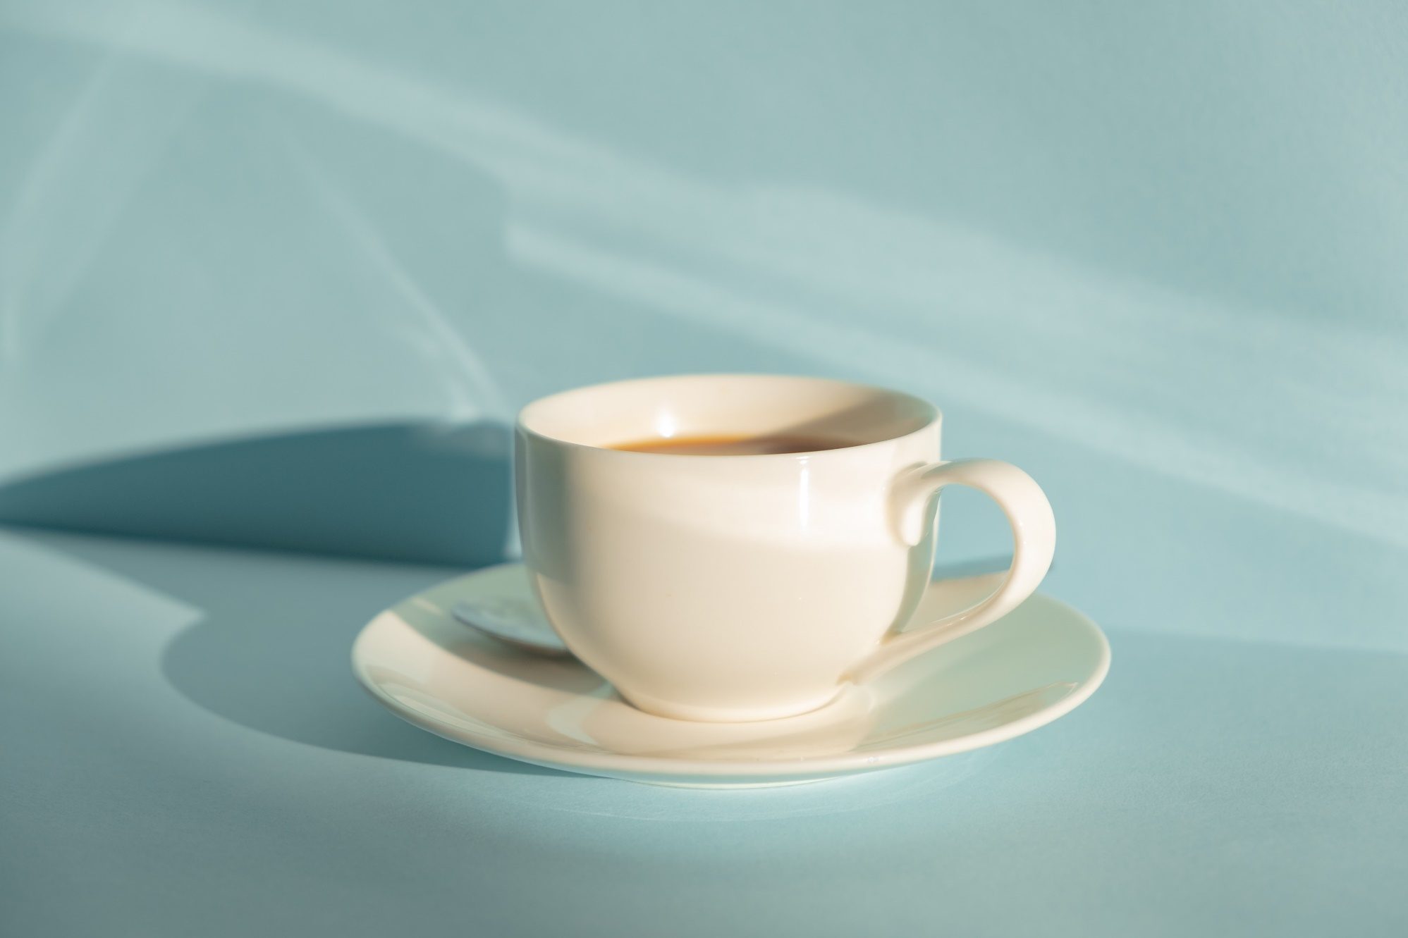
Fresh cup of Tea
1. What is the temperature of a freshly made cup of tea? A. $40 °C$ B. 55$°C$ C. 85$°C$ D. 100$°C$ E. 110$°C$ 2. How confident are you in your answer for Question 1? A. Very confident B. Somewhat confident C. Not so confident D. Not confident E. Complete guess

Slide 6
Fresh cup of tea answer
1. What is the temperature of a freshly made cup of tea?
A. $40 °C$
B. 55$°$
C. 85$°C$
D. 100$°C$
E. 110$°C$
ANSWER: C
The key here is ruling out the impossible:
A and B unlikely – “Freshly” made means its just made, and it is unlikely a cuppa would cool down so much so fast – your own experience helps here.
Real kettles cut out at boiling point of water, so E unlikely.
The moment the kettle cuts out, the temperature of the water will start dropping. So D is unlikely.

Slide 7
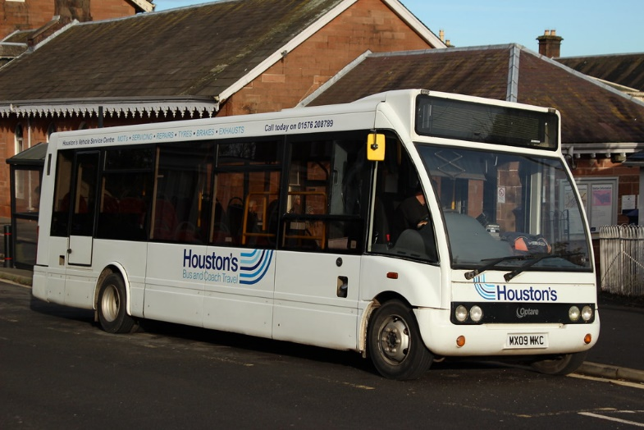
HOUSTON BUS
3. What is the volume of a Houston bus? A. $30 m^{3}$ B. $70 m^{3}$ C. $100 m^{3}$ D. $150 m^{3}$ E. $200 m^{3}$ 4. How confident are you in your answer for Question 3? A. Very confident B. Somewhat confident C. Not so confident D. Not confident E. Complete guess

Slide 8
Houston’s BUS
ANSWER: B
Roughly cuboid, with a square cross section.
Height/width around 2.5 m – compare to size of person or width of road lane.
Estimate length around 10 m
Gives volume of ~2.5 x 2.5 x 10 ~ 62.5 m³
3. What is the volume of a Houston’s bus?
A. $30 m^{3}$
B. $70 m^{3}$
C. $100 m^{3}$
D. $150 m^{3}$
E. $200 m^{3}$

Slide 9
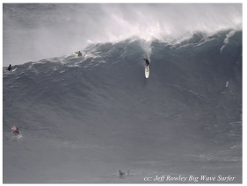
Height of a wave
5. Estimate the height of the wave in this photo. A. $2 m$ B. 3$m$ C. 6$m$ D. $10 m$ E. $20 m$ 6. How confident are you in your answer for Question 5? A. Very confident B. Somewhat confident C. Not so confident D. Not confident E. Complete guess

Slide 10
Height of the wave
5. Estimate the height of the wave in this photo. A. $2 m$ B. 3$m$ C. 6$m$ D. $10 m$ E. . 20 m ANSWER: D Use people in photo for scale Assume 2 m tall surfer Take boundaries of wave to be as shown.
h
~5h

Slide 11
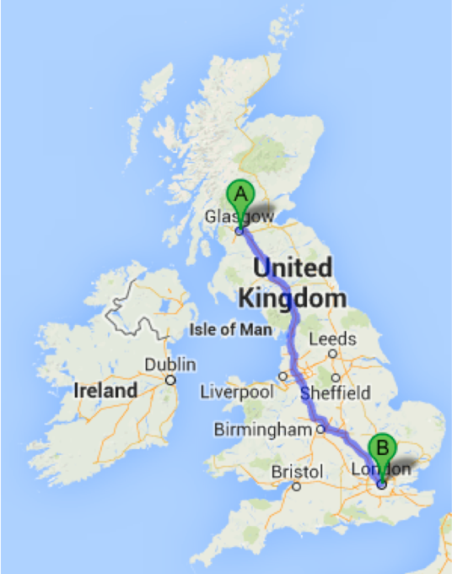
Drive time
13. How much time does it take to drive from Glasgow to London on the motorway network? (Assume NO stopping, and no roadworks!) A. 3 hours B. 7 hours C. 10 hours D. 15 hours E. 20 hours 14. How confident are you in your answer for Question 13? A. Very confident B. Somewhat confident C. Not so confident D. Not confident E. Complete guess

Slide 12
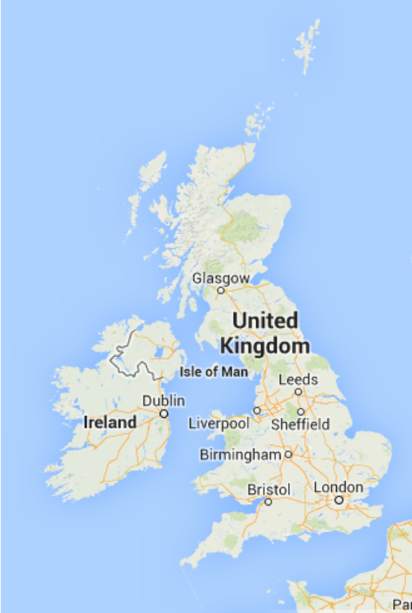
Surface area of the UK
7. Estimate the surface area of the UK. A. $2 × {10}^{3} km$ B. $2 × {10}^{4} km$ C. $2 × {10}^{5} km$ D. $2 × {10}^{6} km$ E. $2 × {10}^{7} km$ 8. How confident are you in your answer for Question 7? A. Very confident B. Somewhat confident C. Not so confident D. Not confident E. Complete guess

Slide 13
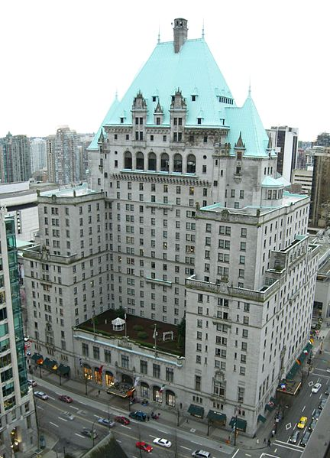
Hotel Vancouver
9. What is the approximate height of the Hotel Vancouver? A. 50 m B. 100 m C. 130 m D. 160 m E. 200 m 10. How confident are you in your answer for Question 9? A. Very confident B. Somewhat confident C. Not so confident D. Not confident E. Complete guess

Slide 14
Hotel VANCOUVER

Slide 15
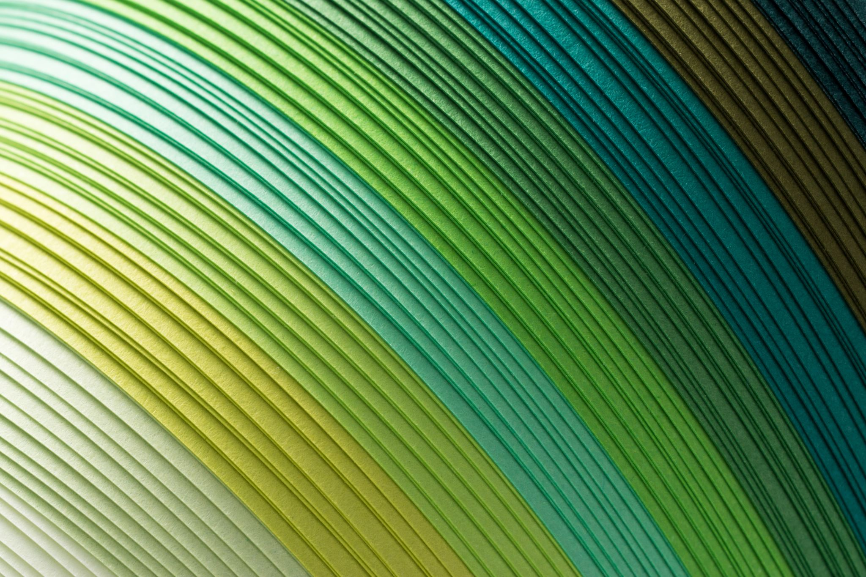
Thickness of a sheet of paper
11. What is the thickness of a single sheet of standard photocopy paper? A. 0.1 mm B. 0.01 mm C. 0.001 mm D. 0.005 mm E. 0.00025 mm 12. How confident are you in your answer for Question 11? A. Very confident B. Somewhat confident C. Not so confident D. Not confident E. Complete guess

Slide 16
Thickness of copy paper
11. What is the thickness of a single sheet of standard photocopy paper?
A. 0.1 mm
B. 0.01 mm
C. 0.001 mm
D. 0.005 mm
E. 0.00025 mm
ANSWER: A
Measure something bigger and divide down
A ream (500 sheets) is 4.5 cm
Gives ~1 x 10⁻⁴ m
= 0.1 mm

Slide 17
Drive time

Slide 18
Surface area of UK

Slide 19
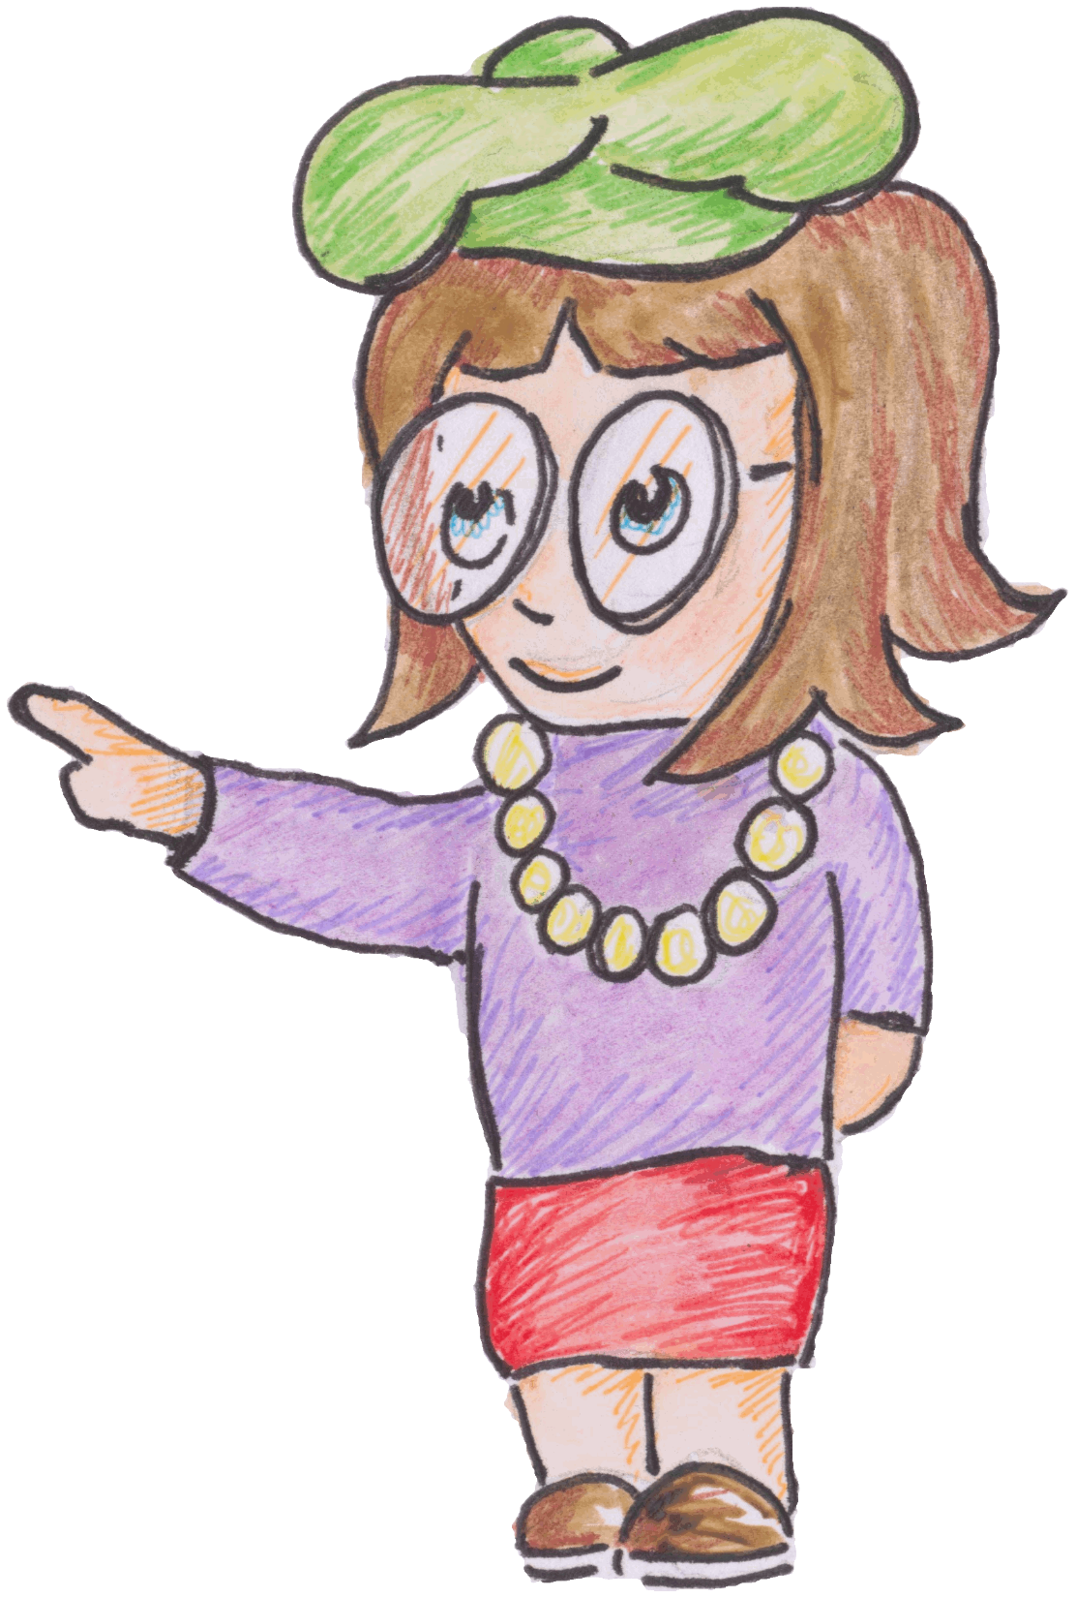
Homework
I am a Physics Teacher!
Debate on TEAMs
Estimate the number of Physics teachers in Scotland!
So am I in H208

