Slide 1
Renewables
A covid recovery S3 Physics Unit
VARIABLES

Slide 2
Collect a whiteboard and pen!
Get ready for a thinking question!

Slide 3
Thinking skill (Review)
You go into a shop and buy a bat and a ball. Together they come to £1.10 (I know it’s a cheap shop). The bat is £1 more than the ball, so how much is the ball?
https://www.youtube.com/watch?v=UBVV8pch1dM

Slide 4
This lesson: tasks you will need to complete
Revision of Variables
Choosing variables
Variables
Controls
Input/output

Slide 5
VARIABLES
What is a variable?

Slide 6
Definitions
Variables are what we change or keep the same during an experiment.
They are given three names
input / independent variable
output/ dependent variable
Control variables

Slide 7
More definitions
The independent/input variable is the variable the experimenter changes, and is assumed to have a direct effect on the dependent variable.
The dependent / output variable the variable that is being measured or tested in an experiment, and is 'dependent' on the independent variable
Your control variables are all the other variables that could have an effect on your experiment so they should remain the same throughout the whole experiment

Slide 8
All these objects are the same, size, shape, and colour. These three things things (size, shape, and colour) are the variables. In our picture the variables are the same. We say they are constant.
Look at these objects
These objects are the same shape and colour but different sizes. We say that the variable which changes is size and the variables that stay the same are shape and colour.

Slide 9
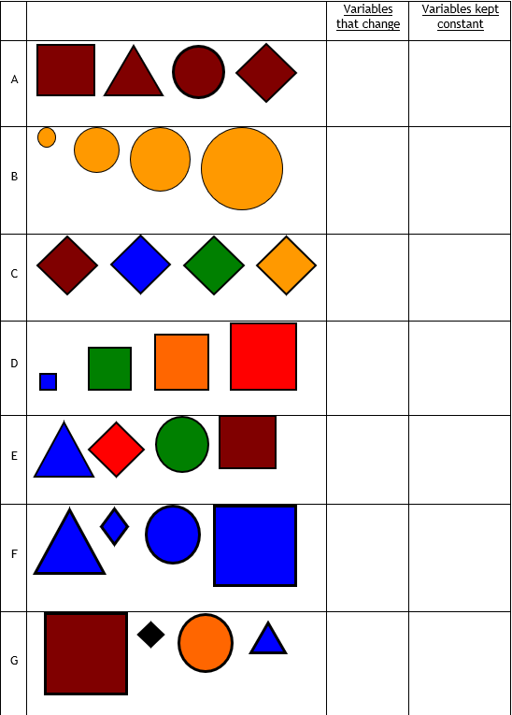

Slide 10
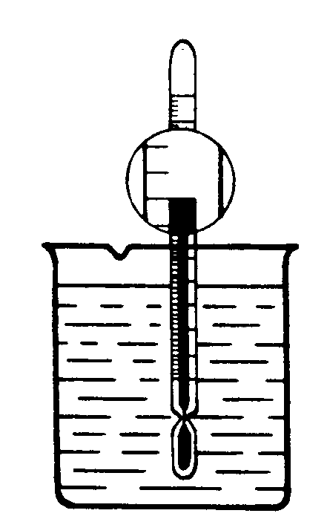
Heat Loss
1. We are now going to consider an experiment on heat loss from a beaker of water. Look at this picture of a beaker of hot water. Try to write down things that could be changed in the experiment. (List the variables!)

Slide 11
Write down which variables have been changed and which variables have stayed the same.

Slide 14
Is this a fair test?
A pupil sets up the following experiment to find out how well different materials keep in heat.

Slide 15
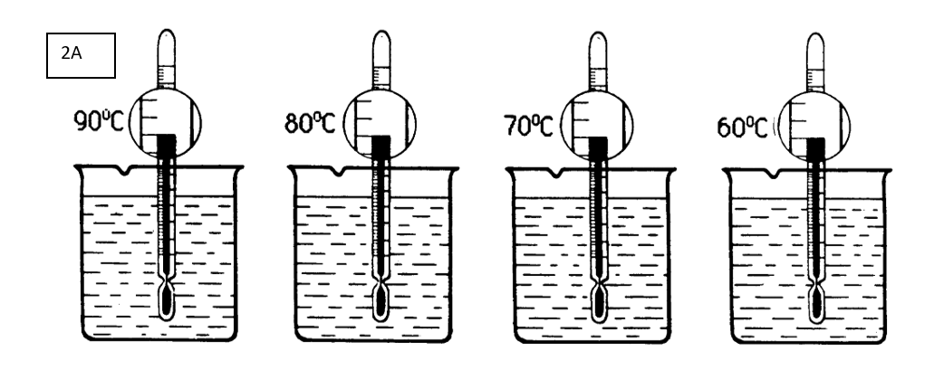
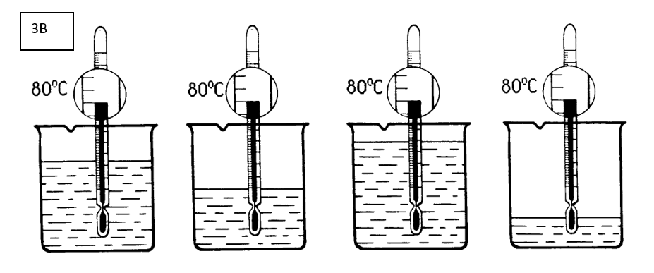
6. If you were asked to do the same experiment as in 5., which experiment from 2, 3 and 4 would you use? Why?

Slide 16
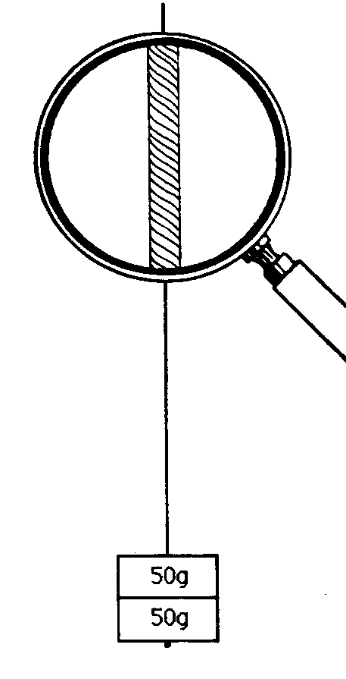
Strength of thread
an experiment which is designed to test the strength of thread. Weights are added to the thread until it breaks. The strongest thread will be the one which will hold the largest weight.
Look at the picture then try to write down which things could be changed in the experiment (that it to say, we want to know what the possible variables are in the experiment).

Slide 17
What is being tested? Write down which variable changes and which stay the same.
2. experiments to test the strength of threads.
Notes:
What is being tested? What variables are constant, what variable is changing? Is this a fair test?

Slide 18
3. Which type of material is strongest? Fair test? EXPLAIN

Slide 19
Notes:
What is being tested? What variables are constant, what variable is changing? Is this a fair test?

Slide 20
What is being tested? What variables are constant, what variable is changing? Is this a fair test?
Notes:
What is being tested? What variables are constant, what variable is changing? Is this a fair test?

Slide 21
6. Look at these four pictures of experiments to test the strength of threads.
Write down which variable changes and which stay the same.

Slide 22
If you were asked to carry out the same experiment as in 6, which experiment out of 2, 3, 4 or 5 would you use? Why?

