Slide 1
HEAT TRANSFER ConVECtion
S2 Physics

Slide 2
ReVIEW
Heat can be transferred in _ ways
_______________
_______________
________________
Usually heat is transferred in all 3 ways at once.
Heat ALWAYS travels from ______ places to ______ places
3
CONDUCTION
CONVECTION
RADIATION
Hot cold

Slide 3
Conduction REVIEW
__________ occurs in ________
________ are good conductors.
Non-metals, liquids and gases are _____ conductors.
Bad conductors are called good ________
Conduction
solids.
Metals
bad
insulators.

Slide 4
A model of heat transfer processes
book is like heat energy
CONVECTION – book taken by a student to the back of the room. The particles carry the energy to a different place.
https://youtu.be/N7k1D9E-5BU
Play the first 95 s only!

Slide 5
conVECTION
CONVECTION this occurs in liquids and gases.
The molecules carry the energy with them. The particles spread out and the fluid becomes less dense.
This is why hot fluids rise. (NB don’t say it is the heat rising, it is the particles that transfer the energy)

Slide 6
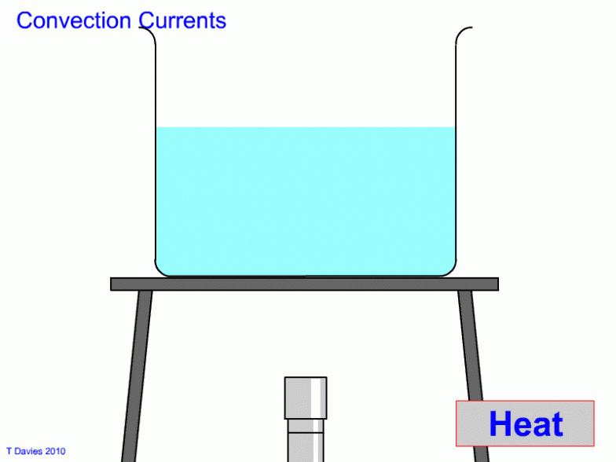
BEWARE
Notes:
Place all of the beakers on a heat proof mat as far from each other as possible.
Pour boiling water into the glass beaker, the plastic beaker, the copper can and the polystyrene cup.
Predict which one you think will be hottest to touch and which will be the coolest etc.
Touch each beaker lightly with your finger. BEWARE OF THE DANGERS OF THIS EXPERIMENT!

Slide 7
Convection Currents
The hot water becomes less dense.
It rises. As it rises it cools and sinks back down.
Notes:
Place all of the beakers on a heat proof mat as far from each other as possible.
Pour boiling water into the glass beaker, the plastic beaker, the copper can and the polystyrene cup.
Predict which one you think will be hottest to touch and which will be the coolest etc.
Touch each beaker lightly with your finger. BEWARE OF THE DANGERS OF THIS EXPERIMENT!

Slide 8
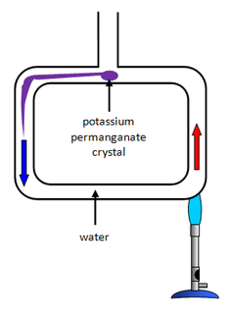
Another example of convection
BEWARE
Notes:
Place all of the beakers on a heat proof mat as far from each other as possible.
Pour boiling water into the glass beaker, the plastic beaker, the copper can and the polystyrene cup.
Predict which one you think will be hottest to touch and which will be the coolest etc.
Touch each beaker lightly with your finger. BEWARE OF THE DANGERS OF THIS EXPERIMENT!

Slide 9
Another example of convection currents

Slide 10
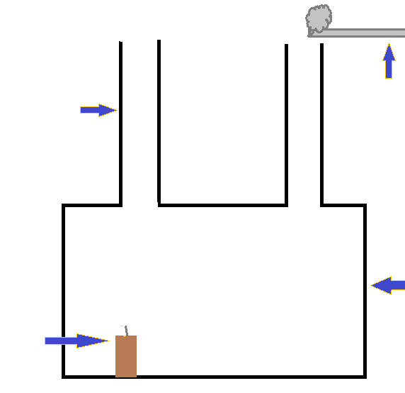
The SMOKE BOX
Wooden
Burning
spill
chimney
Smoke
box
Draw out the smoke box twice and label it once.
candle

Slide 11
The SMOKE BOX
Hot smoke rises
Candle unlit

Slide 12
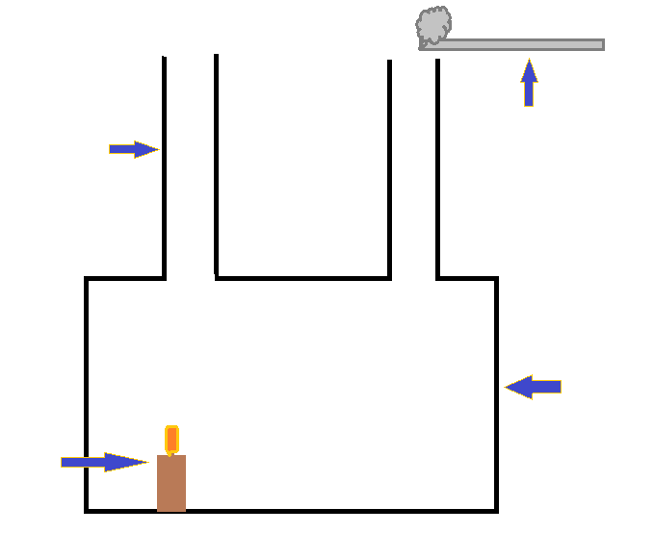
The SMOKE BOX
Candle lit

Slide 13
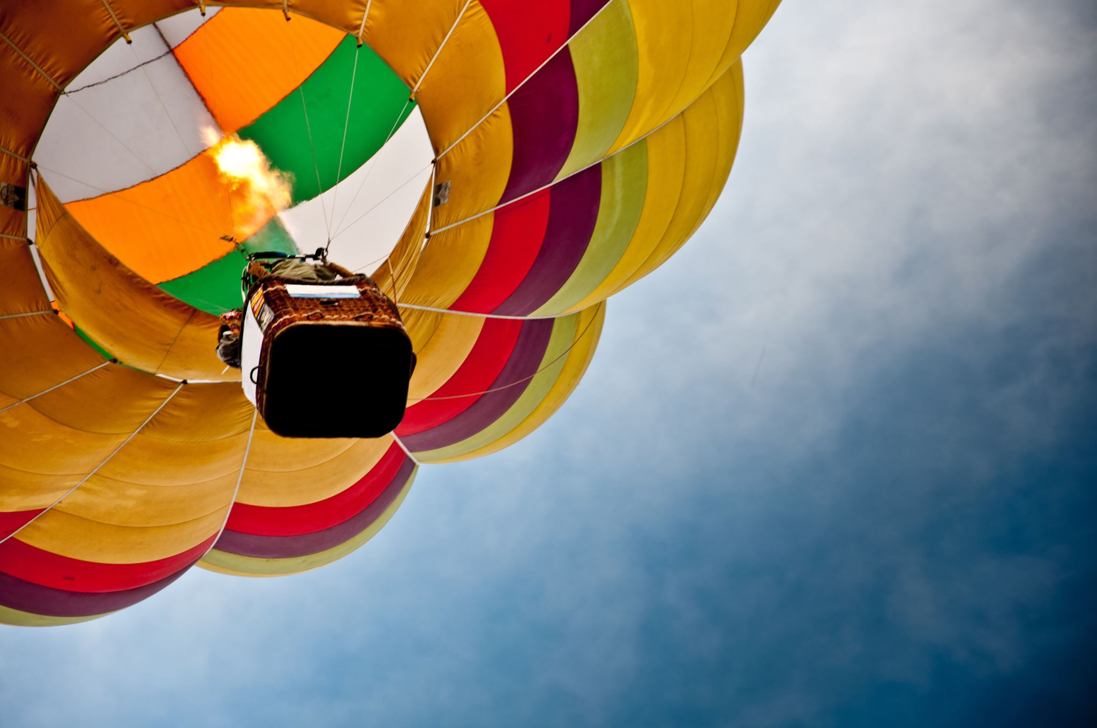
The Hot Air Balloon
https://youtu.be/ugsgmFcnszk

Slide 14
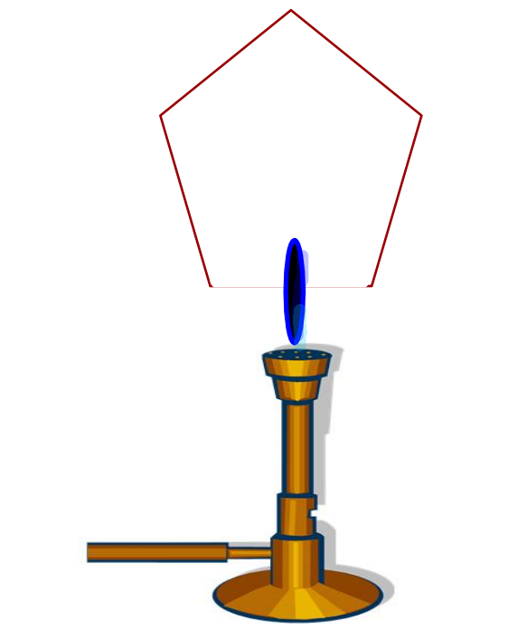
The Hot Air Balloon
Ask your teacher to demonstrate making a hot air balloon.
Describe what happens and why.

Slide 15
Turning Spirals- how your fake fire works!

Slide 16
All 3 States at once! HOW?
https://vimeo.com/384229447#

Slide 17
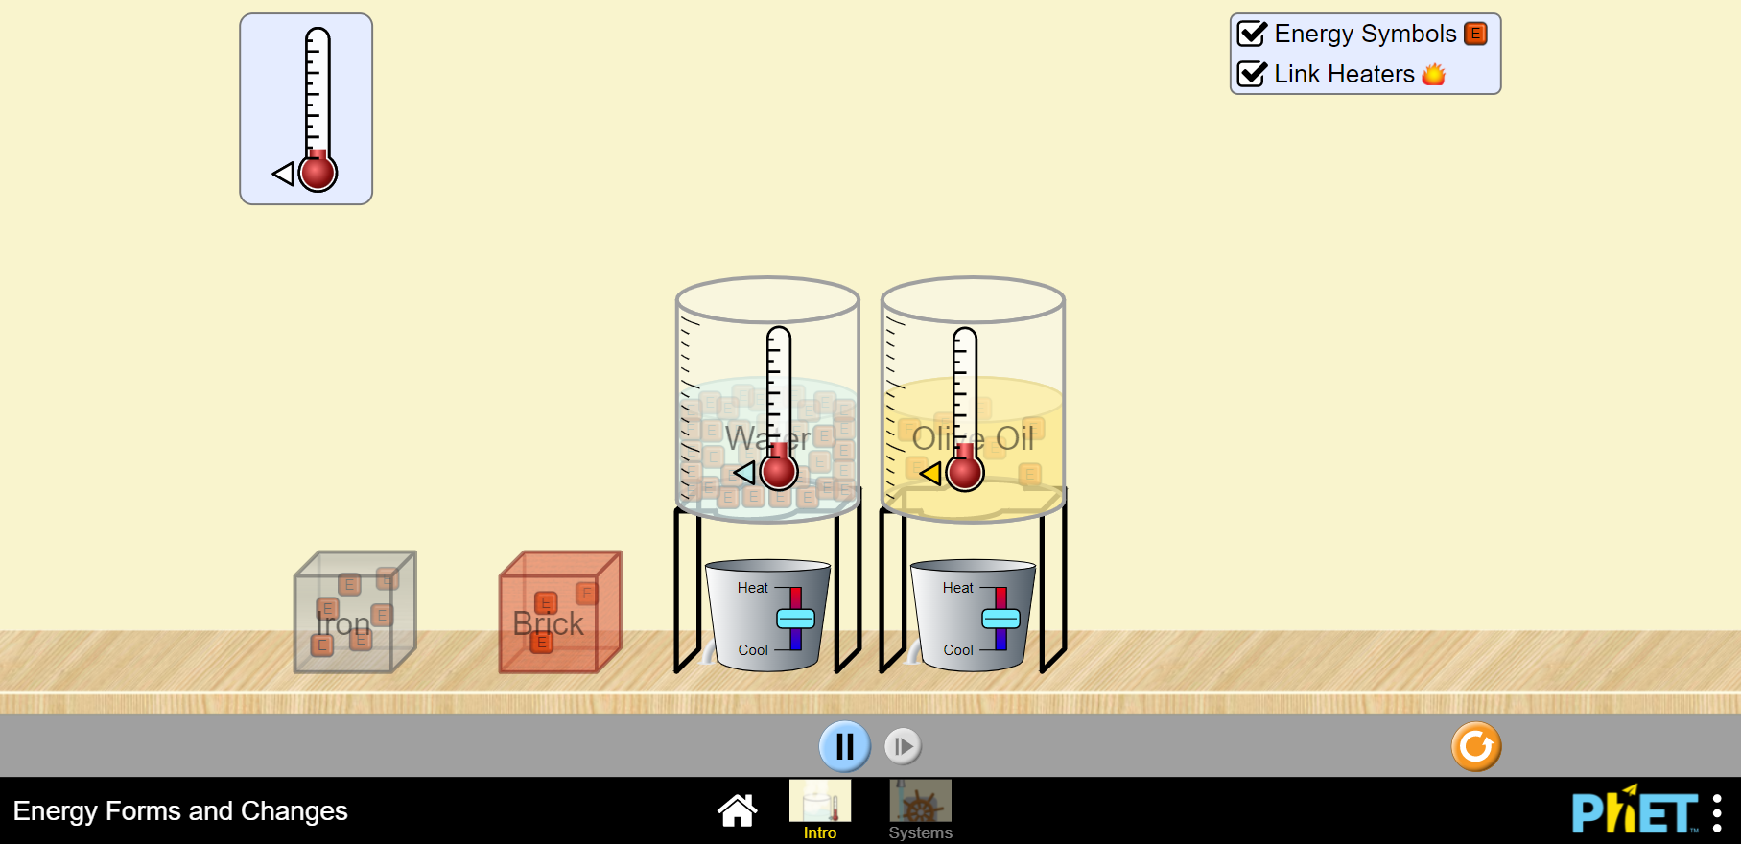
https://phet.colorado.edu/sims/html/energy-forms-and-changes/latest/energy-forms-and-changes_en.html

Slide 18
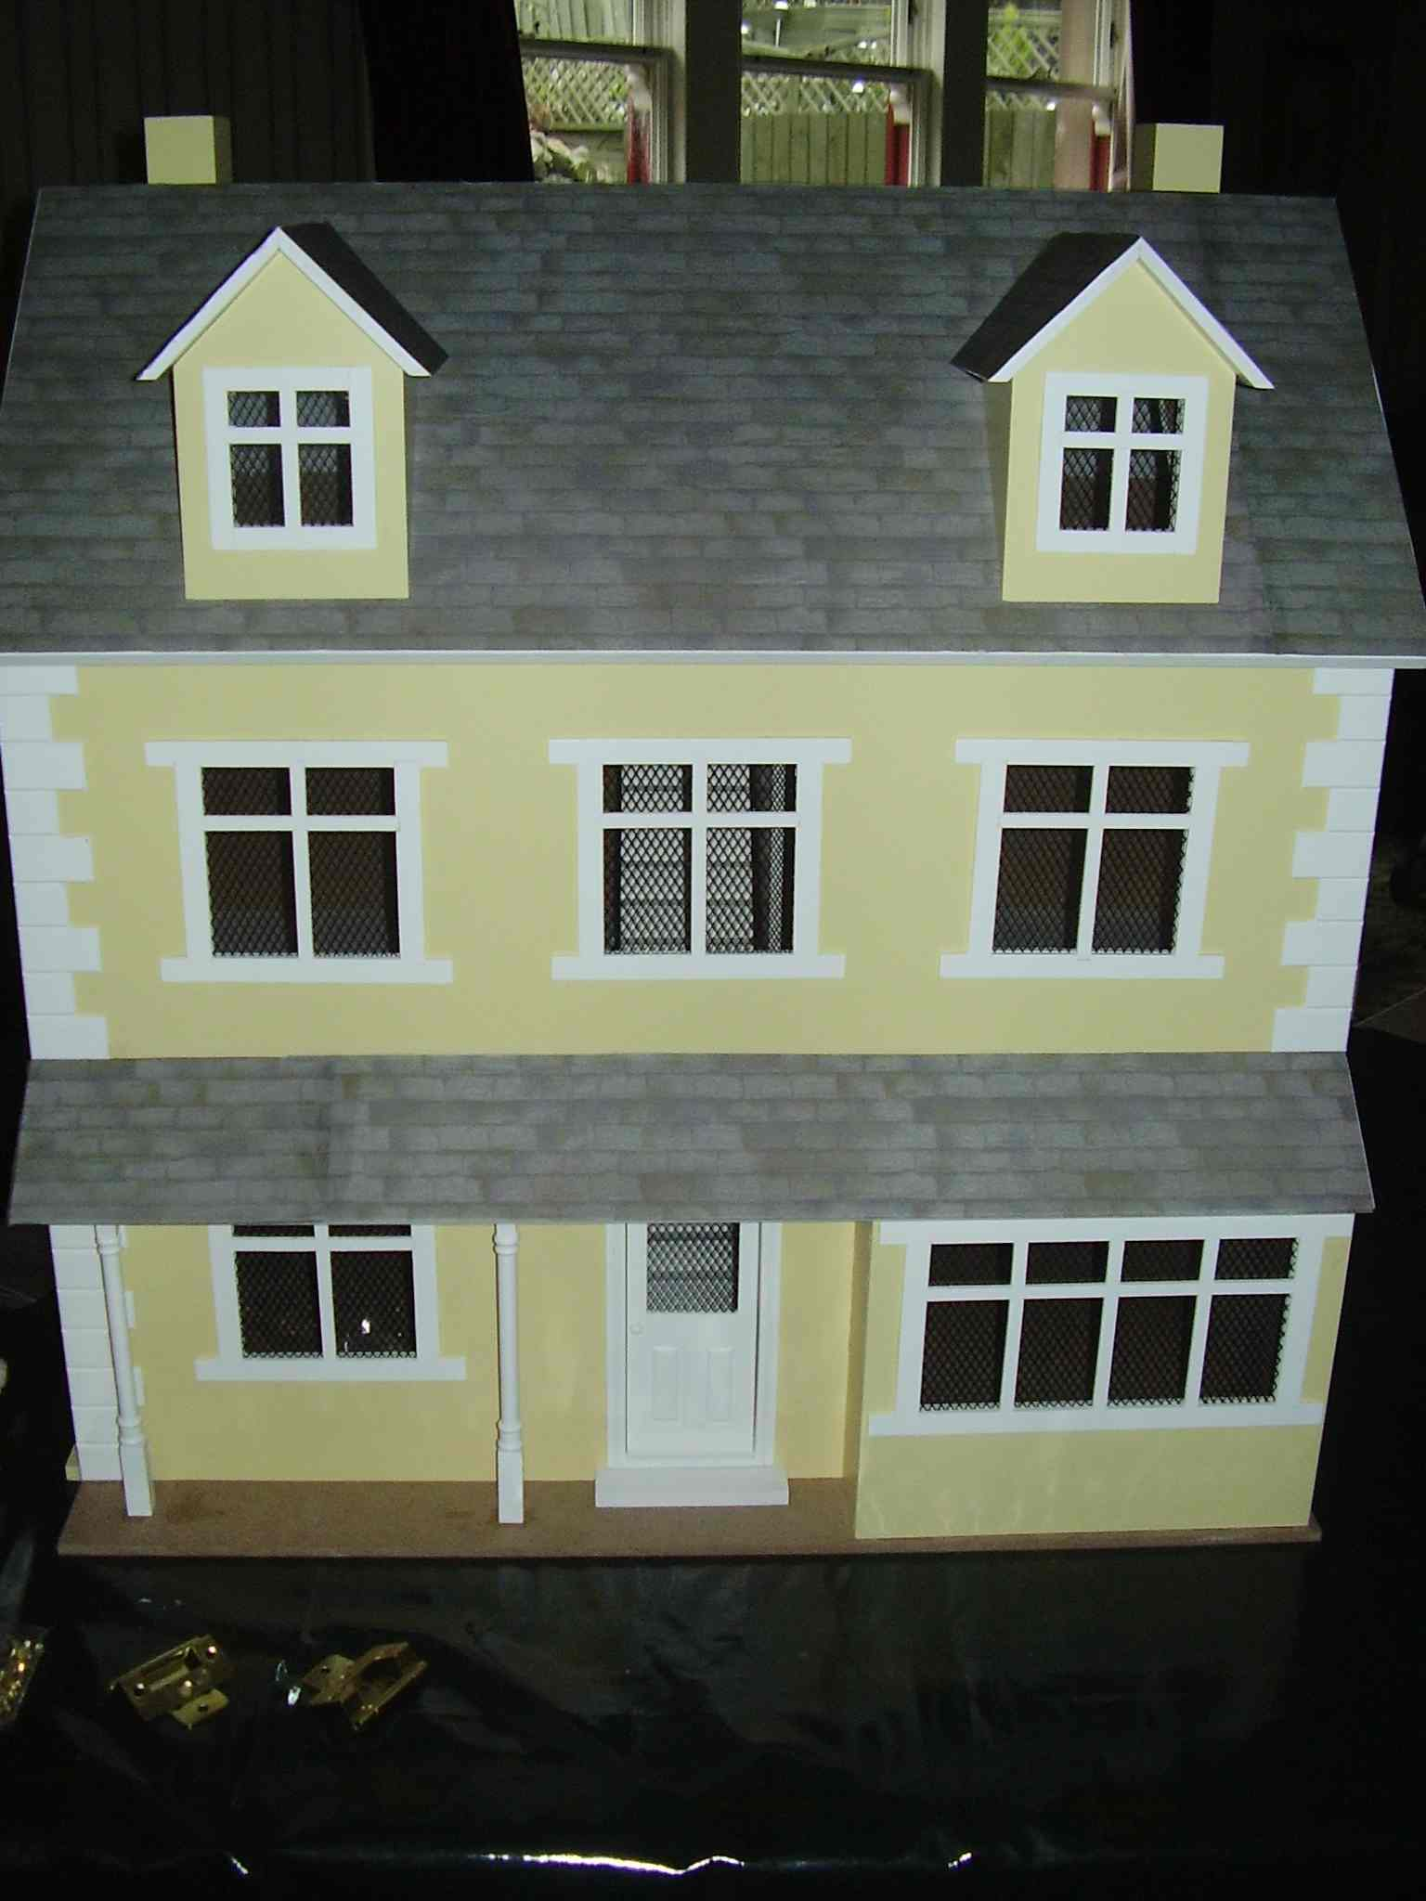
Heat Loss from HOUSES
Have you thought about what you can test?
Have you thought how you can test this in the lab?
What will be your variable?
What will you keep the same?
How long will you run your experiment?

Slide 19
CONVECTION Summary
CONVECTION occurs in fluids (liquids and gases).
The particles with more energy (heat) vibrate more and need more space to move around (like pupils in the PE hall rather than a maths room). As the fluid becomes less dense it rises.
As the fluid rises it cools and so becomes more dense and falls.
This movement is called a convection current.

