Slide 1
HEAT TRANSFER Conduction
S2 Physics

Slide 2
Heat can be transferred in 3 ways
CONDUCTION
CONVECTION
RADIATION
Usually heat is transferred in all 3 ways at once.
Heat ALWAYS travels from HOT places to COLD places
Hot cold

Slide 3
A model of heat transfer processes
book is like heat energy
CONDUCTION – book passed from student to student. The particles vibrate more and pass energy on to particles touching them.
CONVECTION – book taken by a student to the back of the room. The particles carry the energy to a different place.
RADIATION – book thrown to the back of the room. The energy does not need particles to transfer the energy.

Slide 4
TEMPERATURE v HEAT – Are they the same?
We often talk about heat and temperature as if they were the same thing – they are not!
After 2 mins there was a temperature increase in each beaker. The smaller volume of water had a higher increase in temp as there was less mass of water to heat.
Energy input is proportional to the rise in temperature. E_{h} α T
Temperature and Heat are related. The heat caused a change in temperature but they are NOT the same thing......
Notes:
We often talk about heat and temperature as if they were the same thing – they are not!
After 2 mins there was a temperature increase in each beaker. The smaller volume of water had a higher increase in temp as there was less mass of water to heat.
Energy input is proportional to the rise in temperature. Eh  T
Temperature and Heat are related. The heat caused a change in temperature but they are NOT the same thing......

Slide 5
TEMPERATURE v HEAT – Are Not the same
Temperature is how HOT or COLD something is, and it a measure of the speed of the particles.
Temperature is measured in degrees Celsius (°C)
HEAT is a form of ENERGY. Energy is measured in JOULES

Slide 6
https://physicsflashrepo.cyou/
https://youtu.be/qW59Y9lJso8
Notes:
YY^LU3!9X$cadc6h

Slide 7
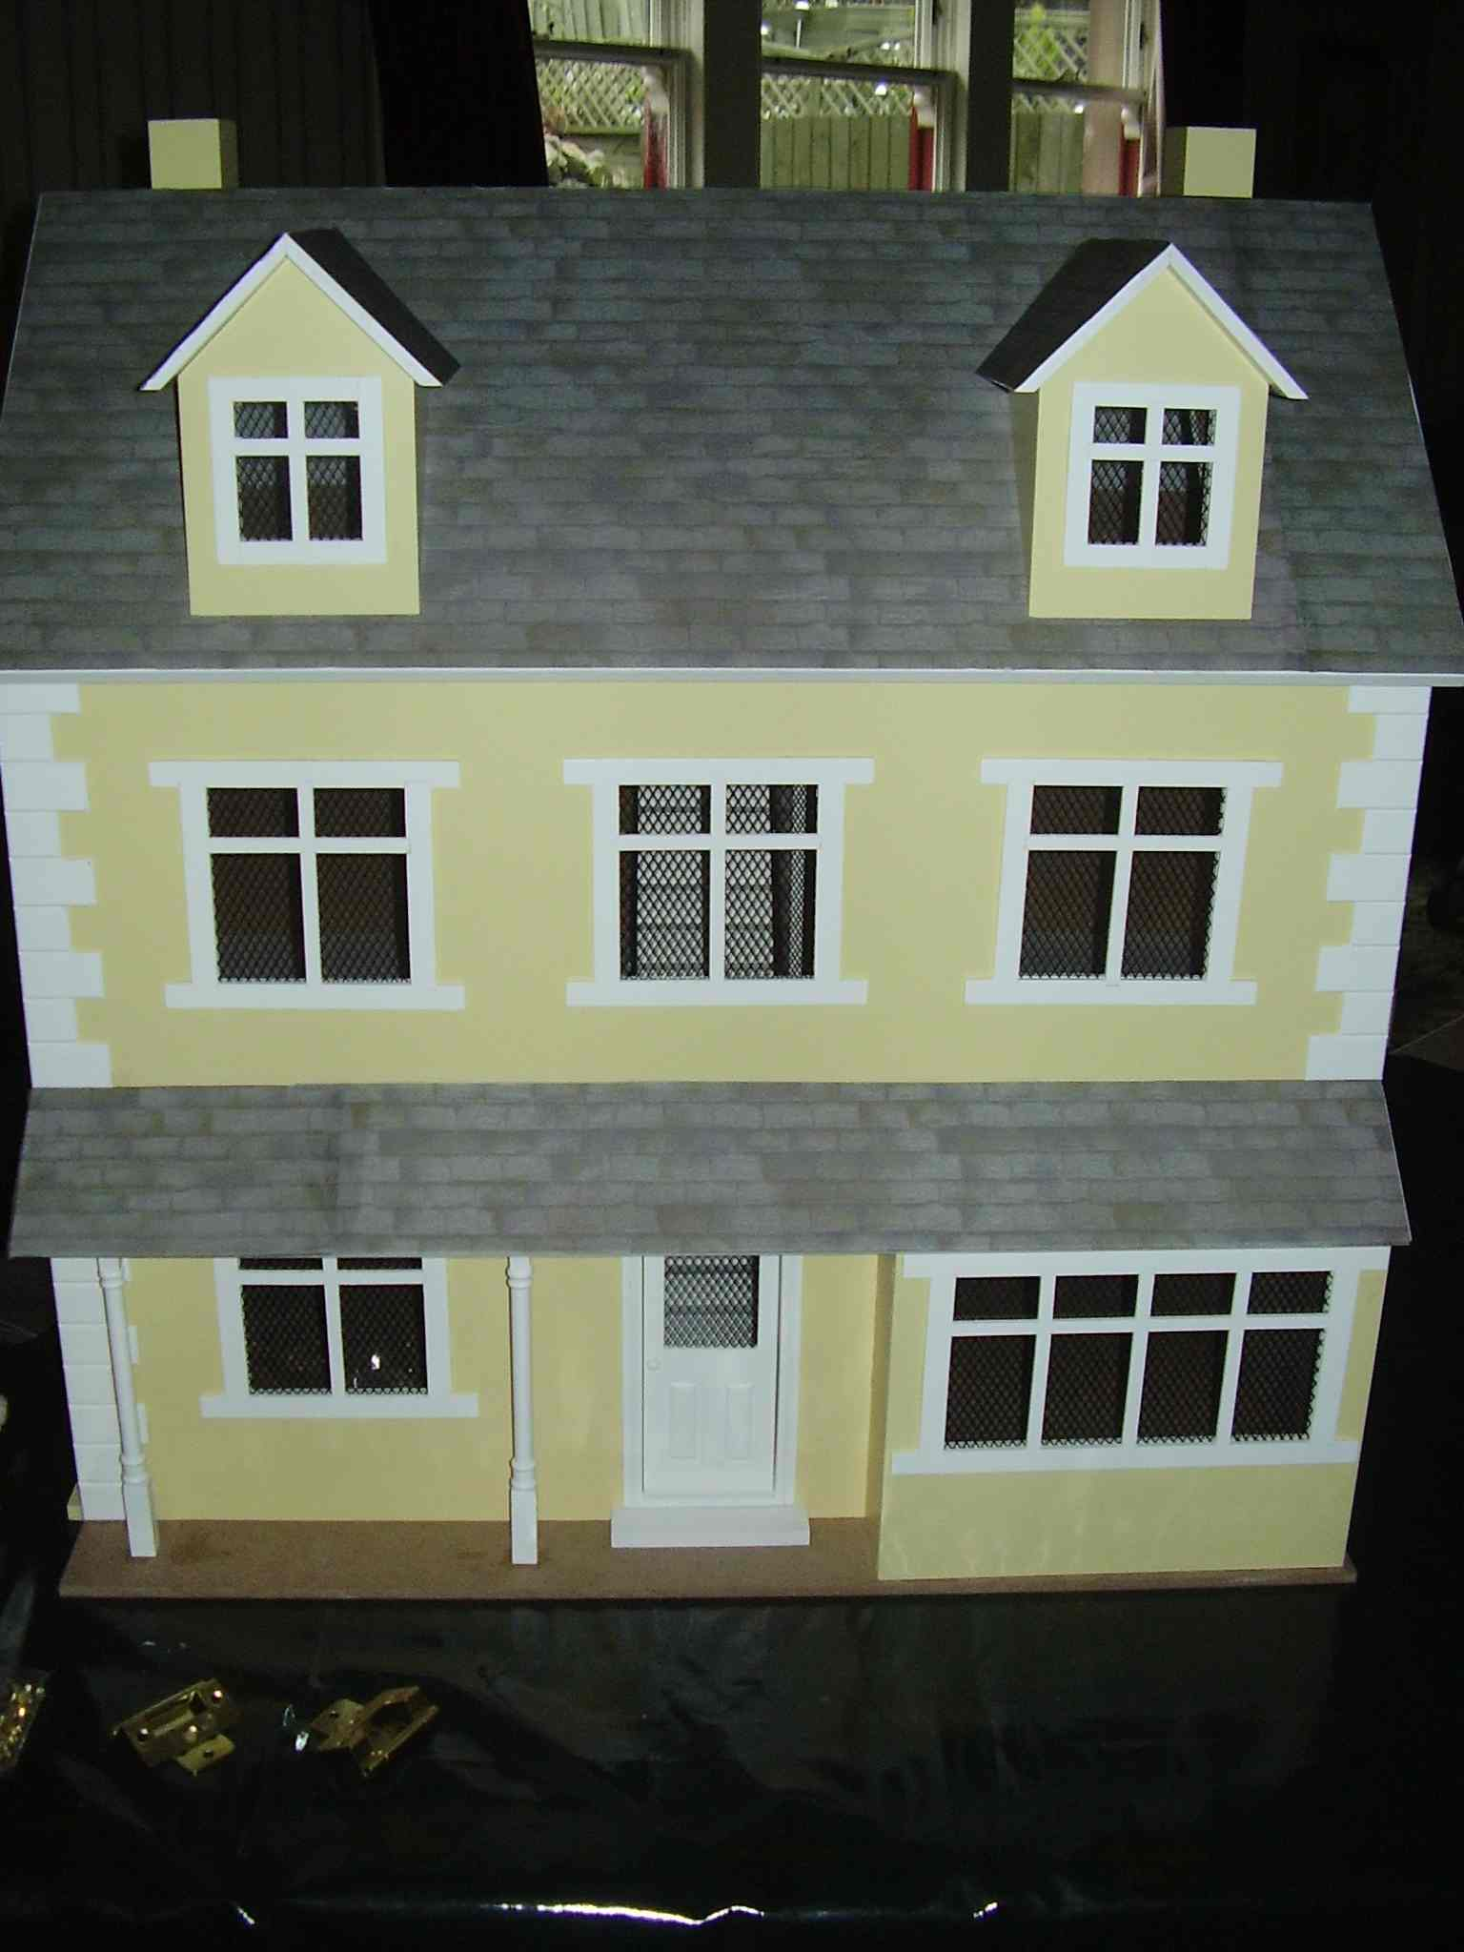
Heat Loss from HOUSES
How is heat lost from houses?
How can we test this in the lab?
How would it depend on ambient (air) temperature?
Can we do a fair test to find out?

Slide 8
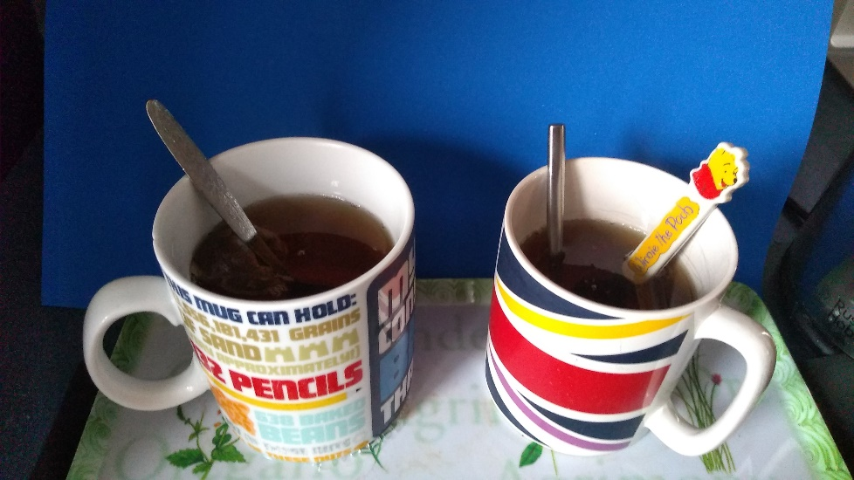
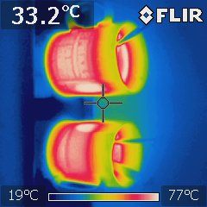
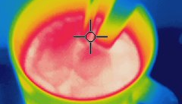
Conduction
Have you ever made a cup of tea or coffee and found the spoon you left in it was hot? The part of the spoon you touched wasn’t in the drink, so why did it feel hot?

Slide 9
Conduction
Conduction occurs in solids.
Metals are good conductors.
Non metals, liquids and gases are bad conductors.
Bad conductors are good insulators.

Slide 10
Which material is the best conductor?
Material | Prediction | Rank (first to heat up as no. 1)
Copper
Iron
Aluminium
Glass
Brass

Slide 11
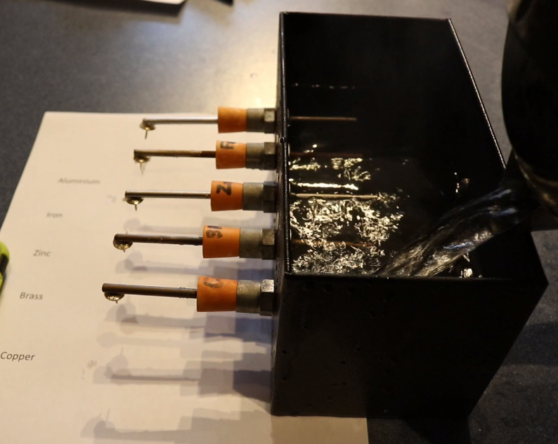
Ingen-Hauze's apparatus.
Material | Time for the pin to fall off (Minutes and seconds)
Copper
Brass
Zinc
Iron
Aluminium
1. Write out
Write out the order you think the drawing pins will fall off the metals.
2. Describe
Describe how the experiment is completed.
3. Watch
Watch the video and record the time when the pin falls off (for the last one you’ll have to guess!)
4. Explain
Explain what this experiment shows

Slide 12
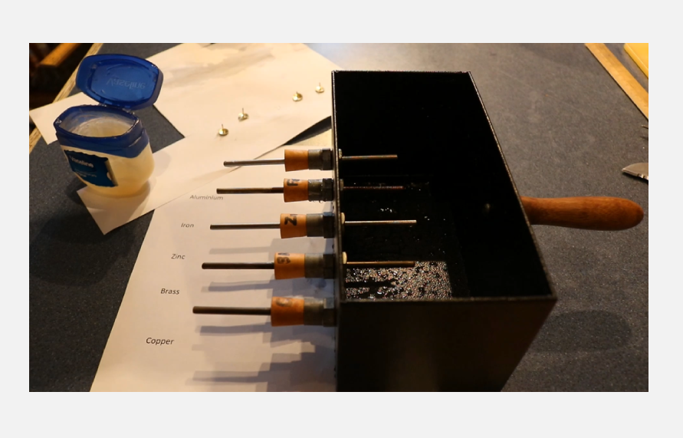

Slide 13
Which metal is the best conductor?
Here is another experiment to show which materials make the best conductors. There is a colour change when the heat moves up the rods. Do the results agree with the last experiment?
Draw the diagram and record the results

Slide 14
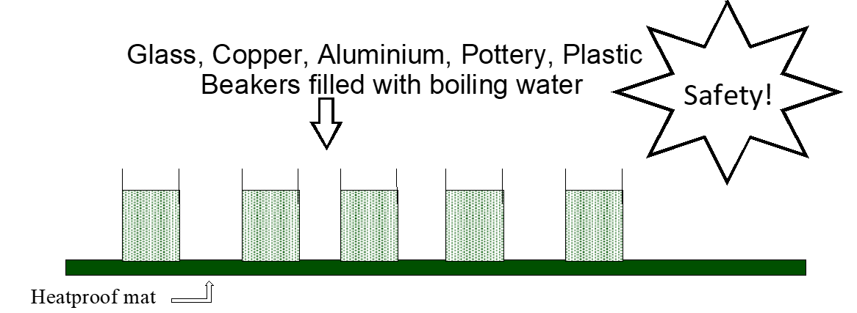
BEWARE
Notes:
Place all of the beakers on a heat proof mat as far from each other as possible.
Pour boiling water into the glass beaker, the plastic beaker, the copper can and the polystyrene cup.
Predict which one you think will be hottest to touch and which will be the coolest etc.
Touch each beaker lightly with your finger. BEWARE OF THE DANGERS OF THIS EXPERIMENT!

Slide 15
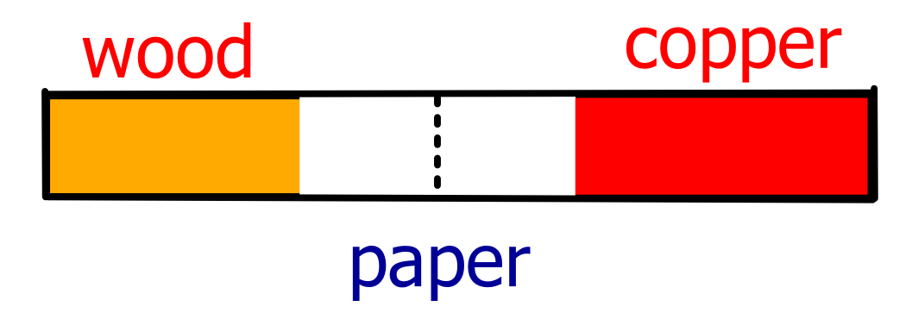
Copper and Wood Experiment
Conduction and Insulation

Slide 16
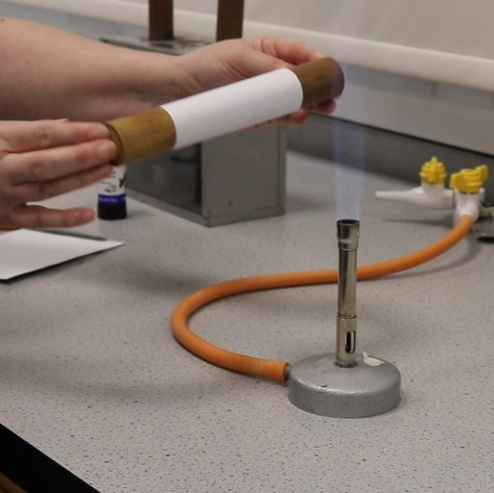
Predict!
Predict what will happen when I put the paper, wrapped over copper and wood, into the flame and move the paper over the flame.

Slide 17
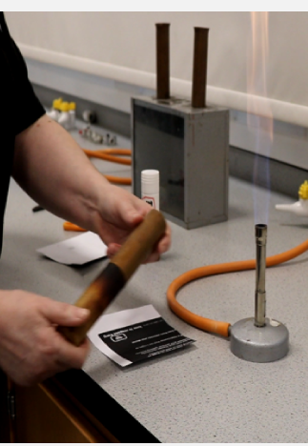

Slide 18
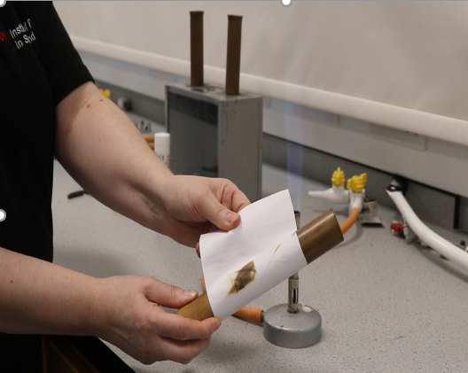

Slide 19
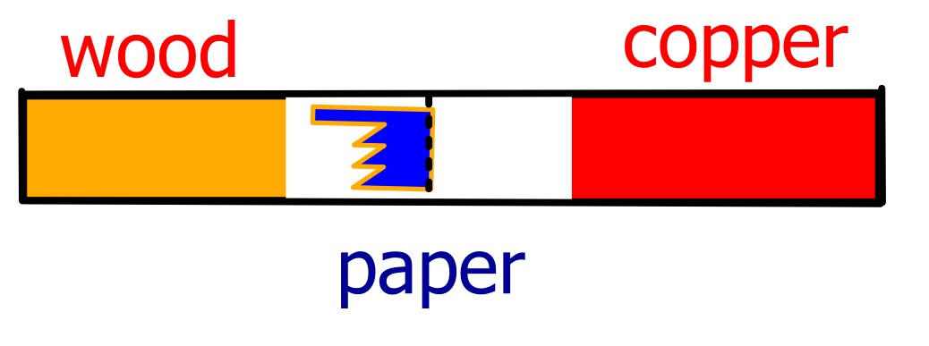
Why?
The paper over the wood burns but not the over the copper.
This is because the copper conducts the heat away and the paper over the copper does not get hot enough to catch fire.
(most paper catches fire at 220 °C - 250 °C)
Wood is a bad conductor, or a good insulator.

Slide 20
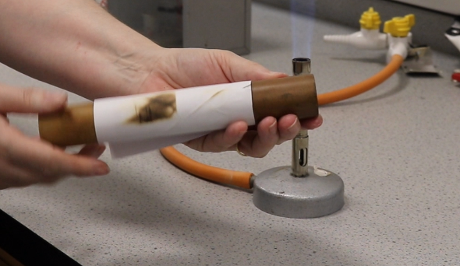
Wood is an Insulator
The paper over the wood burns as the wood is an insulator and the heat cannot escape. The temperature increases above the temperature at which paper catches fire.

Slide 21
Heating metals causes them to expand
When the metal is heated it expands.
We can stick a cast iron rod in the hole and tighten it.
As it has been heated the bar is longer than it was when cold.
When we cover the bar with a cold damp lab coat the bar contracts (gets smaller)
The force of contraction is so large it can break the cast iron rod.

Slide 22
CONDUCTION Summary
Conduction occurs when heat passes through a SOLID
Heat is transferred by making the particles vibrate more passing the energy along the conducting material.
http://www.echalk.co.uk/Science/physics/conduction/conduction.html
Conduction occurs in solids.
Metals are good conductors.
Non-metals, liquids and gases are poor conductors.
Bad conductors are good insulators.
Good conductors of heat are the same materials as good conductors of electrical current, electrical insulators are also insulators of heat

