Slide 1
HEAT TRANSFER RADIAtion
S2 Physics

Slide 2
ReVIEW
Heat can be transferred in _ ways
_______________
_______________
________________
Usually heat is transferred in all 3 ways at once.
Heat ALWAYS travels from ______ places to ______ places
3
CONDUCTION
CONVECTION
RADIATION
Usually heat is transferred in all ways at once
Hot cold

Slide 3
Revision
fluids
Convection occurs in ________________
___________ are liquids and gases
To start a convection current
The substance is __________________
This causes the particles to _____________
There are fewer in the space so become ______ _______
The less dense fluid ___________
The fluid cools and the spacing _________________
The cooler fluid becomes ____ ______ and ______
fluids
heated
spread out (don’t say expand)
less
dense
rises
decreases
more
dense
falls

Slide 4
A model of heat transfer processes
book is like heat energy
3. RADIATION – book thrown to the back of the room. The energy does not need particles to transfer the energy.

Slide 5
RADIATION
Radiation also called INFRA-RED (IR) radiation or thermal radiation, is heat travelling as waves.
The waves are similar to light.

Slide 6
Heat travels from the Sun to Earth by radiation as these waves can travel through a vacuum, but radiation can travel through gases as well.
Notes:
YY^LU3!9X$cadc6h

Slide 7
Radiation is affected by BLACK and SHINY surfaces.
Black surfaces absorb radiation better than shiny ones.
Black surfaces give out (emit) radiation better than shiny ones.
Shiny surfaces reflect radiation better than black.

Slide 8
Best absorbers

Slide 9
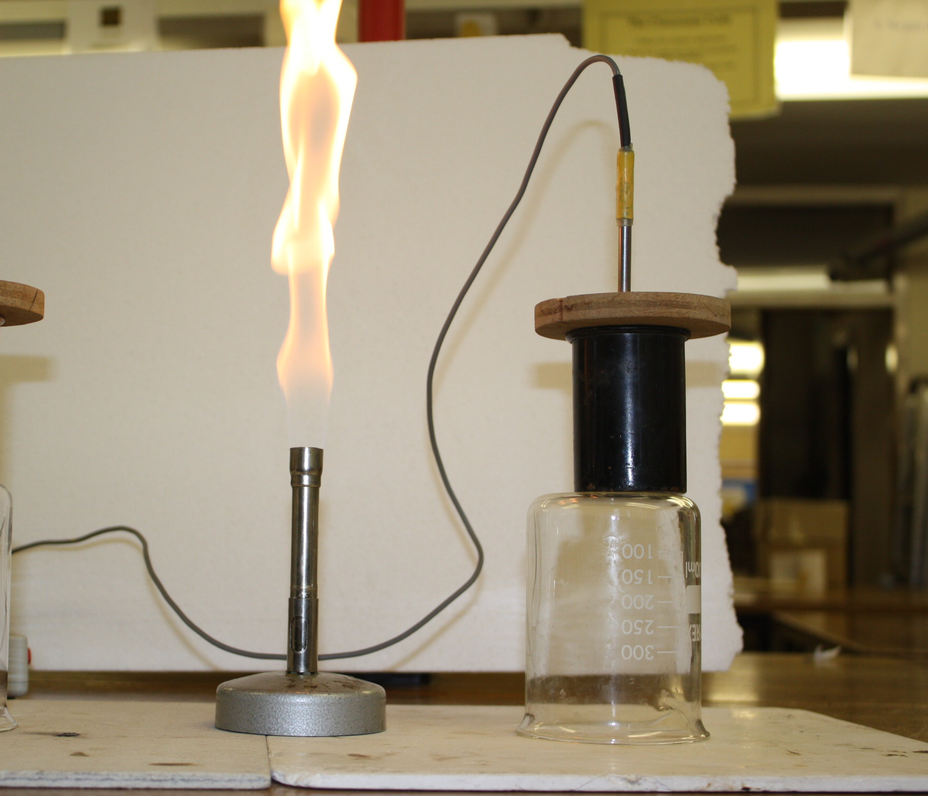
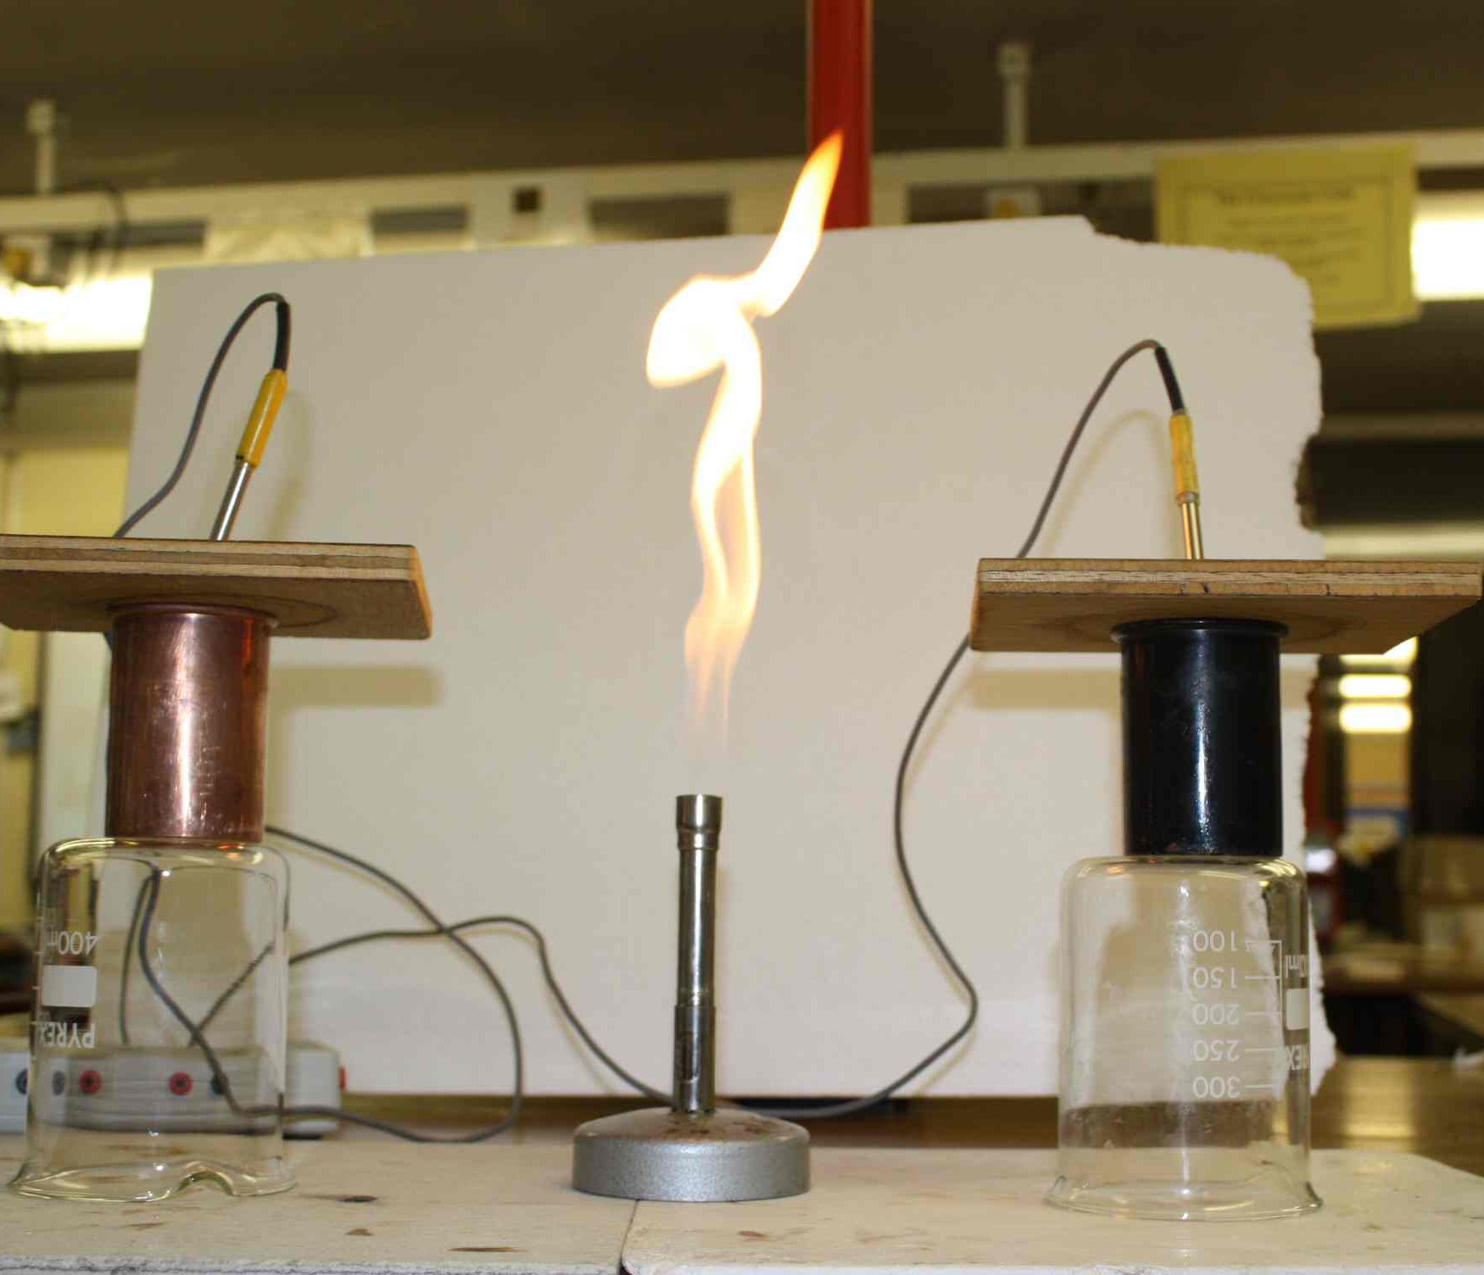
Black or shiny absorbers
How to make it a fair test?
What results would we expect?
How will we know?

Slide 10
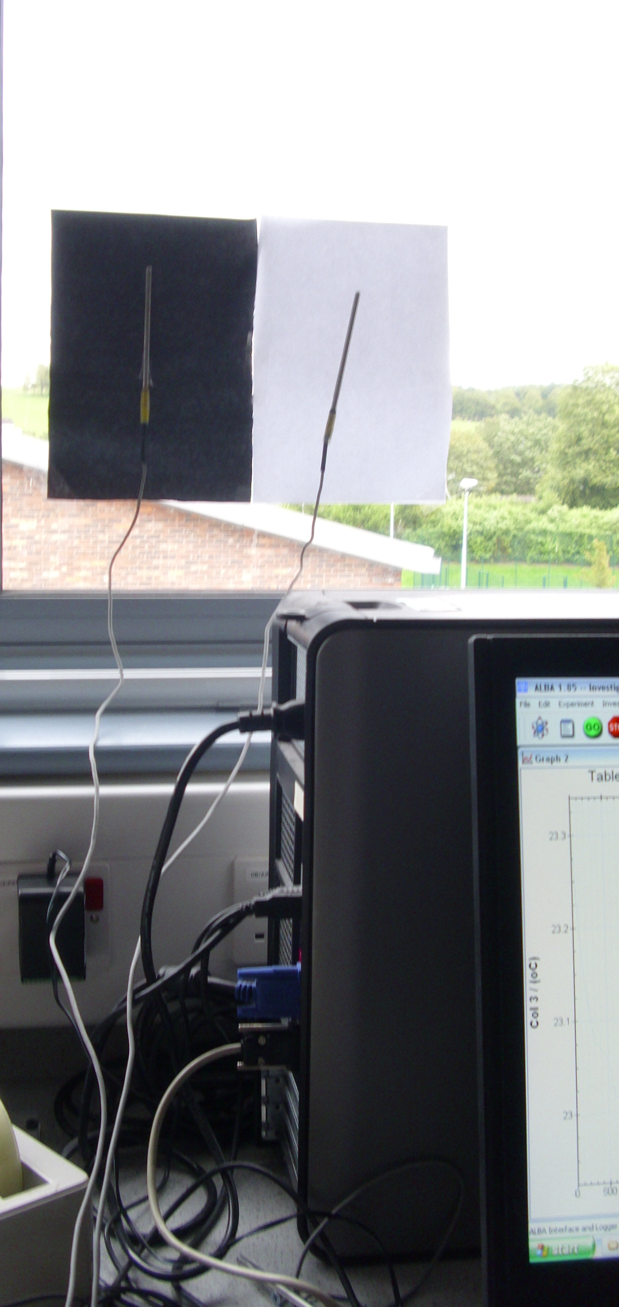
Absorbers of radiation

Slide 11
Black or shiny emitters
How to make it a fair test?
What results would we expect?
How will we know?

Slide 12
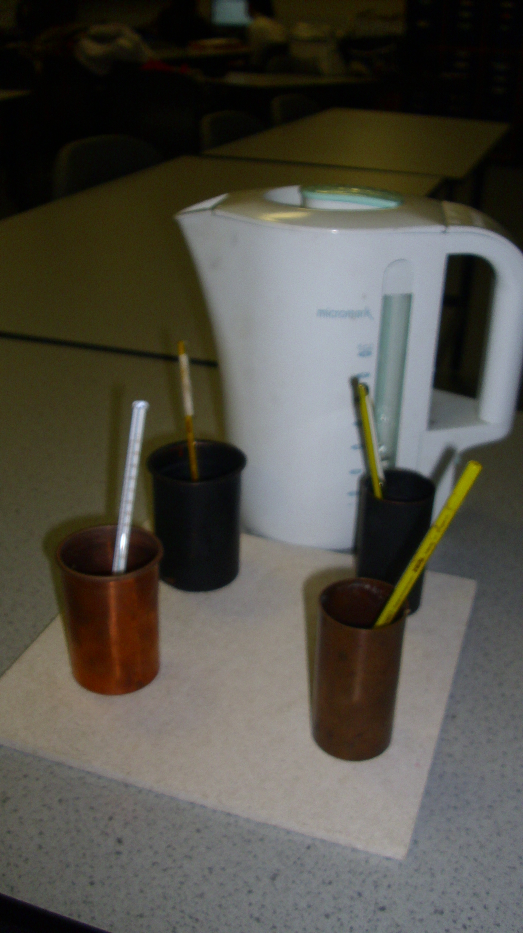
Which emits more radiation?
NB lids required, why?

Slide 13
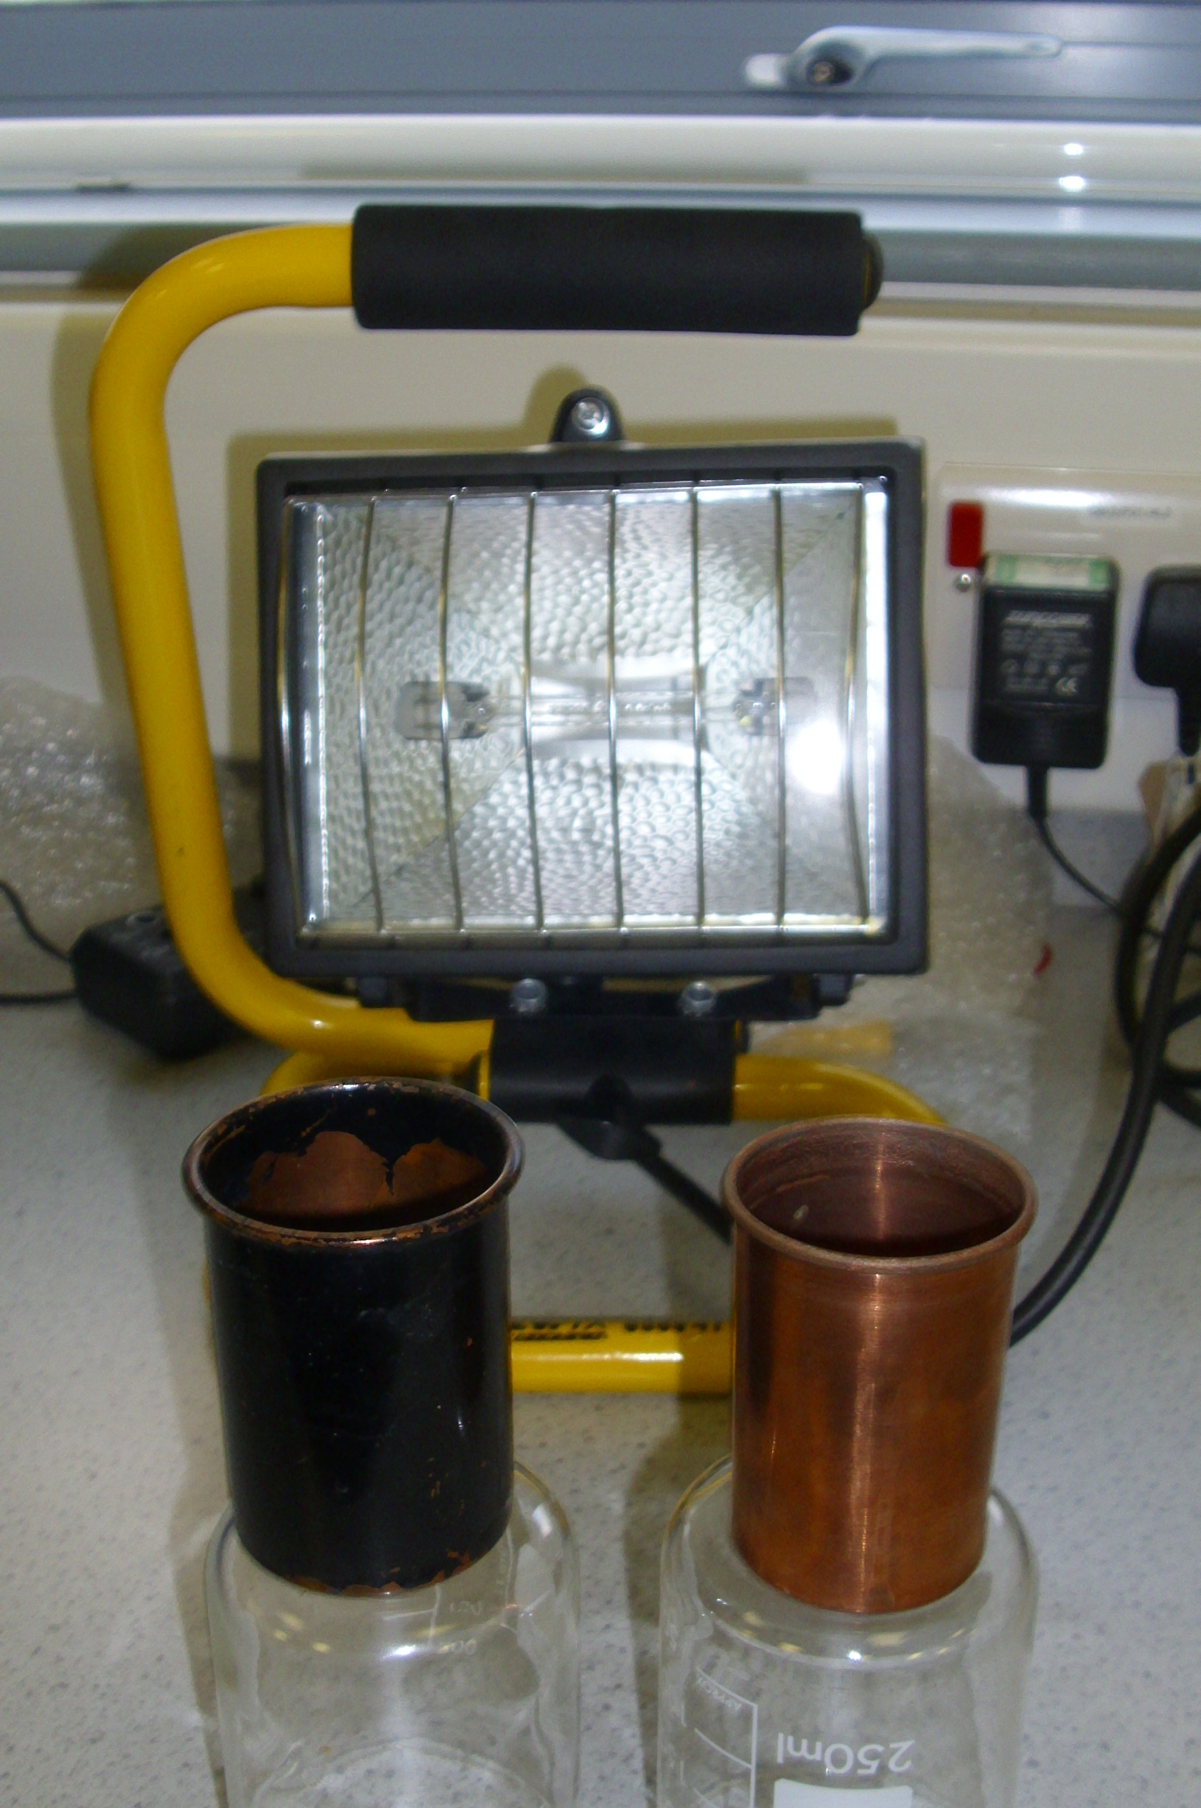
Reflectors of radiation
Could you design an experiment with a radiant heater, a black and shiny surface to determine which surface REFLECTS more radiation?
Where would you place the detector?
What might you use as a detector?

Slide 14
Infra red detectors

Slide 15
RADIAtion
heat travelling as waves
the way heat reaches us from the sun
does not require a medium (particles)
black surfaces good emitters and absorbers of radiation.
shiny surfaces good reflectors of radiation
also called infra red (IR) or thermal radiation

Slide 16
RADIATION Summary
Radiation or Infrared radiation is when heat travels as a wave.
The wave travels at the speed of light through the air. (This speed is 300 000 000 m/s or the equivalent of 7.5 x around the Earth every second)
Black surfaces ABSORB more radiation than SHINY surfaces.
Black surfaces EMIT (give out) more radiation than SHINY surfaces.
Shiny surfaces REFLECT more radiation than BLACK surfaces

Slide 17
3 states in one tube- how?

Slide 18
BLACK OR WHITE ABSORBERS
Mrs Hargreaves has a theory that
black socks absorb more heat than white socks so are smellier at the end of the day.
could you design an experiment to prove it?

Slide 19
FAIR TEST?

Slide 20
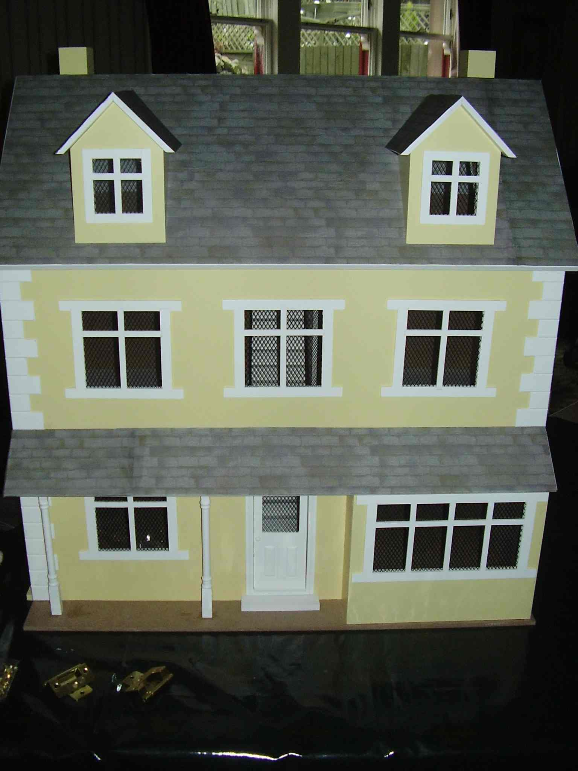
Heat Loss from HOUSES
How is heat lost from houses?
How can we test this in the lab?
How would it depend on ambient (air) temperature?
Can we do a fair test to find out?

