Slide 1

Measuring Acceleration
S3 Physics

Slide 2
The Equation

Slide 3
TASK
Describe how you could measure the acceleration of a small vehicle as it runs down a slope in the laboratory.

Slide 4
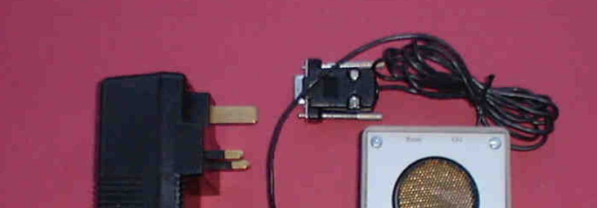
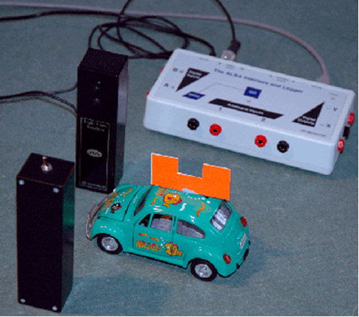
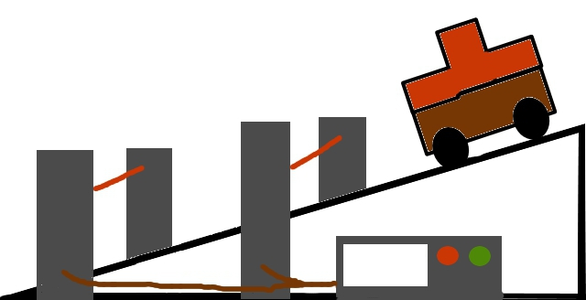
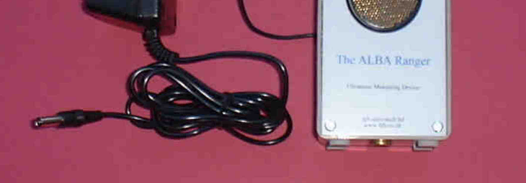
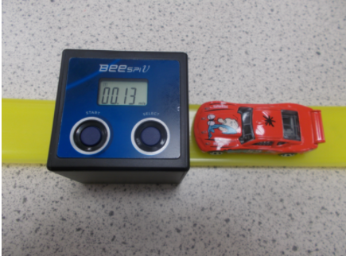
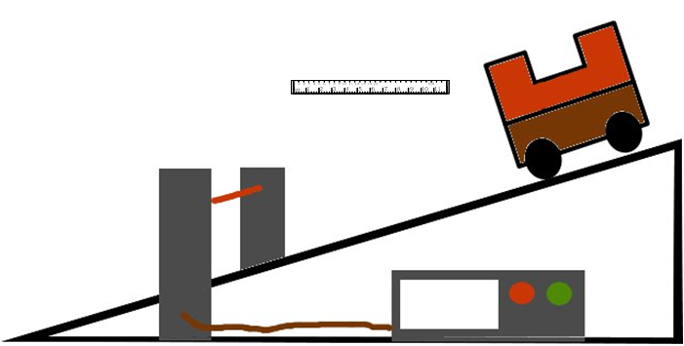
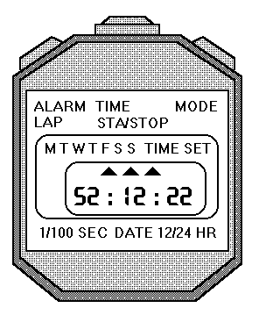
Many different ways

Slide 5

Note to the teacher
Go through this next slide before doing the experiments

Slide 6
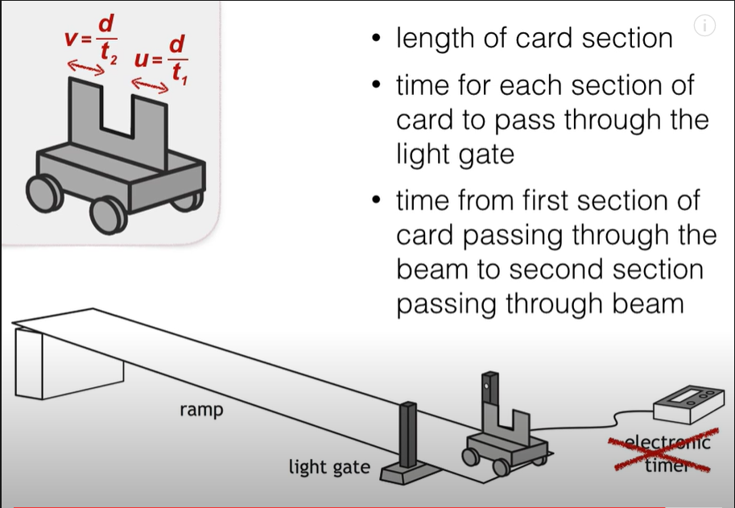
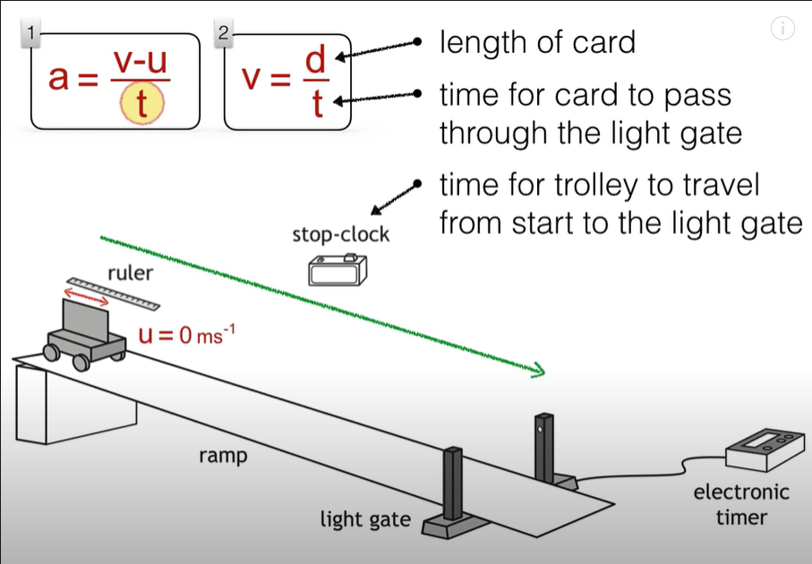
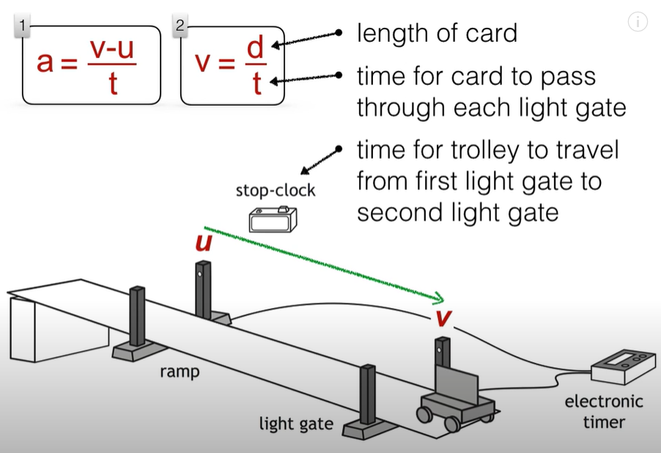
https://www.youtube.com/watch?v=YUqwdD73610
There are different ways to measure acceleration here are a few.

Slide 7
Don’t measure acceleration we calculate it!
We don’t measure v and u we calculate
them from
u=s/t
  Where
    s = length of the card
    t= time for the vehicle to pass through the top light gates.
    v=s/t
  Where
    s = length of the card
    t= time for the vehicle to pass through the bottom light gates.
    We also need to know the time it took the car to go between the light gates.
    Or v=s/t where s= length of second piece of card, and t is the time for the vehicle to pass through the light gate.

Slide 8


Measuring acceleration with the ALBA RANGER
Here the Ranger sends out pulses of sound / ultrasound. The sound waves reflect off the object and the reflected waves return to the ranger.
If the pulses are returning after a longer time what does this tell you about the vehicle?
What about the pulses reflecting in a shorter time?

Slide 9

Measuring acceleration with two light gates and a single mask

Slide 10
Does it matter how far apart the light gates are?
Surely the further apart the light gates the greater the value of v.
No it doesn’t matter how far apart the light gates are if the acceleration down the slope is constant
Yes the further apart the light gates the greater
the value of v but the longer it takes to go between the light gates. If a=v-u/t then v is greater but also t so these two cancel and a remains constant.

Slide 11
Measuring acceleration with only one light gate

Slide 12
How can we only use 1 light gate to find acceleration?
Yes the vehicle has a double MASK. u and v are still taken from the time it takes the mask to pass through the light gate and we need to measure the length of the mask.

Slide 13
Measuring Acceleration
You can measure acceleration in the lab with EITHER one single mask and two light gates or a double mask and one light gate.
Whichever way the experiment is conducted the measurements that need to be made are:
  Width of the mask or masks.
  Time for first light beam to be broken.
  Time for second light beam to be broken.
  Time between the breaks in the light beam to be measured.

Slide 14
Measuring acceleration from rest
If the vehicle is starting from rest then u does not need to be physically measured.
A stopwatch can be used to time the vehicle from the time of release until the mask cuts the light gate
The time for the mask to break the light beam allows the final velocity to be calculate from v=s/t where s is the length of the mask and t the time to pass through the light gate.

Slide 15
How can we only use 1 light gate and a single mask to find acceleration?
TASK
Using equipment of your choice investigate the effect of the angle of a slope on acceleration.
Here we take u, the starting velocity as zero, so we don’t need to measure that.
We time how long the vehicle takes to travel to the light gate. v is found from the time it takes the mask to pass through the light gate and we need to measure the length of the mask.

Slide 16
Measurements | Calculations
t₁ time to pass first light gate
t₂ time to pass second light gate
t₃ time between light gate
Length of mask

Slide 17

Now we need to try it and see what works and what doesn’t
Set up each method and find the value of the acceleration down the slope three times by each method.
Record all of your measurements
Evaluate each method, discussing what is easy or hard to set up, which measurements are easy or hard to take and which measurements do you think are reliable. How confident do you feel that your answer tells you the exact value for the acceleration of your vehicle down the slope?

Slide 18
Many different ways

Slide 19

Method 1
Pros | Cons
No handheld stopwatch | Mustn’t put light gate right at the bottom
Could cope with a high acceleration | Masks both have to be the same width
Consistent results (most of the time) | Sometimes hard to get through both light gates
Doesn’t matter how far apart the light gates are | Don’t put light gates right at the bottom
very consistent
u (m/s) | v (m/s) | t (s) | a (m/s²)
0.49 | 0.83 | 0.78 | 0.45
0.47 | 0.83 | 0.77 | 0.46
0.52 | 0.85 | 0.74 | 0.45
0.36 | 0.77 | 0.89 | 0.47
0.55 | 0.88 | 0.71 | 0.46

Slide 20
Method 2
Pros | Cons
No handheld stopwatch | Mustn’t put light gate right at the bottom
No problem with trolley going through 2 sets of light gates | Masks both have to be the same width
Could cope with a high acceleration
No issues with setting the correct height.
Quite consistent
u (m/s) | v (m/s) | t (s) | a (m/s²)
0.66 | 0.91 | 0.08 | 3.34
0.72 | 0.97 | 0.07 | 3.42
0.79 | 1.03 | 0.07 | 3.74
0.80 | 1.07 | 0.07 | 3.68
0.78 | 1.05 | 0.07 | 3.75

Slide 21

Method 3
Pros | Cons
No mask so no problems with straight edges | Hand held stopwatch so problems with reaction time
Very easy to set up | light gate must be placed where the vehicle is still accelerating
 | Needed the track so car went through light-gate
 | Only some vehicles will go through the light-gate
Not very consistent
u (m/s) | v (m/s) | t (s) | a (m/s²)
0 | 1.8 | 0.49 | 3.7
0 | 1.71 | 0.40 | 4.3
0 | 1.85 | 0.33 | 5.6

Slide 22
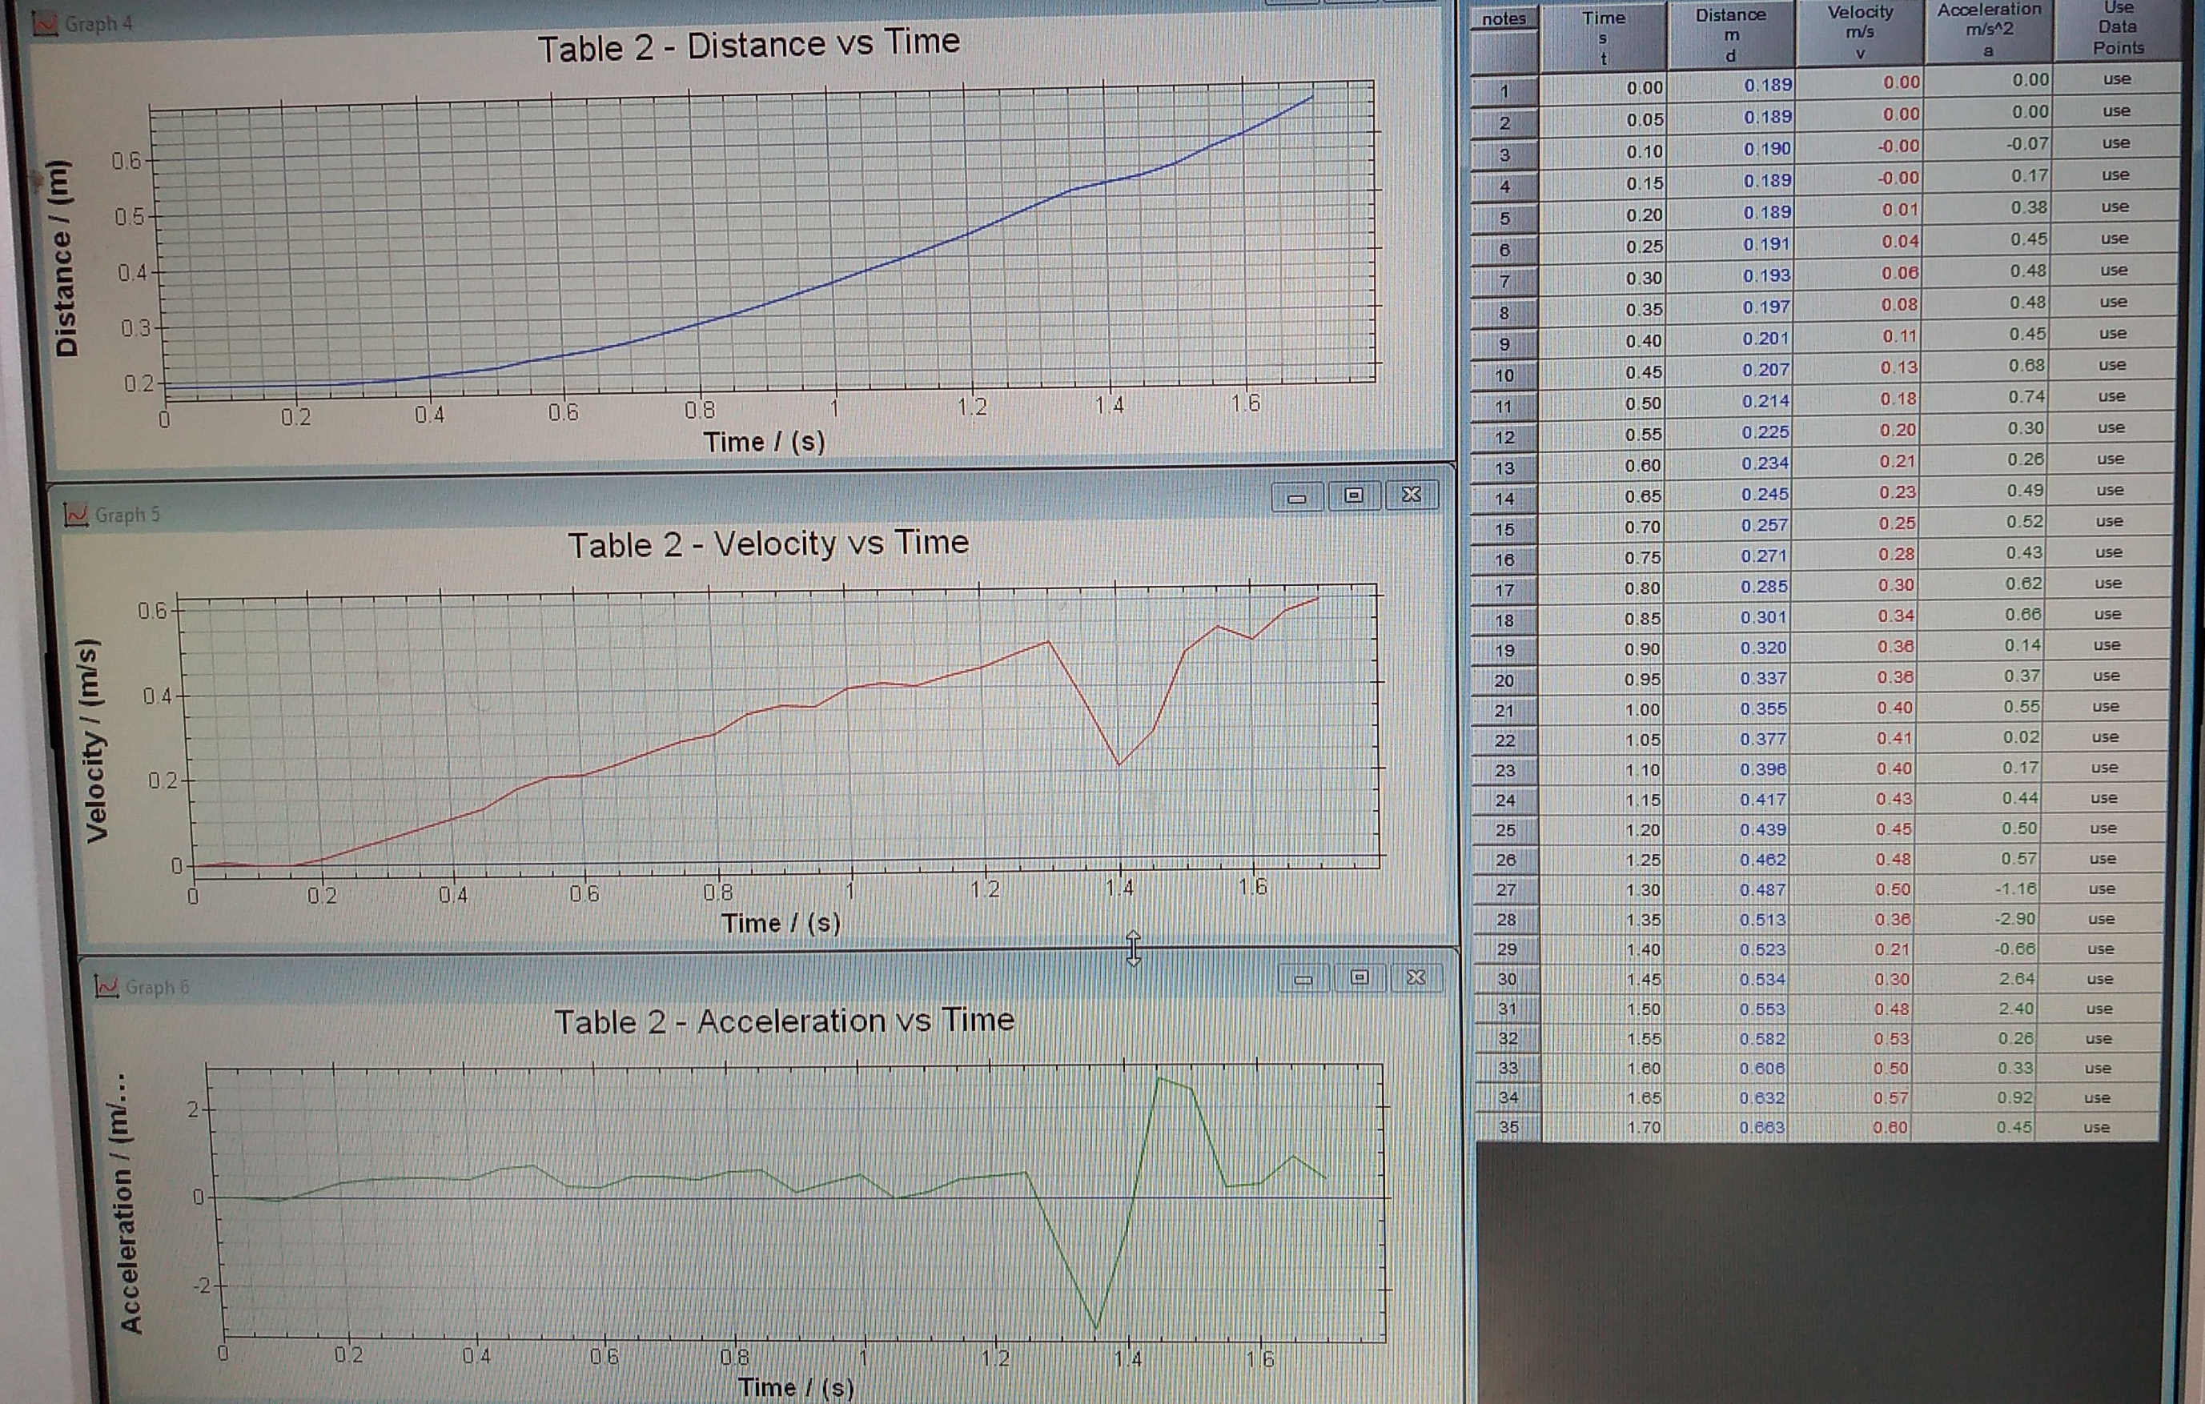
Method 4
Pros | Cons
Instantaneous displacement/ velocity and acceleration | Flat surface must allow the ranger to reflect off it all the way down the slope
 | High air/resistance drag
 | Results are harder to interpret
Nice displacement graph, OK v-t graph a bit rough for the a-t graph

Slide 23
https://www.youtube.com/watch?v=YUqwdD73610
There are different ways to measure acceleration here are a few.

Slide 24
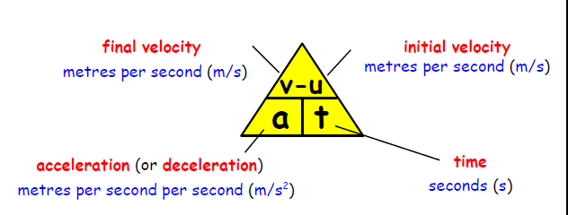
Calculating Acceleration

Slide 25
Acceleration
A Jaguar can reach 27 m/s from rest in 9.0 s, calculate its acceleration.
The space shuttle reaches 1000 m/s, 45 s after launch. Calculate the acceleration.
A car reach 30 m/s from a speed of 18 m/s in 6 s. calculate its acceleration.
A train moving at 10 m/s increases its speed to 45 m/s in 10 s. calculate its acceleration.
A bullet travelling at 240 m/s hits a wall and stops in 0.2 s. Calculate its acceleration.
A car travelling at 20 m/s brakes and slows to a halt in 8 s. Calculate its acceleration, it ought to be a negative value!

Slide 26
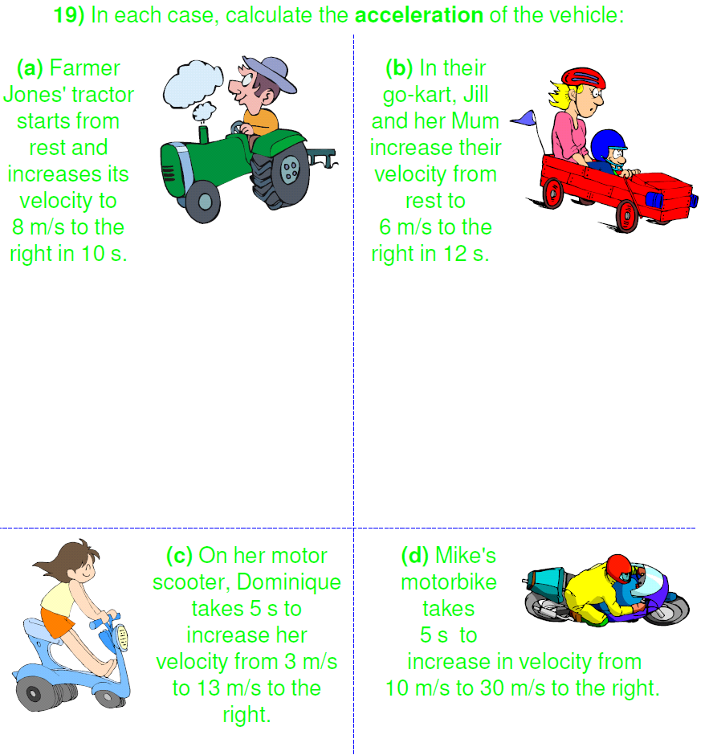
In each case, calculate the acceleration of the vehicle:
(a) Farmer Jones' tractor starts from rest and increases its velocity to 8 m/s to the right in 10 s.
(b) In their go-kart, Jill and her Mum increase their velocity from rest to 6 m/s to the right in 12 s.
(c) On her motor scooter, Dominique takes 5 s to increase her velocity from 3 m/s to 13 m/s to the right.
(d) Mike's motorbike takes 5 s to increase in velocity from 10 m/s to 30 m/s to the right.

