Slide 1

Velocity-Time
GRAPHS
N5 Physics

Slide 2

Describing graphs

Slide 3
The motion of any object can be represented by a line drawn on a speed-time or velocity-time graph. This give a visual indication of how objects are moving.
Speeding up | constant velocity | Slowing down
Increasing velocity Constant Acceleration | Uniform velocity /speed Steady speed/velocity / Zero acceleration | Negative constant acceleration, constant deceleration
velocity (m/s)
velocity (m/s)
velocity (m/s)
Time (s)
Time (s)
Time (s)

Slide 4
Describe the motion represented by the line on each speed-time graph:
0 - 8 seconds: ___________ ____ from ____ metres per second
to ____ metres per second. (Constant/uniform _____________ ).
8 - 11 seconds: __________ _________ of ____ metres per second.
11 - 18 seconds: ___________ _______ from ____ metres per second to ____ metres per second. (Constant/uniform ____________ ).
Increasing velocity
0
40
acceleration
Constant velocity
40
Decreasing velocity
40
0
Negative acceleration

Slide 6
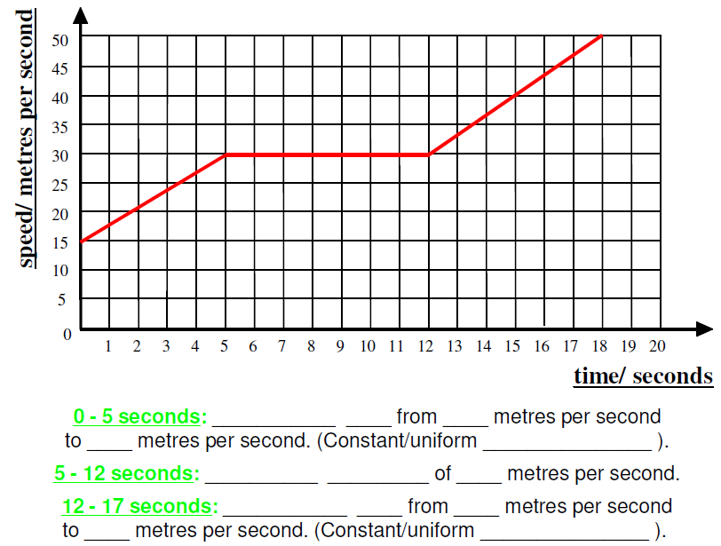

Slide 9
Maximum velocity 9 ms-1, total time 18 s
A cyclist travels at a steady velocity of 9 ms-1 for 6s, before slowing down (negative constant acceleration) to a velocity of 2 ms-1 in 7s. She then travels at this constant velocity for a further 5s.

Slide 10
Draw a velocity time graph for the following motion.
A car brakes at traffic lights, its velocity changes from 9 m/s to rest in 6s.
It remains at rest for 14s. It then accelerates to 12 m/s in 8s.

Slide 11
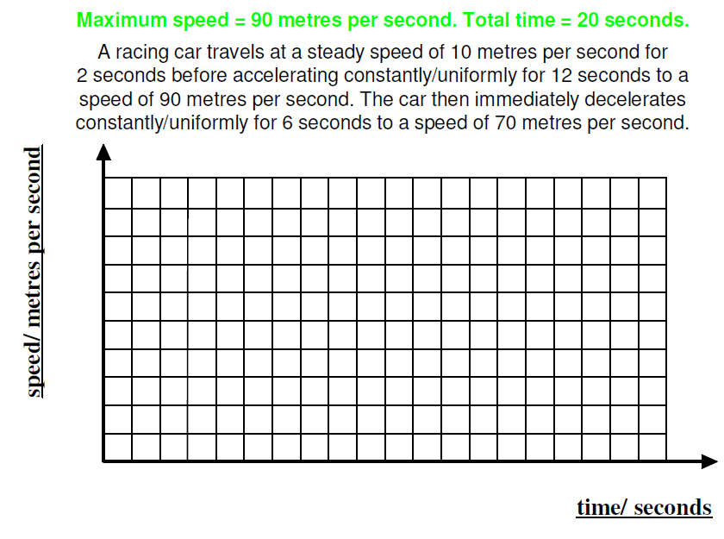
Velocity / ms⁻¹

Slide 12
Velocity-time graph challenge
Draw a set of axes for a velocity-time graph in your jotter.
In your neighbour’s jotter, neatly and using a ruler, draw in a simple journey involving at least two changes in acceleration.
In your own jotter write a short story which could be described by the graph your neighbour drew in your jotter.
LATER WE WILL calculate the accelerations and the total distance travelled on the journey, so leave space.

Slide 13
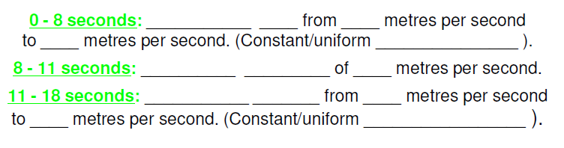
Now you try drawing a graph

Slide 14
Finding the acceleration from velocity-time graphs
S1-S3 Physics Transport

Slide 15
The gradient of a velocity time graph (steepness) tells us the acceleration of the object. The steeper the graph (bigger the gradient) the greater the acceleration.
Velocity (m/s)
Time (s)

Slide 16
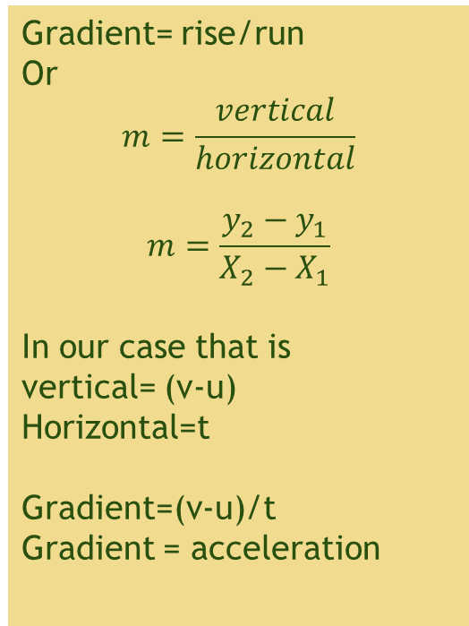
Finding the gradient of a velocity-time graph
v
Gradient= rise/run
Or
$$m=\frac{vertical}{horizontal}$$
$$m=\frac{y_{2}−y_{1}}{X_{2}−X_{1}}$$
In our case that is
vertical= (v-u)
Horizontal=t
Gradient=(v-u)/t
Gradient = acceleration
Velocity (m/s)
u
Time (s)
t

Slide 17
Drawing velocity-time Graphs
Draw a velocity-time graph for the following journey
A train leaves the station and take 30s to accelerate to 15m/s.
It remains at this speed for a further 15 seconds.
As it approaches the next station it slows to 5m/s. It takes 20 seconds to decelerate to this speed
As it finally pulls into the next station it slows to a stop in 15 seconds.

Slide 18
What It Should Look Like
Let’s find out the
accelerations

Slide 19
What It Should Look Like
a=0ms⁻²
a=-0.5ms⁻²
a=0.5ms⁻²
a=-0.3ms⁻²

Slide 20
Describe the motion represented by the line on each speed-time graph:
0 - 10 seconds: ___________ ____ from ____ metres per second
to ____ metres per second. (Constant/uniform _______________ ).
10 - 15 seconds: __________ _________ of ____ metres per second.
15 - 20 seconds: ___________ _______ from ____ metres per second
to ____ metres per second. (Constant/uniform _________________ ).

Slide 21
Finding the Acceleration from velocity-time graph:
Gradient = rise/run
a=(v-u)/t
a=(10-0)/10
a=1m/s²
Gradient = rise/run
a=(v-u)/t
a=(10-10)/5
a=0m/s²
Gradient = rise/run
a=(v-u)/t
a=(0-10)/5
a=-2m/s²

Slide 22
Problems
2. Calculate (a)the acceleration over OA, AB and BC
5m/s², 0, 3.75m/s², 127.5m

Slide 23

Finding the distance and displacement from velocity-time graphs
N5 Physics Dynamics

Slide 24
Distance and Displacement from a graph
The AREA under a speed-time graph tells us HOW FAR we have travelled (DISTANCE)
The area under a velocity-time graph tells us the DISPLACEMENT of the object.

Slide 25
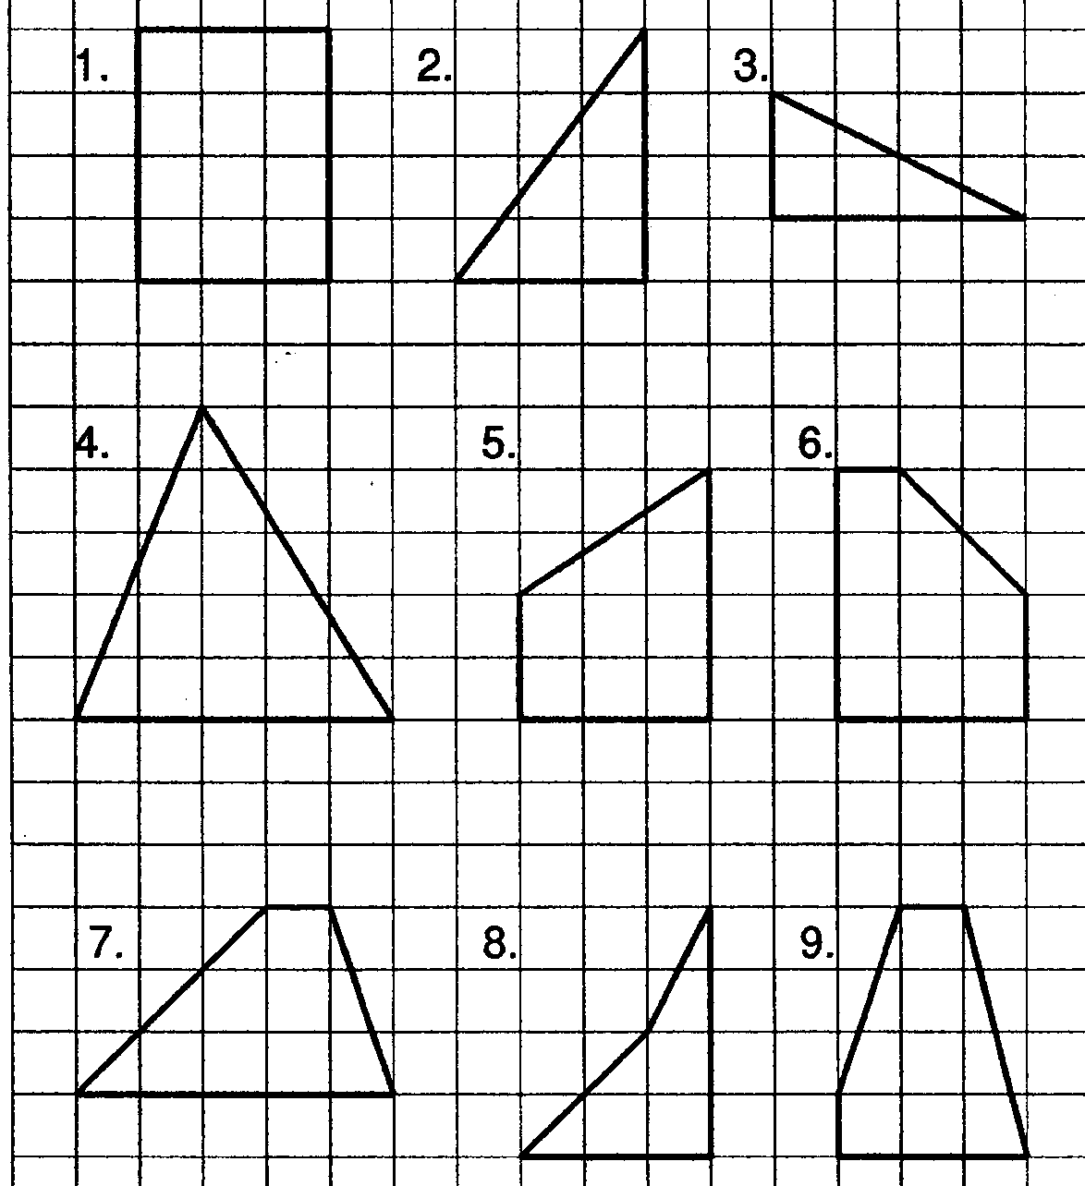
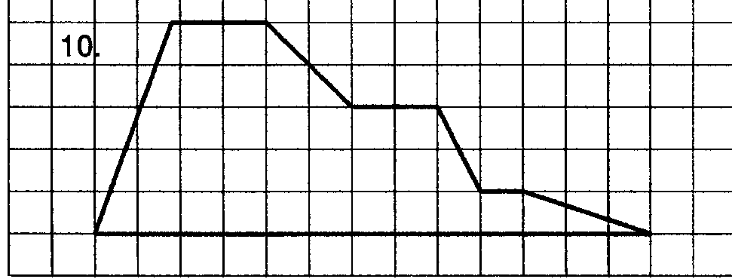
Copy out the shapes and find the area of each shape.
Include your working

Slide 26
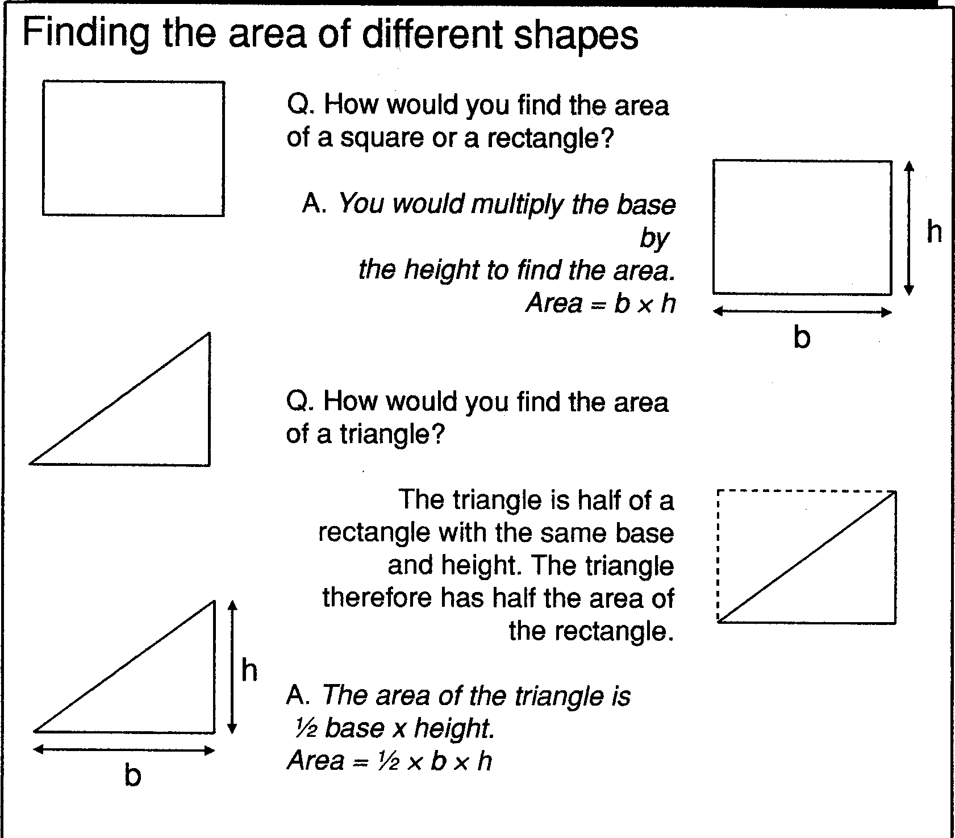

Slide 27
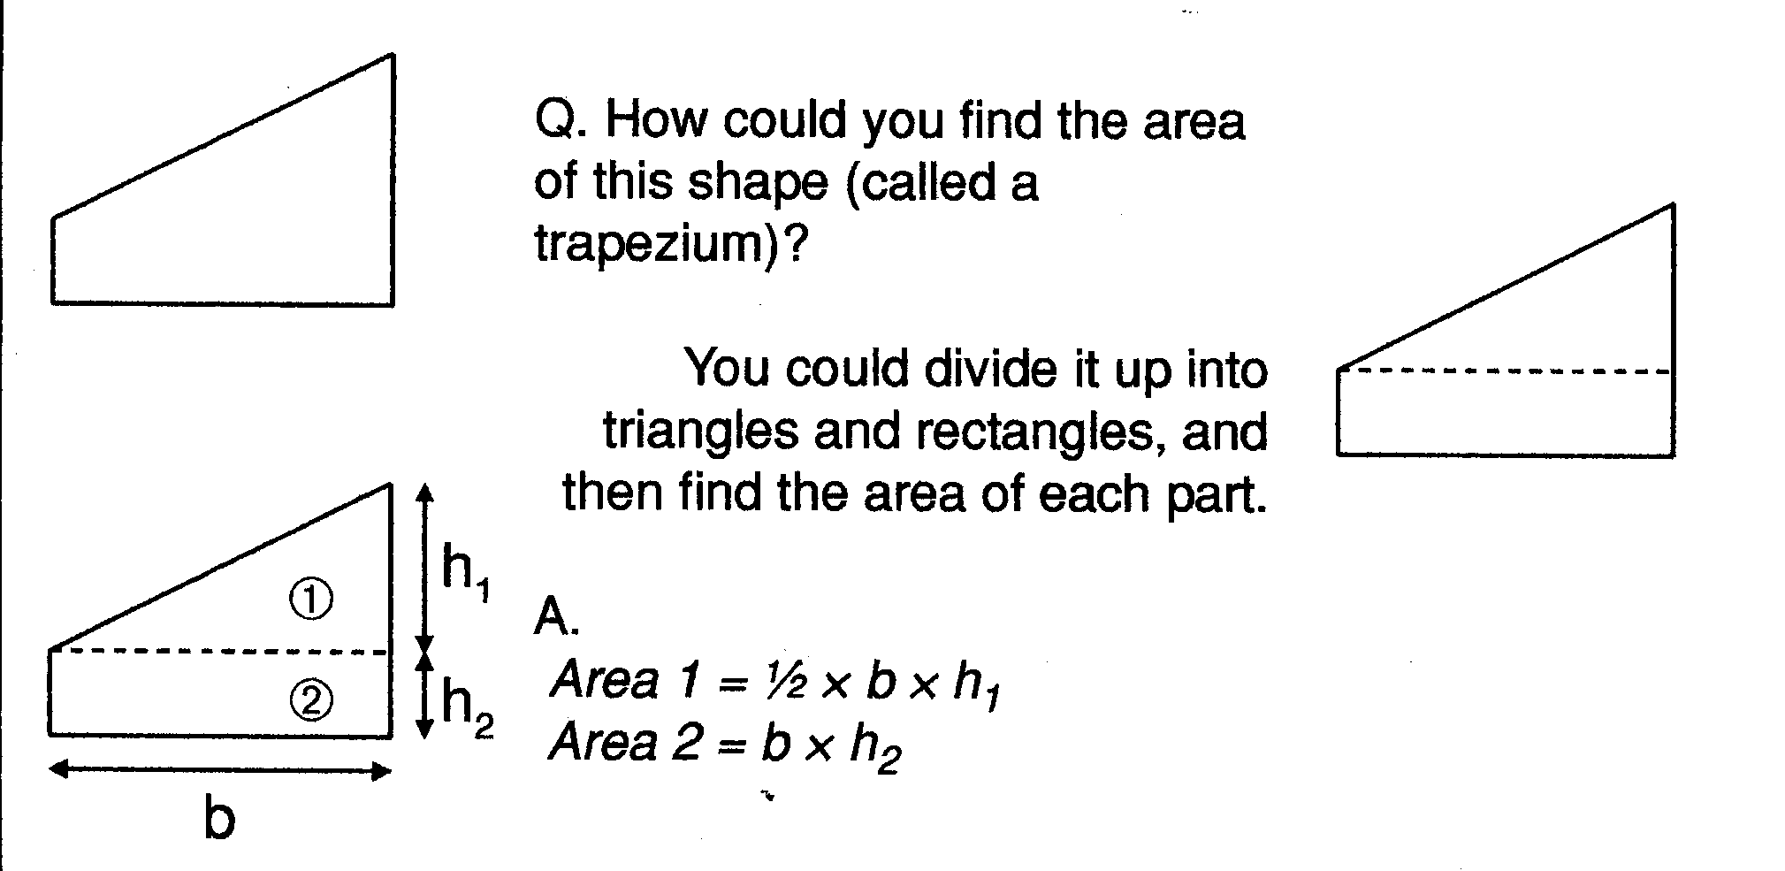

Slide 28
The AREA under a speed time graph tells us HOW FAR we have travelled (DISTANCE)
The AREA under a speed time graph tells us HOW FAR we have travelled (DISTANCE)
v(m/s)
100
0
t(s)
300

Slide 29
My object is travelling very fast. It is travelling at constant speed, its instantaneous speed is constant. It’s acceleration is zero.
To find the distance travelled, d, we’d use the formula;
d= 100x 300=30 000m

Slide 30
Find the average speed for this journey.
v(m/s)
10
5
30
t(s)
The area of the triangle is exactly the same as the area of the rectangle with a speed exactly half way between the two values, u & v

Slide 31
v(m/s)
10
This yellow area is the same as the pink area
Average velocity
30
t(s)
the area of the pink shape is the same as the area of the yellow triangle. Both give you the distance travelled

Slide 32
Speed/ velocity – Time Graphs
Speed time graphs, when drawn accurately can be used to find the total distance travelled during a journey. No matter what the shape of the graph….
Total distance covered = Area under a speed time graph
Often, to find the area, the graph will need to be split into standard geometrical shapes like triangles and rectangles
Speed (m/s)
Make a sketch of this graph and divide it up into appropriate shapes
Time (s)

Slide 33
How far did it go? Distance!
C
A
B
D
E

Slide 34
How far did it go?
B
C
A
D
E
Displacement = area under v-t graph
= Triangle A + Rectangle B + Triangle C + Rectangle D + Triangle E
= (½x30x15) + (15x15) + (½x10x20) + (20x5) + (½x15x5)
= 225 + 225 + 100 + 100 + 37.5
= 687.5 m

Slide 35
Problem
2. Calculate the total distance traveled in the 12 s
127.5m

Slide 36
Problems
1. Calculate the average velocity over OA AB and BC

Slide 37
Velocity time graphs; Summary
The gradient of a velocity time graph gives the acceleration of an object
the area under a velocity time graph gives the total distance travelled
Increasing or decreasing gradient gives the rate at which the acceleration is increasing or decreasing
Zero gradient means the object is travelling at constant speed

Slide 38
Distance-Time
GRAPHS
S1-S3 Physics Transport
Back to mind map

Slide 39
Distance-time graphs
2) Horizontal line =
40
30
20
10
0
4) Diagonal line downwards =
Distance
(metres)
Time/s
20 40 60 80 100
Diagonal line =
3) Steeper diagonal line =

Slide 40
Distance time graphs ; Summary
The gradient of a distance time graph gives the velocity
increasing gradient means object is accelerating
decreasing gradient means object is decelerating
zero gradient means object is stationary

Slide 41
Problems
Describe the motion of the vehicle during the 12s journey
Calculate the average speed over OA AB and BC

Slide 42

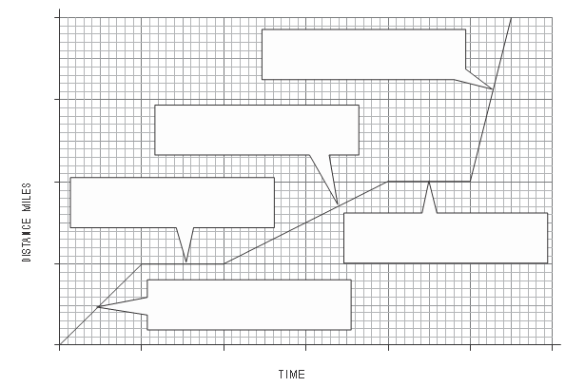




Speed Worksheet: Label the graph

