Slide 1
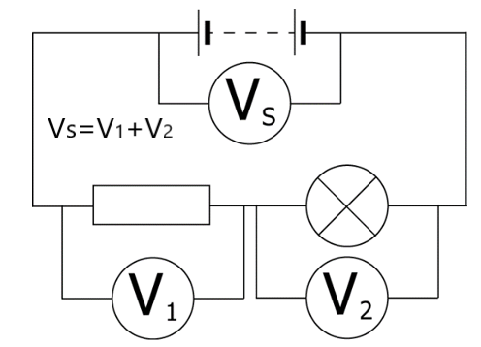
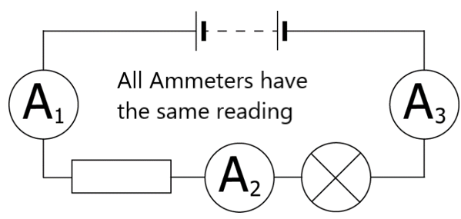
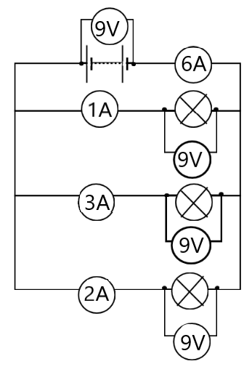
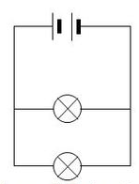
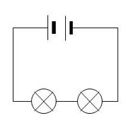
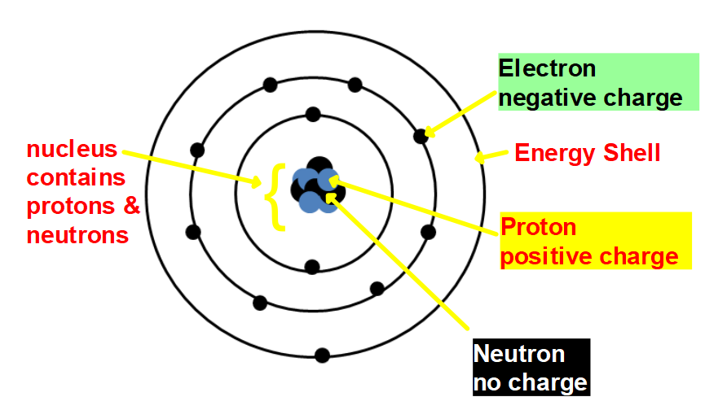
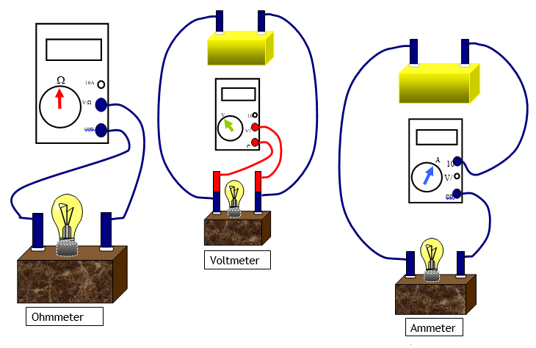
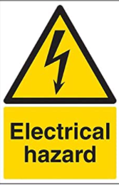
Ωhm CΩmfΩrts
Some particles carry an electric charge. In electric wires these particles are called electrons. An electric current is a flow of charge, and in a wire this will be a flow of electrons.
For an electric current to flow we need:
•Something to transfer the energy to the electrons, such as a cell, battery or power pack.
•A complete path for the electrons to flow through (a complete circuit
Wire
Wires joined
Wires not joined
Cell
Battery
DC supply
AC supply
Fuse
Earth (Ground)
Lamp (lighting)
Lamp (indicator)
Heater
Motor
Bell
Buzzer
On-Off Switch
2-way Switch
Resistor
Variable Resistor
Voltmeter
Ammeter
Ohmmeter
Oscilloscope
Keyword | Definition
resistance | is a measure of how difficult it is for a current to move through an object
voltage | the electrical push that allows charge to flow
charge | is a physical property of matter that causes it to experience a force when placed in an electromagnetic field.
current | electrons passing through a circuit
Multimeter a meter to measure many different electrical quantities | a meter to measure many different electrical quantities
Ohmmeter a meter to measure resistance | a meter to measure resistance
Voltmeter | a meter to measure voltage
ammeter | a meter to measure current
circuit | a complete path for the current to follow
potential difference | the difference in the energy of the charge carriers between two points in a circuit
insulator | a material that free electrons can’t pass through
conductor | a material that free electrons can pass through
the effects of heat, light, magnetism and chemical effects a current | heat, light, magnetism and chemical effects
continuity tester | A circuit to test whether something is a conductor or an insulator, or to find faults in circuits
parallel circuit a circuit with more than one path for the current to follow | a circuit with more than one path for the current to follow
series circuit a circuit with only one path for the current to follow | a circuit with only one path for the current to follow
Series | Parallel
I_{s} = I₁ = I₂… V_{s} = V₁ + V₂… | I_{s} = I₁ + I₂… V_{s} = V₁ = V₂…
Connecting meters
Ammeters -> series
Voltmeters -> Parallel
Ohmmeters -> no power supply
Quantity | Symbol | Unit | Unit symbol
Voltage | V | Volt | V
Current | I | ampere | A
Resistance | R | ohm | Ω
Topic of Electricity

