Slide 1
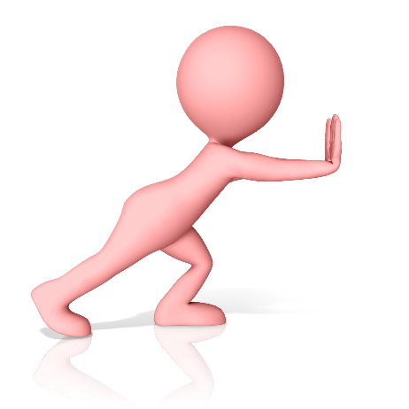
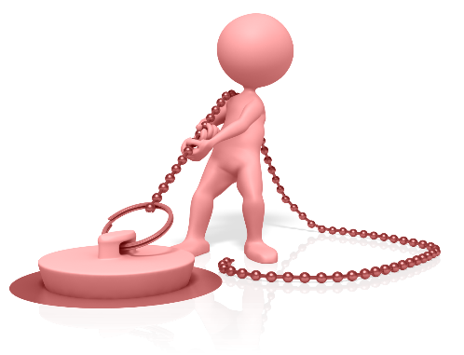

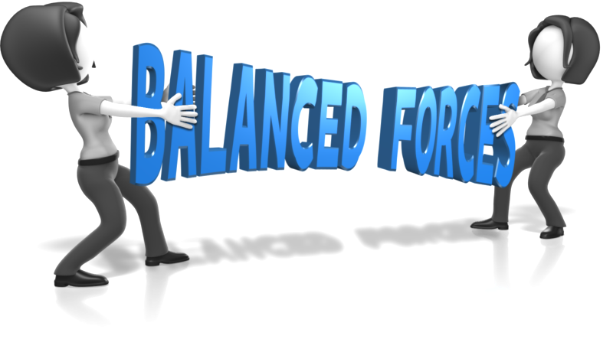
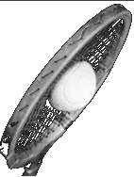

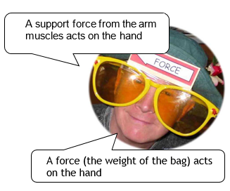
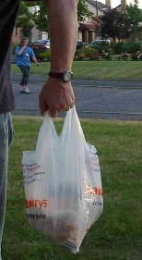
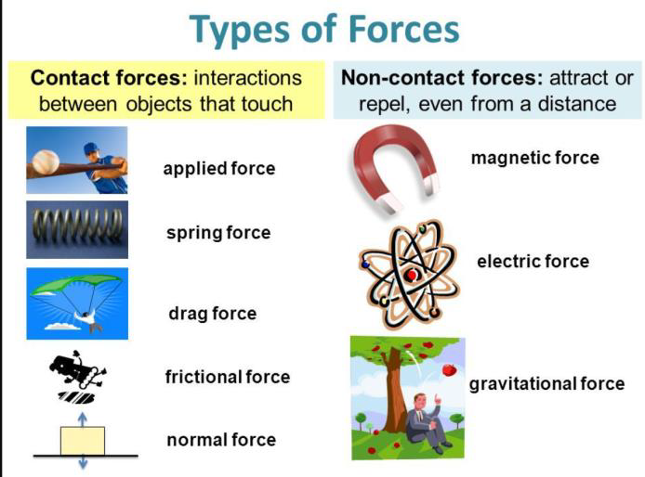
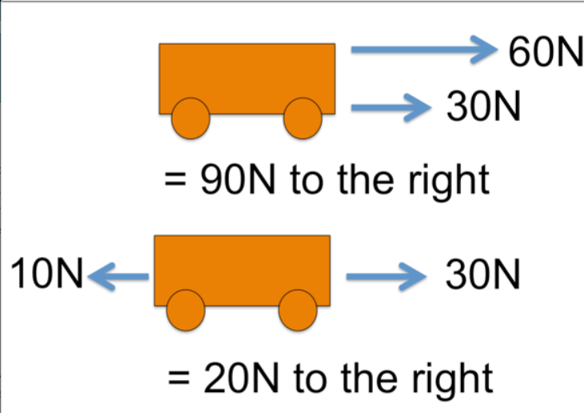

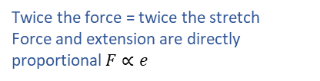

Forces
Mass the amount of matter in an object. Wherever you go mass stays the same.
Push
Pull
Forces change
an object’s
shape, speed, direction
Forces cannot be seen
Mass doesn't move unless forced
Balanced forces - two or more forces cancel out to give the same result as if there was no force acting on an object
Weight is the force due to gravity on an object. The force of gravity is caused by mass pulling objects towards other masses
Any mass has a force of gravity but it is usually too small to measure
2N
2N
balanced forces
Unit of Force= NEWTON, N
1N
2N
1N
Streamlined shapes Reduce friction
A spring balance measures forces
balanced forces cause an object to remain at rest and a moving object to continue at constant speed
Friction is a force which opposes motion
$\text{W}\text{ = }\text{Weight}\text{ (}\text{N}\text{) ,}$ $\text{m}\text{ = }\text{mass}\text{ (}\text{kg}\text{)}$
$\text{g}\text{ = }\text{gravitational} \text{field} \text{strengthth}\text{ (}\text{N}\text{/}\text{kg}\text{)}$
On Earth ‘g’ has a value of 10 N/kg
$$W=mg$$
$$3.35=m ×10$$
$$m=\frac{3.35}{10}=0.335kg$$
Use data sheet to find ‘g’ on other planets
Twice the force = twice the stretch
Force and extension are directly proportional $F∝e$
  Reduce friction: Lubricants, rollers, ball-bearings, cushions of air, streamlining
  Increase friction: less aerodynamic, greater surface area, increase mass, surface, gritting roads, stickier surface
W
Use Excel to make a table, calculate averages, work out formula and plot a graph
m
g
The rougher the surface the bigger the force of friction.
The heavier the object the bigger the force of friction.
Across Universe, mass constant, weight changes
Friction is helpful: braking, walking, space craft re-entry, writing, opening bottles, rock climbing, steering wheel, striking matches
Unbalanced forces
mass
Friction is unhelpful: wears down tyres, soles of shoes, chaffing from clothes, engines wear away, increases fuel consumption
Freebody diagrams
weight
Air resistance the frictional forces of the air against a moving object.

Slide 2
Credits
Balanced forces, Push and Pull images MrsPhysics custom design by presentermedia.com
Unbalanced free body diagram
Friction is helpful | Friction is unhelpful
braking | shooting (drag slows the bullet)
walking | sledging
space craft re-entry | putting on clothes (chaffing)
running | wears down tyres
writing | engines wear away
opening bottles | rotating machinery slowed down and wears away
rock climbing | Increases fuel consumption in
steering wheel | car
striking matches
conveyor belts

