Slide 1
Ready Respectful Safe
Ready | Respectful | Safe
Enter the room quietly, calmly and on time; | Raise your hand, and wait for permission before speaking. | Follow the teacher’s instructions.
Come prepared for the work with jotters and pen or pencil etc. | Allow people to get on with their work. | Follow the laboratory rules
Complete all homework and hand it in on time | No Put Downs | Do not touch equipment that is not part of your work
Pay attention | Not deface jotters, desks folders, etc.
 | Pay attention
 | At the end of a lesson, when told to do so, pack away quietly, place stools under the desk and leave in an orderly manner.

Slide 2

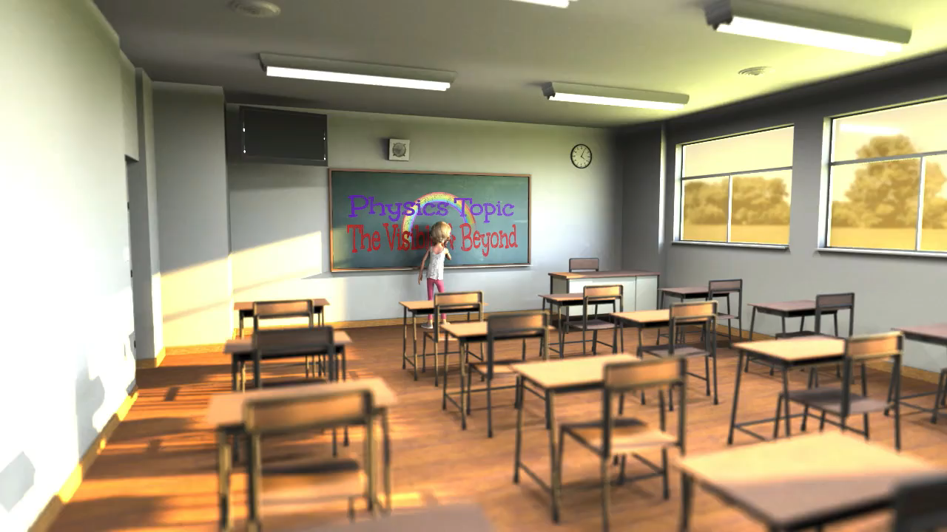
https://www.youtube.com/watch?v=OYK7G6r0Pec
A Physics topic on the Electromagnetic Spectrum

Slide 3
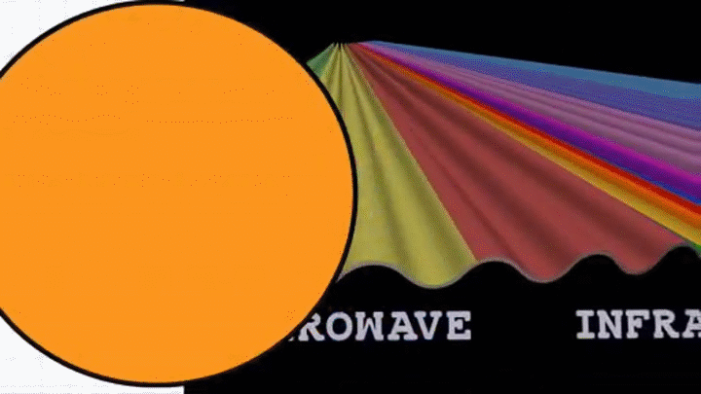
The Visible and Beyond!
A Physics topic on the Electromagnetic Spectrum
But we need some background first

Slide 4
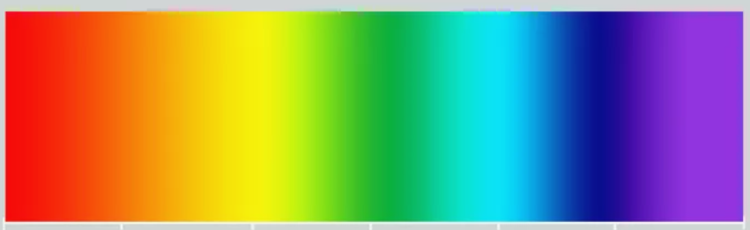
Electromagnetic spectrum
Learning Intentions
Lessons 8-11
There is a collection of waves that all travel at the speed of light and these form the electromagnetic spectrum.
Each of the waves travel in the same way but have different properties, uses and methods of detection.
The speed of light in air is 300 million metres per second,
Written as 300 000 000 m/s
Find a source, detector, protector and use for each type of electromagnetic wave

Slide 5
Light is an electromagnetic wave
Electromagnetic waves travel VERY FAST –
300, 000, 000 m/s or 300,000 kilometres per second (the speed of light).
At this speed the waves can travel the equivalent of 7.5 times around the world in one second. (but light travels in straight lines)

Slide 6

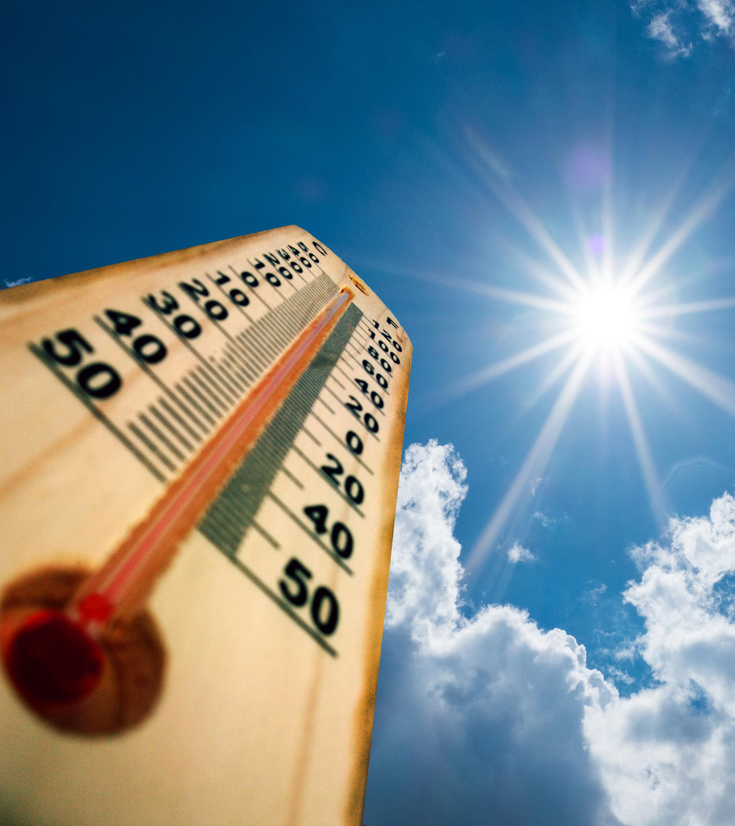
Extension
Here is a simple question with a difficult answer!
How is light made?

Slide 7
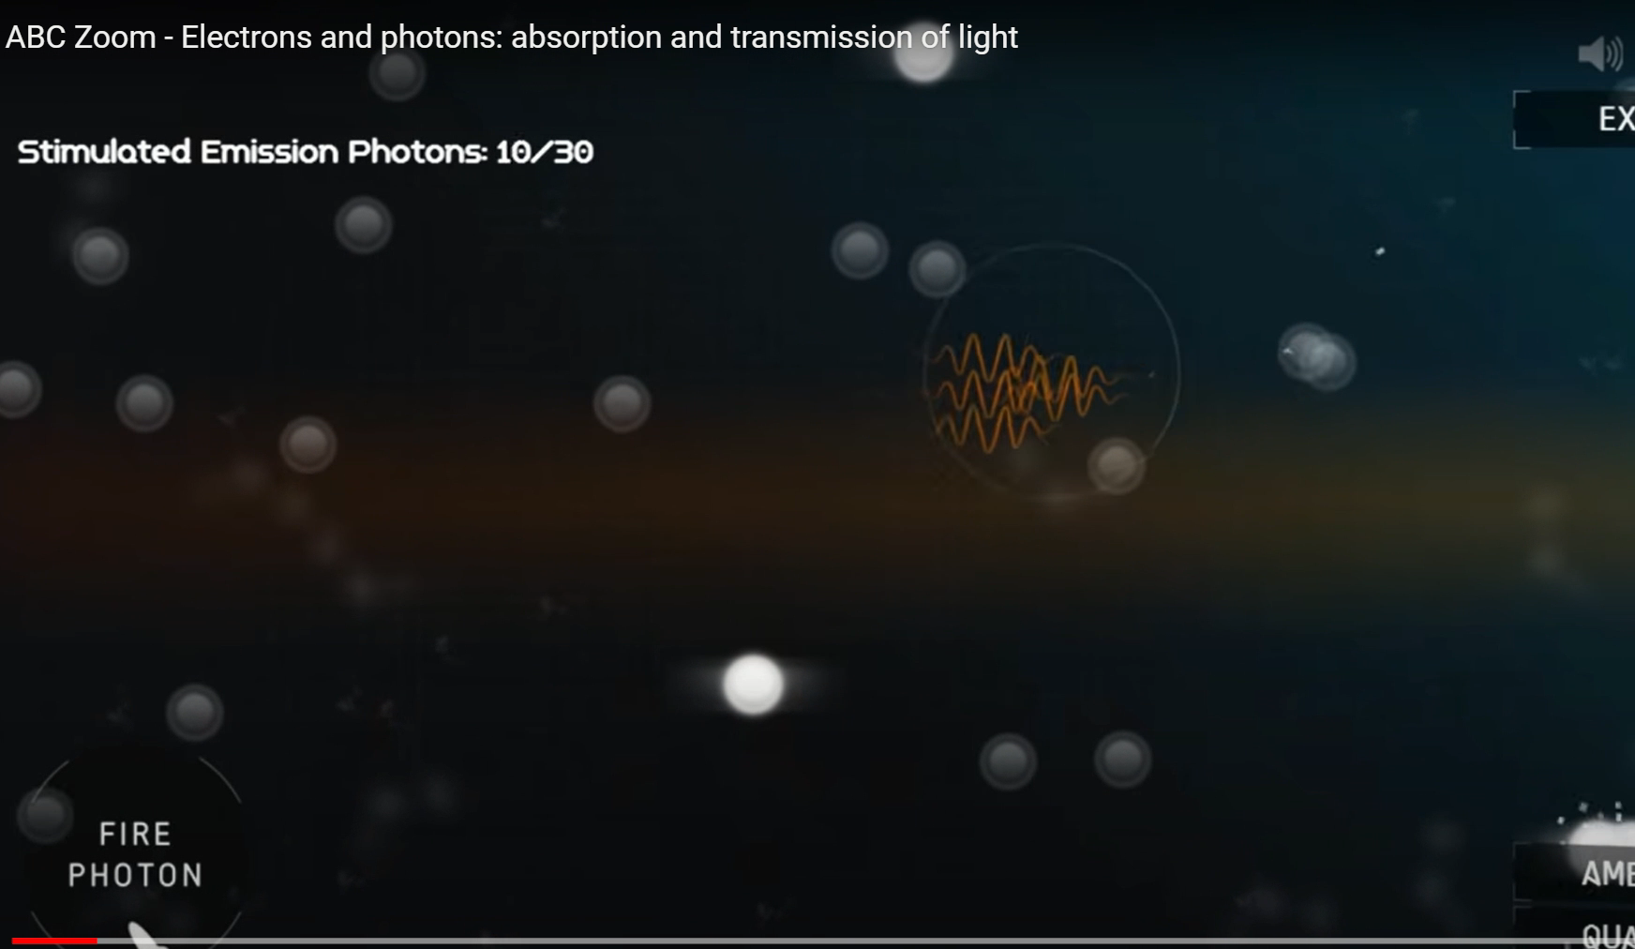
Only for the most curious!
https://www.youtube.com/watch?v=N9nWdNadklE

Slide 8
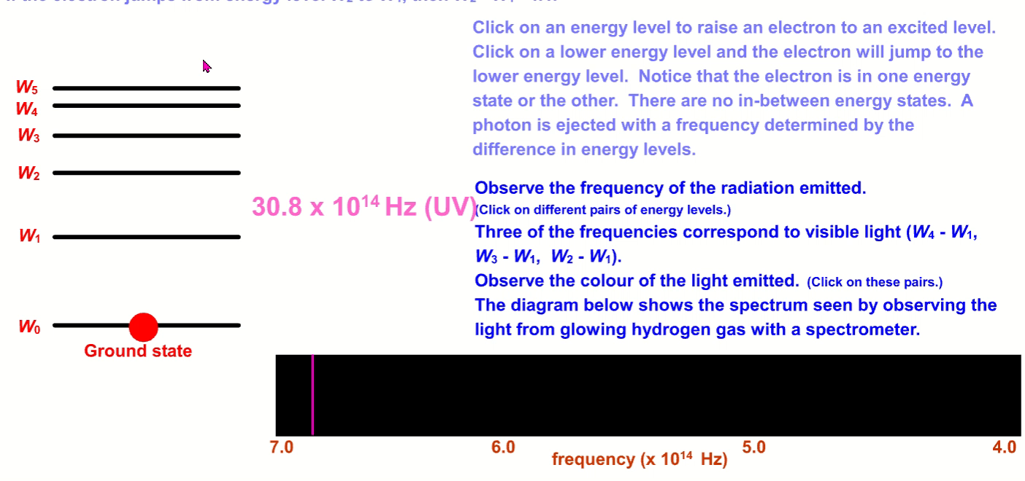
Yes things that burn or get hot give off light
Extension
only
But how?
When electrons drop from different energy levels in atoms they give off energy as packets of light

Slide 9

Let’s start with a song to set the scene!
https://www.youtube.com/watch?v=bjOGNVH3D4Y
Before we do work on the EM Spectrum we need to find out more about WAVES

Slide 10


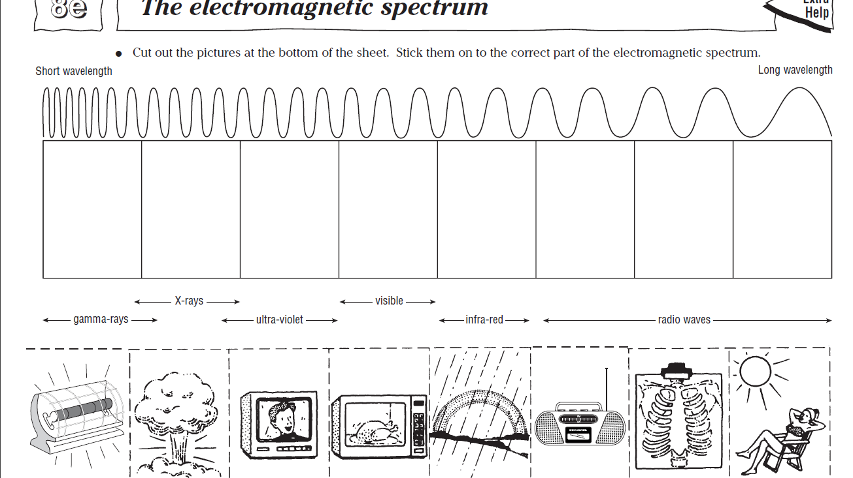

Slide 11
The Electromagnetic Spectrum
Copy the diagram over a double page in your jotter. Research using books and the internet to complete the table
Type of EM Waves | Use | Detector | Danger | Protector | Sources
Radio & TV
Microwaves
Infra Red
Visible
Ultra violet
X-Ray
Gamma Rays
Notes:
Additional sheets are available for differentiation. PLEASE NOTE THE WORDS THAT ARE NOT ACCEPTABLE TO GO IN THE TABLE AND ENSURE THE STUDENTS DON’T WRITE THESE IN, EG IT IS NOT ENOUGH TO SAY THE EYE DETECTS VISIBLE, IT MUST BE THE RETINA

Slide 12


Exit Pass join in the song
https://www.youtube.com/watch?v=-H8HjxGtoXw
Exit ticket
Write down the em waves in order.

Slide 13
Electromagnetic Waves
Electromagnetic Waves
All electromagnetic waves travel at the same speed through space (the speed of light)
Gamma rays, X-rays, Ultra-violet waves, Light, Infra-red rays, Microwaves, and Radio waves are all electromagnetic waves with different wavelengths
Some substances absorb EM waves, some reflect them and others transmit them

Slide 14
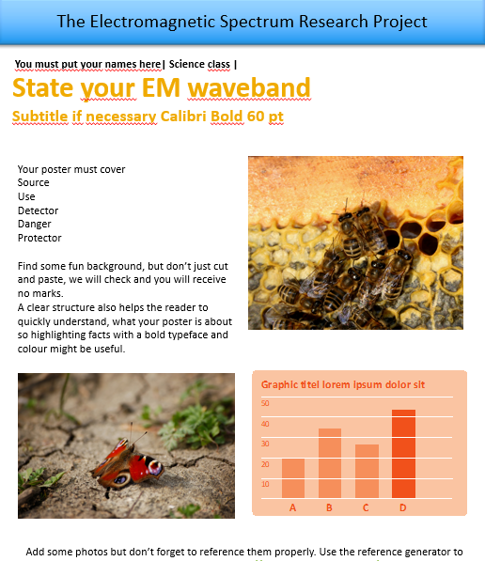
EM Spectrum Research TasK
In pairs you are going to use the template to produce a scientific poster on the EM spectrum. Your teacher will show you an example on the visible waveband.
Research,
Cover all areas
Make it clear
Don’t copy
Reference properly

Slide 15

Superhero Homework
Design a SUPERHERO who has some superpowers related to the electromagnetic spectrum. There are websites that can help you if you can’t draw.
Your superhero should be:
Drawn
Named
Super powers explained
Any weaknesses discussed
Explain how he/she/they can save the word
Miss Violet
Can see in the UV, flies, travels at the speed of light, is stopped by some glass, cures some cancer, jaundice, and kills bacteria and viruses but causes skin cancer in enemies

Slide 16

RADIO WOMAN
Can detect all radio waves and can override what is on the radio.
Can be in many places at once, but not visible to everyone
Looses superpowers in a metal tank.
Can have influence on people via social media and can make social influencers say whatever she wants them to.

Slide 17

Starter thinkers
Draw a diagram of a transverse wave and label as much as you can
State the function of the iris in the eye
State one form of eye defect
List the colours in a rainbow!

Slide 18
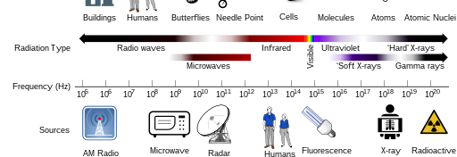

Electromagnetic spectrum
practicals
https://upload.wikimedia.org/wikipedia/commons/6/60/Electromagnetic_spectrum_clothesUS.svg

Slide 19
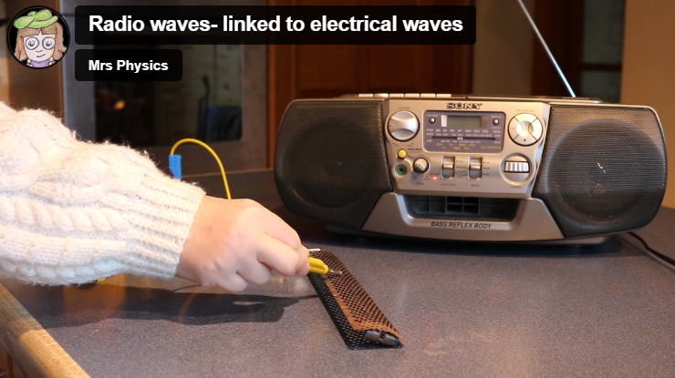
radio

Slide 20
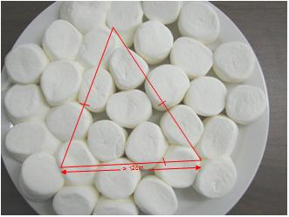
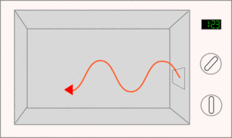
Microwaves
Speed of light with cheese slices/ marshmellows
Remove the turntable from the microwave
Place the cheese slices on a cardboard “tray”
Put on the microwave for 1-1.5 minutes
Measure the distance between the burnt spots (this should be ½ a wavelength
Find the frequency of the waves from the back of the microwave (not the 50Hz electrical supply)
Use speed = frequency x wavelength to calculate the speed of light/ em waves

Slide 21
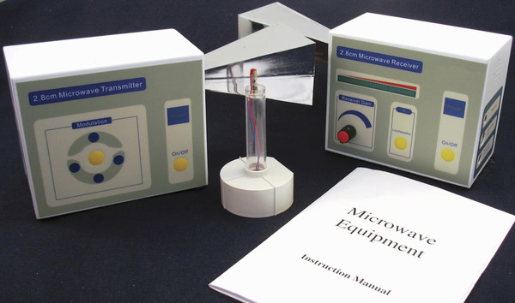
Microwave 2
Use the microwave transmitter to send a signal to the receiver
Try receiving the signal after you have reflected it from a metal surface, how much signal do you lose?
What happens when you put a baking sheet or oven shelf between the transmitter and receiver and turn the shelf? This is polarisation!!

Slide 22
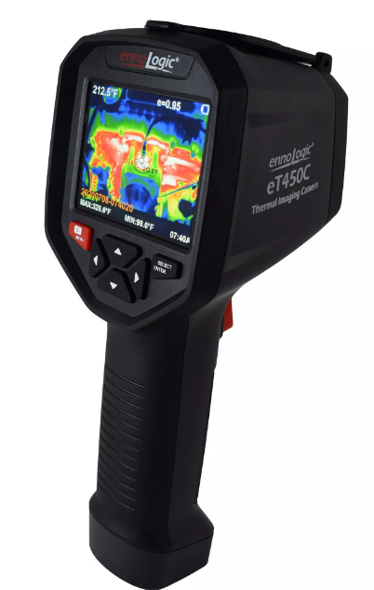
Infra-red/ heat
Use the ir camera to take photos around the room. Be careful it is really really expensive.
Take an image of someone in the class
Take another photo of the same person holding up a bin bag in front of their face. What does this say about bin bags and ir radiation
https://vimeo.com/498104023

Slide 23
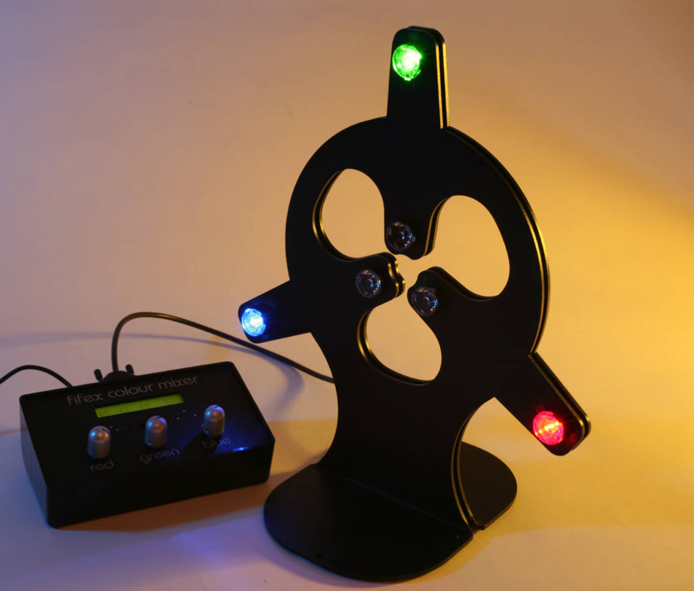
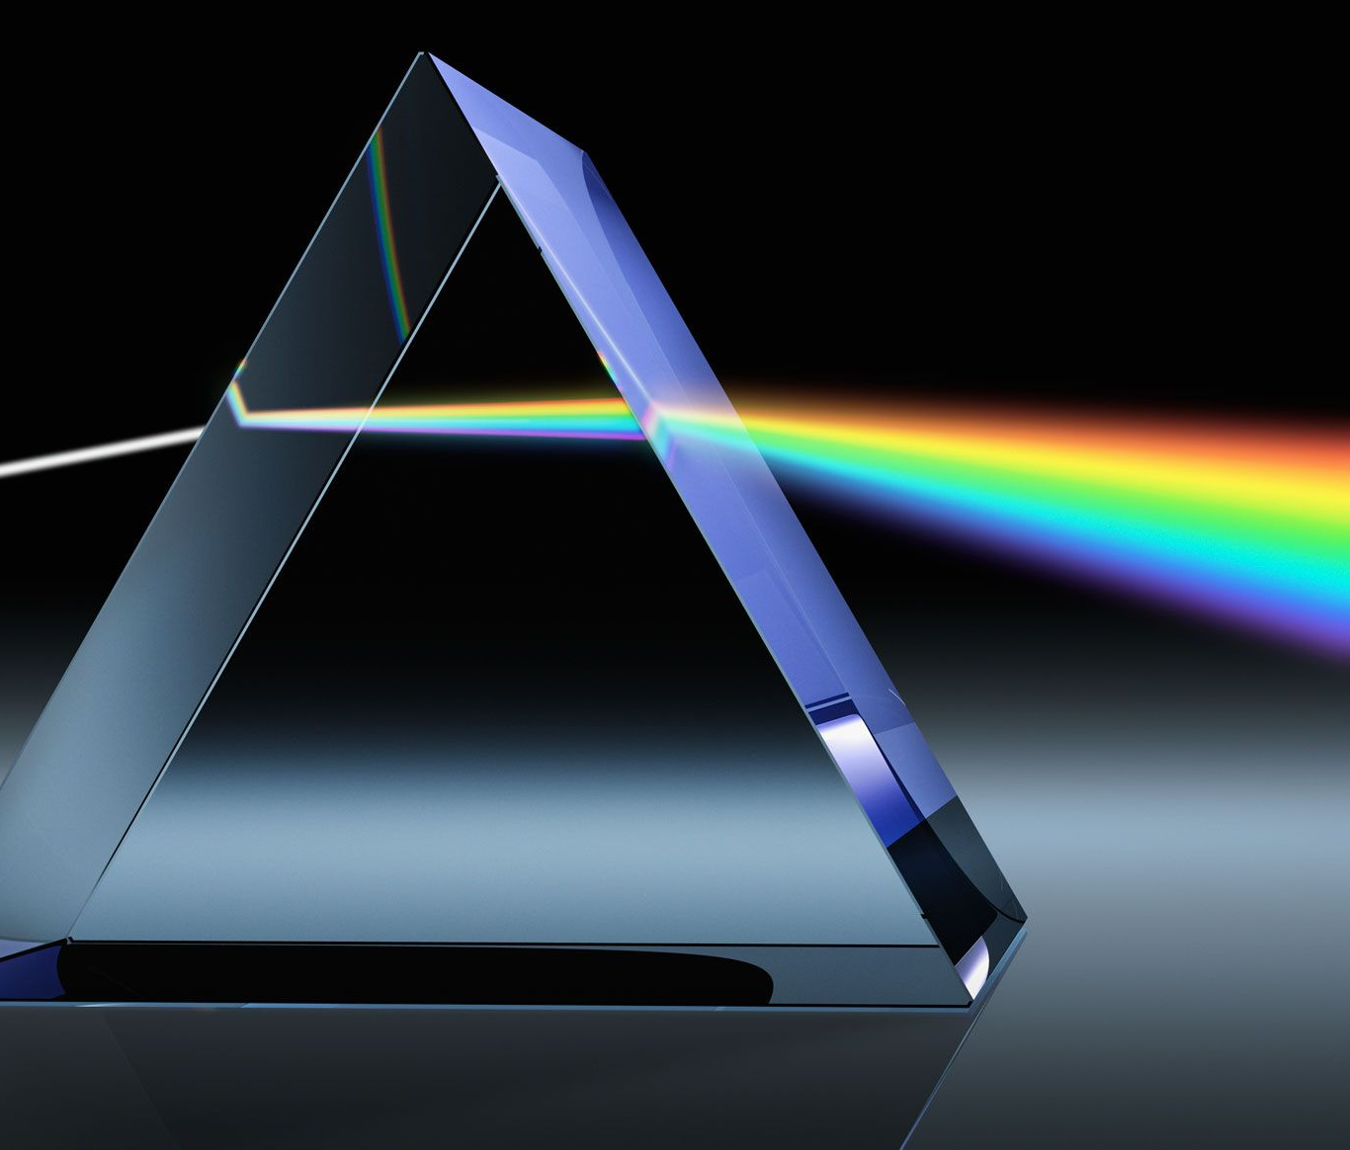
visible
Find the primary, secondary and tertiary colours of light
Find out about other animals and what they can see.
Split light with a prism

Slide 24
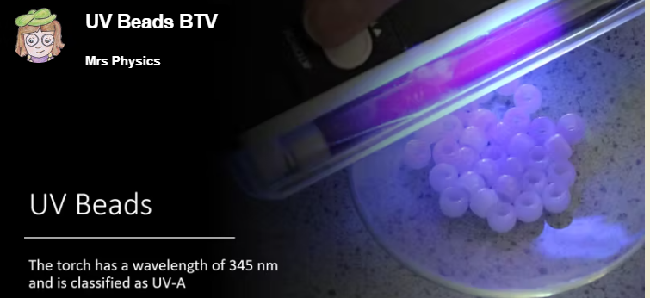
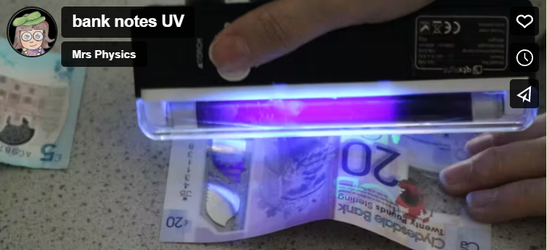
ultraviolet
https://vimeo.com/498085647
Use the uv torch to check out different bank notes
Shine the torch on the uv beads. How long to they take to change colour?

Slide 25
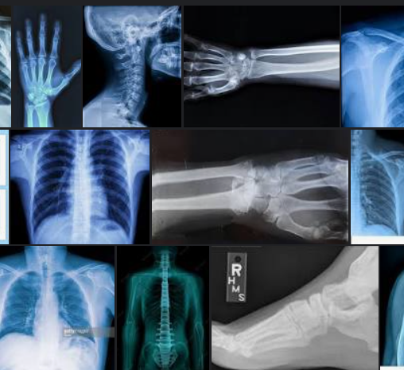
X-rays
Check out some of the x-rays that we have in the faculty. Can you spot what is wrong with some of the patients?
Check out youtube videos on the things found on x-rays

Slide 26
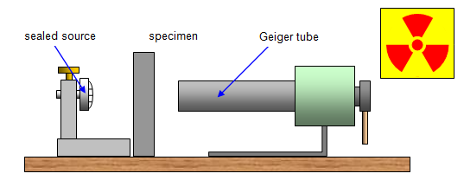
Gamma radiation ……………..
Teacher demo only
Teacher training needed
Only show gamma radiation Cs-137 source
Check the background
Use the Perspex screen
Notes:
https://www.stem.org.uk/resources/elibrary/resource/30944/demonstrating-physics-radioactivity

Slide 27
Exit Pass join in the song
https://www.youtube.com/watch?v=-H8HjxGtoXw

Slide 28
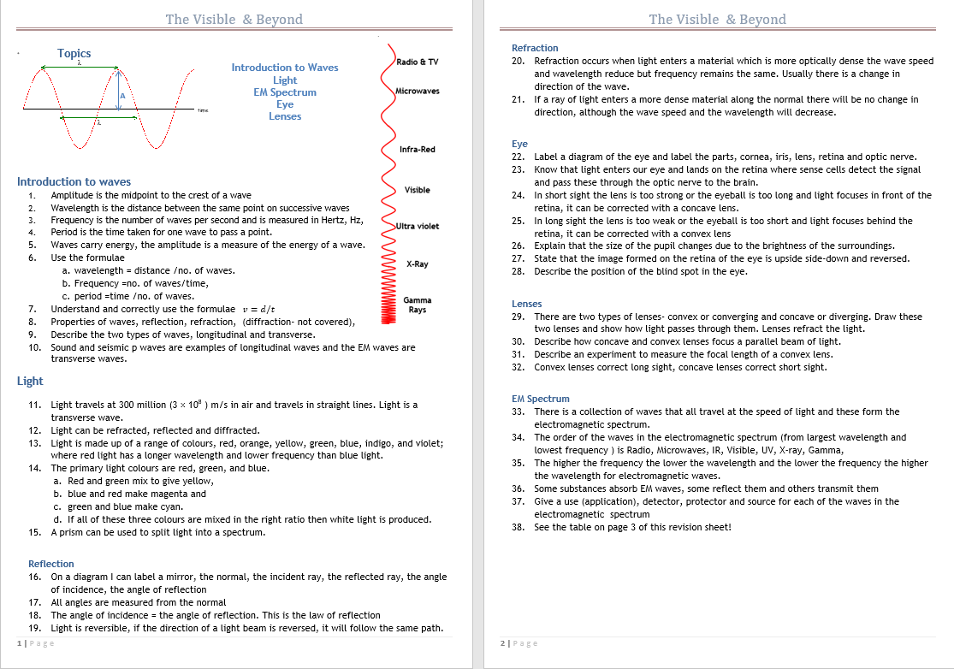
Revision

Slide 29
Mind Map
The visible and beyond
reflection
refraction
Lenses
EM Spectrum
Colour/visible
The eye & defects
Waves, frequency and period
Copy the diagram and write down all you can remember on each section of the work

Slide 30
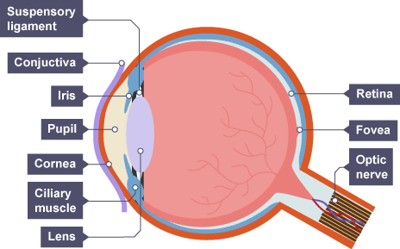
How many parts of the eye can you name?
Stretch: Do you know their function?
Do this in pencil to start!

