Slide 1
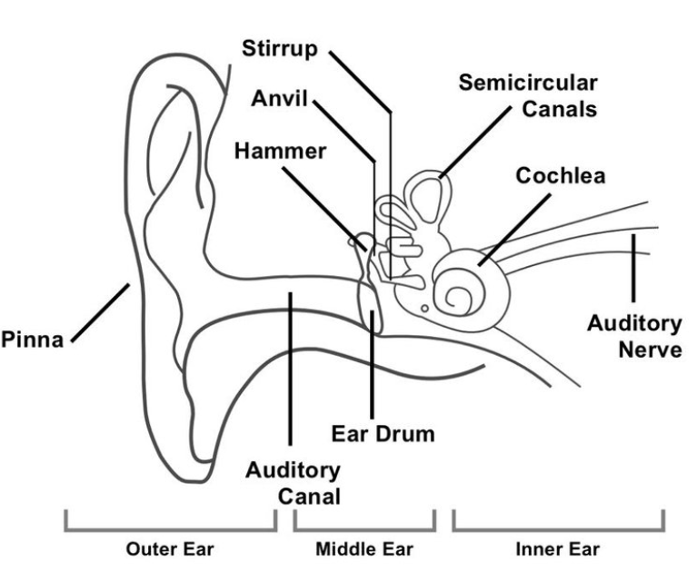
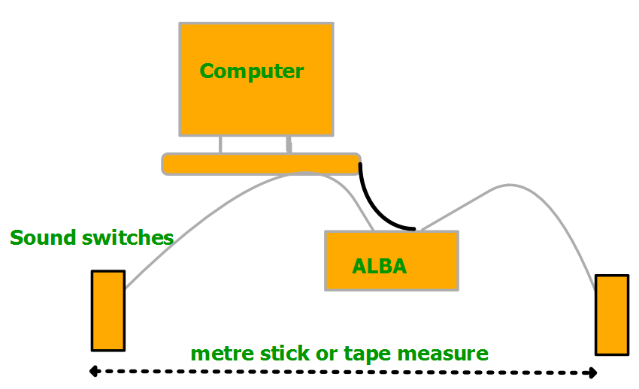
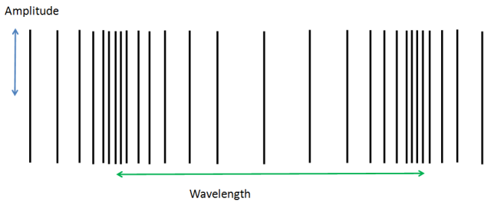
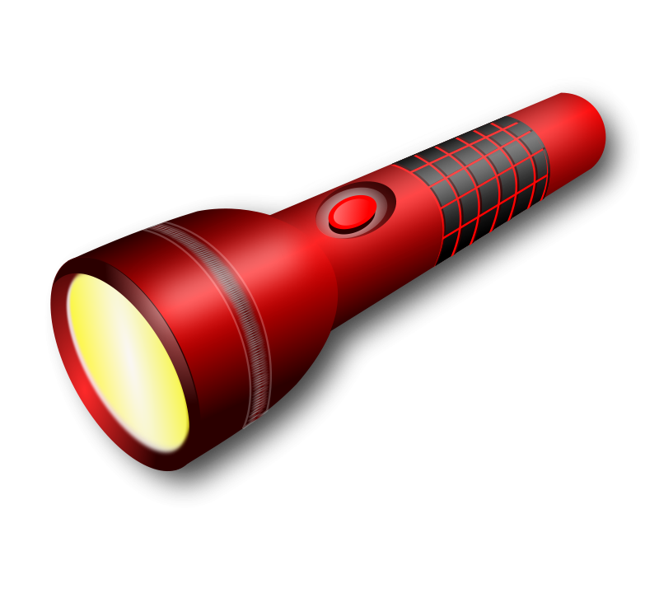
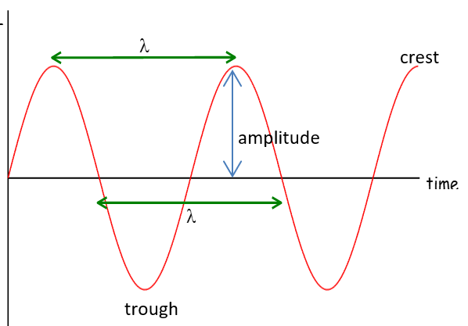
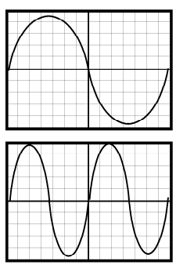
Forms of Energy
Gravitational
Elastic
Chemical
Light
Sound
Electrical
Kinetic
(Nuclear)
Heat
Part of Human Ear | What It Does
Pinna | Collects as many sound waves as possible.
Ear Drum | Detects sound waves by vibrating.
Stirrup, Anvil and Hammer | Amplifies the vibrations.
Cochlea | Has a liquid that vibrates which makes cilia create an electrical signal.
Auditory Nerve | Passes electrical signals to the brain.
20-20,000 Hz
340 m/s
speed sound in air
Range of human hearing
Danger level for permanent damage
85dB
Name | Definition/ Meaning
Wavelength | The length of one complete wave( e.g. crest to crest or similar). Unit: metres (m).
Amplitude | The distance from the axis to the crest or from axis to the trough. Unit: metres (m).
Frequency | The number of waves passing a point per second. Unit Hertz (Hz).
Period | The time taken for one complete wave to pass. Unit: seconds (s)
Energy | Dependant on amplitude- the larger the amplitude, the larger the Energy
Crest | The highest point on the wave
Trough | The lowest point on the wave
Cup ears with hand
to
Improve
hearing or
cup the other way to reduce hearing
Energy unit joule (J)
Energy is needed to get jobs done, or make things work.
Energy cannot be created or destroyed we can only change its form or transfer it to other objects
d
Speed = distance ÷ time ($v=\frac{d}{t}$)
$$\overline{v}$$
t
Energy will end up as less useful forms (heat)
In an echo, distance travelled is twice the distance to the reflecting surface, so divide total distance by 2 to find distance to surface etc
Potential Energy: Stored
Gravitational- stored at height
Elastic- stored in stretch
Chemical- stored in chemicals
Sound can travel in a solid, liquid, or gas, but not a vacuum
Measuring the speed of sound Expt ⇑
Information Equation, Substitution, Solution, Units, Underline
⇐longitudinal wave The direction of particle movement is parallel (moving the same way) to the direction of travel of the wave. e.g sound waves
Energy can be transferred from one object to another or can be converted from one form to another.
The direction of particle motion is at 90˚ to the direction of travel of the wave. E.g water waves radio, light, microwaves, X-rays, gamma rays
Notes an octave apart higher note twice the frequency of the lower note, see diagrams right, the top note is one octave below the bottom wave if the controls aren’t altered.
Torch:
chemical → electrical→ light
energy in wires in bulb+ heat
in cell
Transverse wave ⇒

