Slide 1
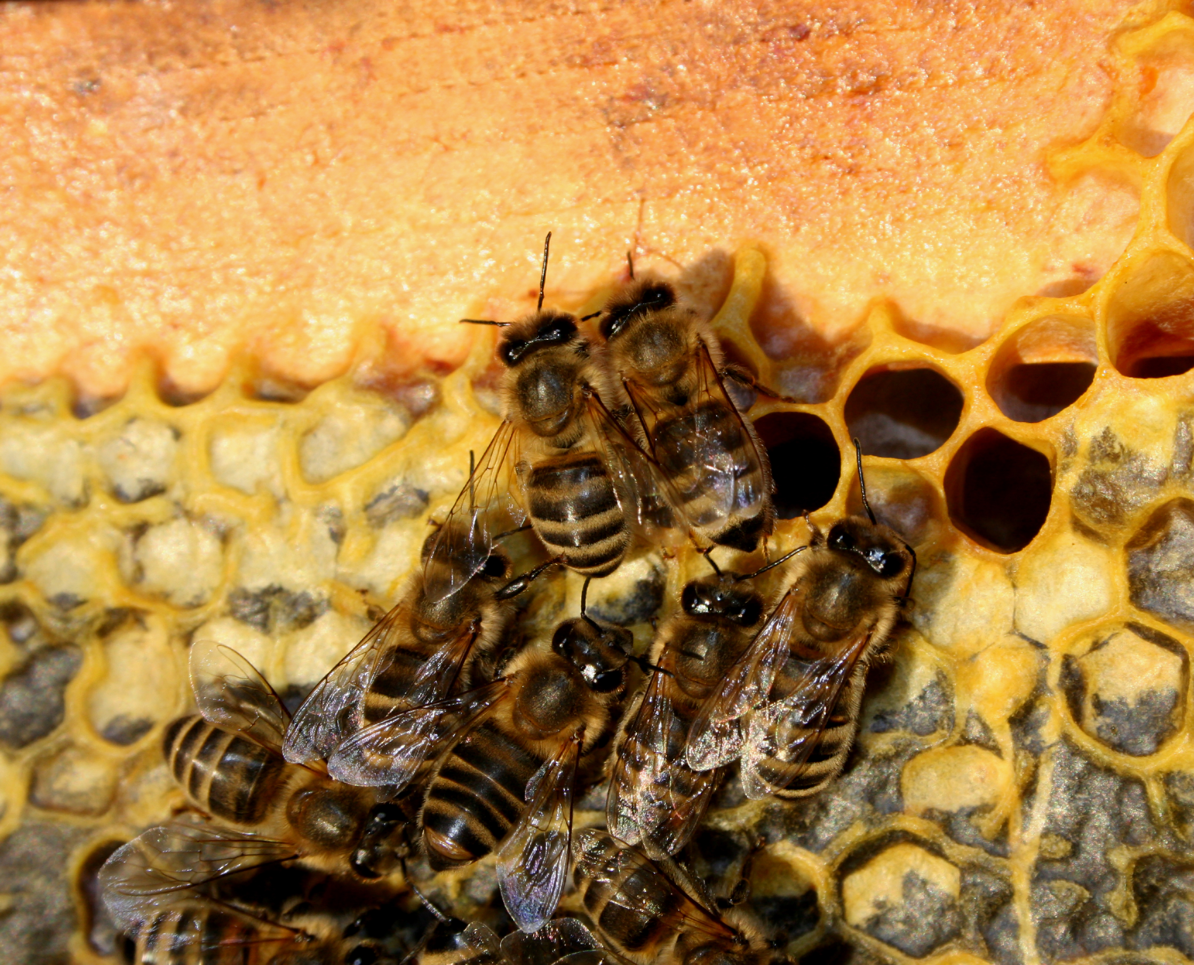
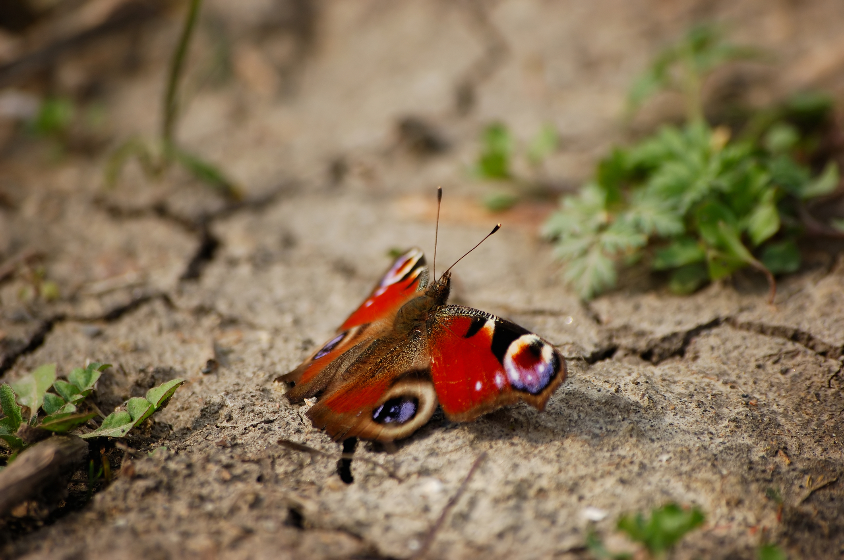
You must put your names here| Science class |
State your EM waveband
Subtitle if necessary Calibri Bold 60 pt
Your poster must cover
Source
Use
Detector
Danger
Protector
Find some fun background, but don’t just cut and paste, we will check and you will receive no marks.
A clear structure also helps the reader to quickly understand, what your poster is about so highlighting facts with a bold typeface and colour might be useful.
Add some photos but don’t forget to reference them properly. Use the reference generator to help you. Eg paste your websites into here https://www.citethisforme.com/
Background information on renewables and your
Conclusion: At the end of the poster you might place a conclusive sentence which in this case runs over 4 lines and is set Calibri, 60 points.

