Slide 1
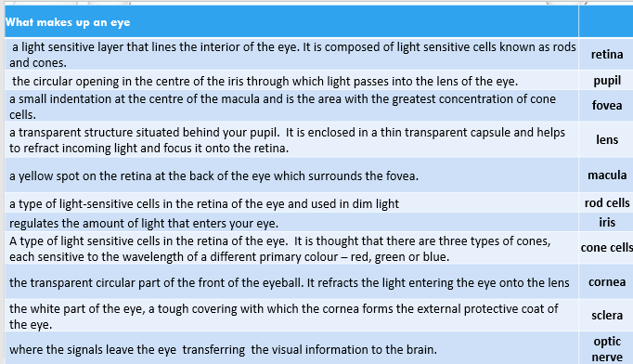
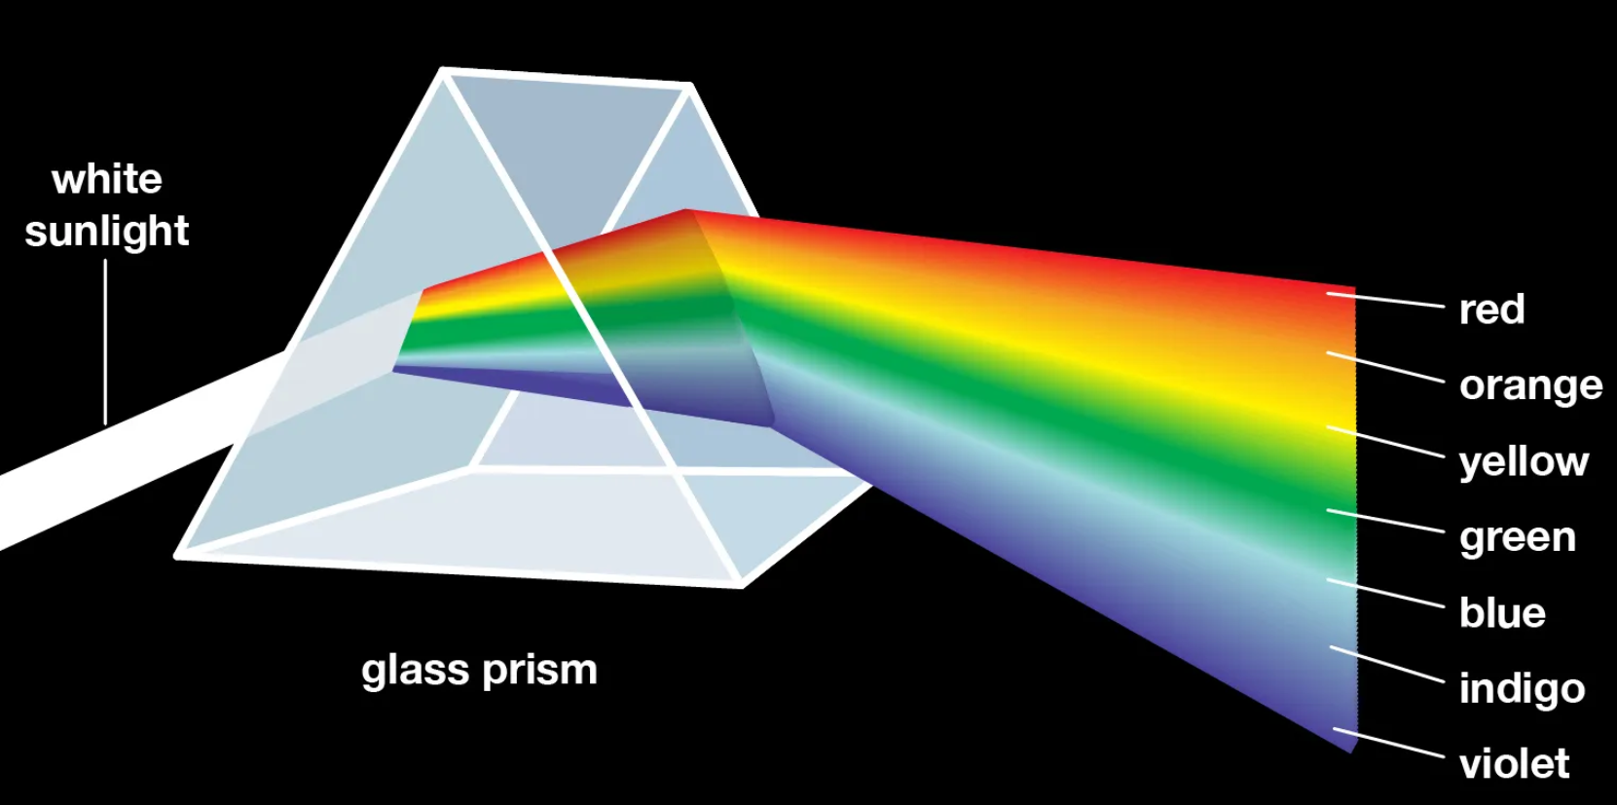
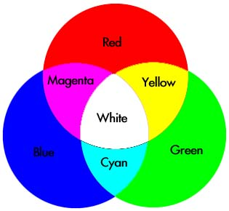
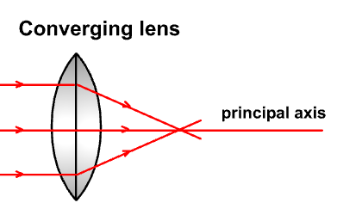
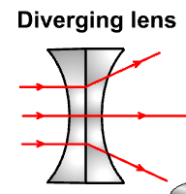
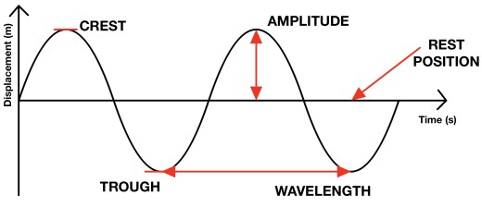
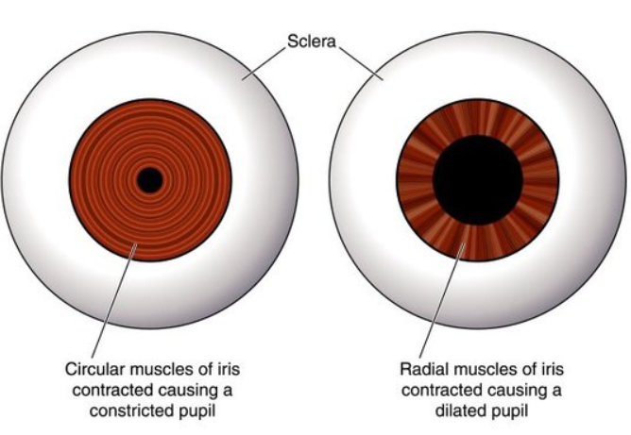
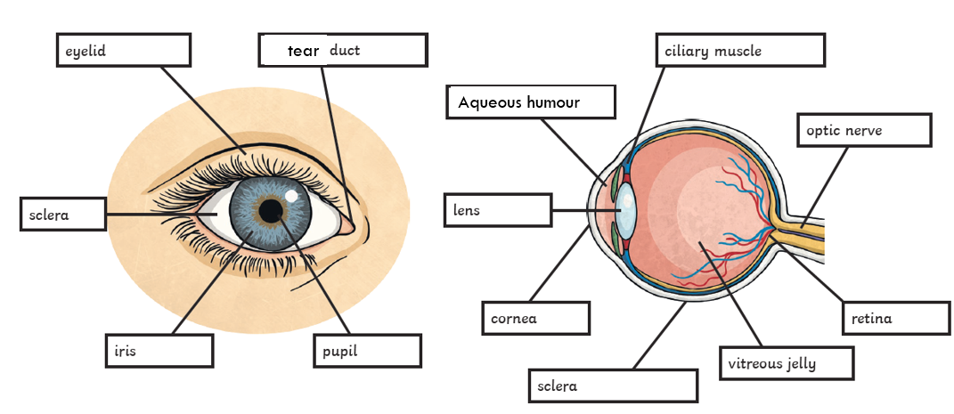
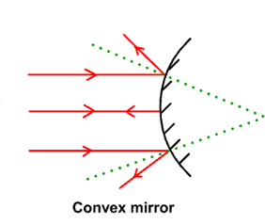
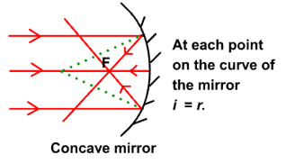
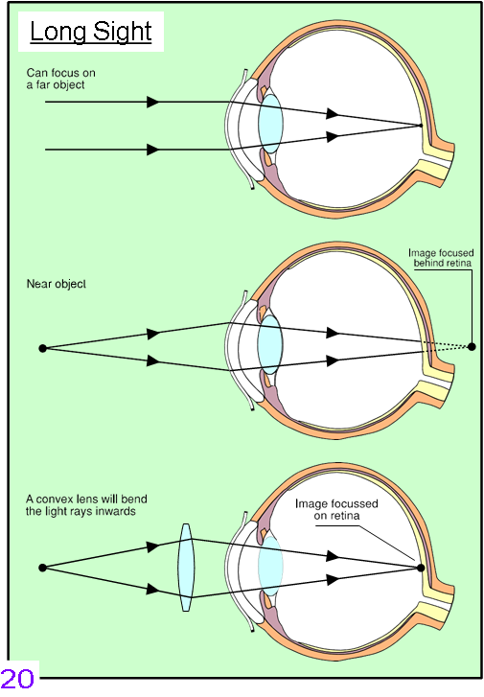
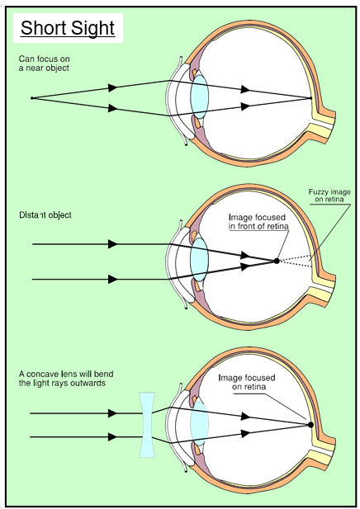
$$T=\frac{time}{number of waves}$$
$$f=\frac{number of waves}{time}$$
$$f=\frac{1}{T}$$
Beyond the Visible
blue
Mirror
Incident Ray
i
Reflected Ray
r
transverse
Normal
direction of energy travel ⇒
⬄longitudinal
Law of Reflection
The angle of incidence = the angle of reflection.
Normal: an imaginary line at right angles from a surface at the point where the incident ray strikes the mirror. All angles are measured from the normal
All EM waves travel at 300 million metres per second in air
They are all transverse waves

Slide 2
Type of EM Waves | Use | Detector | Danger | Protector | Source
Radio & TV | communication (under the sea, in space) Watching TV programmes, films, listening to the news | aerial | Large doses are believed to cause cancer, leukaemia and other disorders. | metal | transmitter, outer space
Microwaves | heating water molecules to warm food, communications | aerial | Cataracts, high levels can cause painful burns | metal screen | magnetron, transmitters, outer space
Infra Red | remote controls, security systems, automatic external lights searching for people in dark | photodiode, thermocouple, thermistor black bulb thermometer | clouding of the eye, thermal injury, high exposure damages the skin making hyperpigmentation worse. | aluminium foil, thermal insulators | warm objects, sun convector heaters
Visible | humans viewing the world, photography, | photodiode, photographic film, retina CCD | cataracts | polarising glasses, filter glasses | stars including the sun, LEDs, cinema screens
Ultra violet | detecting forged bank notes, causing white shirts to look cleaner kills bacteria and viruses | photodiode / melanocyte skin cells, , fluorescent materials | skin cancer, Arc eye damages the outmost protective layer of cells in the cornea. | glass / sunscreen cream | Fluorescent tubes, very hot objects, sun
X-Ray | detecting broken bones, checking suitcases at the airport, | photodiode / photographic film / electrical current detectors | cancer premature ageing | lead | X-ray tubes, stars
Gamma Rays | medical tracers to detect cancer, killing bacteria, sterlilising intruments, detecting broken pipes underground | Photodiode / photographic film / Geiger Muller Tube | cause damage to DNA, cancer | several cm of lead several m of concrete | Radioactive nuclei, outer space (stars)
"cataracts" in your eyes, which is a clouding of the lens preventing you from seeing clearly |  |  |  | http://www.darvill.clara.net/emag/

