Slide 1
Define Electric field
Define Voltage
(potential difference)
1
2
Right hand rule for finding the direction of the force on charged particles moving in a magnetic field.
Orders of Magnitude
3
4
Beta Decay
Hadron
5
6
Baryons
Mesons
7
8
Fermions
Bosons
9
10

Slide 2
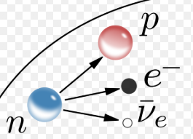
V = W / Q
Work done per coulomb of charge.
A region where a charged particle experiences a force.
First finger = Direction of magnetic field (N to S)
Middle finger = direction of electron current.
Thumb = direction of the force on the particle.
1x10³ is 3 orders of magnitude smaller than 2.4x10⁶
Composite particle consisting of quarks.
This was the first evidence for the neutrino
Hadrons consisting of quark – anti-quark pairs
Hadrons consisting of 3 quarks
These are the force mediating particles. Photons (electromagnetic force), W and Z bosons (weak nuclear force), gluons (strong nuclear force) & Higgs boson.
These are the matter particles. Consisting of quarks (Six types: up, down, charm, strange, top, bottom) and leptons (electron, muon and tau, together with their neutrinos).

Slide 3
E = mc²
Nuclear fusion reactors
11
12
Irradiance
Point source of light
13
14
Photoelectric effect
Threshold frequency
15
16
E_{k} = hf – hf₀
Work function
17
18
Interference
Coherent waves
19
20

Slide 4
Require charged particles at very high temperature (plasma) which have to be contained by magnetic fields.
In nuclear fission and fusion reactions mass is lost. This lost mass is converted into energy
A source of light coming from a single point and giving off light in all directions e.g. small light bulb or a distant star.
I = k/d² for a point source.
I₁ d₁² = I₂ d₂²
Power per unit area
I = P / A
This is evidence for the particle model of light. Photons of a sufficient energy can eject electrons from the surface of a material (photoemission).
Minimum frequency of a photon required for photoemission.
Electron kinetic energy = energy of photon - work function
Minimum energy of photon required for photoemission.
Waves that have the same frequency and constant phase difference
This is evidence for the wave model of light

Slide 5
Constructive Interference
Destructive interference
21
22
Diffraction grating formula
mλ = d sin θ
Bohr model of the atom - Ground state
23
24
Bohr model of the atom – Ionisation level
Emission spectrum
25
26
Fraunhofer lines
Absorption spectrum
27
28
Absolute Refractive Index
Snell’s Law
29
30

Slide 6
Occurs when 2 waves with a phase difference of an integer multiple of ½ wavelengths meet and combine.
Path difference = (m+1/2) λ
Occurs when 2 waves with a phase difference of an integer multiple of wavelengths meet and combine.
Path difference = m λ
m = order of maximum
λ = wavelength of source
d = distance between slits
Θ = angle from the central (zero order) maximum
The lowest energy level an electron can be in. This corresponds to the level closest to the nucleus.
Range of frequencies emitted when electrons fall to lower energy levels. Each element has a unique emission spectrum.
The energy level an electron is in when it has zero potential energy and can escape from the atom.
Absorption lines in the spectrum of sunlight. These give evidence for the composition of the sun’s outer atmosphere
Range of frequencies absorbed when electrons rise to higher energy levels. Each element has a unique absorption spectrum.
The ratio of the speed of light in a vacuum to the speed of light in a medium.

Slide 7
Refractive index and frequency relationship
Critical Angle
31
32
Total internal reflection
Relationship between refractive index and critical angle
33
34
Electric field patterns for single point charges.
Electric field patterns for pairs of point charges.
35
36
Electric field pattern between two charged parallel plates.
37
38
39
40

Slide 8
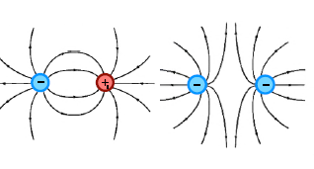
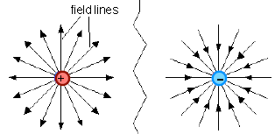
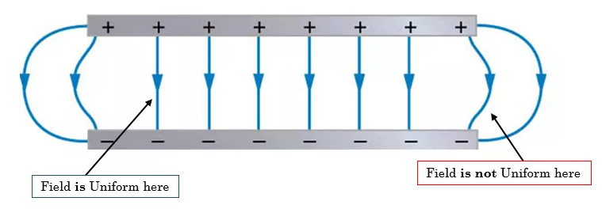
The angle of incidence when the angle of refraction is equal to 90 degrees.
Refractive index of a medium increases as the frequency of incident radiation increases.
This occurs whenever the angle of incidence is greater than the critical angle.

