Slide 1



p-n Junctions and uses
Higher Physics

Slide 2
Semiconductors and p-n junctions
j) | I know that, during manufacture, semiconductors may be doped with specific impurities to increase their conductivity, resulting in two types of semiconductor: p-type and n-type.
k) | I know that, when a semiconductor contains the two types of doping (p-type and n- type) in adjacent layers, a p-n junction is formed. There is an electric field in the p-n junction. The electrical properties of this p-n junction are used in a number of devices.
l) | I know and can explain the terms forward bias and reverse bias. Forward bias reduces the electric field; reverse bias increases the electric field in the p-n junction.
m) | I know that LEDs are forward biased p-n junction diodes that emit photons. The forward bias potential difference across the junction causes electrons to move from the conduction band of the n-type semiconductor towards the conduction band of the p- type semiconductor. Photons are emitted when electrons ‘fall’ from the conduction band into the valence band either side of the junction
n) | I know that solar cells are p-n junctions designed so that a potential difference is produced when photons are absorbed. (This is known as the photovoltaic effect.) The absorption of photons provides energy to ‘raise’ electrons from the valence band of the semiconductor to the conduction band. The p-n junction causes the electrons in the conduction band to move towards the n-type semiconductor and a potential difference is produced across the solar cell.

Slide 3
Semiconductors
SOME Slides by Chris Hooley, University of St Andrews
Videos from Mr Smith’s Physics online- thank you guys!

Slide 4
Meet the popular guys
These are all called Si. They are rather boring but really popular

Slide 5
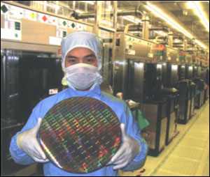
A silicon ‘wafer’
http://cdn.zedomax.com/blog/wp-content/uploads/2009/12/silicon-wafer.jpg

Slide 6
But there are always those less popular
Adding Group 3 (eg. Gallium, Ga, and Indium, In) gives a POSITIVE material (p-type, hole or positive hole). | Adding Group 5 (eg. Arsenic, As, and Antimony, Sb) gives a NEGATIVE material (n-type, electron).

Slide 7
Doping to create a p-type material
Remember it is REALLY IMPORTANT
The overall charge on the p-type material is zero, as every electron has a bound proton in the nucleus, and every “hole” has one less proton in the nucleus.
The no.of protons in the nucleus = the no. of electrons in the bands
HOLE

Slide 8
Creating an n-type semiconductor
Group 5 material
Remember - REALLY IMPORTANT
The overall charge on the p-type material is zero, as every electron has a bound proton in the nucleus.
ELECTRON

Slide 9
Doping a semiconductor (n-type)
Because of its very small energy gap, a semiconductor can be made more conducting just by increasing the temperature.
There is, however, a more efficient way. If, when we grow the silicon, we include a few atoms of a different type, they can donate their electrons to the conduction band. This process is called doping, and the extra atoms are called donors. An example of a donor atom is phosphorus.
This raises the Fermi level into the conduction band. The sample becomes metallic, with the negatively charged doped electrons doing the conduction.

Slide 10
Doping a semiconductor (p-type)
Alternatively, we can dope the semiconductor with atoms which remove electrons from the bands. Such atoms are called acceptors. An example of an acceptor atom is boron.
This moves the Fermi level down, into the valence band.
But the system still becomes a metal – now with the positively charged doped holes in the valence band doing the conduction.
The two types of doping are called n-type (‘n’ for ‘negative’) and p-type (‘p’ for ‘positive’) respectively.

Slide 11
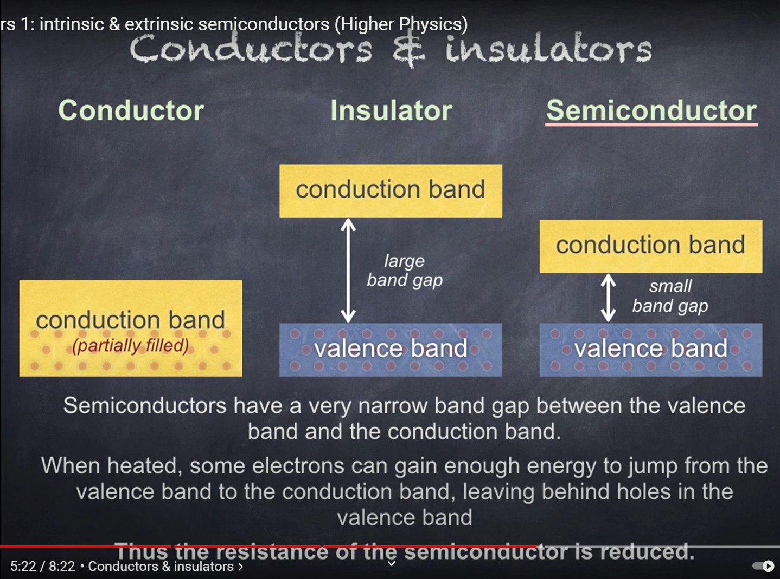
Let’s see how Mr Smith explains this!

Slide 12
Band diagram for an
n-doped semiconductor
Band diagram for a
p-doped semiconductor
donor level
conduction band
acceptor level
valence band
Dopants donate electrons → more free electrons in crystal → more occupied states → Fermi level goes up, into conduction band
Dopants absorb electrons → fewer free electrons in crystal → more empty states → Fermi level goes down, into valence band

Slide 13

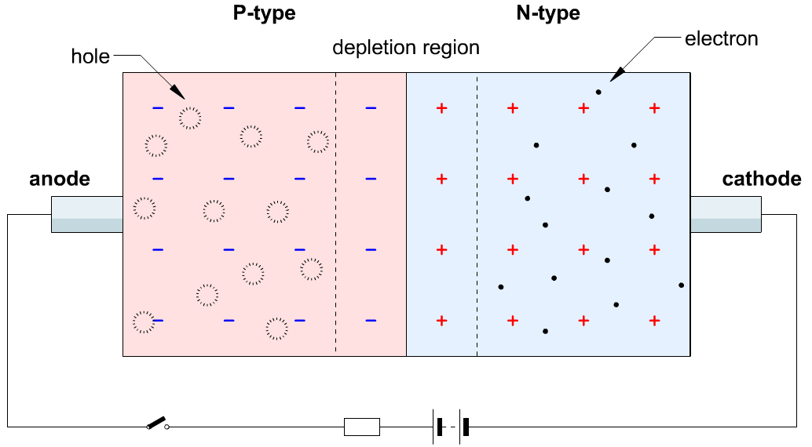
Joining a p-type to an n-type semiconductor
Now for the interesting (and technologically useful) bit.
Suppose we take a p-type semiconductor – one with a small density of holes in the valence band – and join it to an n-type semiconductor – one with a small density of electrons in the conduction band. This makes a device called a p-n junction. What happens?
Electrons from the n-type material meet holes from the p-type material and annihilate. This creates a depletion layer (or space charge region) which has very few carriers of either type, and where the dopants are ‘exposed’.

Slide 14





Now let’s think about including the p-n junction as a component in an electrical circuit.
For simple components like an incandescent light bulb or a switch, which way round we connect them doesn’t matter.
But for the p-n junction, we shall see that the sign of the applied voltage has an important effect on the results. This is called the diode effect.
The two possibilities are called forward bias and reverse bias.
https://youtu.be/32vMzGTCzPU

Slide 15
PN junction
https://qph.fs.quoracdn.net/main-qimg-a1b93afaeb99d6d6420c4ad218ea12be

Slide 16
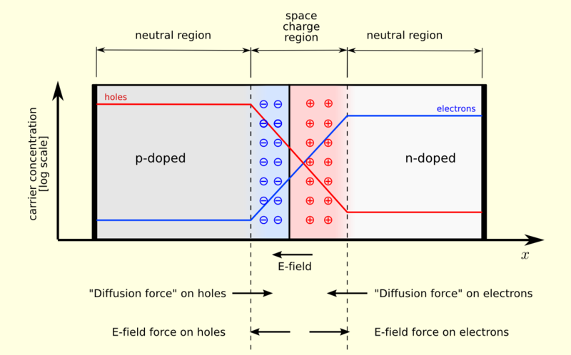
A diagram of a p-n junction in equilibrium
In the space charge region, there are not many electrons or holes – just exposed dopant ions.
These ions create an electric field, which eventually gets strong enough to keep other carriers away from the junction.
The junction is now in equilibrium, with an electric field across its depletion layer.

Slide 17
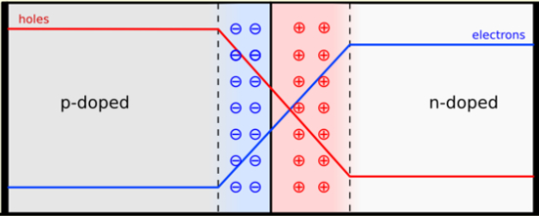
Forward bias
electrical current
The electromotive force from the cell pushes both electrons and holes towards the junction.
Here they annihilate, making room for more electrons and holes to enter the sample at the ends.
This process continues indefinitely, and results in a constant current in the device.
Forward bias → conduction!
holes pushed this way
electrons pushed this way

Slide 18
Reverse bias
no current
force on holes from bigger depletion layer
force on electrons from bigger depletion layer
The electromotive force from the cell pushes both electrons and holes away from the junction.
But this exposes more of the dopant ions, which strengthens the electric field pulling them back.
Equilibrium is reached with a slightly wider depletion layer, but no current.
Reverse bias → insulator!
emf pushes holes this way
emf pushes electrons this way

Slide 19
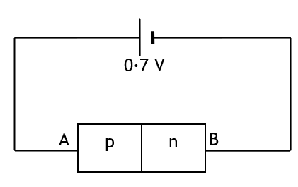
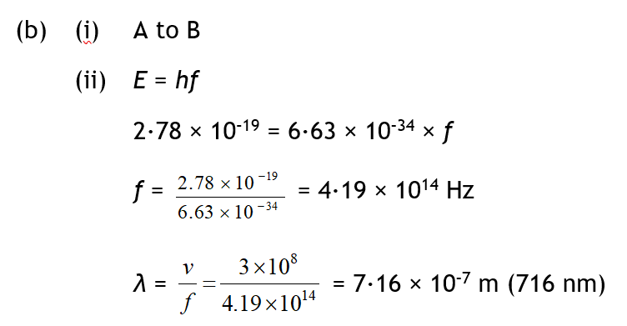
(a) Explain how a semiconductor is ‘doped’ to form a p-type semiconductor and how this doping affects the electrical properties of the semiconducting material.
(b) A potential difference of 0.7 V is maintained across the ends of a p–n diode as shown in the diagram:
In what direction do the majority of the charge carriers in the p-type material flow?
The recombination of charge carriers in the junction region can be represented by a transition between two energy levels separated by 2·78 × 10^{–19} J. What is the wavelength of the radiation emitted from the junction region?

Slide 20
2. The conductivity of a semiconductor material can be increased by ‘doping’.
(a) Explain what is meant by the ‘conductivity’ of a material.
(b) Explain, giving an example, what is meant by ‘doping’ a semiconductor.
(c) Why does ‘doping’ decrease the resistance of a semiconductor material?
3.(a) A sample of pure germanium (four electrons in the outer shell) is doped with phosphorus (five electrons in the outer shell). What kind of semiconductor is formed?
(b) Why does a sample of n-type semiconductor still have a neutral overall charge?
4. Describe the movement of the majority charge carriers when a current flows in:
(a) an n-type semiconductor material, (b) a p-type semiconductor material.

Slide 21
ANSWERS
(a) the conductivity of a material depends on the concentration of free electrons in it.
(b) doping is the addition of a tiny number of group 3 or group 5 atoms to a crystal of group 4 material to create a p-type or n-type material
(c) More dopant provides more charge carriers, decreases resistance, or it decreases the energy gap as it lowers the conduction band (by having a donor level) or increasing the valence band (acceptor level) charge carries can more easily move between the bands.
3(a) Germanium is an intrinsic semiconductor adding P, with 5 outer electrons creates an n-type material. (b) the n-type semiconductor is still neutral as there is a proton in the nucleus for every electron in a shell/band.
4. (a) conduction in an n-type material is from the majority charge carriers, negative electrons moving in the conduction band.
(b) conduction in p-type semiconductors is from the majority charge carriers, positive “holes”, moving in the valence band.

Slide 22
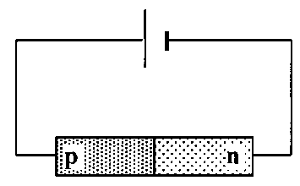
p connected to p, n to n is forward bias
The electromotive force from the cell pushes both electrons and holes towards the junction.Here they annihilate, making room for more electrons and holes to enter the sample at the ends. This process continues, and results in a constant current in the device.
The only charge carriers that are actually moving across the junction are electrons
A p-n junction diode is connected across a d.c. supply as shown.
(a) Is the diode connected in forward or reverse bias mode?
(b) Describe the movement of the majority charge carriers across the p-n junction.
(c) What kind of charge is the only one that actually moves across the junction?

Slide 23
So what can we use this for? (I)
Light-emitting diode:
  Consider operating the p-n junction in forward bias mode.
  In forward bias, a current is flowing, so electrons and holes are continually annihilating in the depletion layer.
  Where does the energy go? It’s emitted as light.
  If we pick our semiconductor(s) and our dopants correctly, we can engineer the device so that the emitted light is in the visible frequency range.
  We have made a diode that emits light! – or a ‘crystal lamp,’ as John Allen used to say.

Slide 24
So what can we use this for? (II)
The photovoltaic effect (as used in solar cells):
  Consider operating the p-n junction in reverse bias mode.
  In reverse bias mode, there is no current flowing, because we cannot magically produce electrons and holes from the depletion layer.
  But what if we shine light on the depletion layer? The device should then function like a light-emitting diode, except in reverse!
  The incident light creates an electron-hole pair, then the depletion-layer field sweeps the electron into the n-type region and the hole into the p-type region. Current flows!

Slide 25
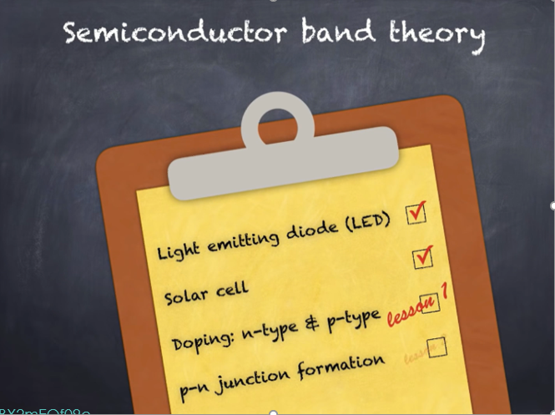
https://youtu.be/4BX2mEQf09c

Slide 26
Summary of key points
A semiconductor is just a special type of insulator: one with a very small energy gap between its valence and conduction bands.
Doping can raise the Fermi level into the conduction band (n-type) or lower it into the valence band (p-type). Either way we get a metal. In an n-type semiconductor the charge carriers are electrons; in a p-type they are holes.
At a p-n junction, a depletion layer forms. This is the key to understanding the diode effect (including the light-emitting kind) and the photovoltaic effect.

Slide 27
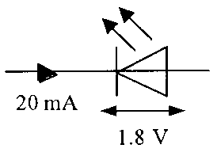
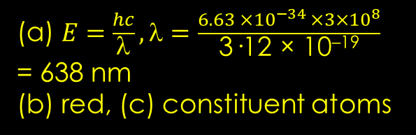
Questions
6. When positive and negative charge carriers recombine at the junction of ordinary diodes and LEDs, quanta of radiation are emitted from the junction.
(a) Does the junction have to be forward biased or reverse biased for radiation to be emitted?
(b) What form does this emitted energy take when emitted by:
(i) an LED
(ii) an ordinary junction diode?
7. A particular LED is measured as having a recombination energy of
3·12 × 10^{–19} J.
(a) Calculate the wavelength of the light emitted by the LED.
(b) What colour of light is emitted by the LED?
(c) What factor about the construction of the LED determines the colour
of the emitted light?
8. (a) State two advantages of an LED over an ordinary filament lamp.
(b) An LED is rated as follows: operating p.d. 1·8 V, forward current 20 mA
The LED is to be operated from a 6 V d.c. power supply.
(i) Draw a diagram of the circuit, including a protective resistor, which allows the LED to operate at its rated voltage.
(ii) Calculate the resistance of the protective resistor that allows the LED to operate at its rated voltage.
Forward Biased
(i) light, (ii) heat
(a) $E=\frac{hc}{λ}, λ=\frac{6.63 ×{10}^{−34 }×3×{10}^{8}}{\text{3·12 × 10}\text{–19}}$
= 638 nm
(b) red, (c) constituent atoms
210 Ω

