Slide 1



Semiconductors and band theory
Higher Physics
Slides by Chris Hooley, University of St Andrews
Videos from paul from high school physics, ChRIS HOOLEY and Mr Smith’s Physics online- thank you guys!

Slide 2
Semiconductors and p-n junctions
a) | I know and can explain the terms conduction band and valence band.
b) | I know that solids can be categorised into conductors, semiconductors or insulators by their band structure and their ability to conduct electricity. Every solid has its own characteristic energy band structure. For a solid to be conductive, both free electrons and accessible empty states must be available.
c) | I can explain qualitatively the electrical properties of conductors, insulators and semiconductors using the electron population of the conduction and valence bands and the energy difference between the conduction and valence bands. (Reference to Fermi levels is not required.)
d) | I know that the electrons in atoms are contained in energy levels. When the atoms come together to form solids, the electrons then become contained in energy bands separated by gaps.
e) | I know that for metals we have the situation where one or more bands are partially filled.
f) | I know that some metals have free electrons and partially filled valence bands, therefore they are highly conductive.
g) | I know that some metals have overlapping valence and conduction bands. Each band is partially filled and therefore they are conductive.
h) | I know that in an insulator, the highest occupied band (called the valence band) is full. The first unfilled band above the valence band is the conduction band. For an insulator, the gap between the valence band and the conduction band is large and at room temperature there is not enough energy available to move electrons from the valence band into the conduction band where they would be able to contribute to conduction. There is no electrical conduction in an insulator.
i) | I know that in a semiconductor, the gap between the valence band and conduction band is smaller and at room temperature there is sufficient energy available to move some electrons from the valence band into the conduction band allowing some conduction to take place. An increase in temperature increases the conductivity of a semiconductor.
Given in loads of detail!
Think why!

Slide 3
Outline
Conductors, insulators, and semiconductors: a basic introduction.
Energy bands: what are they, and where do they come from?

Slide 4







Slide 5
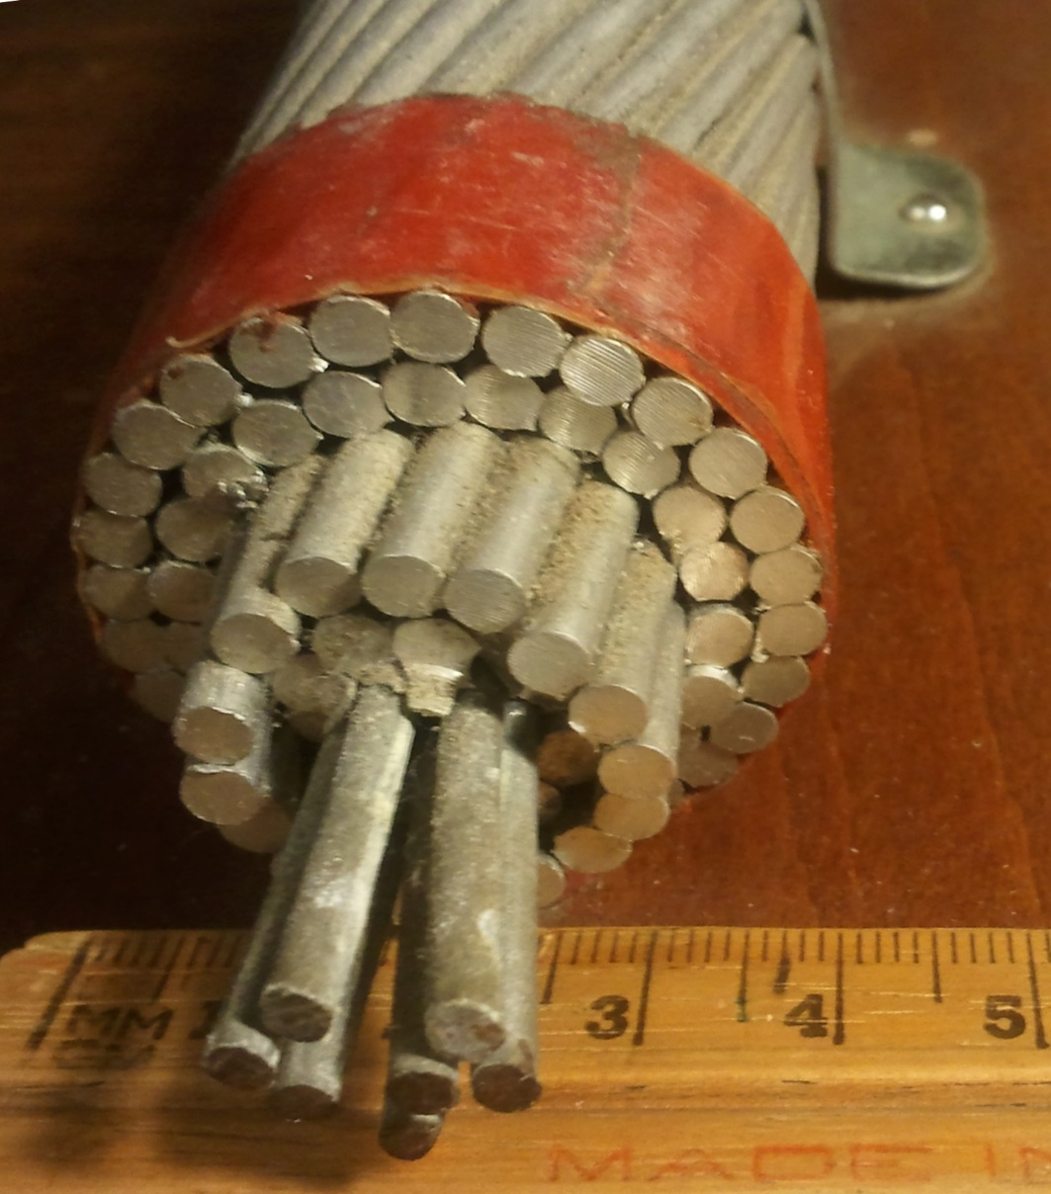
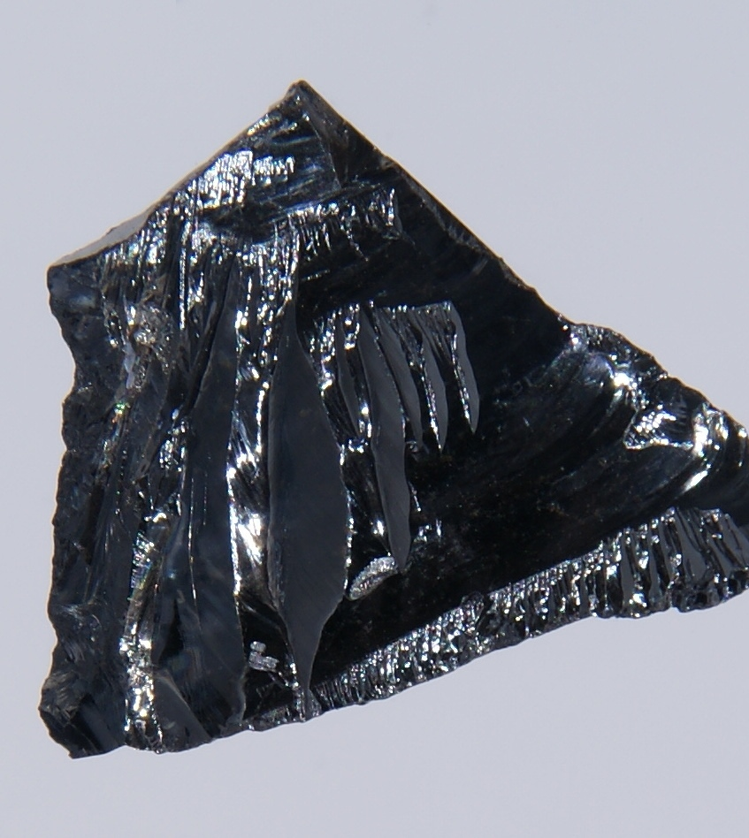
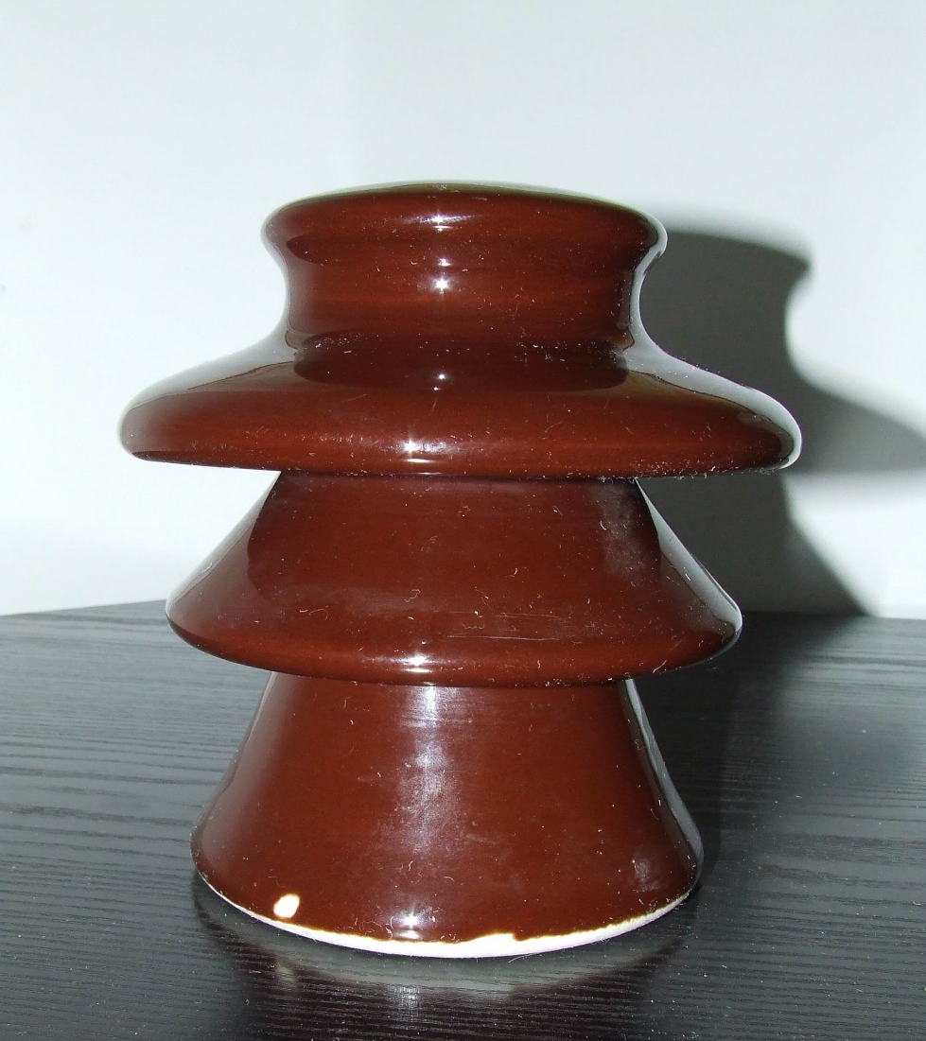
Conductors, insulators, & semiconductors
Notes:
Pictures:
Aluminium steel-reinforced cable (power line);

Slide 6
Conductors vs. insulators
Resistance
Resistance
Conductor
Insulator
Temperature
Temperature

Slide 7
Conductors, insulators, & semiconductors
Conductor: A material for which an applied voltage causes a current to flow. The current is proportional to the voltage (Ohm’s law).
Insulator: A material for which an applied voltage causes very little current. The current remains very small until the voltage becomes very large.
Semiconductor: Really just an insulator, but where the voltage necessary to drive a current is smaller than usual.

