Slide 1
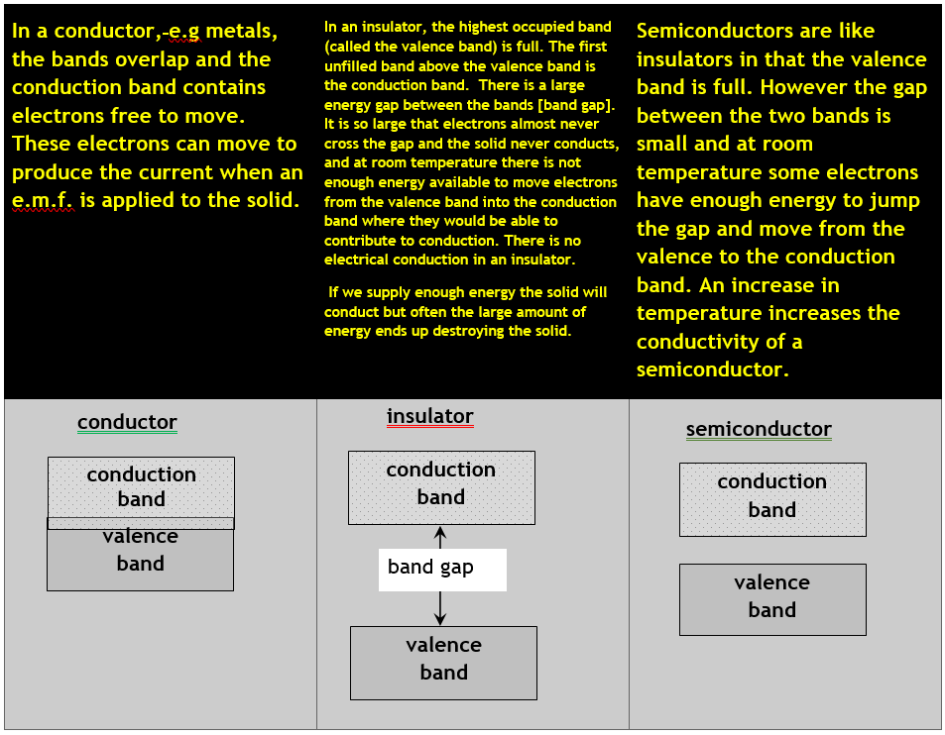

Summary

Slide 2


For those that want to know how this happens
You are not required to know about Fermi Level or quantum tunnelling, but be aware that the previous versions are a simplified versions of what is happening

Slide 3
Energy bands and energy gaps
Energy
vacuum level
{
energy gap
{
empty states
We represent this in band diagrams like the one on the left.
Blue regions are the energy bands where electrons can exist.
We call the energy of the highest occupied state the Fermi level.
The dashed line is the energy of a stationary electron in the vacuum.
{
energy gap
{
empty states
Fermi level
{
occupied
states
Position within sample

Slide 4
Band diagram for a metal
Band diagram for an insulator
conduction band
energy gap Δ
valence band
There are empty states immediately above Fermi level → electrons can be excited even with very small amounts of energy
Next available empty state is a finite energy away (Δ, the energy gap) → no conduction until electrons can be excited across this gap

Slide 5
Note that a semiconductor is really just a particular type of insulator: one with an energy gap small enough that we can easily excite electrons into the conduction band.
We can do this by heating the semiconductor, or by applying a large enough potential difference across it.
Band diagram for a semiconductor
conduction band
very small energy gap Δ
valence band
Next available empty state is a finite energy away (Δ, the energy gap) → no conduction until electrons can be excited across this gap

Slide 6
How do energy bands form?
This can be explained by a thought experiment.
Imagine building the crystal by bringing the constituent atoms together one by one.
A single atom has a discrete set of allowed energy levels.
As the second atom is brought up, the electron can quantum tunnel from one nucleus to the other and back again. This creates new orbits, and thus new possible energy levels.

Slide 7
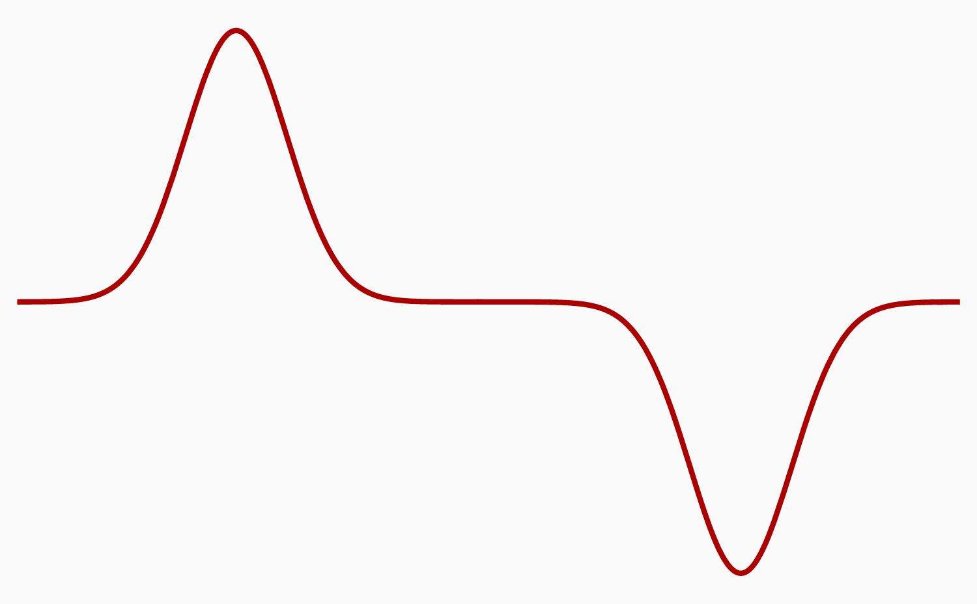
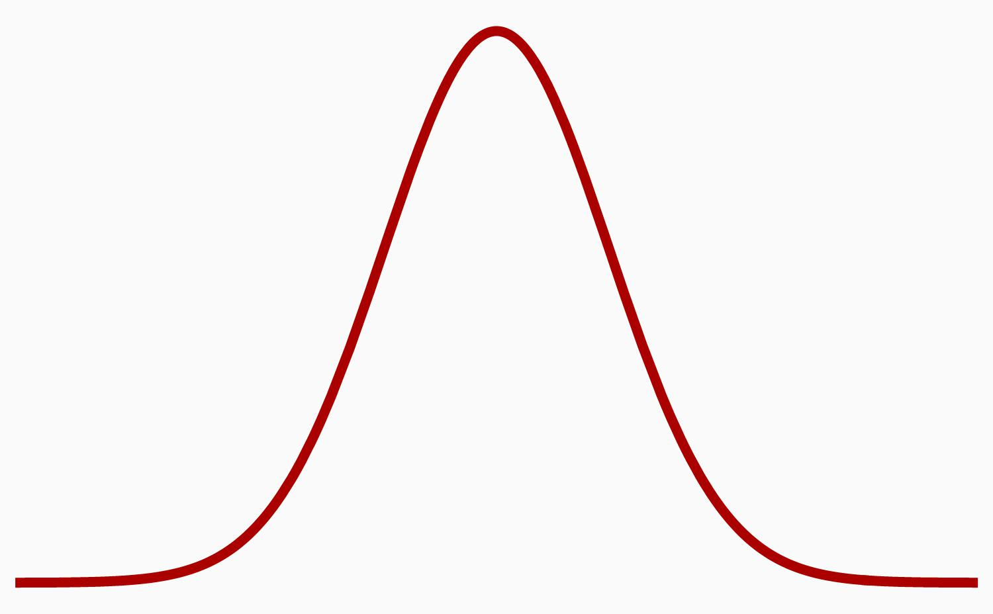
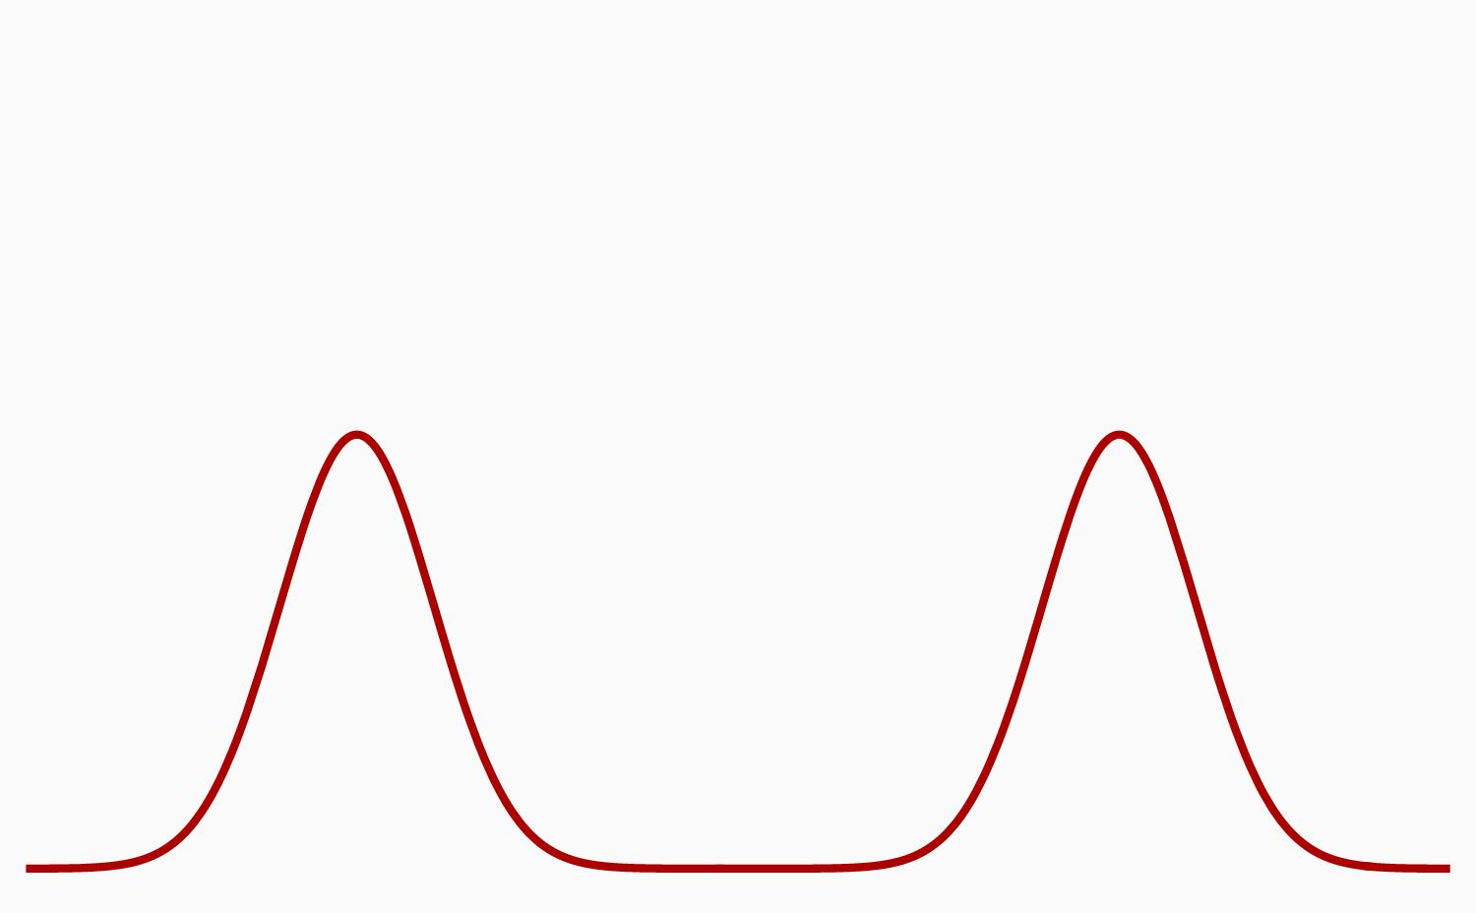
Two atoms, no tunnelling
Two atoms, with tunnelling
Energy
Energy
wave function
Position within sample
Position within sample

Slide 8
Building a crystal one atom at a time

