Slide 1
IOP Scotland Teacher Network
This event will start shortly
Assignment Higher Physics
Monday 4 September 2023 7:30 pm

Slide 2
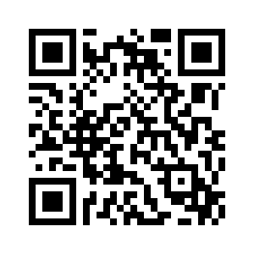
IOP Scotland Teacher Network
Please complete this short evaluation form:
https://forms.office.com/e/UXY7uqKpuv
Completing this evaluation is important to help ensure continued support for IOP activities and to ensure they meet your needs.

Slide 3
Higher Assignment
Complete recipe sheet or topic suggestions? - cannot give too much assistance
What is appropriate at Higher Level ?
One or two experiments?
Enough results to produce a good graph?
Timings - prelim time?
Still to come..
Possible topics
Practice investigations
Tonight!

Slide 4
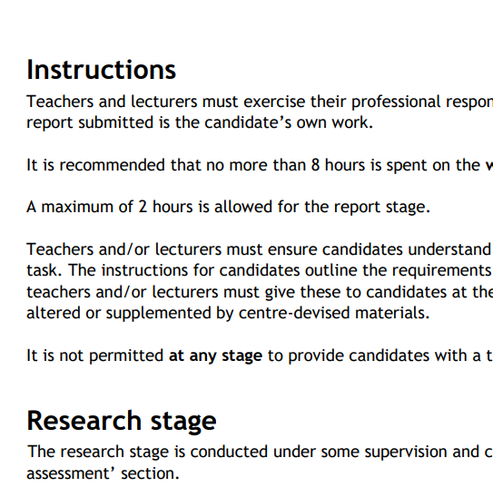
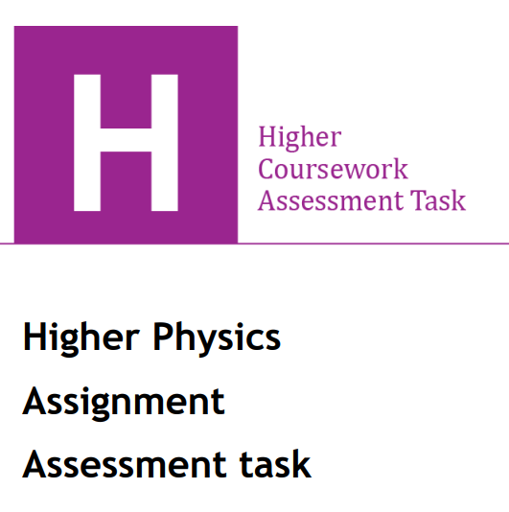
SQA Coursework Assessment Task – your first port of call!
Very detailed - since 2019
-Instructions for teachers and lecturers
-Marking Instructions
-Instructions for candidates
https://www.sqa.org.uk/files_ccc/HigherCATPhysics.pdf

Slide 5
IOP Scotland Teacher Network
Programme:
Potential experiments for assignments
Some other points to note

Slide 6
SQA Higher Assignment
The assignment has two stages:
research
report
8 hours of which a maximum of 2 hours is allocated to the reporting stage

Slide 7
SQA Higher Assignment
The assignment offers challenge by requiring candidates to apply skills, knowledge and understanding in a context that is one or more of the following:
unfamiliar
familiar but investigated in greater depth
integrating a number of familiar contexts
So anything goes!

Slide 8
Practical Ideas - Must be able to generate Numerical Graphable Data
Probably best to stick to these as standards. If you notice several are the same expt but with different titles!
ODU | P&W | Electricity
Measuring g $s=\frac{1}{2}{at}^{2}$ | Finding Planck’s constant | EMF by different methods $E=V+Ir$or $R=\frac{E}{I}−r$
Measuring g $v^{2}=2as$ | λ By diffraction $d sin=m $ | Switch on voltage
Measuring g $g\sin{θ}=a$ | Inverse Square law (lasers don’t, lights do) | Thermistors (timing)
Veryfying Equations of motion, weighing the Earth | Finding refractive index or critical angle | Capacitors (C=Q/V)
 | v sound by interference | AC v DC
 | Wavelength of microwaves by interference | I & f in a capacitor circuit c.f. I & f in a resistor circuit

Slide 9
Practical Ideas- check out the SQA past papers!
ODU | P&W | Electricity
Measuring g pendulum (AH?) | Op amps in inverting mode | Capacitors Area of plates Distance between plates
 | Op amps and bandwidth
 | F on a I carrying wire
 | Out-of-balance Wheatstonestone bridge as two potential divider circuits
 | Mosfet board

Slide 10
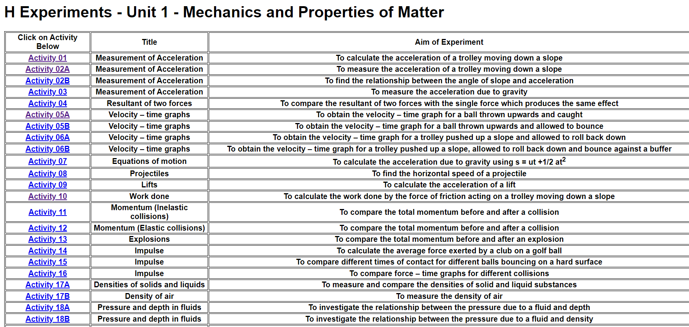
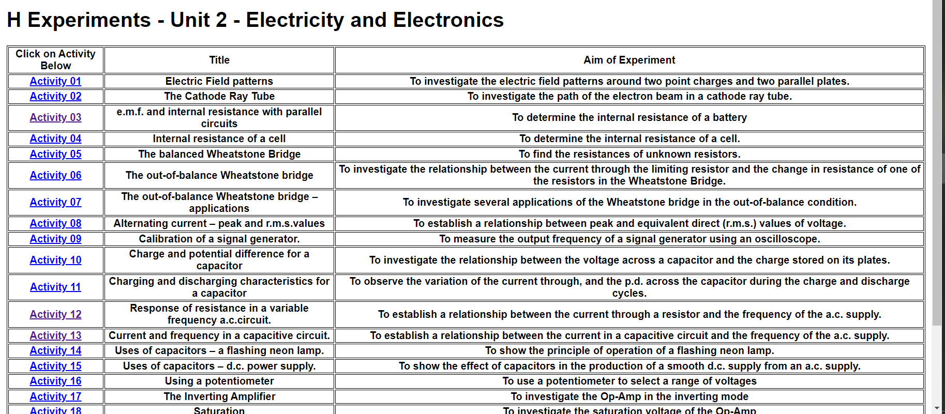
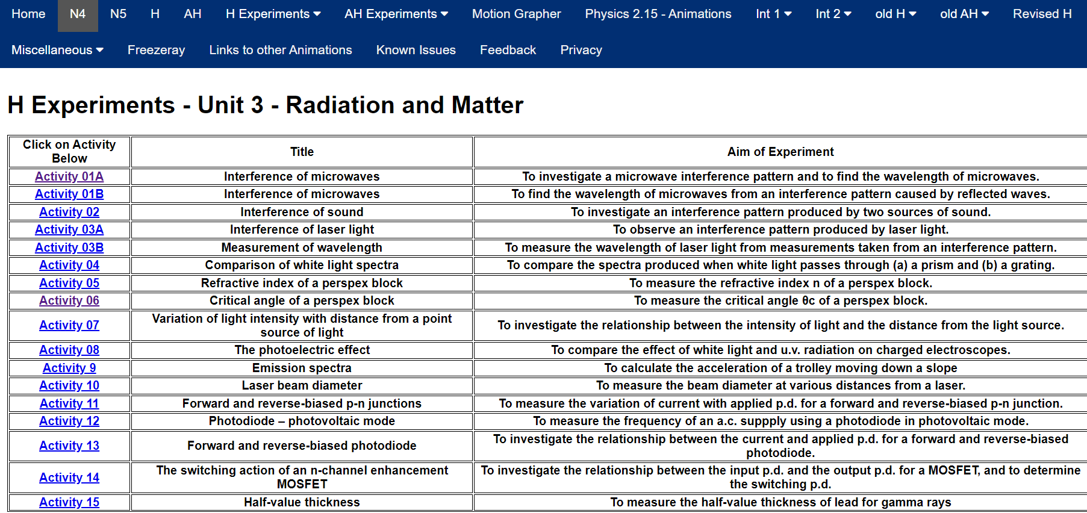
https://physicsflashrepo.ovh/
potential
Ideas!

Slide 11
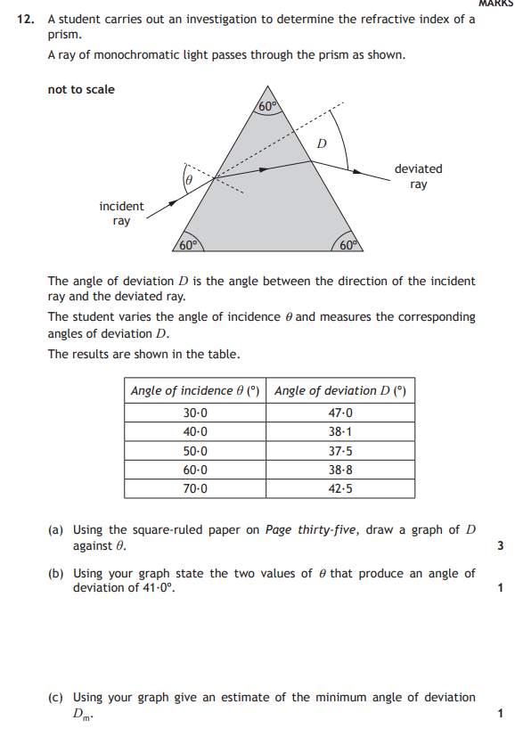
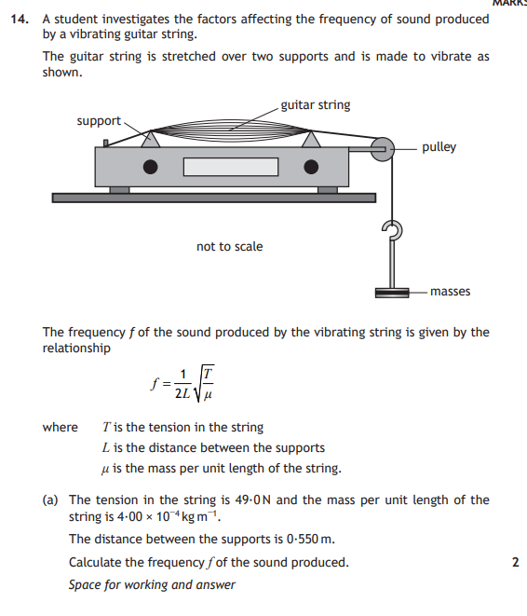
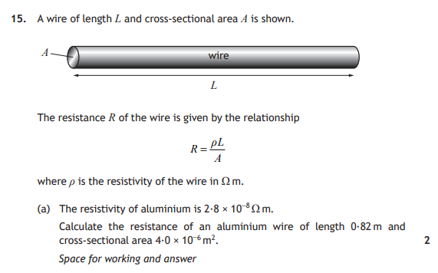
Check out ideas from past papers
But don’t use as a source
2017 Q15
2015 Q12
2016 Q14

Slide 12
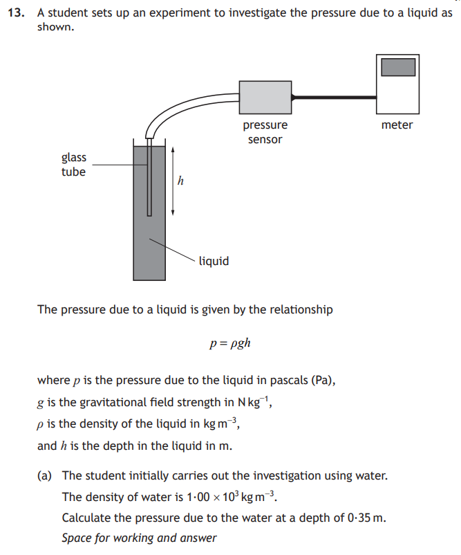
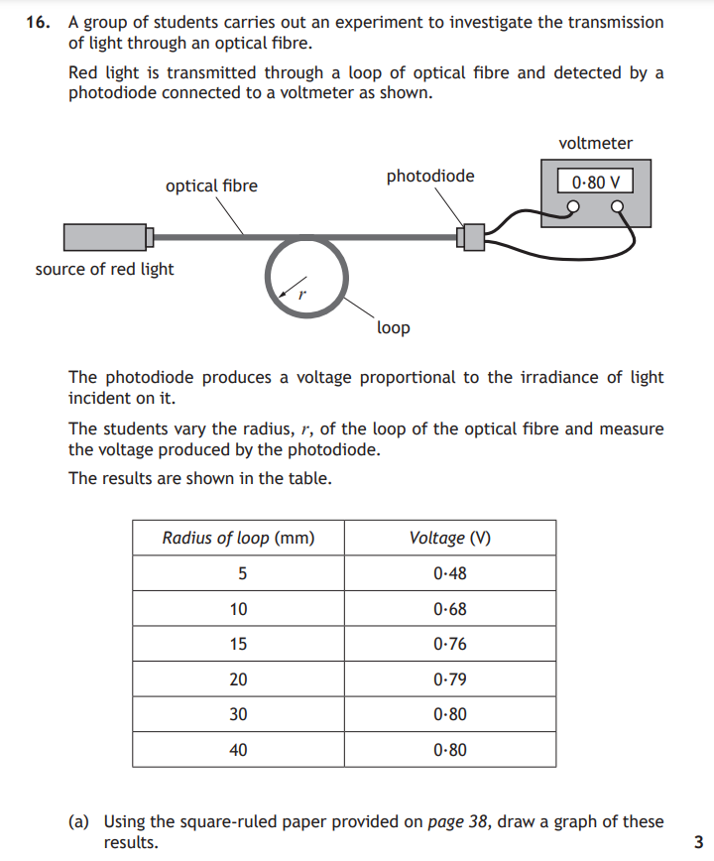
2018 Q13
SQP Q16

Slide 13
One experiment v two
One experiment | Two experiments
Time to write up (max 2 hours) | Two attempts at graphing
Find additional DATA (table or graph) | You are the second source
Reduces stress on students | Less time searching the web, not limited by finding data
More able to write up | data from two related experiments must gather extracts for underlying physics
Only one chance to mess up! | You will be awarded the mark if one of the two descriptions is acceptable.
Gather extracts to support the candidate description of underlying physics
One experiment + data source or two experiments but must be the same aim
U.S 2023 appear to push for two experiments but is this right for your students?

Slide 14
Notes
RESEARCH
5 measurements, 5 repeats? Depends on the time to collect repeats ΔR for 6-12 readings Remember candidates should repeat measurements not take 5 sets of readings at once!
Scale reading uncertainty for each measurement
Data could be a table or a graph something that allows your aim to be verified.
REPORT
Do not use ifs in your aim where your answer could be yes- see full MI
Do not use or show a relationships in your aim where your answer might not be able to show a relationship
An extract must be a direct copy, which can be a printout, photocopy or handwritten (word for word) and must not be annotated. There is no size limit on an extract, but it must be an extract and not the full document.
Your extracts can include any formulae or relationships you may need but must not include sample calculations.
During the report stage you will need to show your understanding by writing your description of the physics relevant to your aim using your own words.
It is important that you record where you get your data or extracts from in enough detail

Slide 15
Rules
RESEARCH
Not sending students to websites, so print off the method sheets first
No feedback to be given on their research, only for health and safety and protection of kit
Research only from websites, journals and/or books. NOT student notes
Research can be completed at home
Individual
REPORT
Almost exam conditions
No feedback to be given
2 hours max (plus any additions in line with written paper)
Research only from websites, journals and/or books. NOT student notes
Research can be completed at home
Individual

Slide 16
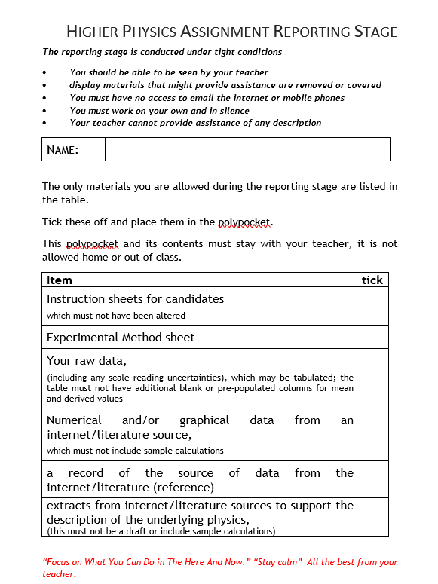
To take in
This can be used to check off student work and make sure candidates are only taking in to the write-up what is allowed
https://www.mrsphysics.co.uk/higher/wp-content/uploads/2023/12/H-What-I-can-take-in.docx

Slide 17
Higher Assignment - Useful Links
SQA Higher Physics Coursework Assessment Task
https://www.sqa.org.uk/files_ccc/HigherCATPhysics.pd
https://www.understandingstandards.org.uk/Subjects/Physics/Higher/Assignment
Some ideas for practical work
https://www.mrsphysics.co.uk/higher/assignments-from-2018/
https://www.youtube.com/watch?v=PAXVkcJLTKk&list=PLuzo1XZjZIcUkRFoPBx84W_RrJW3pjHnA&index=17
www.sserc.org.uk/wp-content/uploads/2017/07/Practical_physics_guide.pdf
Notes:
Best to do “standard” experiments probably from the “required” experiments. Avoid ones where the underlying physics is not at Higher level
Note pupils should not be given the AIM.

Slide 18
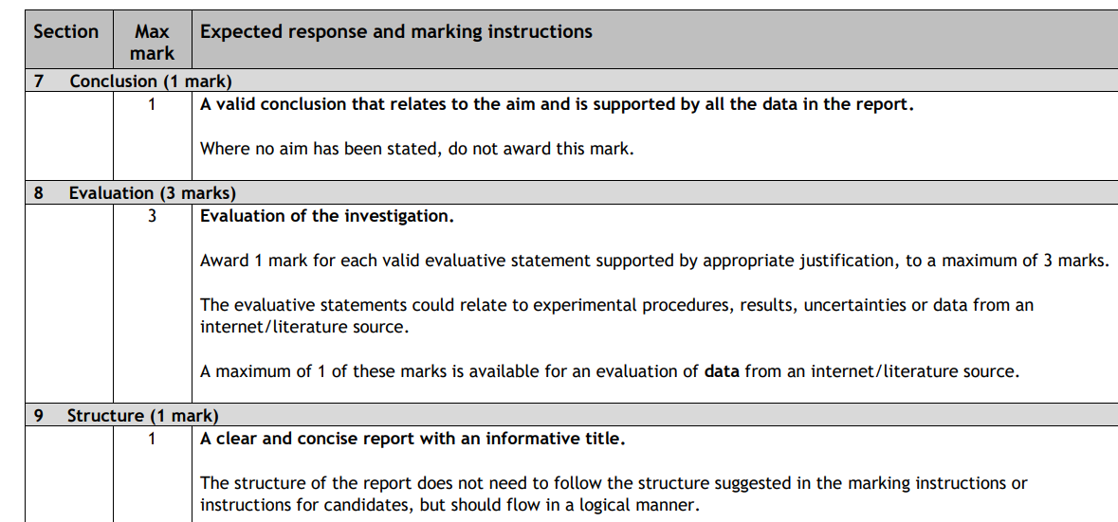
Detailed marking can be shared in advance but not during report writing
https://www.sqa.org.uk/files_ccc/HigherCATPhysics.pdf

Slide 19
Graphs..
A scatter graph is the only appropriate format for presentation of data in this section. Graphs must be based on the candidate’s experimental data.
Mark computer-generated graphs in the same way as hand-drawn graphs.
Graphs should be of a size that allows the scaling and labelling of the axes, and the accuracy of the plotting of the data points, to be readily checked.
It may not be possible to check the accuracy of plotting if data points are excessively large, minor gridlines are omitted or the candidate has not used graph paper.
Where a candidate has graphed data from two experiments, both graphs should be marked, and the mark associated with the higher-scoring graph awarded.
https://www.sqa.org.uk/files_ccc/HigherCATPhysics.pdf

Slide 20
Uncertainties..
Award 2 marks if the candidate includes all appropriate scale reading uncertainties and correctly calculates random uncertainties.
Award 1 mark if the candidate includes all appropriate scale reading uncertainties or correctly calculates random uncertainties.
https://www.sqa.org.uk/files_ccc/HigherCATPhysics.pdf

Slide 21
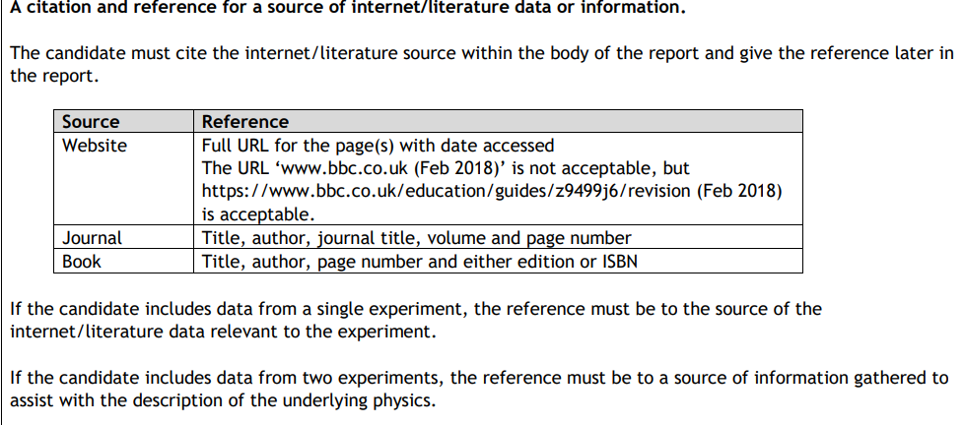
References..
https://www.sqa.org.uk/files_ccc/HigherCATPhysics.pdf

Slide 22
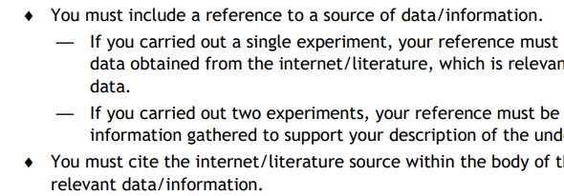
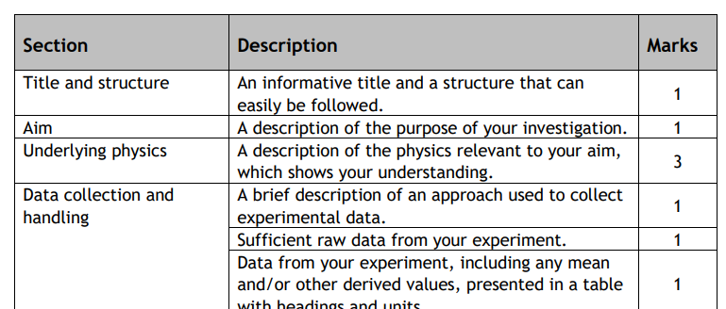
Candidate Guide (pages 20 -26) “Read it or greet!”
https://www.sqa.org.uk/files_ccc/HigherCATPhysics.pdf

Slide 23
Candidate Guide - From course report
“Assignment
There is evidence that candidates who follow the ‘instructions for candidates’ section of the coursework assessment task manage to access the majority of available marks.”
https://www.sqa.org.uk/files_ccc/2019HCourseReportPhysics.pdf

Slide 24
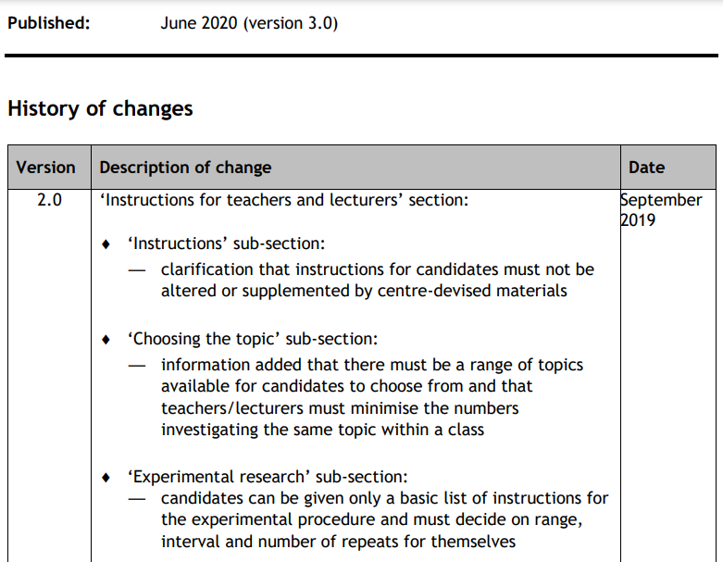
CAT change log pages….
https://www.sqa.org.uk/files_ccc/HigherCATPhysics.pdf

Slide 25
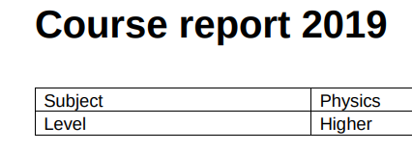
Course Report 2019
https://www.sqa.org.uk/files_ccc/2019HCourseReportPhysics.pdf

Slide 26
Course Report 2019
Centres should continue to ensure that candidates have a choice of assignment and that if candidates are only performing one experiment, they have an opportunity to find data from literature sources. Whole classes or cohorts investigating the same topic is not acceptable. Centres are encouraged to give candidates opportunities to take part in a wide range of practical work before choosing a topic for investigation. Centres should ensure that candidates can cite and reference their sources correctly. While a formal citing and referencing system isn’t required, candidates should be strongly encouraged to follow a system such as the Vancouver referencing system. Candidates should be made aware that they need to conclude all of their data, both practical and literature. Where a candidate’s experimental data does not agree with their literature data, their conclusion should reflect this. Centres should ensure that candidates are provided with opportunities to develop the necessary skills to evaluate their data and experimental procedures.

Slide 27
Course Report 2019
When referencing their secondary data, many candidates did not cite their source as well as reference it. When candidates referenced an internet source, a number did not give the date when the site was accessed. Many candidates did not write a conclusion that referred to all of their data. Candidates were often only stating a conclusion about their own experimental data. Some candidates ignored their experimental data and concluded using only their literature source. In the evaluation section, candidates did not always supply a justification for their evaluation. For example, candidates should make it clear why a suggested experimental change would produce an improvement in their data. Some candidates are continuing to evaluate the reliability of their literature source. This does not gain any marks in the revision to the assignment. There is one mark available for evaluating the data from the literature source but not for evaluating the source itself.
https://www.sqa.org.uk/files_ccc/2019HCourseReportPhysics.pdf

Slide 28
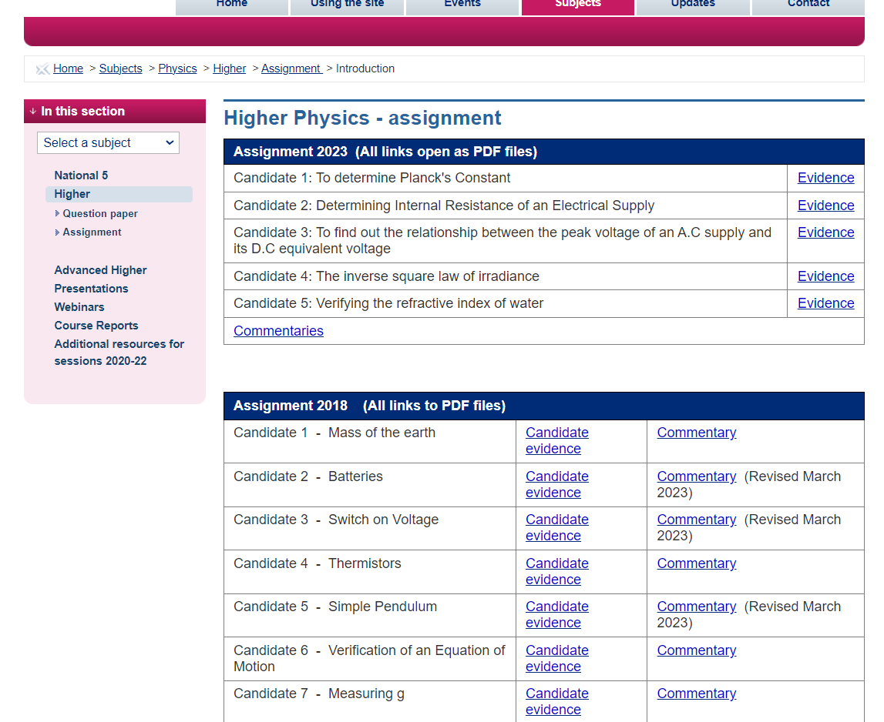
Understanding Standards -updated
https://www.understandingstandards.org.uk/Subjects/Physics/Higher/Assignment

Slide 29
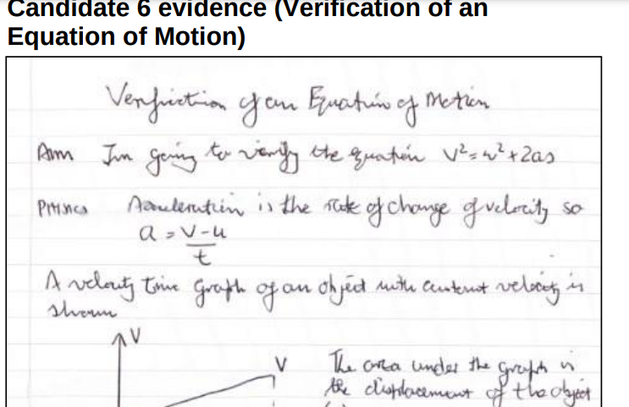
Understanding Standards - candidate evidence
https://www.understandingstandards.org.uk/Higher_images/physics/PhysicsHigherAssignment2018-19Candidate6.pdf

Slide 30
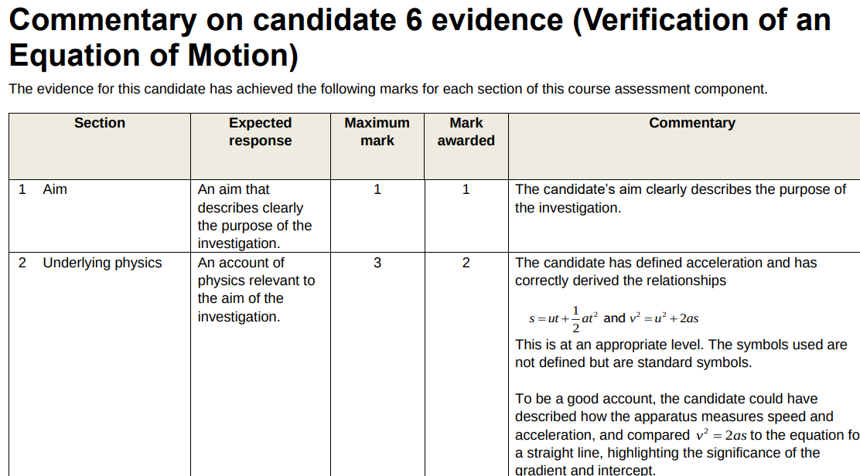
Understanding Standards - candidate evidence
https://www.understandingstandards.org.uk/Higher_images/physics/PhysicsHigherAssignment2018-19Commentary6.pdf

Slide 31
Possible investigations - Photos, no aims!
https://docs.google.com/document/d/1h7QbHqPmqXKRM1teDUmu6TlEUilhyWibhKv6aaxoRnQ/edit

Slide 32
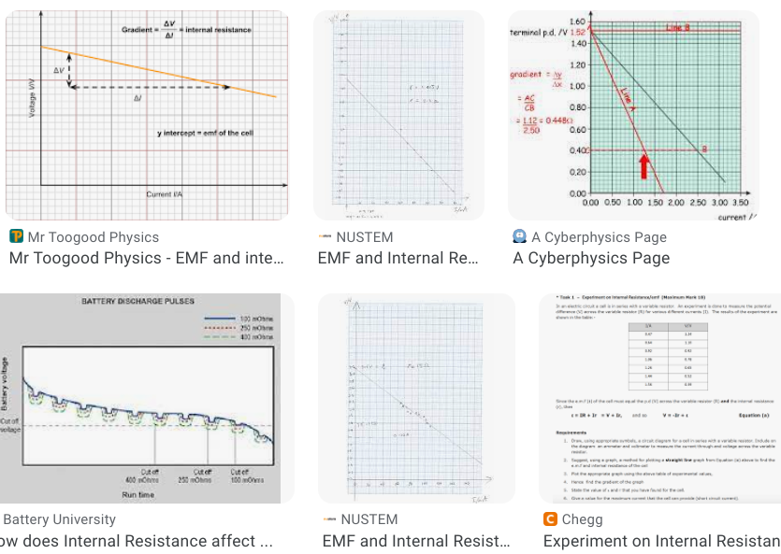
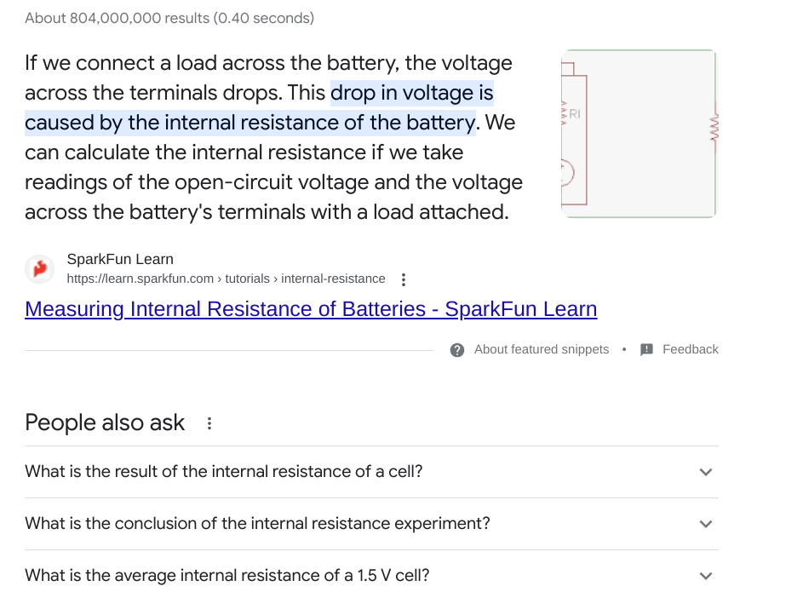
Image searches - “all” vs “image search”

Slide 33
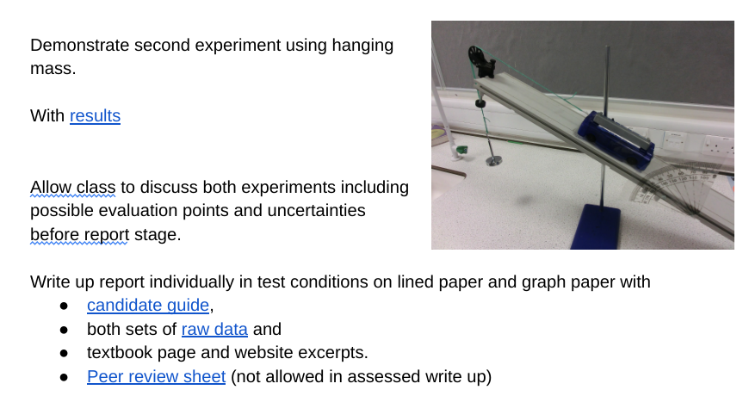
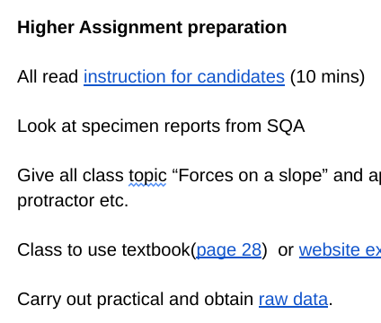
If time permits - practice assignment?
Slope force - two ways?
https://docs.google.com/document/d/1X4SoI7RbQi1OUj5Jk4-VEKWDvwzfIbQD9APUSj3uw-Q/edit

Slide 34
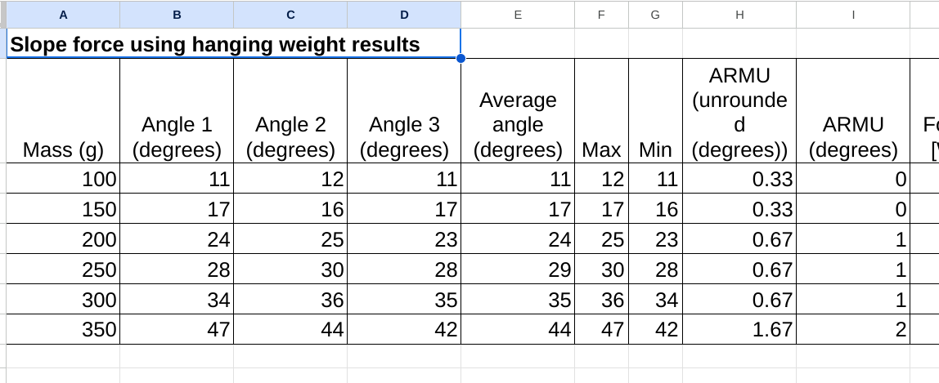
Slope force - Specimen results exemplify uncerts
https://docs.google.com/spreadsheets/d/1PLqTGRVccGMFebCJp-2Ny9Nabgo8jVKfULMd3-Sn1zg/edit#gid=0

Slide 35
Raw Data – what can go in!
distance | Irradiance (units)
(m) |  |  |  |  | average
0.200 | 57.0 | 65.8 | 55.2 | 57.9 | 59.0
0.250 | 38.2 | 36.4 | 39.7 | 38.4 | 38.2
0.300 | 25.6 | 24.9 | 25.4 | 25.8 | 25.4
0.400 | 14.9 | 15.5 | 15.5 | 16.2 | 15.5
0.600 | 7.8 | 7.5 | 7.6 | 7.7 | 7.7
0.800 | 5.3 | 5.2 | 5.3 | 5.0 | 5.2
1.000 | 4.0 | 3.5 | 3.2 | 3.4 | 3.5
distance | Irradiance (units)
(m)
0.200 | 57.0 | 65.8 | 55.2 | 57.9
0.250 | 38.2 | 36.4 | 39.7 | 38.4
0.300 | 25.6 | 24.9 | 25.4 | 25.8
0.400 | 14.9 | 15.5 | 15.5 | 16.2
0.600 | 7.8 | 7.5 | 7.6 | 7.7
0.800 | 5.3 | 5.2 | 5.3 | 5.0
1.000 | 4.0 | 3.5 | 3.2 | 3.4
Can’t take calculated values in e.g. averages
This is what can be taken in, notice there are no blank unpopulated tables
Students can have plotted a graph during the experimental phase, but this must not be taken in to the reporting stage. Good practice to do this for any experiment

Slide 36
Possible table (after write-up)
distance | 1/d² | Irradiance (lux) |  |  |  |  | ΔR | % uncertainty
(m) | (m⁻²) |  |  |  |  | average | (lux) | (%)
0.200 | 25.0 | 57.0 | 65.8 | 55.2 | 57.9 | 59.0 | 2.7 | 4
0.250 | 16.0 | 38.2 | 36.4 | 39.7 | 38.4 | 38.2 | 0.8 | 2
0.300 | 11.1 | 25.6 | 24.9 | 25.4 | 25.8 | 25.4 | 0.2 | 1
0.400 | 6.25 | 14.9 | 15.5 | 15.5 | 16.2 | 15.5 | 0.3 | 2
0.600 | 2.78 | 7.8 | 7.5 | 7.6 | 7.7 | 7.7 | 0.1 | 1
0.800 | 1.56 | 5.3 | 5.2 | 5.3 | 5.0 | 5.2 | 0.1 | 1
1.000 | 1.00 | 4.0 | 3.5 | 3.2 | 3.4 | 3.5 | 0.2 | 6
An example of a final table but sample calculations should be given in the analysis to show how these were calculated
Control+tilda accent grave (the key above the tab) reveals the formula in a table
distance | 1/d² | Irradiance (lux) |  |  |  |  | ΔR | % uncertainty
(m) | (m⁻²) |  |  |  |  | average | (lux) | (%)
0.2 | =1/(A3*A3) | 57 | 65.8 | 55.2 | 57.9 | =AVERAGE(C3:F3) | =(MAX(C3:F3)-MIN(C3:F3))/COUNTA(C3:F3) | =H3/G3*100
0.25 | =1/A4^2 | 38.2 | 36.4 | 39.7 | 38.4 | =AVERAGE(C4:F4) | =(MAX(C4:F4)-MIN(C4:F4))/COUNTA(C4:F4) | =H4/G4*100
0.3 | =1/A5^2 | 25.6 | 24.9 | 25.4 | 25.8 | =AVERAGE(C5:F5) | =(MAX(C5:F5)-MIN(C5:F5))/COUNTA(C5:F5) | =H5/G5*100
0.4 | =1/A6^2 | 14.9 | 15.5 | 15.5 | 16.2 | =AVERAGE(C6:F6) | =(MAX(C6:F6)-MIN(C6:F6))/COUNTA(C6:F6) | =H6/G6*100
0.6 | =1/A7^2 | 7.8 | 7.5 | 7.6 | 7.7 | =AVERAGE(C7:F7) | =(MAX(C7:F7)-MIN(C7:F7))/COUNTA(C7:F7) | =H7/G7*100
0.8 | =1/A8^2 | 5.3 | 5.2 | 5.3 | 5 | =AVERAGE(C8:F8) | =(MAX(C8:F8)-MIN(C8:F8))/COUNTA(C8:F8) | =H8/G8*100
1 | =1/A9^2 | 4 | 3.5 | 3.2 | 3.4 | =AVERAGE(C9:F9) | =(MAX(C9:F9)-MIN(C9:F9))/COUNTA(C9:F9) | =H9/G9*100

Slide 37
I’ve added
major and minor gridlines
Changed the points to crosses (5pt) no fill, solid border
A trendline in a black solid line
Equation for the line & R2 value
Tick marks on the axes
Labels with units with / between
Title
Don’t extrapolate beyond your points!

Slide 38
Using Excel for SQA work
https://www.mrsphysics.co.uk/advanced/project-2019/
https://www.mrsphysics.co.uk/bge/using-excel/
https://www.mrsphysics.co.uk/advanced/wp-content/uploads/2020/06/Excel-Tables-Hookes-Law-AH-EXTENSION-2020.pdf (last one goes up to AH, but parts are ok for higher)

Slide 39
Uncertainties
You must include scale reading uncertainties for all the measurements you have made in your experiment, and calculate the random uncertainty in your repeated measurements.
If you carried out two experiments, you should include the uncertainties in the measurements from both experiments. Both sets of uncertainties will be marked, and you will be awarded the mark for the better set.
Make sure the examples you use are for SQA at Higher Level. Other methods might be equally correct but won’t get students the marks!
https://www.mrsphysics.co.uk/higher/uncertainties/
https://www.youtube.com/watch?v=5oH6qR5iFvA

Slide 40
Uncertainties
This was a great little table given in resources for the 2000 Higher Still Higher. I think this still works to show scale reading uncertainties
Uncertainties must be stated for all the measuring instruments used. For most experiments a mean should also be calculated together with the approximate random uncertainty.
Please use the table below to help you record your uncertainties.
 | Scale reading uncertainty | comment | % uncertainty [if needed] | random uncertainty [if needed]
(name of x) | ± (value) unit | half smallest scale division |  | see readings table, max - min used No. of readings
(name of y) | ± (value) unit | one in last digit |  | Not done, only two readings taken

Slide 41
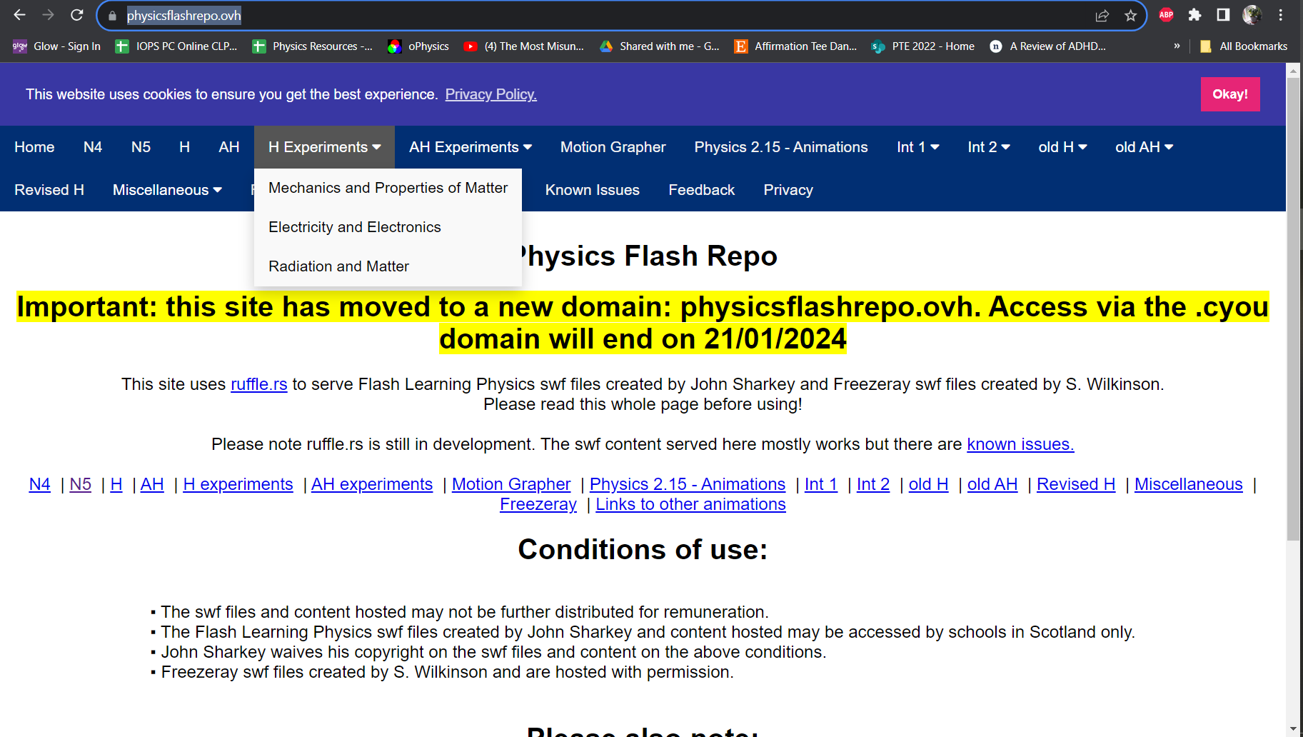
Some of the References I couldn’t show you in the talk!
https://www.understandingstandards.org.uk/Subjects/Physics/Higher/Assignment
https://www.focuseducational.com/a-level-physics-required-practicals/
https://filestore.aqa.org.uk/resources/physics/AQA-7407-7408-SUG-P2.PDF
https://physicsflashrepo.ovh/
https://www.mrsphysics.co.uk/higher/wp-content/uploads/2023/09/A-GUIDE-TO-Assignments-2023.pdf

Slide 42
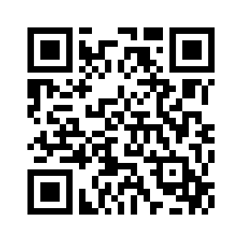
IOP Scotland Teacher Network
Please complete this short evaluation form:
https://forms.office.com/e/SauaTs3UAs
Completing this evaluation is important to help ensure continued support for IOP activities and to ensure they meet your needs.

Slide 43
IOP Scotland Teacher Network - Online
Early Career Teacher TeachMeet 19:30-20:30, Wednesday, 13 December 2023
Using AI in Physics Education 16:30-17:30, Wednesday, 17 January 2024
Alternative Pathways in Physics 19:30-20:30, Wednesday, 31 January 2024

Slide 44
49th
23 May 2024

Slide 45
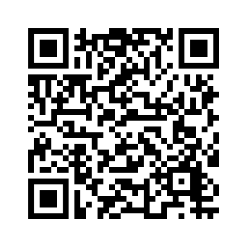
IOP New Contact List
Register for our new email list:
www.iop.org/education/sign-up-learning-skills-community

