Slide 1
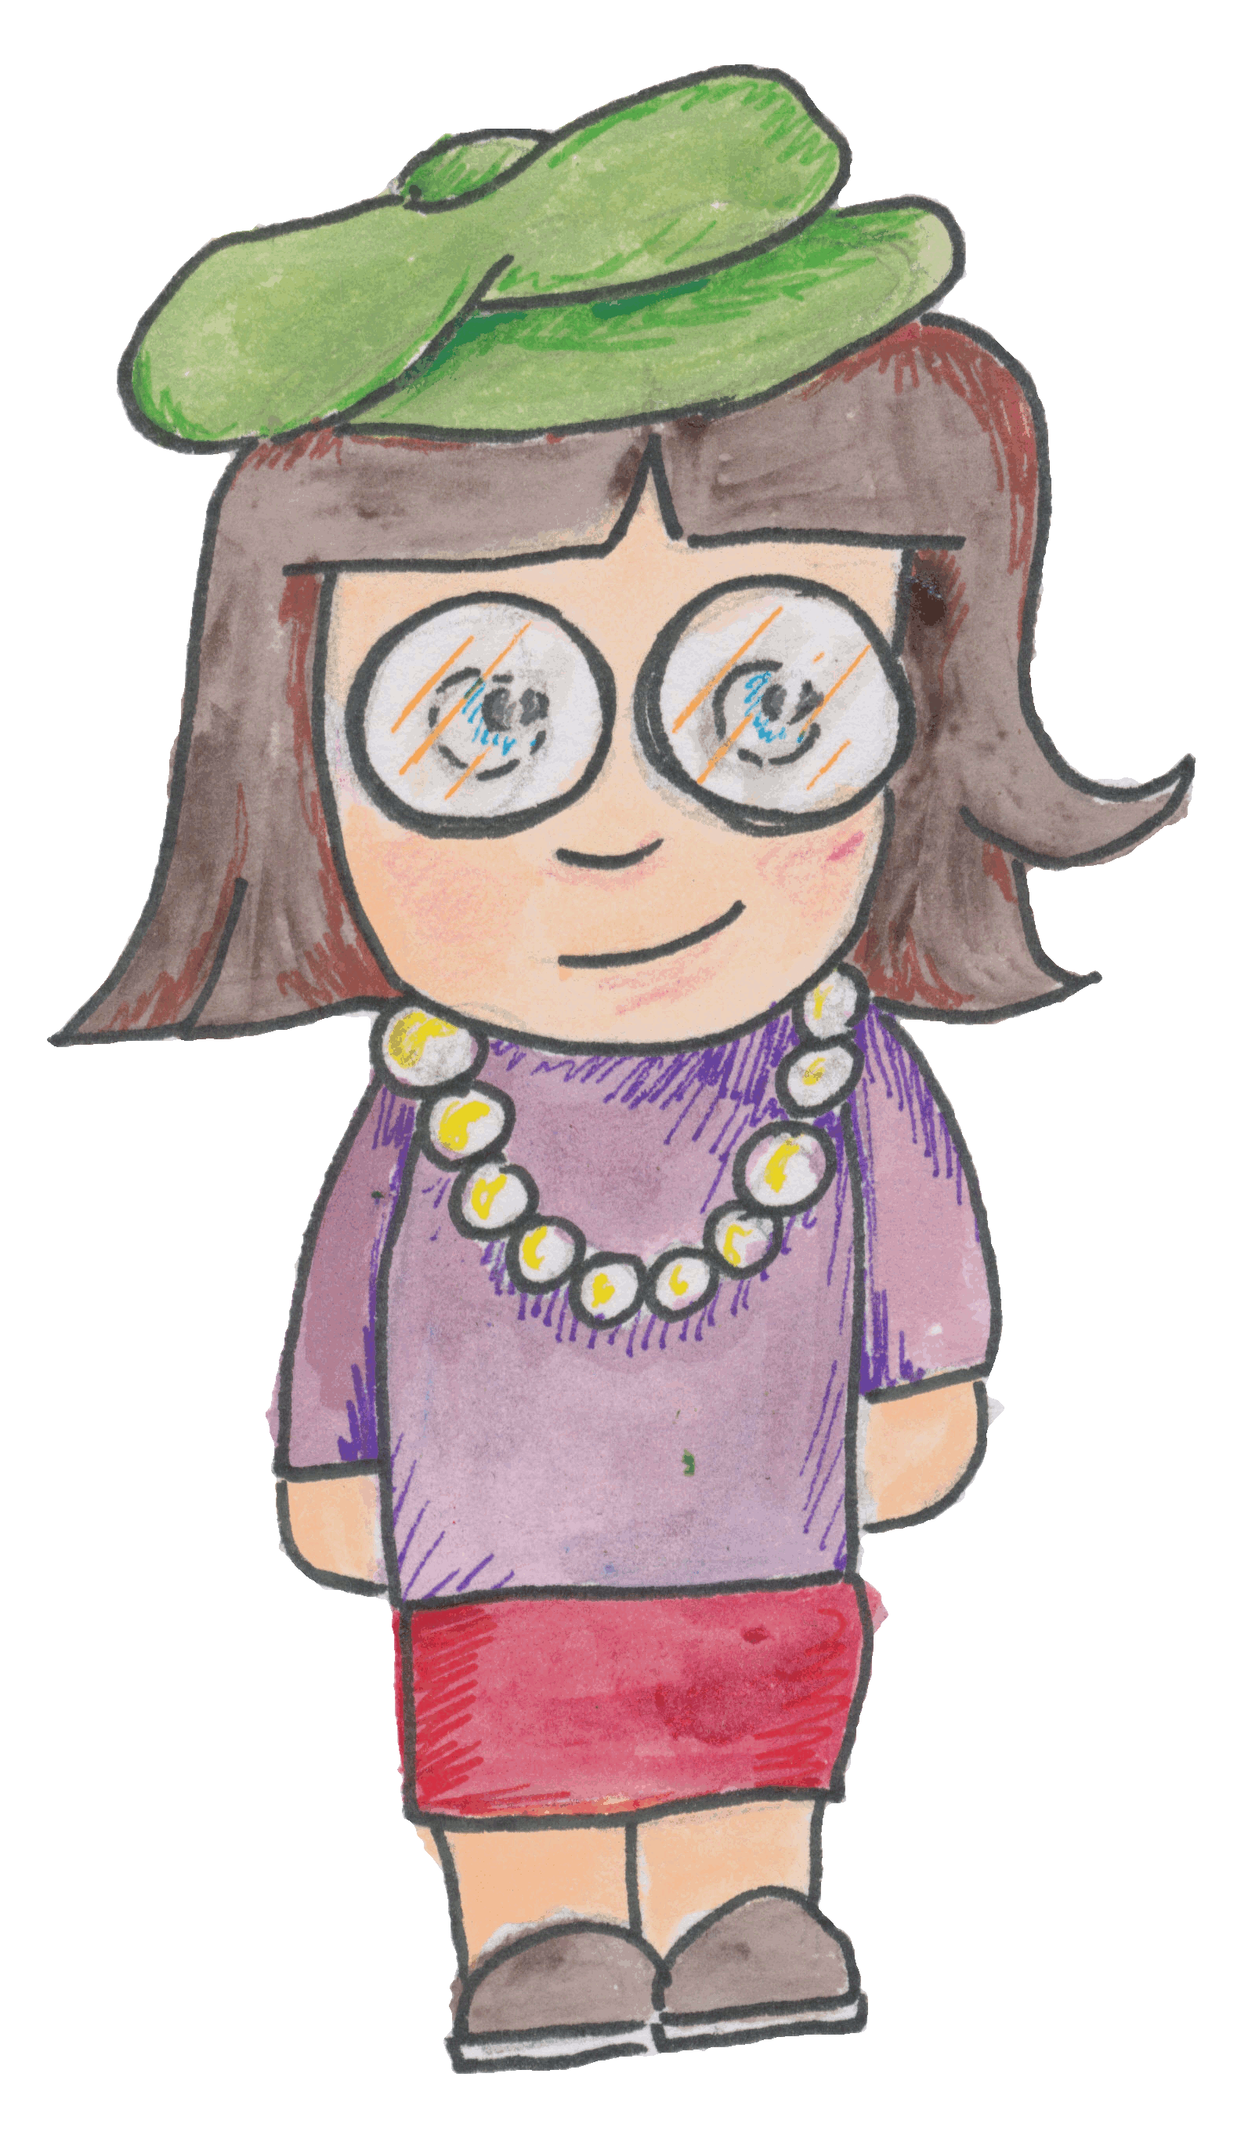
Our Journey
Safe
^
Lockerbie Academy
&
Police Scotland

Slide 3
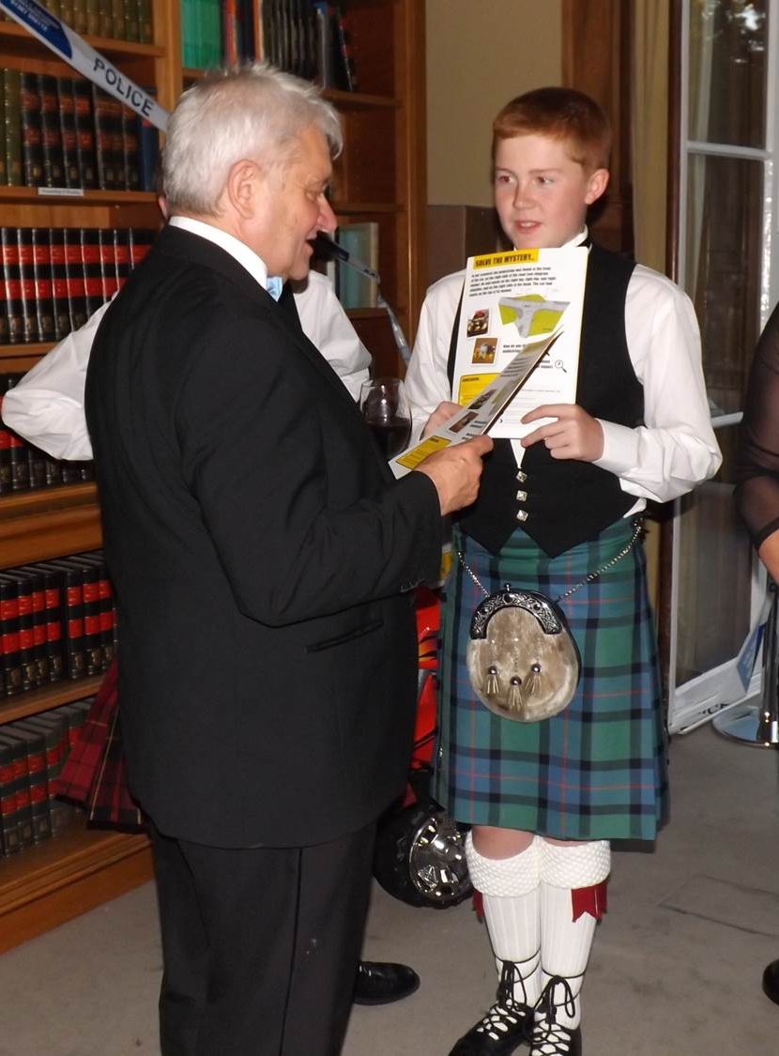
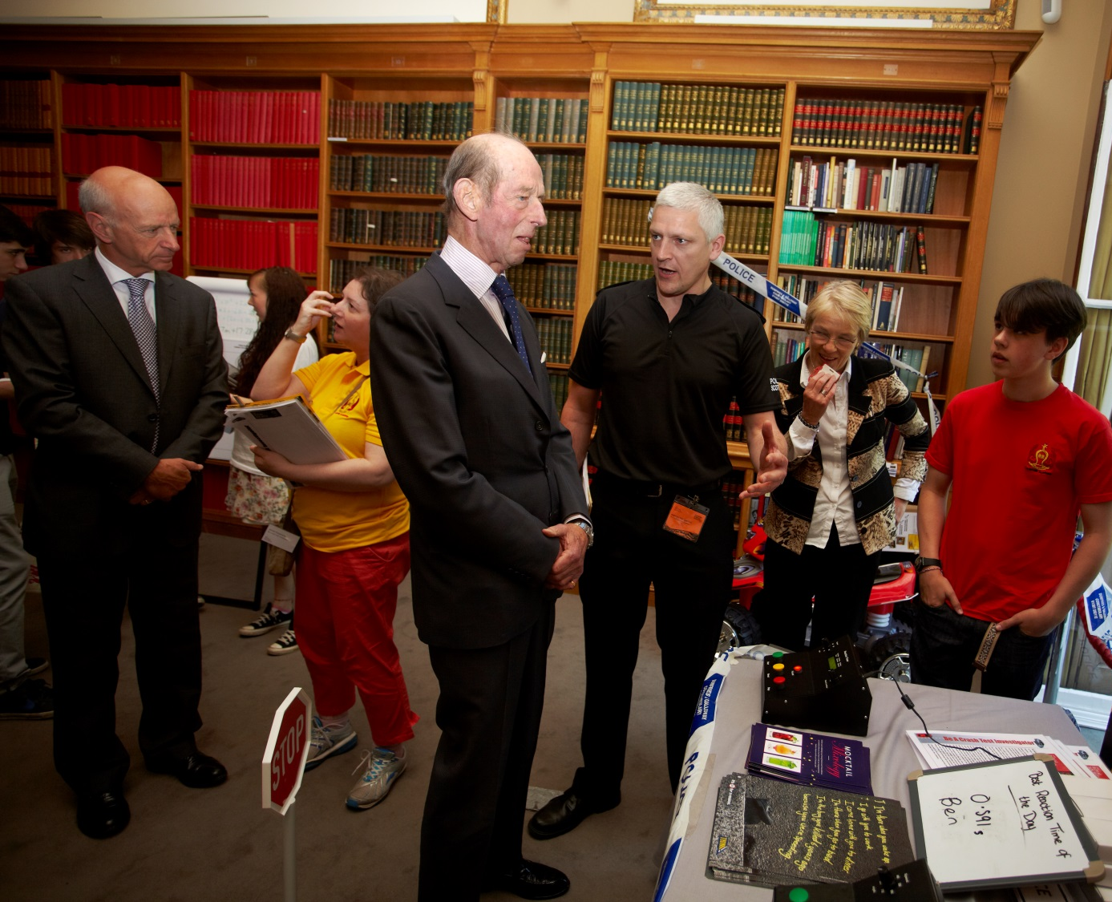
⇐Nobel Prize Winners
Royalty ⇒

Slide 4
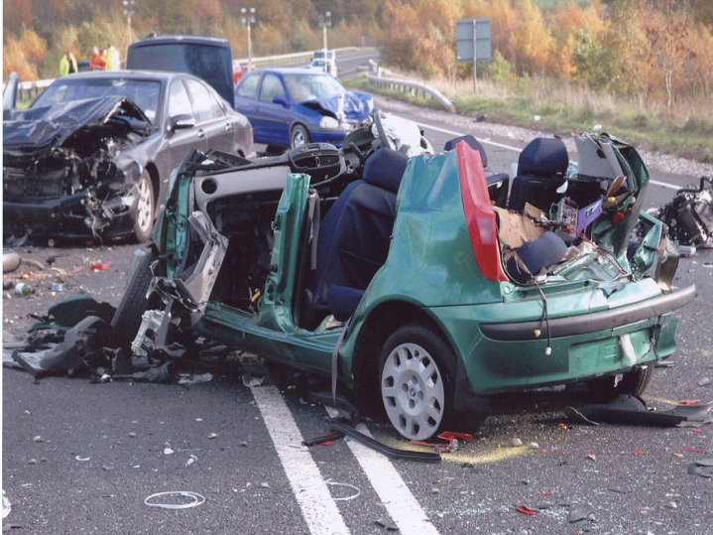
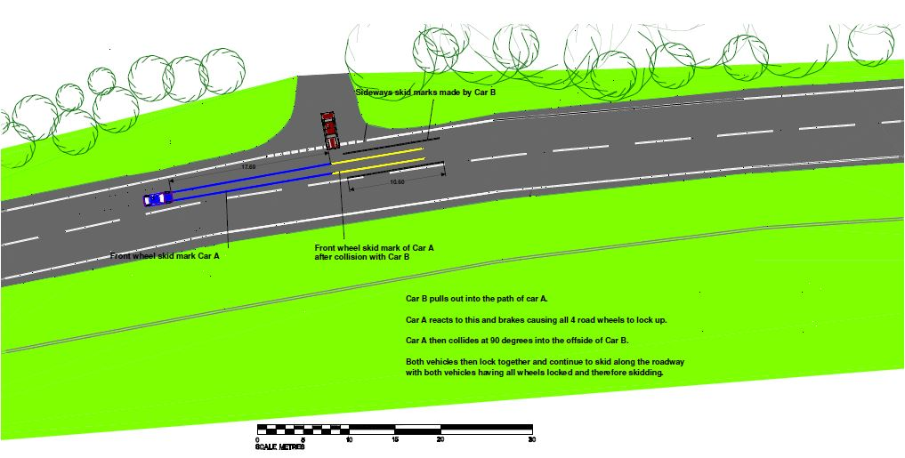
The GLEN crash of 2006
Relevant
Hard hitting
Thought provoking
Necessary
Context
Notes:
Slide 10:
At Higher we’ve been fortunate enough to have the Police Investigators come in and talk about a crash that many of the local police investigators were involved in. This is a hard hitting talk and really good for the students who are just coming up to driving age. This part of the project actually preceded our initiatives, but through our collaboration with Police Scotland we were able to incorporate our resources so the lesson ends with the students using more equations of motion and completing momentum equations and being road crash investigators too.

Slide 5
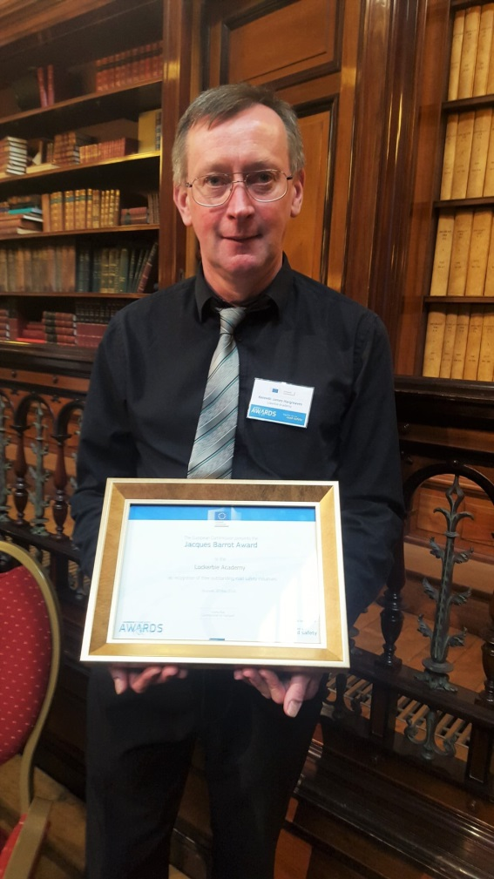

Slide 7
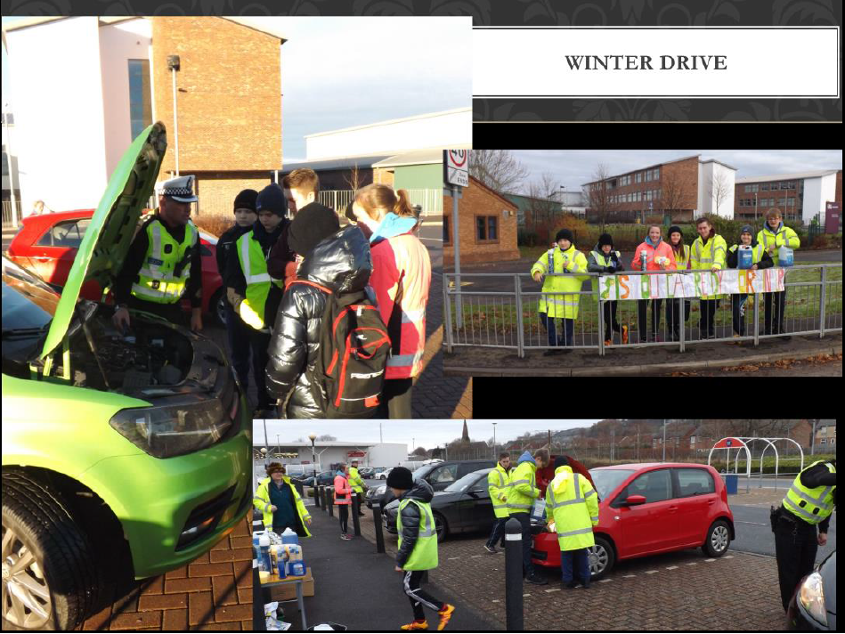

Slide 8
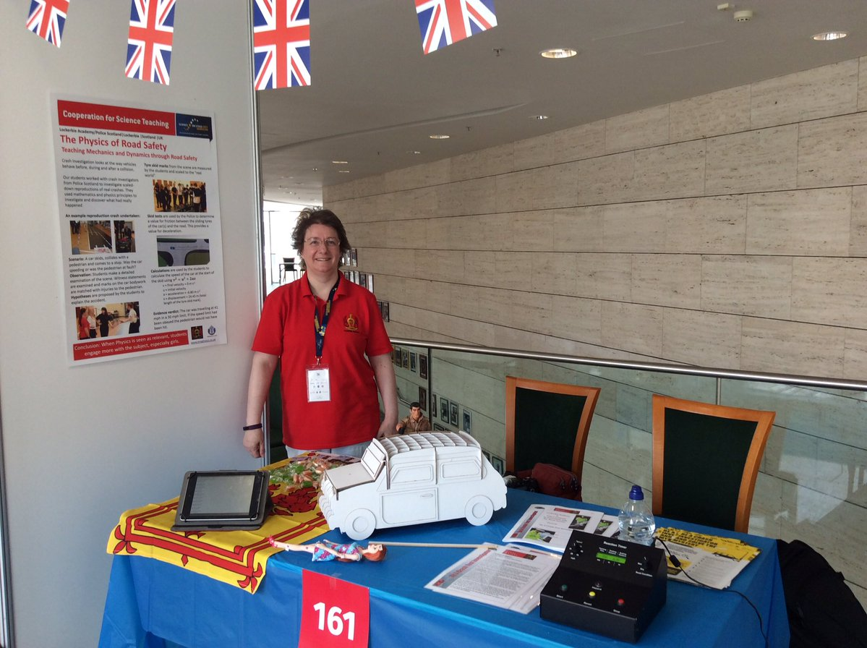

Slide 9
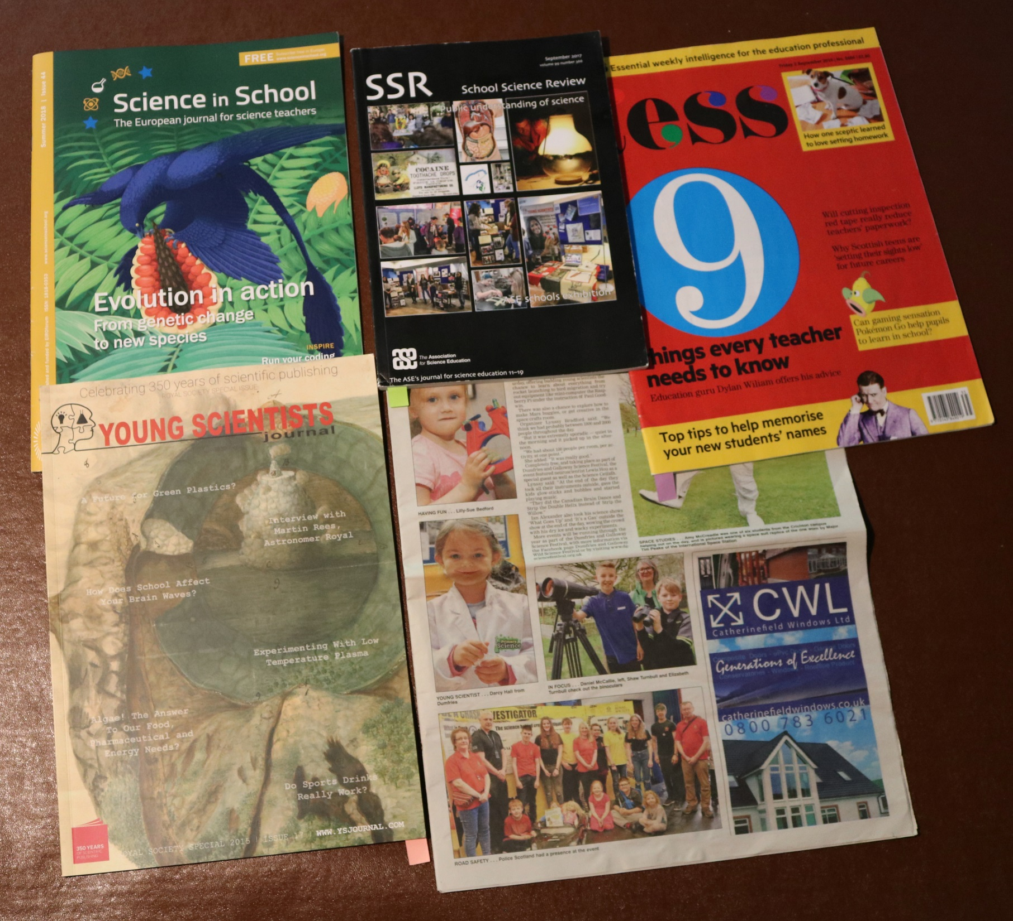

Slide 13
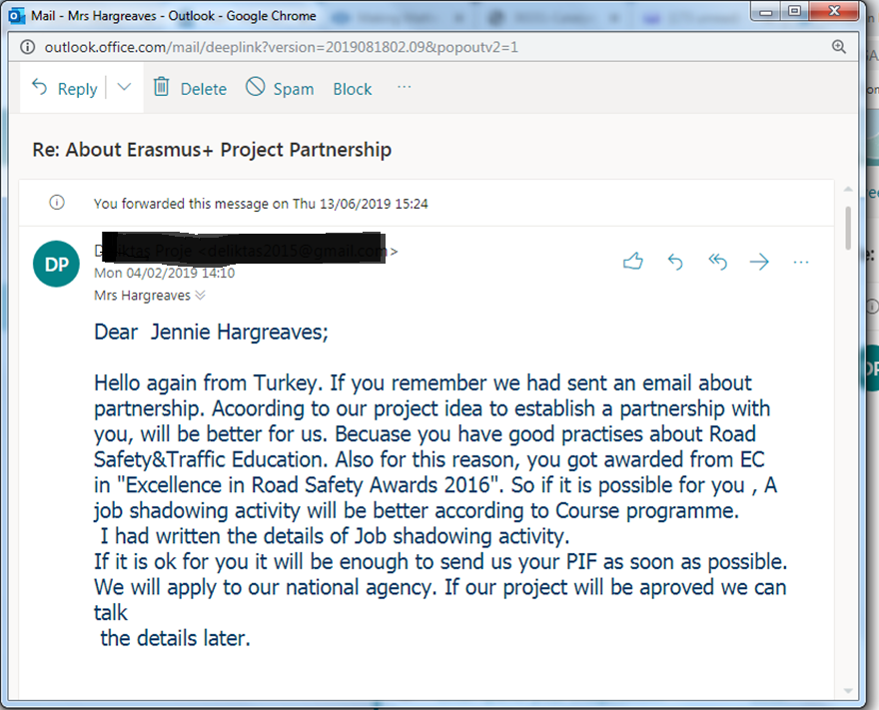

Slide 14
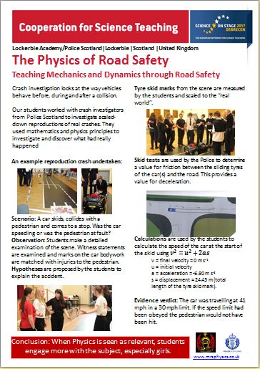
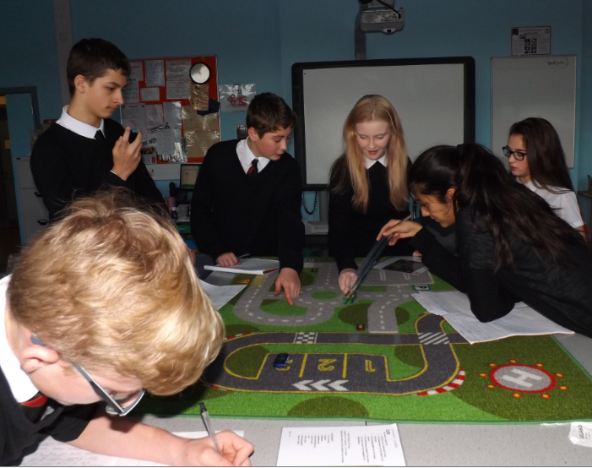
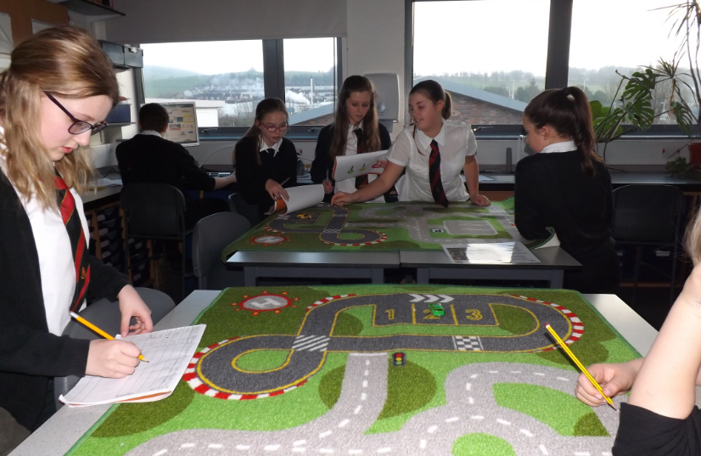

Slide 15
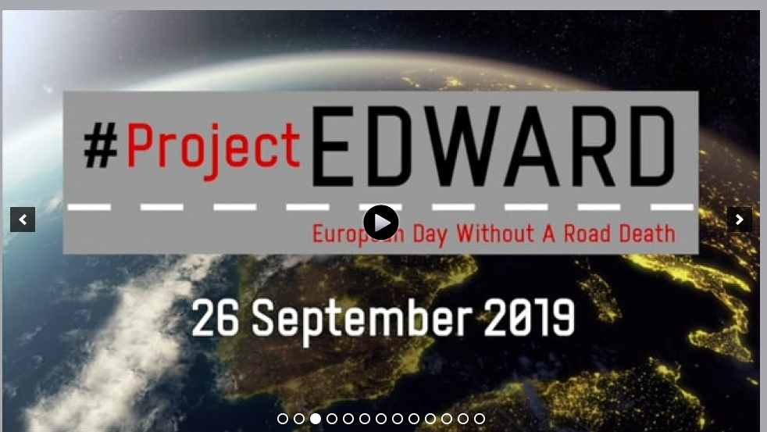

Slide 16
Evaluation: Road Safety =7.6/10
it was the best topic that we had done so far and I really enjoyed it
it was very exciting and had a lot of practical
road safety was really fun and it will help in the future
I enjoyed the road safety topic because I got to learn what makes a good driver.
I enjoyed this topic and found it easy for me to understand.
I liked this topic my favourite part is when we were seeing the speed with the toy cars on the road mat.
I enjoyed this topic when we were learning about all the different road signs and what they meant and how you can get fined for not following them correctly.
I enjoyed playing with the toy cars

Slide 17
Happy 15th Anniversary ERSC
Life is for living, so let’s continue to stop people from cutting it short

